Slide 1
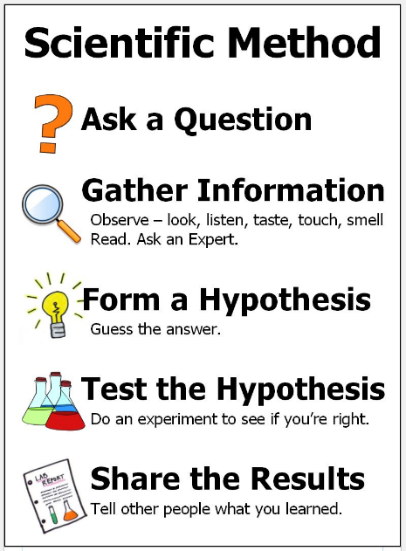
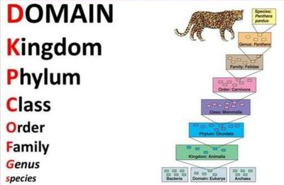
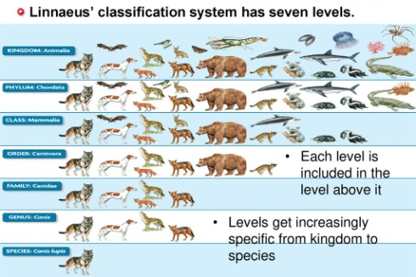
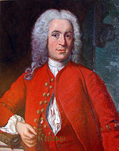

Science: Habitats
What is classification? Classification is the process by which living things are organised into groups according to their features, e.g. micro-organisms and animals. These can then be grouped into even smaller groups. | How many species live on Earth and how do we know? Scientists believe there may be as many as 10 million different species on Earth. Carl Linnaeus developed the first system for recording these and grouping them. | What is the Linnaeus system? The system of observing the minute differences of animals and grouping them based on these. Each animal is then given a series of Latin names which makes them unique. | Why are we called humans? Our name comes from the Linnaeus system. Our Latin name is homo sapiens sapiens and this, in Middle English, was made into ‘human’. | Investigations: What do different types of micro-organisms do? Are they always harmful? How does temperature affect how much gas is produced by yeast?
Key Vocabulary
Term | Definition
classify (verb) | Arrange (a group of people or things) in classes or categories according to shared qualities or characteristics.
classification (noun) | The arrangement of animals and plants in groups according to their similarities.
genus (noun) | Is a grouping in the classification of living organisms having one or more related or morphologically similar species
species (noun) | A group of similar organisms that are able to reproduce.
characteristics (noun) | A distinguishing quality, trait or feature of an individual, thing, disorder, etc.
vertebrate (noun) | An animal of a large group distinguished by the possession of a backbone or spinal column, including mammals, birds, reptiles, amphibians, and fishes.
invertebrate (noun) | An animal that does not have a backbone or skeleton inside its body. Insects, spiders, worms, snails, clams, crabs, and squids are some kinds of invertebrates.
micro-organisms (noun) | Microorganisms, or microbes, are a diverse group of minute, simple forms of life that include bacteria, algae, fungi, protozoa, and viruses.
organism (noun) | A living thing made up of one or more cells and able to carry on the activities of life.
Key Diagram / Image
Key Diagram / Image
Key Figures
Carl Linnaeus | Carl Linnaeus was a Swedish scientist who believed that a standard system of classification was important. | Libbie Hyman | Libbie Henrietta Hyman (1888-1969) was a specialist in invertebrate and vertebrate zoology.
“Science is simply the word we use to describe the method of organising our curiosity.” – Tim Minchin
1609: The moon is observed for the first time by Galileo using a telescope
1687: Newton discovers the law of gravity and motion
1751: Benjamin Franklin establishes that lightening is electrical (kite).
1859: Charlies Darwin publishes Theory of Evolution
1905: Albert Einstein’s theory of relativity E=MC2
1927: Lemaître produces the Big Bang theory
1969: The moon is walked on for the first time by Neil Armstrong
1997: Dolly the sheep is cloned by the Roslin Institute

