Slide 1
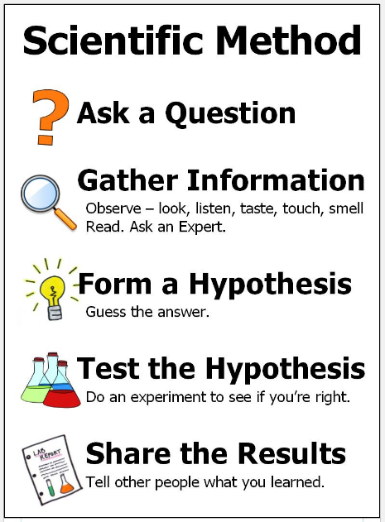
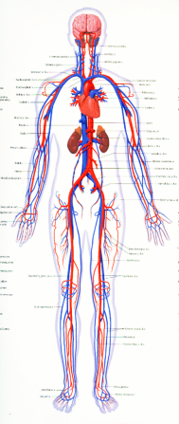
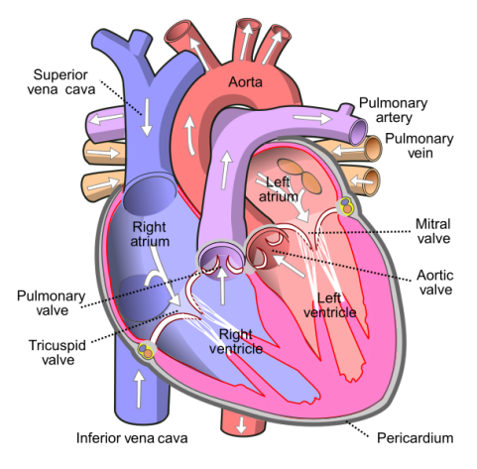
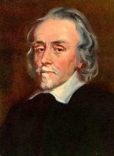
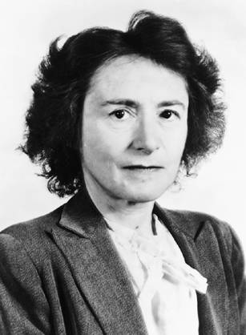
Science: Circulatory System
What is the circulatory system? The circulatory system, also called the cardiovascular system or the vascular system, is an organ system that permits blood to circulate and transports nutrients, oxygen, carbon dioxide and bloods cells to and from the cells in the body. | Why is the heart important? The heart is important because it pumps blood around your body. Your heart will beat about 115,000 times each day. Each day, your heart pumps about 2,000 gallons of blood. | How does the human body use nutrients? Digestion is the process the body uses to break down food into nutrients. The body uses the nutrients for energy, growth, and cell repair. | Where do we get nutrients from? People and animals get most of their nutrients from food. And water. Essential nutrients include carbohydrates, proteins, fats, vitamins, and minerals. | Investigations: What is your blood made up of? Why does it need all the different elements? How does exercise affect your pulse and heart rate? Why does it change?
Key Vocabulary
circulatory system (noun) | The system that circulates blood and lymph through the body, consisting of the heart, blood vessels, blood, lymph, and the lymphatic vessels and glands.
artery (noun) | Any of the muscular-walled tubes forming part of the circulation system by which blood (mainly that which has been oxygenated) is conveyed from the heart to all parts of the body.
Vein (noun) | Any of the tubes forming part of the blood circulation system of the body, carrying in most cases oxygen-depleted blood towards the heart.
aorta (noun) | The main artery of the body, supplying oxygenated blood to the circulatory system.
pulse (noun) | A rhythmical throbbing of the arteries as blood is propelled through them, typically felt in the wrists or neck.
plasma (noun) | The yellowish liquid portion of the blood that contains electrolytes, nutrients and vitamins and hormones as well as red blood cells, white blood cells and platelets.
alveoli (plural noun) | Any of the many tiny air sacs of the lungs which allow for rapid gaseous exchange.
heart (noun) | A hollow muscular organ that pumps the blood through the circulatory system
pulmonary artery (noun) | The artery carrying blood from the right ventricle of the heart to the lungs for oxygenation.
Key Diagram / Image
Key Diagram / Image
Key Figures
William Harvey | He is recognised as the man who discovered and published the first accurate description of the human circulatory system. | Gerty Cori | She became the first woman to win the Nobel Prize for Physiology of Medicine for her discoveries of how the body produces and uses energy.
“Science is simply the word we use to describe the method of organising our curiosity.” – Tim Minchin
1609: The moon is observed for the first time by Galileo using a telescope
1687: Newton discovers the law of gravity and motion
1751: Benjamin Franklin establishes that lightening is electrical (kite).
1859: Charlies Darwin publishes Theory of Evolution
1905: Albert Einstein’s theory of relativity E=MC2
1927: Lemaître produces the Big Bang theory
1969: The moon is walked on for the first time by Neil Armstrong
1997: Dolly the sheep is cloned by the Roslin Institute

