Slide 1

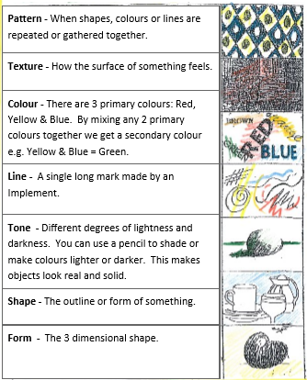
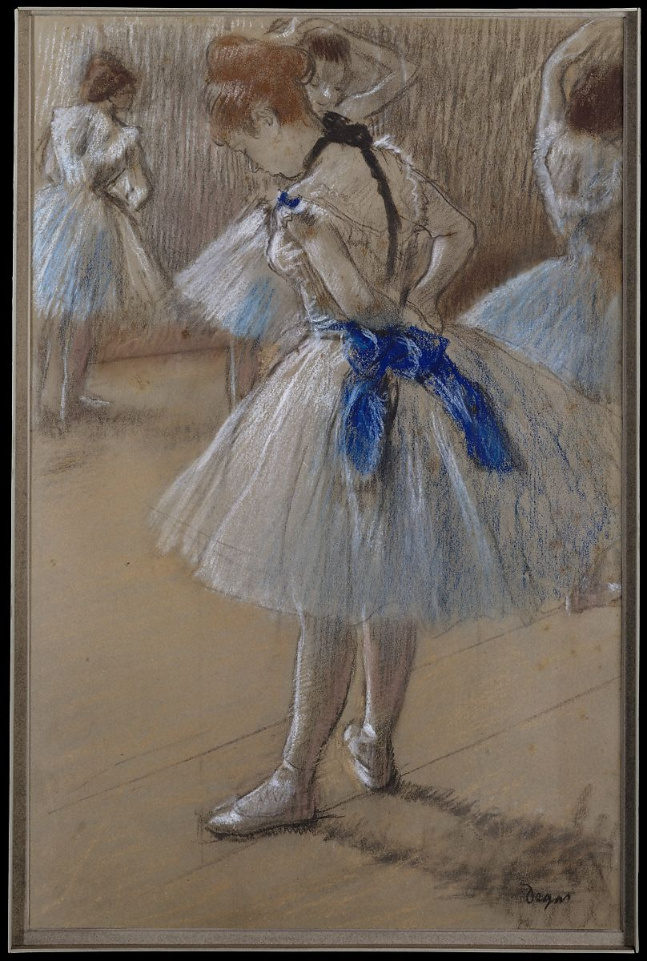
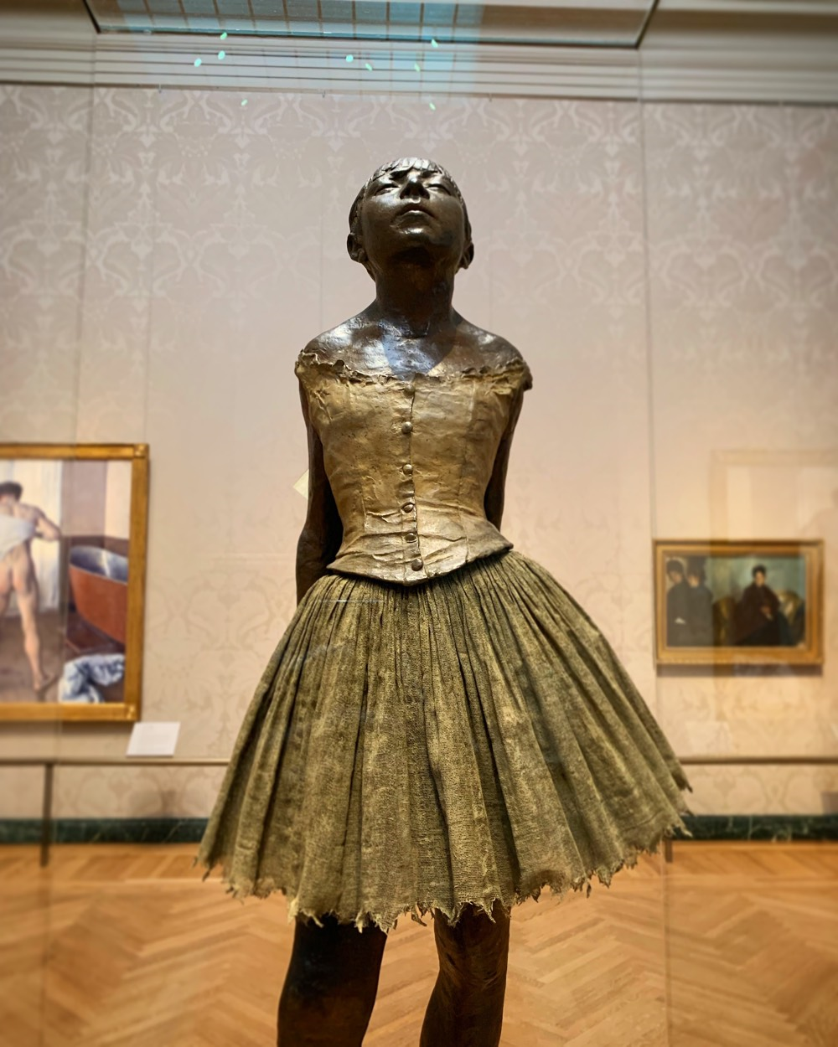
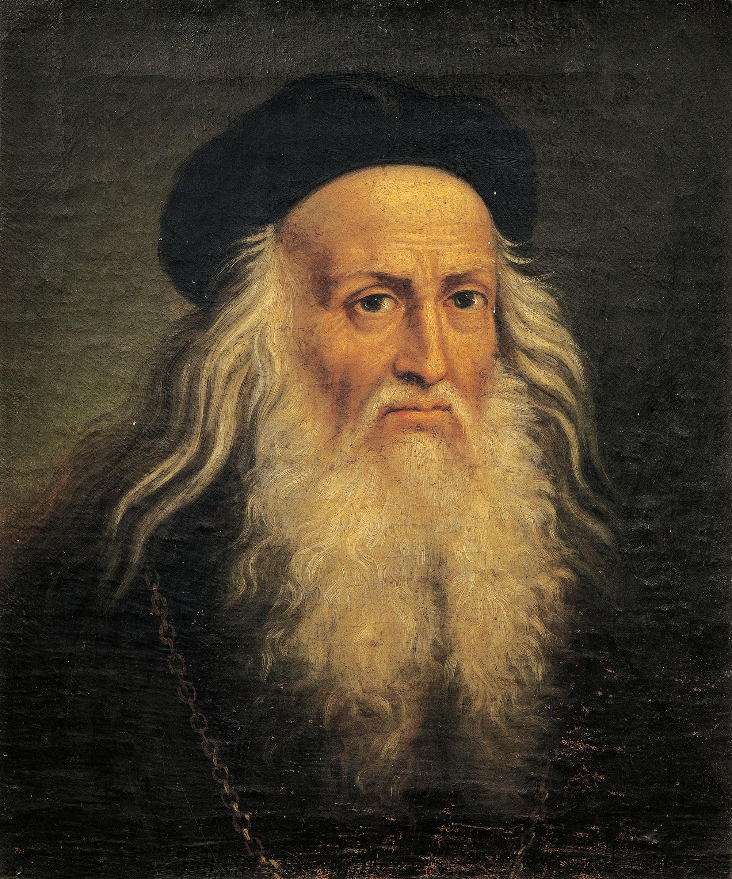
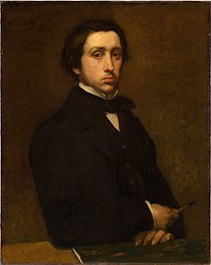
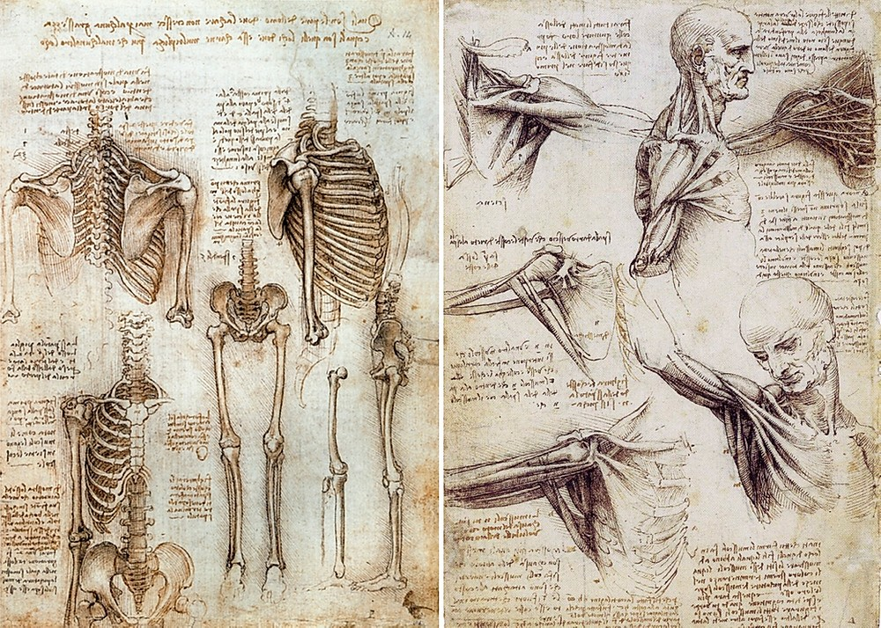
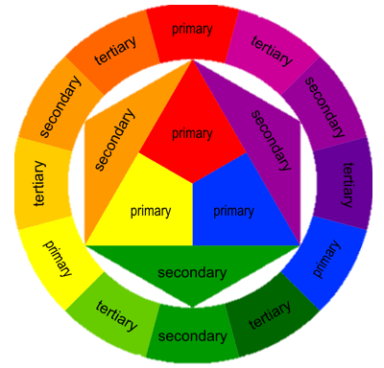
Art
Perspective: view
Mood: atmosphere of picture
Interpret: explain meaning
Tone: match strength of colour
Illustrate: to add pictures
Composition: how the picture is organised
Transparency: how see through
Hue: intensity of colour
Layering: building ideas/colour on top
Important Artists
Leonardo Da Vinci | Edgar Degas
Focus of study | Description / detail
Leonardo Da Vinci | Leonardo da Vinci was an artist, scientist, and inventor during the Italian Renaissance. He is considered by many to be one of the most talented and intelligent people of all time Many of his drawings were on the subject of anatomy. He studied the human body including many drawings on muscles, tendons, and the human skeleton.
Edgar Degas | His scenes of Parisian life, his off-center compositions, his experiments with color and form made him an Impressionist. Degas painted portraits of individuals and groups but mostly ballet dancers from 1870 onwards.
1150 – 1425: Gothic
1400 – 1520: Renaissance
1600 – 1700: Baroque
1765 – 1850: Neo-Classicism
1765 – 1850: Romanticism
1870 –1890: Impressionism
1907 – 1915: Cubism
1700 – 1775: Rococo
1924 – 1939: Surrealism
1946 – 1956: Abstract Expressionism
1954 – 1970: Pop art
“Art is not what you see, but what you make others see.” – Edgas Degas

