Slide 1
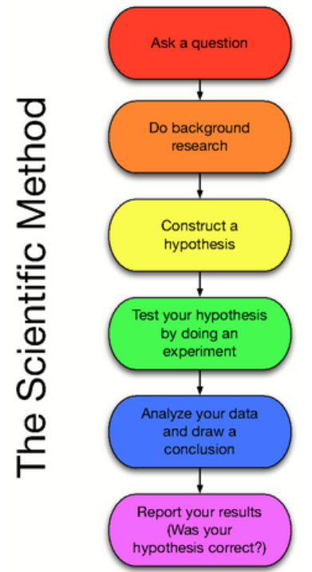
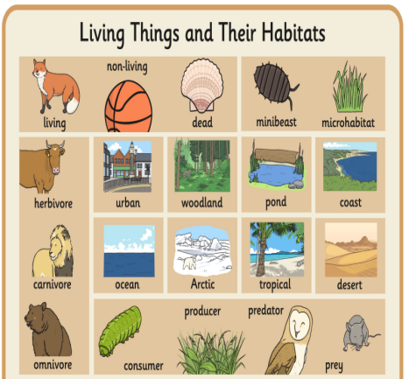

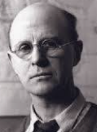
Science: Habitats
How can we compare objects? We can explore and compare the differences between things that are living, dead and things that have never been alive. | Where do animals live? Most animals live in habitats to which they are suited and which provide for their basic needs. | Can you name a variety of plants and animals? Animals come in many categories (mammals, fish, birds, insects) and plants have various categories too (flowering, deciduous, evergreen). | How do animals get food? Animals get their food from plants and other animals,. We can show this in a simple food chain and show the sources of food.
Key Vocabulary
Term | Definition
living (adjective) | Having life, being alive, not dead.
dead (adjective) | No longer living, deprived of life.
habitat (noun) | The natural environment of an organism
suited (adjective) | Something that is compatible or appropriate
needs (verb) | Something that is a requirement or necessary
microhabitat (noun) | A very small scale habitat e.g. A tree stump
food chain (noun) | The order in which living things depend on each other for food.
source (noun) | Any thing or place from which something comes or arises.
Living things and their habitats
Food Chains
Key Figures
Charles Elton
Charles Elton investigated animals in their habitats and their food chains.
“Science is simply the word we use to describe the method of organising our curiosity.” – Tim Minchin
1609: The moon is observed for the first time by Galileo using a telescope
1687: Newton discovers the law of gravity and motion
1751: Benjamin Franklin establishes that lightening is electrical (kite).
1859: Charlies Darwin publishes Theory of Evolution
1905: Albert Einstein’s theory of relativity E=MC2
1927: Lemaître produces the Big Bang theory
1969: The moon is walked on for the first time by Neil Armstrong
1997: Dolly the sheep is cloned by the Roslin Institute

