Slide 1
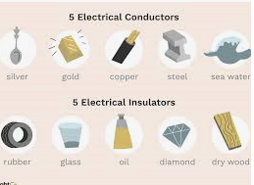
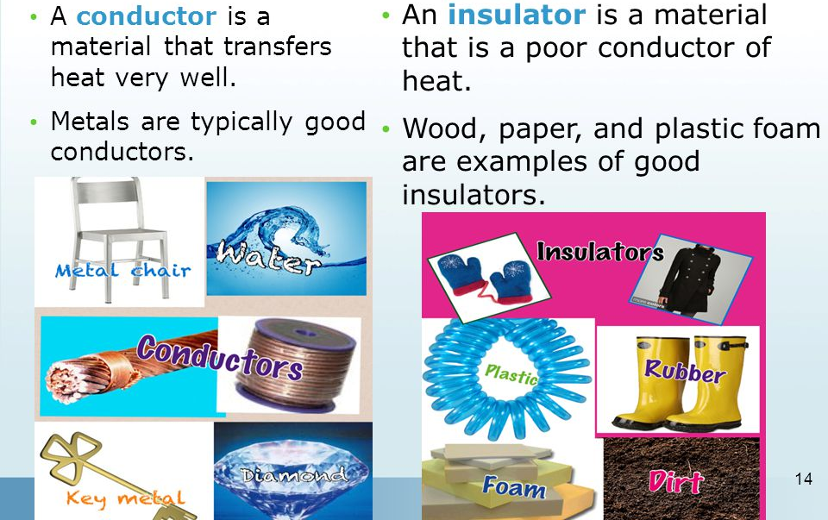
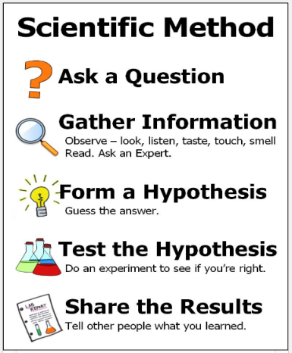
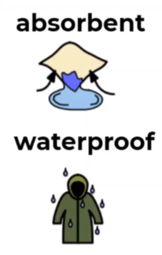
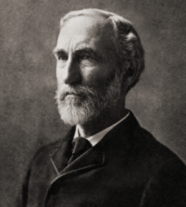
Science: Properties of Materials
 | Conductors and Insulators: A conductor is a material that heat or electricity can easily travel through e.g. most metals. However, an insulator is a material that does not let heat an electricity travel through e.g., wood and plastic. | Variable: The things that are changing in an experiment are called variables. A variable is any factor, trait, or condition that can exist in differing amounts or types. | Fair test: A test which controls all but one variable. Only changing one variable allows the person conducting the test to know that no other variable has affected the results of the test.
Properties of materials:
What is meant by the term ‘properties of materials’?
*Something that we can measure, see or feel .
*Different types of matter have different material properties that make them useful for different jobs.
Key Vocabulary
Term | Definition
materials (noun) | The substance that something is made out of e.g. wood, plastic, metal.
transparency (noun) | An object that lets light through so that the object can be looked through e.g. glass.
waterproof (adjective) | Impervious to water
absorbent (adjective) | A materials which is able to soak up water easily
conductor (noun) | A material which allows heat or electricity to travel through.
insulator (noun) | A material that does not allow heat or electricity to travel through.
solubility (noun) | Solubility is the ability of a substance (the solute), to mix into a liquid (the solvent).
Electrical insulators and conductors
Thermal insulators and conductors
Key Figures
Josiah Willard Gibbs
“Science is simply the word we use to describe the method of organising our curiosity.” – Tim Minchin
Gibbs discovered that properties related to atomic structure in various phases are related to the physical properties of a material.
1609: The moon is observed for the first time by Galileo using a telescope
1687: Newton discovers the law of gravity and motion
1751: Benjamin Franklin establishes that lightening is electrical (kite).
1859: Charlies Darwin publishes Theory of Evolution
1905: Albert Einstein’s theory of relativity E=MC2
1927: Lemaître produces the Big Bang theory
1969: The moon is walked on for the first time by Neil Armstrong
1997: Dolly the sheep is cloned by the Roslin Institute

