Slide 1
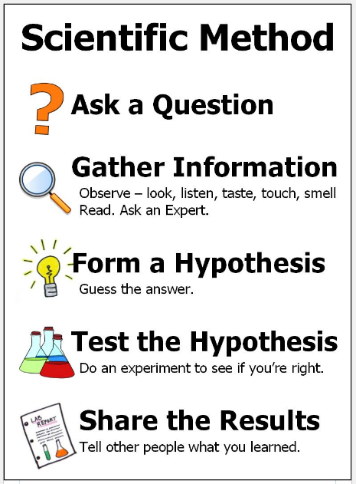
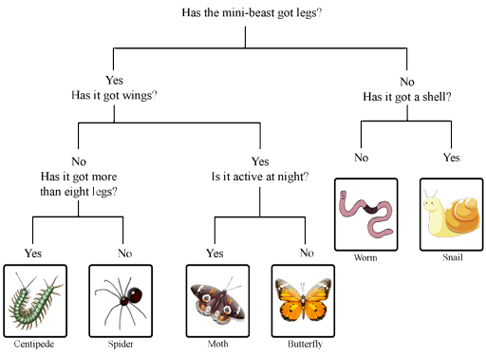
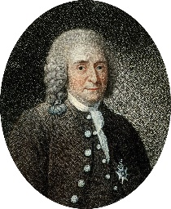
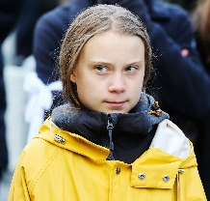
Science: Living things and their habitats
Living things can be grouped in a variety of ways: Animals & Plants Vertebrates & Invertebrates Flowering & Non-flowering | Classification keys help us group, identify and name a variety of living things. | Describe the life process of reproduction in some plants and animals. | Environments can change and that this can sometimes pose dangers to living things.
Key Vocabulary
Term | Definition
organism (noun) | An individual animal, plant or single-celled life form.
reproduction (noun) | A biological process by which “offspring” are produced from their “parents”.
sensitivity (noun) | The capacity of an organism to respond to stimulation.
nutrition (noun) | Providing or obtaining food for healthy growth.
excretion (noun) | The process of getting rid of waste matter.
respiration (noun) | A process in living organisms involving the production of energy.
habitat (noun) | The natural home or environment of an animal, plant or other organism.
classification (noun) | The process of grouping organisms according to their similarities.
vertebrate (noun) | An animal with a backbone.
invertebrate (noun) | An animal without a backbone or a skeleton of bones.
deforestation (noun) | The action of clearing a wide are of trees.
Classification Key
Key Figures
Carolus Linnaeus | Carolus Linnaeus is considered to be the founder of modern taxonomy. His work is the start of modern botanical and zoological classification. | Greta Thunberg | Swedish environmental activist who is internationally known for challenging world leaders to take immediate action against climate change.
“Science is simply the word we use to describe the method of organising our curiosity.” – Tim Minchin
1609: The moon is observed for the first time by Galileo using a telescope
1687: Newton discovers the law of gravity and motion
1751: Benjamin Franklin establishes that lightening is electrical (kite).
1859: Charlies Darwin publishes Theory of Evolution
1905: Albert Einstein’s theory of relativity E=MC2
1927: Lemaître produces the Big Bang theory
1969: The moon is walked on for the first time by Neil Armstrong
1997: Dolly the sheep is cloned by the Roslin Institute

