Slide 1
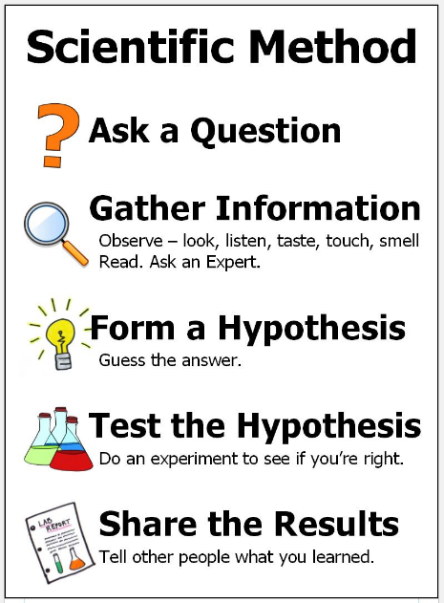
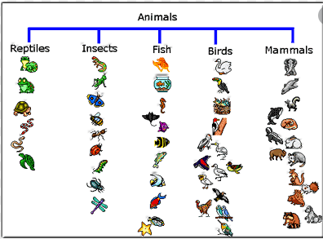

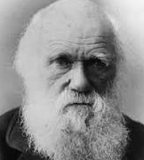

Science: Animals (Animals including humans)
Key concepts: How are animals similar or different? Can we group types of animals together? We will be exploring a variety of common animals, looking at their physical features and what they eat. | Animals: fish amphibians reptiles birds mammals | We will be classifying animals according to features such as how they have babies, breathe and travel. We will also be thinking about their skin and blood. We will also be thinking about which animals make good pets and how best to look after them | Think like a scientist: What makes an animal a mammal? We will be grouping animals and forming rules about how we can classify animals that we have not seen before.
Key Vocabulary
animal (noun) | fish (noun)
amphibian (noun) | reptile (noun)
bird (noun) | mammal (noun)
carnivore (noun) | herbivore (noun)
omnivore (noun) | warm-blooded (adjective)
cold-blooded (adjective) | scales (noun)
feathers (noun) | gills (noun)
eggs (noun) | lay (verb)
Animal Classification
Pets
Key People
Charles Darwin (1809-1882) | Charles Darwin was a British naturalist who travelled the world studying plants and animals. He made many famous discoveries. | David Attenborough | David Attenborough is a broadcaster and natural historian. He is famous for presenting BBC programs such as Blue Plant and Plant Earth. He is an expert on animal conservation.
1609: The moon is observed for the first time by Galileo using a telescope
1687: Newton discovers the law of gravity and motion
1751: Benjamin Franklin establishes that lightening is electrical (kite).
1859: Charlies Darwin publishes Theory of Evolution
1905: Albert Einstein’s theory of relativity E=MC2
1927: Lemaître produces the Big Bang theory
1969: The moon is walked on for the first time by Neil Armstrong
1997: Dolly the sheep is cloned by the Roslin Institute
“Science is simply the word we use to describe the method of organising our curiosity.” – Tim Minchin

