Slide 1



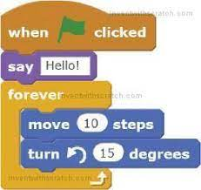

Computing
Programming | identify the pros and cons of different types of quizzes. decompose a problem into smaller parts. write a program using Scratch. identify errors and debug a program using Scratch. Changing and altering different parts of code including the sprite. Debugging any problems that arise
Communication | Use the chromebooks to create a presentation about different cities in England e.g Brighton, London and then present the information to the class.
Research | Use the internet to research appropriate cat shelters to copy when building our own shelter for Varjak Paw.
Multimedia | Importing photos into Powerpoint presentations. Changing the colours and fonts of wording
Data | Answering and asking quiz questions. Following code examples to generate their own basic games.
Sprite
Import
Quiz
De-bug
Document
Logical sequence
Command
Block
Google
Picture / app / programme
Picture / app / programme
“Man is still the most extraordinary computer of all.” – John F Kennedy

