Slide 1
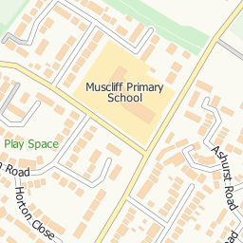
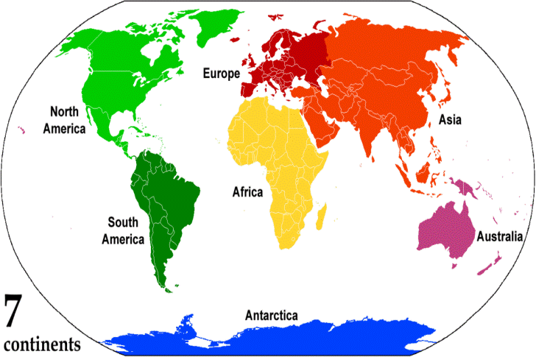
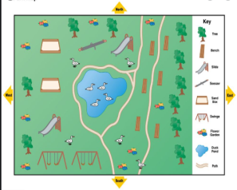
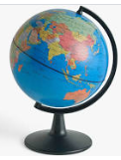
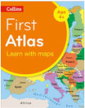
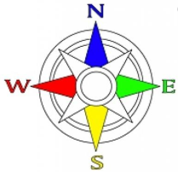
 | Geography: Maps
Human Geography | How are maps created? Maps use a birds-eye view of a piece of land and label the key features. | Can you find key features on a map? Key features such as: rivers (blue), paths (dotted), churches (a cross) and schools (S) and a hospital (H). | Can you find land and sea on a map? The land is coloured green and the sea is coloured blue on a map. | Investigation: Can you follow directions using a compass?
Physical Geography | What are the seven continents? The seven continents are; Asia, Africa, North America, South America, Antarctica, Europe and Australia. | What are the five oceans? The five oceans are Atlantic Ocean, Pacific Ocean, Indian Ocean, Arctic Ocean and Southern Ocean. | Can you name the 4 countries in the UK? The four countries are; England, N. Ireland, Scotland and Wales. | Field Work: Can you locate the four countries of the UK on a map?
“Geography has made us neighbours.” – John F Kennedy
Key Skills
Can you create your own map of a local area with roads, rivers and schools? Exploring the local area of Throop. Having a map to locate features e.g. farm, river, roads. Use simple fieldwork and observational skills to study the geography of the school and its grounds and the key human and physical features of its surrounding environment.
Key Vocabulary
Term | Definition
map (noun) | Representation of an area of land or sea. Map (verb) to make a map.
compass (noun) | an instrument containing a magnetized pointer which shows the direction of magnetic north and bearings from it.
key (noun) | Information needed for a map to make sense.
direction (noun) | a course along which someone or something moves.
human (noun) | How humans affect an area.
physical (noun) | Natural features.
symbol (noun) | A character, letter or symbol on a map.
scale (noun) | How big or small a representation is compared to its actual size.
route (noun) | A way of getting from a starting point to a destination.
UK (noun) | Great Britain and N. Ireland
Key pictures or diagrams
Oceans and continents | key | compass | globe | atlas
1040: First compass used to navigate (In China).
1271: Marco Polo sets off for China
1492: Columbus discovered America
1497: John and Sebastian Cabot discovered Canada
1540: Nicolaus Copernicus discovered the Solar System
1770: Captain James Cook discovered Australia
1911: Roald Amundsen led the first expedition to the South Pole
1969: Neil Armstrong was the first man to walk on the moon.
1507: First true map of the world by Martin Waldseemüller

