Slide 1
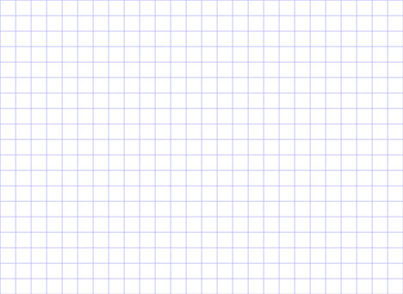
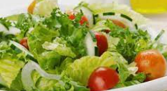
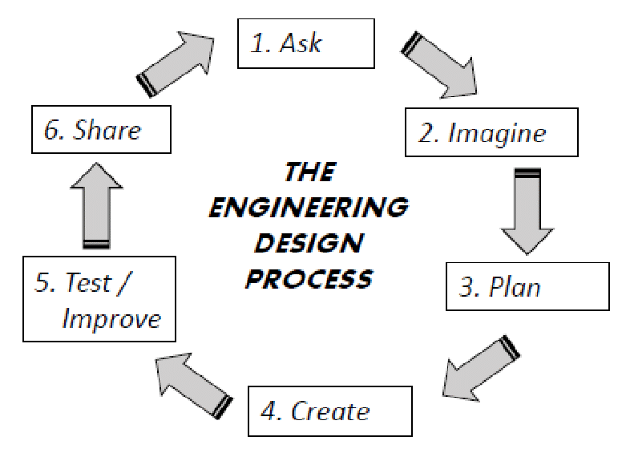
Design Technology
Design project: make a salad
Facts A salad consists of more than one fruit or vegetable |  | Skills Wash Peel Grate Chop
Ideas (noun)
Evaluate (verb)
Cut (verb)
Select key tools (verb)
Design (verb)
Grate (verb)
Chop (verb)
Vegetable
Fruit
Fat
Carbohydrate
Protein
Vitamins
Healthy
Unhealthy
“I have not failed. I have just found 10,000 ways that won’t work.” – Thomas Edison
1650: First daily newspaper
1876: telephone invented
1902: first radio signals
1969: internet invented
1994: world wide web established
1957: first space shuttle launched
1927: first television broadcast
1817: First push bike invented and used
2007: first Iphone in use
1884: Firs motor car in use

