Slide 1

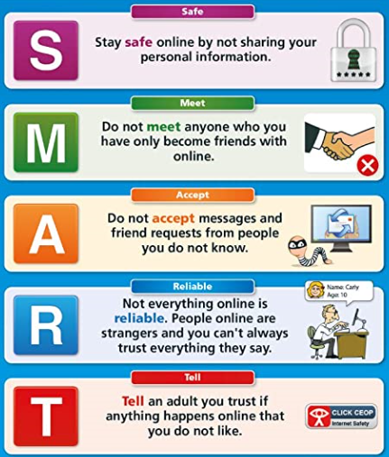
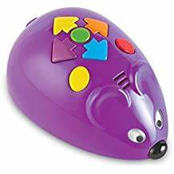


Computing
Computer
Camera
Mouse
Website
Enter
Keyboard
Tablet
Algorithm
Space
Programming | Understanding how to give commands and make a set of instructions.
Communication | Sorting items into groups and simple graphs and tables
Research | Using websites, buttons, menus and hyperlinks
Multimedia | Using cameras and visual equipment. Using paint to colour and undo colouring
Data | Using the keyboard to type keywords, use punctuation and press enter
“Man is still the most extraordinary computer of all.” – John F Kennedy

