Slide 1
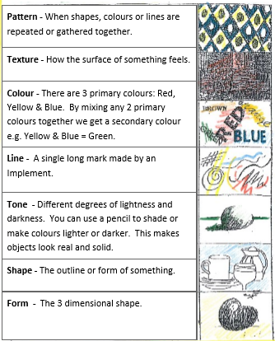
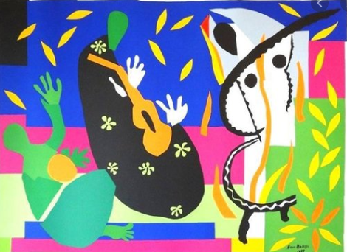
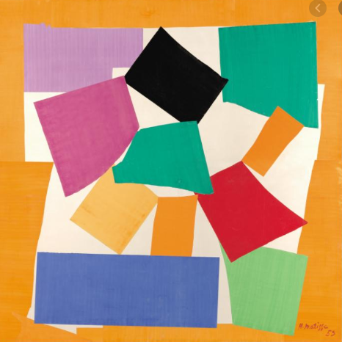
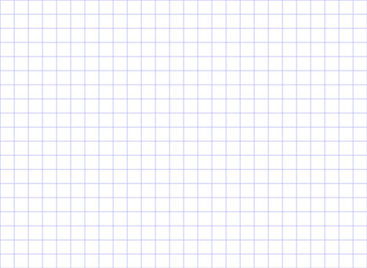
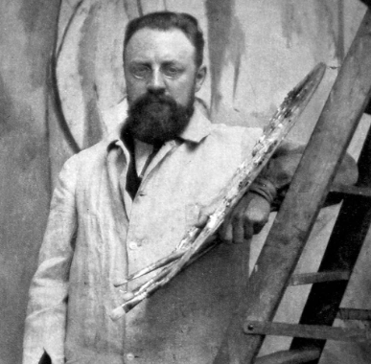
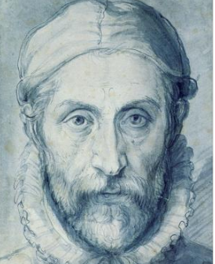
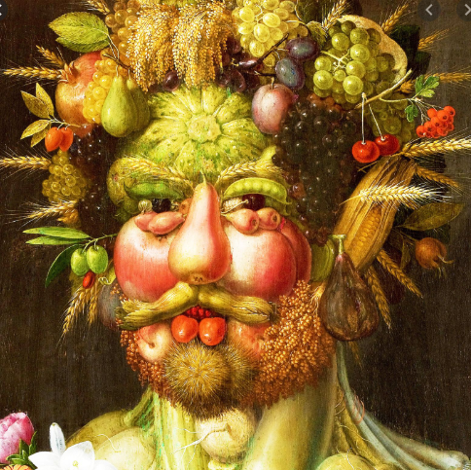
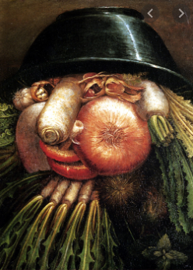
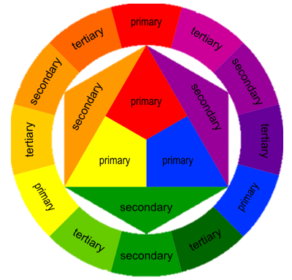
Art
Texture- to explore different surfaces and tools to make texture
Drawing tools- oil pastels, charcoal, pastels, pen
Observation- to draw from sight
Colour- mix primary colours
Collage- rip and cut paper and layer with glue
Weave- weave paper to make a pattern
Sculpture- make and join clay shapes
Manipulate and arrange- move everyday objects to make a new form
Print- make repeated patterns using paint/rubbings
Important Artists
Henri Mattise | Giuseppe Archimboldo
Focus of study | Description / detail
Henri Mattise | Henri Mattise was a leading figure in Modern Art. He loved bright colours and used collage, painting and sculpture to make his artwork.
Giuseppe Archimboldo | Giuseppe Archimboldo use fruits, vegetables, books, animals and other objects to create his portraits. He arranged his objects to make faces and then painted them.
1150 – 1425: Gothic
1400 – 1520: Renaissance
1600 – 1700: Baroque
1765 – 1850: Neo-Classicism
1765 – 1850: Romanticism
1870 –1890: Impressionism
1907 – 1915: Cubism
1700 – 1775: Rococo
1924 – 1939: Surrealism
1946 – 1956: Abstract Expressionism
1954 – 1970: Pop art
“Art is not what you see, but what you make others see.” – Edgas Degas

