Slide 1


SEND Information Report
Ready Respectful Safe

Slide 2
Our Aim
At Muscliff Primary School, we aim to provide a creative, stimulating and inclusive environment in which everyone can feel safe and flourish socially and academically. Relationships are at the heart of every interaction. Our ambition is to provide high-quality education for all children, including those identified as having ‘special educational needs or disabilities.’ We emphasise the importance of Quality First Teaching for all pupils but recognise that some pupils may require additional support to enable them to access the curriculum and make progress.
Our Staff Team
We have an experienced staff team who receive regular training to ensure that they are able to meet the needs of all learners. We have strong links with a range of outside specialist agencies, including The Educational Psychology Service, Outreach Team, Speech and Language Therapists, Learning Support Service, CAMHs, Early Help and Occupational Therapist Team. We also employ a Play Therapist and Counsellor to help support our children who need more focused support.
What we do

Slide 3
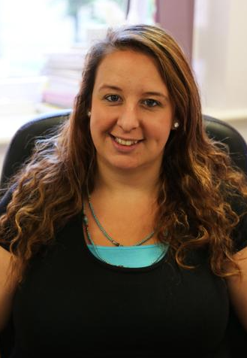
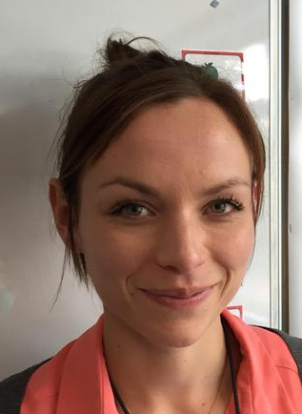
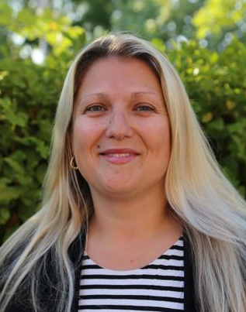
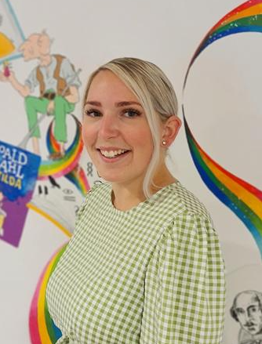
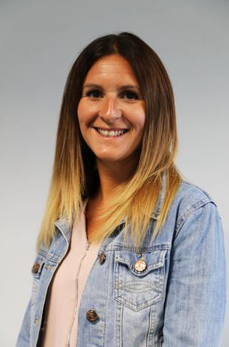
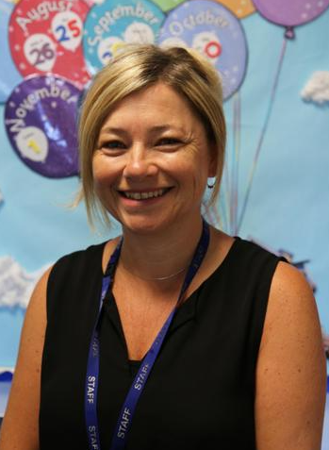
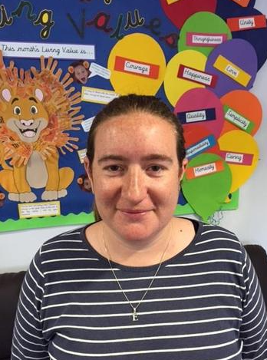
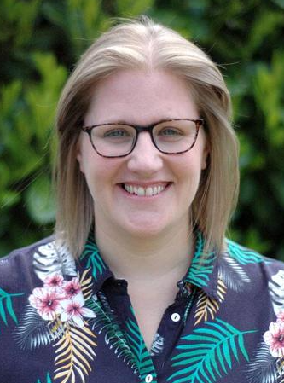
Meet the Team
Becca Lewis
Assistant Head and SENCo
Laura Frampton
SEN Team
Natalie Flynn
SEN Team
Charlotte Blanch
SLT and SENCo Administrator
Kim Willis
Pastoral Support Team
Jayne Dawson
Pastoral Support Team
Emma Powner
Pastoral Support Team
Michelle Pestridge
Counsellor

Slide 4
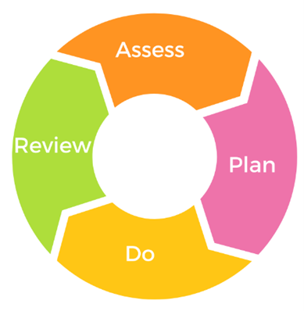
At the heart of the work in our school is a continuous cycle of assessing, planning, teaching and reviewing which takes account of the wide range of abilities, aptitudes and interests of our children. The majority of children will learn and progress within these arrangements.
Those children whose overall attainments or attainment in specific subjects/area of learning fall significantly outside the expected range may have special educational needs (SEN). Our staff quickly identify who may need additional support in school and this is an ongoing, continuous cycle. Children's needs change over time and therefore the levels of and type of support needed reflect these changes.
A significant amount of support is also in place for our children who do not have SEN but may experience a range of challenges in the school environment.
How will Muscliff Primary know if my child needs extra help?

Slide 5
Early identification of pupils with SEN is a priority. The school will use appropriate screening and assessment tools, and ascertain pupil progress through:
Evidence obtained by teacher observation/ assessment
Their performance in relation to age-related expectations
Information from parents
Standardised screening or assessment tools – Dyslexia Screening Test - Junior (DST-J) Salford Reading Test - Neale/ Young analysis - YARC
Reports or observations
Records from feeder schools/ settings
Early identification of need

Slide 6
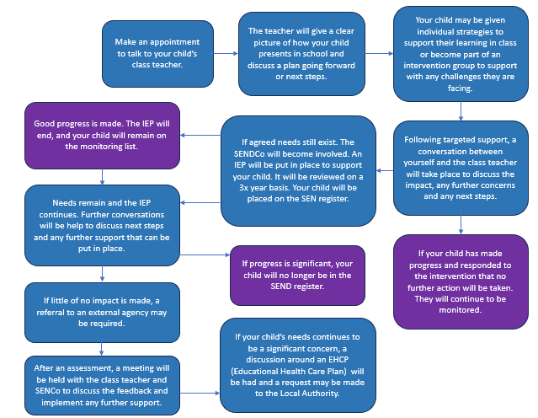
What should I do if I think my child has Special Educational Needs?

Slide 7
Our graduated response document shows the support that can be put in place in all of our classrooms, as our standard practice as well as additional interventions and support we offer children in our school.
We use the assess, plan, do, review process to monitor all our children.
Your child may have an ‘Individual Support Plan’ or ‘Behaviour Support Plan’ which will outline key targets for your child and the provision in place to support them. The plans will be reviewed and shared with you at least three times a year.
Support is provided for children through adapted/ additional resources, targeted support from staff, intervention groups.
Children are monitored through plans, assessments and regular meetings between the SEND team and class teachers.
We work closely with outside agencies to meet the needs of individual children. We act upon their advice and monitor and review progress and support regularly, with parents/carers and the child concerned being central to this process.
How will the school support my child?

Slide 8
We will follow the graduated approach and the four-part cycle of assess, plan, do, review. The class or subject teacher will work with the SENCO to carry out a clear analysis of your child’s needs.
This will draw on:
The pupil’s own views
The teacher’s assessment and experience of the pupil
Their previous progress and attainment
Other assessments, where relevant
The individual’s development in comparison to their peers and national data
The views and experience of parents
Advice from external support services, if relevant this assessment will be reviewed regularly.
All teachers and support staff who work with the pupil will be made aware of their needs, the outcomes sought, the support provided, and any teaching strategies or approaches that are required. We will regularly review the effectiveness of the support and interventions and their impact on your child’s progress.
How will the school support my child?

Slide 9
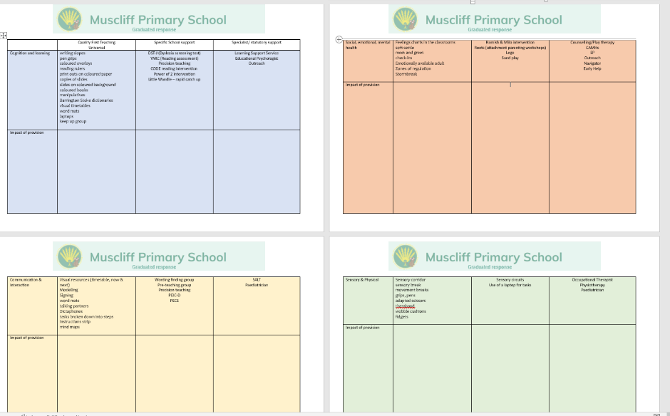
Graduated response document

Slide 10
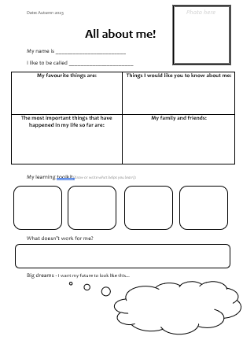
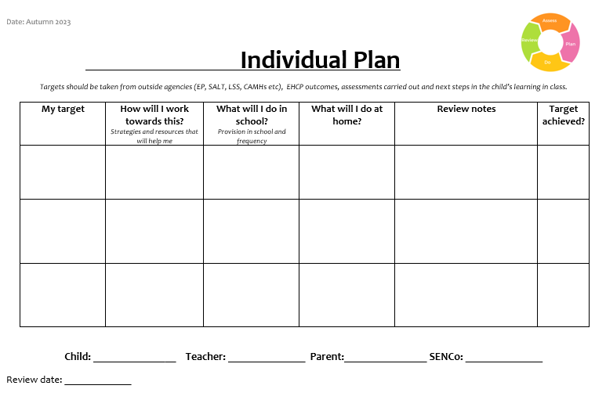
IEP

Slide 11
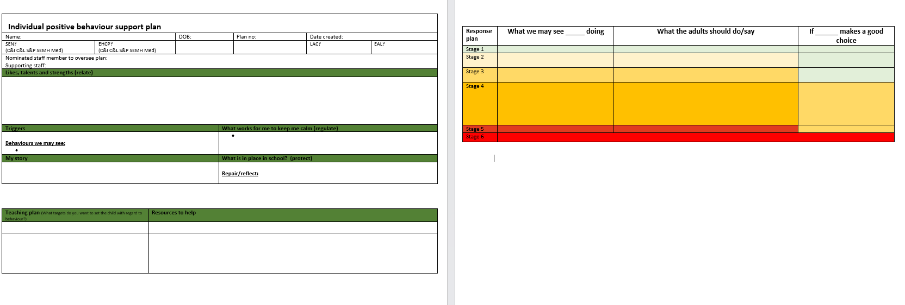
Behaviour Support Plan

Slide 12
How will the curriculum be matched to my child's needs?
Our curriculum continues to evolve. We recognise that it will perpetually change and be reshaped and remolded so that it reflects our ever-changing world and local community. We are always seeking ways to improve our curriculum offer to the children of Muscliff. Whether the change is fueled by our passion for books (for example, if we come across a new beautiful book that we feel our children simply must read) or if it is prompted by significant events and the changing landscape, we remain adaptable and reflective.
When we make changes to our curriculum, we consider what we know about the needs of our learners and look to evidence-based research; our curriculum is rooted in our culture of enquiry. By embracing change, we are creating a curriculum that is successive and durable.

Slide 13
At Muscliff Primary School, we are continuously monitoring and reviewing each individual child's progress. We do this throughout the day, informally, and use our observations to inform the planning and delivery of subsequent learning opportunities. We work as a team at Muscliff and any concerns around a child's progress are always shared with parents as we know that this is the most effective way to support your children. We seek advice from each other as a staff team and support each other with our respective areas of strength - sharing good practice. At the end of each term, we formally record our assessments of each child in the key areas of reading, writing, maths and science. This information is closely monitored and analysed by our teachers, year group teams and senior leadership team. Regular meetings between these groups ensure all of our children are closely monitored and provision for them is under constant review.
How will both the school and I know how my child is doing?
Parent’s evenings
(twice a year)
Appointments can be made to meet to discuss your child's progress at any stage during the school year.
Review meetings:
TAF (Team around the Family)
IEP
External agencies
Annual report
EHCP annual review

Slide 14
Read the learning overviews on the website.
Read the school newsletter to find out what is coming up - talk to your child about it to prepare them for future events.
Support your child with their home learning (not do it for them!). Structure a time and space for them to complete their home learning at regular times in the week - a predictable, structured routine will support them in developing healthy and positive learning approaches and habits.
Do be positive and avoid confrontation around home learning - please speak to your child's class teacher if you have any concerns around this.
If your child has an IEP be clear about their targets and ways to help - this should come from the meeting you have with their teacher.
If your child has an EHCP be clear about their objectives and ways you can support, again this should be apparent from the review meetings.
General tips when a child has a learning difference:
Be predictable, clear and have routine - this will help them understand and know what will happen next and what is expected at given times.
Provide an uncluttered, distraction-free space to complete any focused tasks.
Visual timetable to support their understanding of what the evening/morning/day will 'look like'.
Speak to your child's class teacher about their specific learning profile, e.g. do they need information in very small chunks? Do they need frequent, short breaks? What equipment should be available? How long can I expect them to spend on this?
How can I support my child’s learning?

Slide 15
Your child's health, safety and wellbeing is of paramount importance to us. We know that children need to be 'ready' to learn; this involves being in an emotional place which supports rather than hinders their access to learning. We understand that many things in life can impact your child and we have layers of support systems in place which help our children regulate and understand themselves and others.
In school, we feel these approaches below support your child's wellbeing:
Relationships are the centre of everything we do
Emotionally Available Adults
1:1 time with an adult in school
Celebrations of success
Roots parent and child workshops
Hamish and Milo well-being intervention
Clear expectations
Counsellor and Play therapists in school
What support will there be for my child's overall wellbeing?

Slide 16
At Muscliff, we work with many specialist services and other professionals to support children both at school and at home. We have developed and foster positive relationships with local services who support us in developing our provision at school and offering helpful advice to our families.
It is essential for our children and families that education, health and social care services all work together to support the development of our young people. All services are striving to achieve this.
What specialist services and expertise are available at, or accessed by, the school?
External agencies:
- Educational Psychology Service
- Learning Support Service
- Community paediatricians
- Speech and Language service
- CAMHs (Children & Adolescent Mental Health Team
- Early Help
- Children’s Social Care
- Outreach
- Occupational therapy team
- Physio therapy team
- Hearing support
- Vision support
- BCP SEND team
- BCP inclusion team
- BCP Navigator
- Local secondary schools, nurseries and pre-schools
- Specialist language teachers

Slide 17
All of our teaching staff experience a range of training opportunities with SEND as the focus. See the list below for examples of the types of training some/most/all of our staff may have:
Trauma Informed Schools
Attachment
Making sense of Autism
Good Autism practice
Autism and anxiety
Making sense of Autism (Early Years)
Dyslexia
Dyscalculia
Precision Teaching
Emotionally Based School Non-Attendance (EBSA/EBSNA)
Sensory Integration
Hamish & Milo
PEIC-D (Promoting Early Interactive Conversations)
Restorative conversations
Consultation and training with specialist teachers around small groups and individuals.
'In-house' staff meetings and INSET with SENCo
Sensory Circuits - supported by other schools and Active Play Therapies
Bereavement
What training do the staff supporting children with special educational needs & disabilities have?

Slide 18
The physical environment of the school is fully accessible.
There is a lift to access the first floor and level floors throughout.
There are two disabled washroom facilities. Adjustments have been made to specific areas within the children's toilets, as appropriate, to support individual's with independent use of the toilets - i.e handrails, platforms.
We have disabled parking allocated in the car park to ensure manageable and safe access to the site, when required.
Our classrooms have needed adjustments, at times, to meet individual needs. Reasonable adjustments will always be made to ensure full accessibility.
Any equipment provided which supports a child in their access to the learning environment is used as appropriate, and as directed by specialists, e.g. hearing packs, walkers, wobble cushions, specialist seating etc.
Appropriate staff will attend any specific medical training required to ensure an individual child has full access to their learning and stays safe in this environment.
​Throughout the school there are signs, symbols and visual cues to support our children in independently accessing the environment appropriately. This helps children know where they are, what is expected in certain places and how to move through the building. Visual timetables help them know what is happening next, what is happening over the rest of the morning/afternoon/day and what went before. Signs, symbols and other visual cues support access to the environment by aiding reciprocal communication too. Displays and concrete learning resources accessible in the classroom further promote access to learning. Routine, structure and clear expectations are also essential in promoting independent access to Muscliff Primary's learning environment.
How accessible is Muscliff Primary School's environment?

Slide 19
How will my child be included in activities outside the Classroom, including School trips?
All of our children are able to be included in all activities and trips (unless there was a very specific reason/incident/set of circumstances which would make it unsafe for anyone involved, at that particular time).
Every activity/trip is designed to be fully inclusive.

Slide 20
We recognise that transitions can sometimes be a challenge for a child with SEND, and we take steps to ensure that any transition is as smooth as possible.
If your child is joining us from another school/pre-school:
Reception teachers & teaching assistants (if appropriate) visit children in their pre-school setting.
The SENCo will visit pre-schools with the Reception teacher, when appropriate.
If your child would be helped by a book/passport to support them in understanding moving on, then one will be made for them.
Your child will be able to visit our school, if this is appropriate.
We would meet with you ahead of the transition to ensure a planned and agreed approach. This would often involve the previous setting's staff too as they have invaluable knowledge and an understanding of your child in an educational environment.
If your child is moving to another school:
We will contact the school SENCo and ensure he/she knows about any special arrangements or support that need to be made for your child. Where possible, a planning meeting will take place with the SENCo from the new school.
We will make sure that all records about your child are passed on as soon as possible.
If your child would be helped by a book/passport to support them in understanding moving on, then one will be made for them.
Where appropriate and possible, additional visits to the new school can be facilitated.
When moving classes in school:
Information will be passed on to the new class teacher in advance and a planning meeting will take place with the new teacher. IEPs and Waves of Provision maps will be shared with the new teacher.
If your child would be helped by a book/passport to support them in understand moving on, then one will be made for them.
Where necessary, and a need is identified, we aim to ensure you can meet with your child's current and new class teacher together in order to further support the transition. Often the children will attend these meetings too.
The children have a taster session in their new classes before the summer holidays.
Where appropriate, additional visits are arranged for children who may need extra support in a new classroom environment.
Other areas such as the cloakrooms, toilets and any new doors in/out of school to be used, will be frequented and your child will become more familiar with any new areas to be used.
In Year 6:
Your child's class teacher attends a transition meeting with the secondary schools and transfers all information relating to your child, in person.
The SENCo will discuss the specific needs of your child with the SENCo of the child’s secondary school. In most cases, a transition review meeting to which you will be invited will take place with the SENCo from the new school.
Your child will participate in focused learning relating to aspects of transition, to support their understanding of the changes ahead. This will usually take place over the summer term before they move.
Where possible, your child will visit their new school, and in some cases staff from the new school will visit your child in this school.
If your child would be helped by a book/passport to support them in understand moving on, then one will be made for them.
How will the School prepare and support my child to join the School?

Slide 21
Transition meetings are planned between settings to support children.
Additional visits to new setting
Transition activities in school (small group work, 1:1, transition books/ photos)
How will the School prepare and support my child to transfer to/from another setting?

Slide 22
Staff deployment is reviewed termly based on pupil progress outcomes and children’s needs. Each year we map our provision to show how we allocate resources to each year group and calculate the cost of the whole of our SEN provision. The previous year’s maps of needs are used as a basis for staff deployment. Practical resources are kept in a central place so everyone can access them. Children's individual resources and equipment are kept in their classroom environment.
The SENCo/SEN team has a range of resources and information available to all staff.
When allocating any resources within school, desired outcomes, progress indicators and needs are central to all decision making.
How are the School’s resources allocated and matched to children’s Special Educational Needs?

Slide 23
Decisions about how much and what type of support a child needs would always be made in consultation with parents/carers and the child (where appropriate). With an understanding of the resources/types of support available, parents/carers and the child themselves will have a good idea of what may help at school.
The class teacher will suggest and explain what may further support the child in the classroom/school environment and will know how the child may respond to any given intervention.
Any other professionals involved would also be able to offer their views around how much and what type of support would help meet the child's needs. When a child has a special educational need and/or disability then all of these decisions would be made as a team - with the child at the centre.
An education, health and care (EHC) plan is for children and young people aged up to 25 who need more support than is available through special educational needs support.
EHC plans identify educational, health and social needs and set out the additional support to meet those needs.
This ensures that each child has provision entirely tailored to their specific needs. The local authority may allocate funding for each child with an EHCP. Within the realms of that budget, how much support and what it 'looks like' for that individual child is discussed and reviewed regularly. Progress against desired outcomes is measured in order to assess any impact of support and inform planning for future provision.
How does the School decide the type and amount of support my child will receive?

Slide 24
We welcome and encourage the involvement and support of our parents/carers and whole community. Our children really benefit from having parents/carers in to support with curriculum areas, under the direction of our teachers, and to support with trips and outings. Members of our community with areas of expertise are encouraged to let us know so we can use their skills to further enhance our curriculum.
If you are able to offer any time to support in school then please give your details to the office staff. We manage offers of help centrally so support can be targeted to where it is needed the most.
How are parents involved in the School?

Slide 25
▪ SENDCO – Special Educational Needs and Disabilities Coordinator (Becca Lewis)
▪ EHCP – Education Health and Care Plan – for children and young people aged up to 25 who need more support than is available through special educational needs support.
▪ SALT – Speech and Language Therapist
▪ EP – Educational psychologist
▪ OT – Occupational therapist
▪ PT – physiotherapist
▪ APDR – Assess, Plan, Do, Review
Glossary

Slide 26
Who can I contact for further information?
Your first point of contact for any concerns is your child’s class teacher.
▪ If you have a query about SEND procedures in school or about getting further advice, you can contact the SENDCo, Becca Lewis on 01202 549654 or via email: muscliff@muscliffprimary.co.uk
▪ Muscliff Primary school’s SEND and Inclusion Policy is available on the policies page of the school website.

