Slide 1

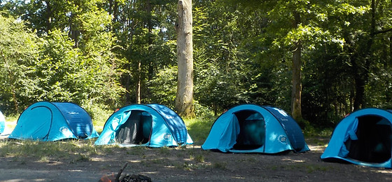
RESIDENTIAL Wednesday 11th – Friday 13th June 2025

Slide 2
Plan for the evening:
Ferny Crofts
Sleeping and Eating
Activities
Kit List
Questions

Slide 3
Not attending?
Whilst we would like to encourage as many children as possible to attend the residential as it is such a valuable experience, each year we have a small group of children who stay at school.
This is absolutely fine and these children will work with an adult in school on some fun activities.

Slide 4

https://www.youtube.com/watch?v=mHskVgN3OiU

Slide 5
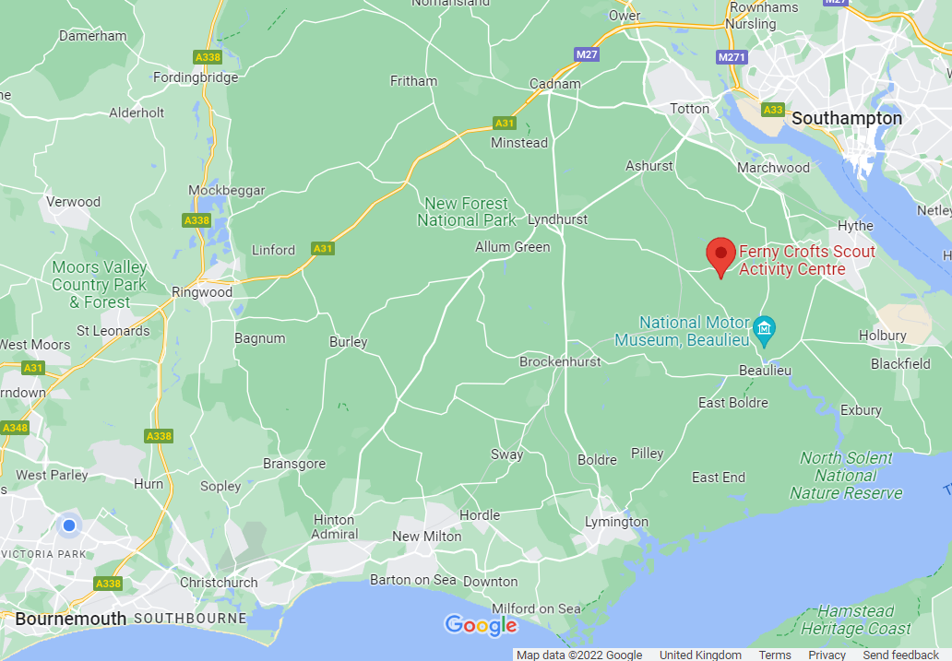

Slide 6
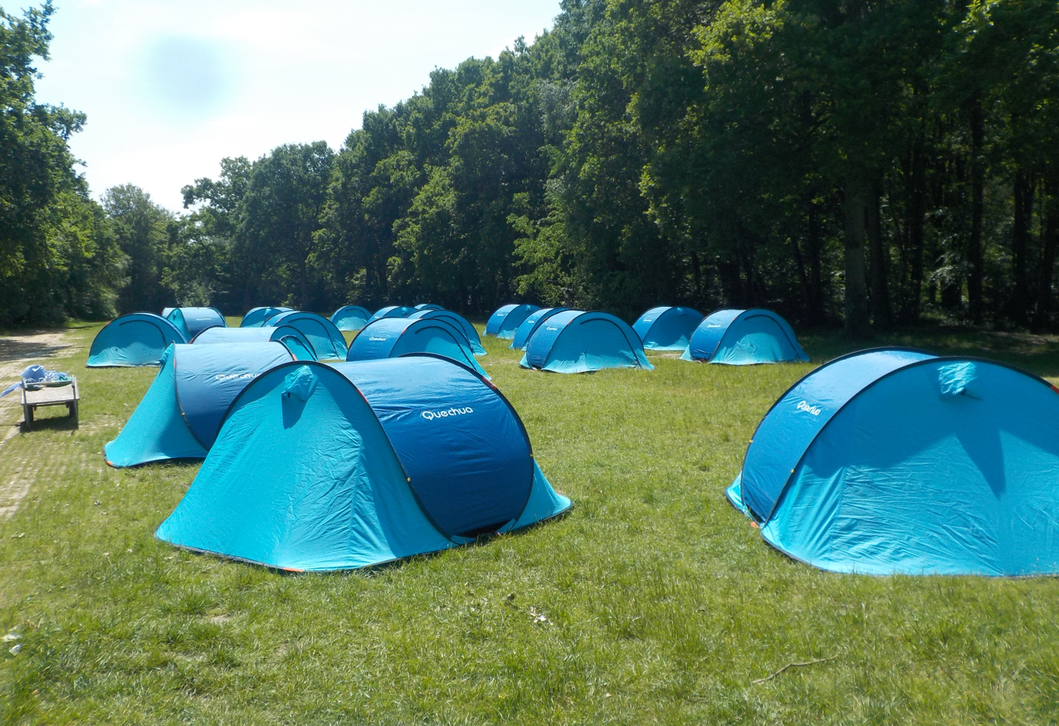
Children will stay in a tented camp. The tents are 3-person tents and will be shared by 2 or 3 children.

Slide 7
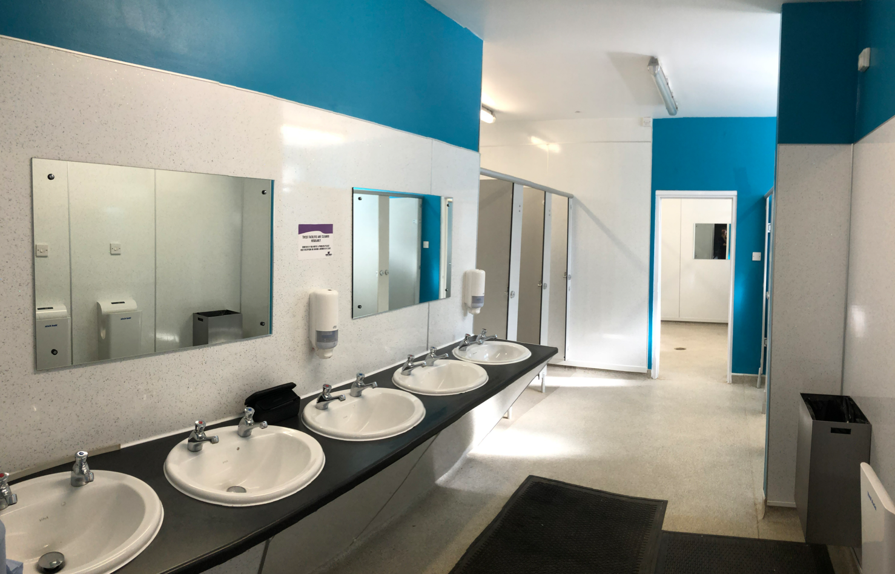
We will use a shared toilet block with private cubicles for toilets and showers.

Slide 8
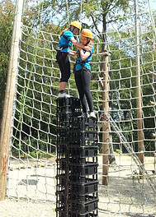

Activities
Groups and Activities
Activity groups will have 10 – 12 children with 1 or 2 members of staff. Some activities will be instructor led and some will be led by our school staff.
Activities include: raft-building, mega climb, crate stacking, tomahawk throwing, zip wire, leap of faith, go-karts and an adventure course.

Slide 9
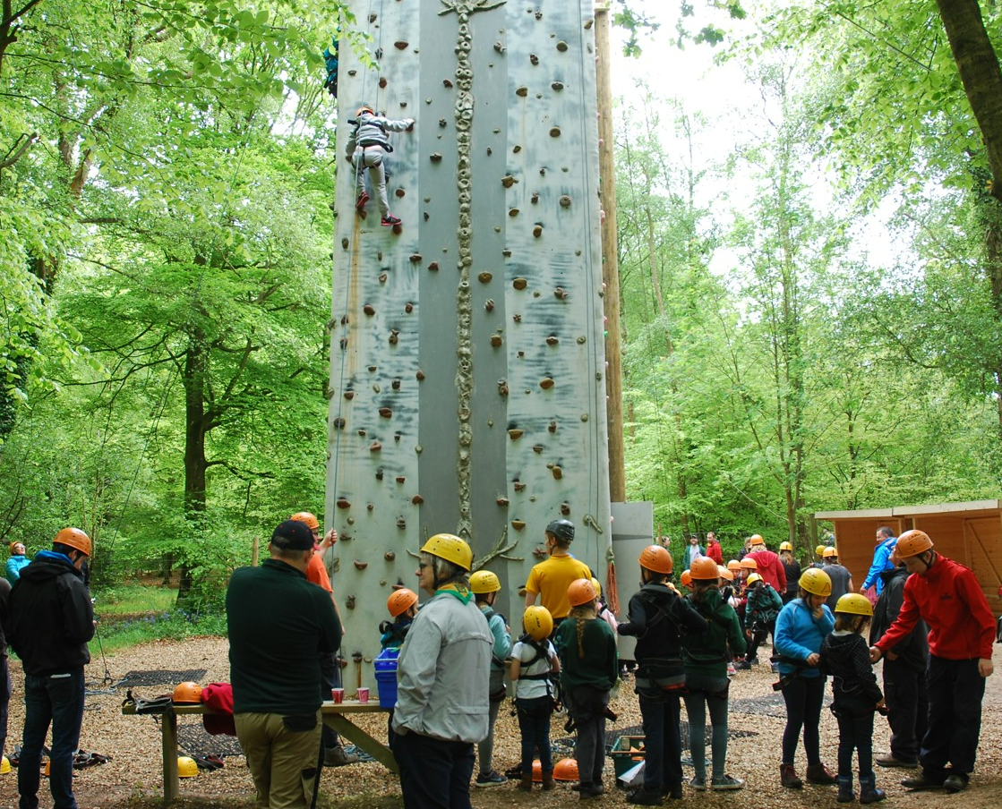
Activities

Slide 10
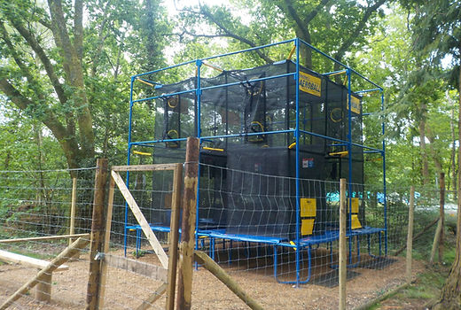
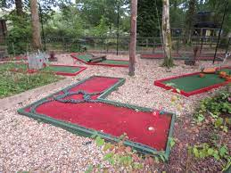
Evenings
The fun will not stop after the daytime activities.
For evening entertainment, we will have access to a games box, PE equipment, volleyball, aeroball and crazy golf.
We will also have access to a marquee tent should wet weather put a dampener on things…

Slide 11
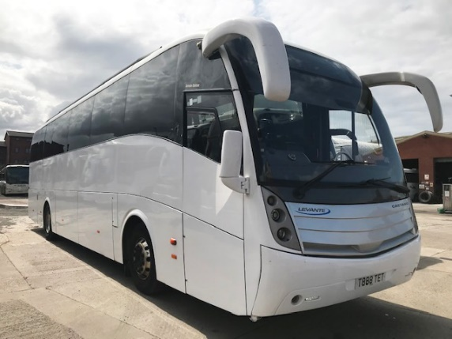
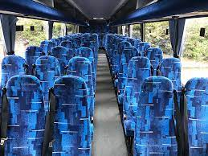
Wednesday Drop Off
Past feedback tells us that getting ready for residential can be a little stressful for children (and parents!). To alleviate this, children can have longer in the morning to get ready and check they have packed everything, arriving at school at 10am.
We will then have a departure briefing with children and load up the coaches ready for an 11am departure.
We can accommodate children where parents need a normal drop-off time due to work. Please confirm this in advance.

Slide 12
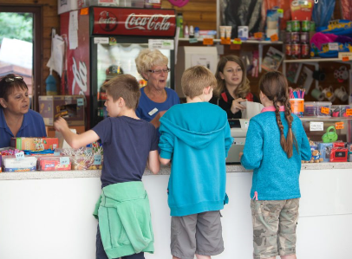
Typical timetable:
Wednesday:
Drop off at school at 10am.
Travel to FC.
Drop off bags at tented camp.
Welcome and tour of grounds.
Lunch and 2 activities.
Dinner and evening activities.
Thursday
Breakfast and 2 activities.
Lunch and 2 activities.
Dinner and evening activities.
Friday
Breakfast and 2 activities.
Lunch and coach travel home.
Arrive back at school by 2:40pm (traffic dependent).
Evening activities: games box, PE equipment, volleyball, aeroball, crazy golf

Slide 13

Food
All dietary needs can be catered for.
If you have not already done so, please inform us of any dietary requirements for your child.

Slide 14

Food
Lunch: 12:30 Wednesday – bring own packed lunch
Thursday/Friday: Provided packed lunch
Sandwich/wrap
Crisps
Yoghurt/jelly/fromage frais
Fruit
Squash

Slide 15

Food
Breakfast: 8:00
Available each day: Toast with butter, jam, marmalade Selection of cereals Fruit juice
Plus daily option:
Pain au chocolate
Bacon/veggie sausage wrap

Slide 16
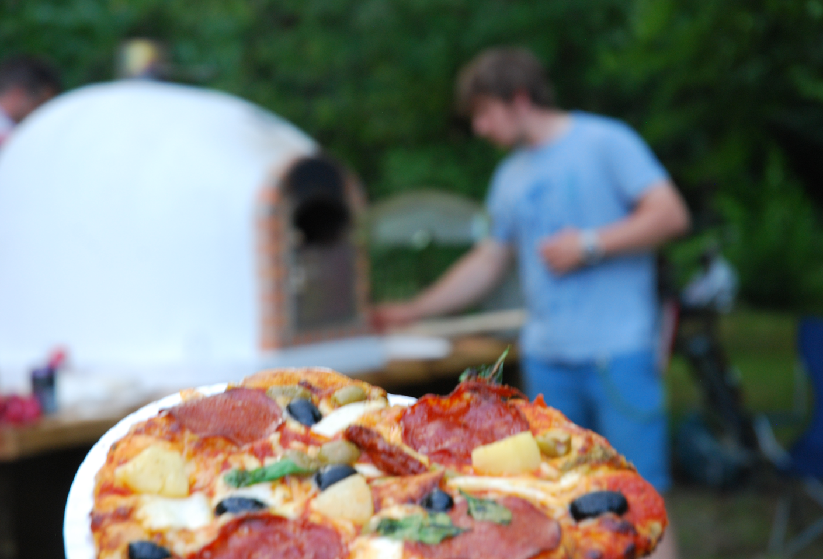
Food
Dinner: 17:30
Pizza oven Choice of toppings Salad, pasta salad dessert
Burger with cheese Pasta Salad Salad Dessert Squash

Slide 17
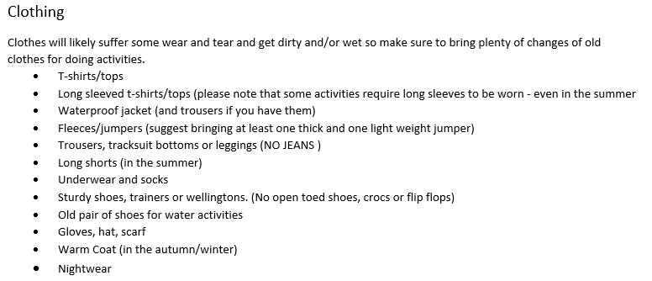
Kit List

Slide 18
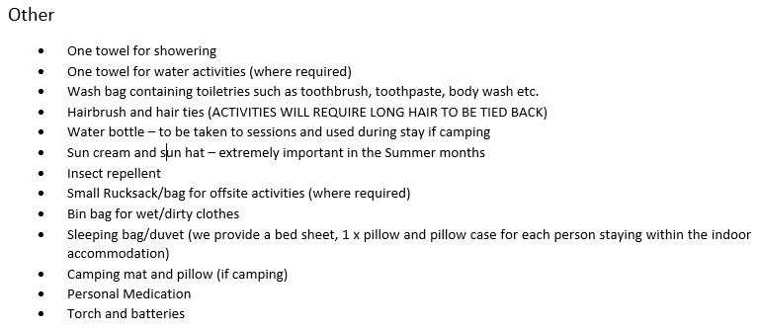
Kit List

Slide 19
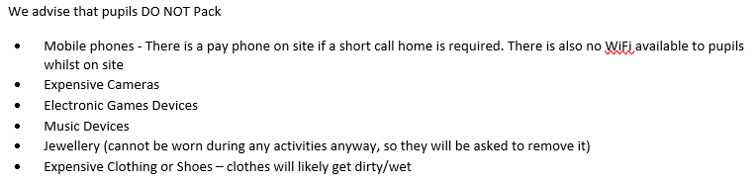
Kit List
Please make sure children do not bring electronic devices or additional food/snacks.

Slide 20
Other information:
Drop off at 10am on the Wednesday. Enter through the hall with bags.
Return by 2:40pm on the Friday, depending on traffic. Children can be collected from the coaches in the carpark.
We will send out a final reminder, nearer the time, for medication and any outstanding payments.

Slide 21
Next steps…
If you haven’t already, please return:
Medical Forms
Code of conduct agreements
No later than Friday 21st March
Please can we also ask that you continue to liaise with the office in regards to the payment schedule.

Slide 22
FAQs
Communication Staff will be in daily contact with school to share general good news. We will share updates and photos through the school Facebook page.
In the event of illness or injury, parents will be contacted by the school.
What happens if my child is unhappy, can’t sleep or does not want to participate in an activity?
We will take good care of them! We will encourage participation but never force them. We will make sure they are tired out and be kind to them at bedtime. We will contact you, should we need advice, rather than allow your child to remain distressed.
Do I give my child medicine to take with them (Calpol etc.)?
Yes. Each child requires a completed medical questionnaire and relevant medication bag which their staff group leader will keep. This will be requested before we depart.
How can I prepare my child for the residential?
Encourage independence in packing, looking after own belongings and personal hygiene. Encourage children to have a positive attitude towards challenges and new experiences, and food.

Slide 23
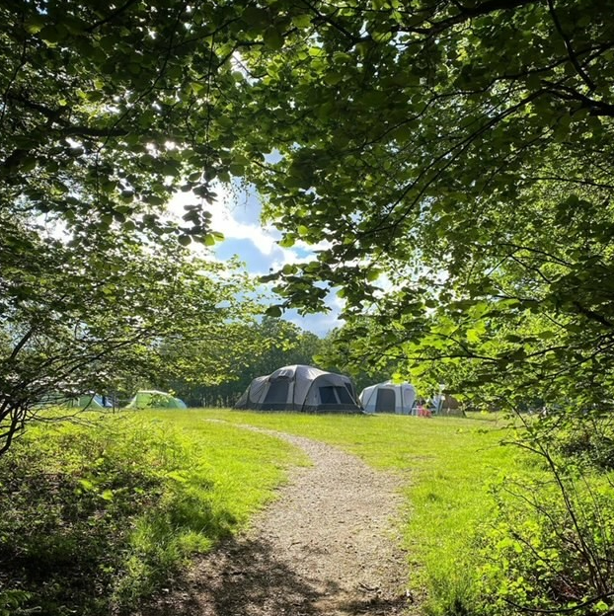
Any Questions?

