Slide 1

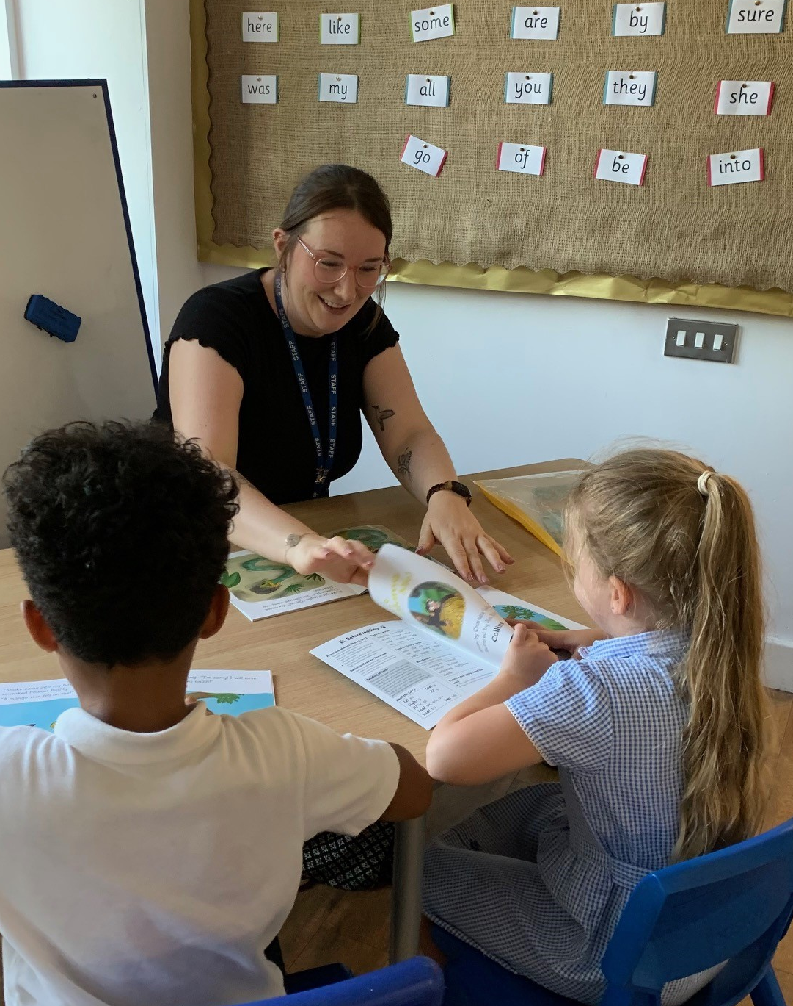
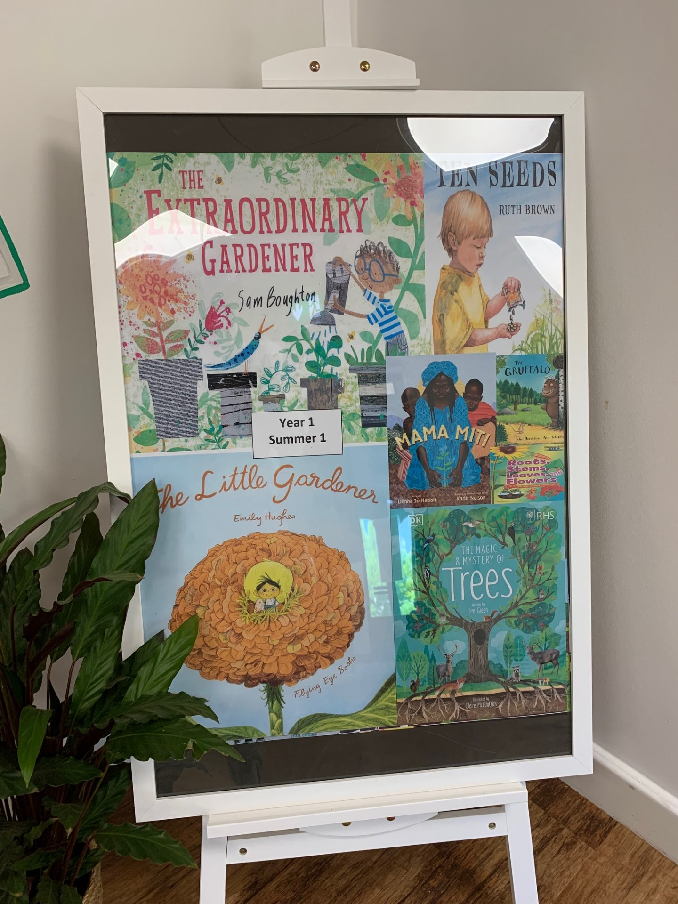
Ready Respectful Safe
Welcome to Reading in Year 1!
In Year 1, we understand that oracy is a key ingredient in reading development and consequently there is plenty of book talk going on.
Our aims in Year 1 are to:
ensure that phonics is taught with fidelity
ensure pupils are supported to read aloud accurately those books that are consistent with their developing phonic knowledge and that do not require them to use other strategies to work out words.
ensure pupils who have learnt how to decode develop fluency through regular and monitored reading, and texts are read aloud to pupils who are unable to decode
develop pupils’ ability to read aloud with prosody to support the development of pupils’ language and vocabulary
encourage children to talk about the books we read with confidence.

Slide 2
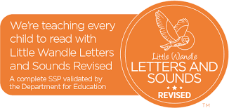
Ready Respectful Safe
Which phonics programme do we follow?
We use Little Wandle, which is a DfE approved phonics programme.
We chose this particular programme after much research. We knew that part of the pathway to effectively developing reading involves a well-implemented approach to teaching phonics.
We read the Simple View of Reading (SVOR) by Gough and Tunmer and considered how we would approach phonics at our school. The SVOR informs the current government policy on this aspect of early reading teaching. We chose Little Wandle as our programme because it stood out: the expectations set out by Little Wandle are high. And expectations should be high! We want all children to achieve well in phonics as a springboard to their future success as readers.
The impact is that we have a high quality, government approved, phonics programme that sets high expectations.
What does a reading session look like in Year 1?
Children read three times every week with an adult.
The three sessions:
Session 1: Decoding
In this session, the focus is purely on phonic strategies to ‘break the code’ in order to read the word. We look at GPCs also, specific words or tricky words that need additional practice.
Session 2: Prosody
We challenge the children to use an expressive voice. We discuss how our voices change depending on what we want our listener to understand from our reading.
Session 3: Comprehension
Our talk around the text supports the children’s understanding. We ask simple questions about the main ideas. In this session, we use the pictures to support our reading experience.

Slide 3
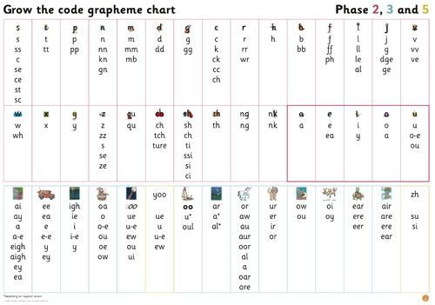
Ready Respectful Safe
Which phases to Year 1 learn?
In the first part of the year, Little Wandle provides a recap of Phase 3 and Phase 4 so that all children are ready to progress to Phase 5 by the second part of the Autumn Term.
Phase 5 generally takes children the whole of Year 1. We introduce alternative spellings for sounds, like ‘igh’. Children master these in reading first, and as their fluency develops, we begin to see them using them correctly in spelling.
Children learn new graphemes (different ways of spelling each sound) and alternative pronunciations for these: for example, learning that the grapheme ‘ow’ makes a different sound in ‘snow’ and ‘cow’.
They should become quicker at blending, and start to do it automatically.
They learn about split digraphs, such as the a-e in ‘name.’
They’ll start to choose the right graphemes when spelling, and will learn more tricky words, including ‘people,’ ‘water’ and ‘friend’. They also learn one new phoneme: /zh/, as in ‘treasure.’
What’s a sound button?
Sound buttons are visual cues to help children break up a word into graphemes. Sound buttons are circles or spots that can be written underneath a sound to support reading. When you touch the sound button you then practice saying the sound aloud. This method fits into the phonics phases and tricky words section of the curriculum.

Slide 4
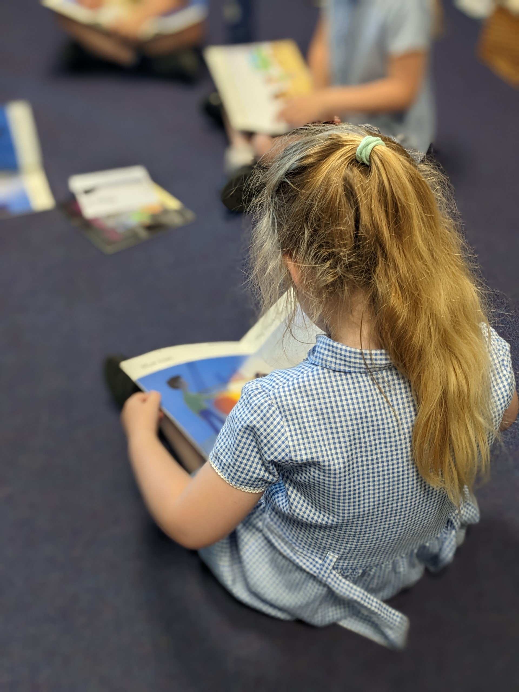
Ready Respectful Safe
Year 1 End of Year Expectations Read accurately by blending the sounds in words that contain the common graphemes for all 40+ phonemes.
Read accurately some words of two or more syllables that contain the same grapheme-phoneme correspondences (GPCs).
Read many common exception words.
Read aloud many words quickly and accurately without overt sounding and blending.
Sound out many unfamiliar words accurately.
Answer questions and make inferences based on what is being said and done in a familiar book that is read to them.
What happens if children aren’t ‘getting it’?
Our heat mat assessments diagnose the exact strand the needs additional support; this could be the child’s knowledge of GPCs, word reading, blending, tricky words or automacity (their ability to read the word in their head or immediately by sight).
From this, we provide children with 1:1 catch up sessions each afternoon.
Our phonics tracking and intervention provision shows how well we know our children.

Slide 5
Ready Respectful Safe
Who teaches my child phonics?
Any adult who teaches phonics at Muscliff (including our TAs, HLTAs and even our regular supply teachers) have undertaken full training to teach phonics. We ensure all of our Muscliff staff keep up-to-date with Little Wandle training. Our Year Leader regularly leads the team’s training and directs the team to LW training videos and guidance. We consider it best practice to always keep on top of Little Wandle training.
Heat Mats and Grouping
Responsive grouping is a key factor in successful organisation. Regular assessment ensures that children move between groups as appropriate to their level of attainment. It is also important to make sure that children are taught by the teachers(s) as well as the teaching assistants as pedagogical knowledge is a significant factor for impact.
Texts involve the reinforcement and practice of taught phonemes only to ensure that children are developing automaticity in decoding GPCs to pronounce words.
Do we use other phonics programmes at Muscliff?
No.
Fidelity matters
Synthetic phonic programmes have one thing in common: they teach children GPCs, to blend phonemes into spoken words and segment spoken words into phonemes.
However, programmes use programme-specific systems and terminology such as actions, mnemonics, prompts, key words and routines to teach knowledge and skills.
It is important not to confuse children by mixing material from different programmes or across different classrooms – hence the phrase ‘fidelity to the programme’. For example, one programme might use the term ‘split digraph’, while another might refer to ‘magic e’ for the same vowel GPC in a word such as ‘late’.
At Muscliff, we ONLY use Little Wandle to teach phonics.

Slide 6
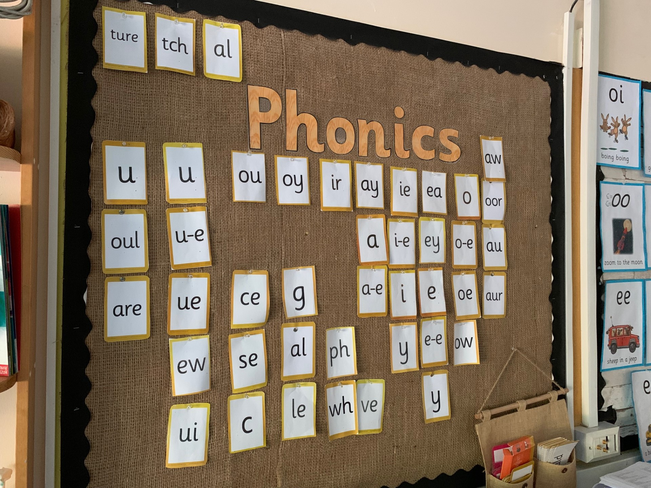
Ready Respectful Safe
But what is phonics?
Phonics is an approach to teaching how to read by focusing on the relationship between written symbols and speech sounds. This involves several skills: skills of hearing, identifying and using the patterns of sounds or phonemes to read written language. Systematic approaches are the most effective in teaching pupils the relationship between these sounds and the written spelling patterns, or graphemes, which represent them. Phonics emphasises the skills of decoding new words by sounding them out and combining or ​‘blending’ the sound-spelling patterns.
How and why we teach phonics:
1. Phonics has a positive impact overall (+5 months, according to EEF) with very extensive evidence and is an important component in the development of early reading skills, particularly for children from disadvantaged backgrounds.
2. The teaching of phonics should be explicit and systematic to support children in making connections between the sound patterns they hear in words and the way that these words are written.
3. The teaching of phonics should be matched to children’s current level of skill in terms of their phonemic awareness and their knowledge of letter sounds and patterns (graphemes).
4. Phonics improves the accuracy of the child’s reading but not necessarily their comprehension. It is important that children are successful in making progress in all aspects of reading including comprehension, the development of vocabulary and spelling, which should also be taught explicitly.

Slide 7
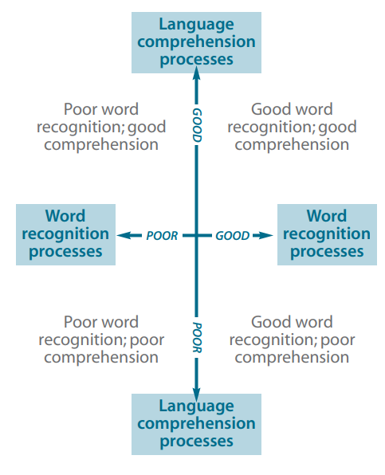
Ready Respectful Safe
Year 1’s Evidence-Based Research
The Simple View of Reading (SVoR) helps us to understand the barriers to a child’s reading fluency (and therefore how we can best support them to make progress). By using assessments carefully we can identify areas of the reading process that are contributing less effectively to the integration of skills. However, the model helps us understand that reading can be expressed by a multiplicative theorem – so development in both linguistic and word reading areas are both necessary as they interact.

Slide 8
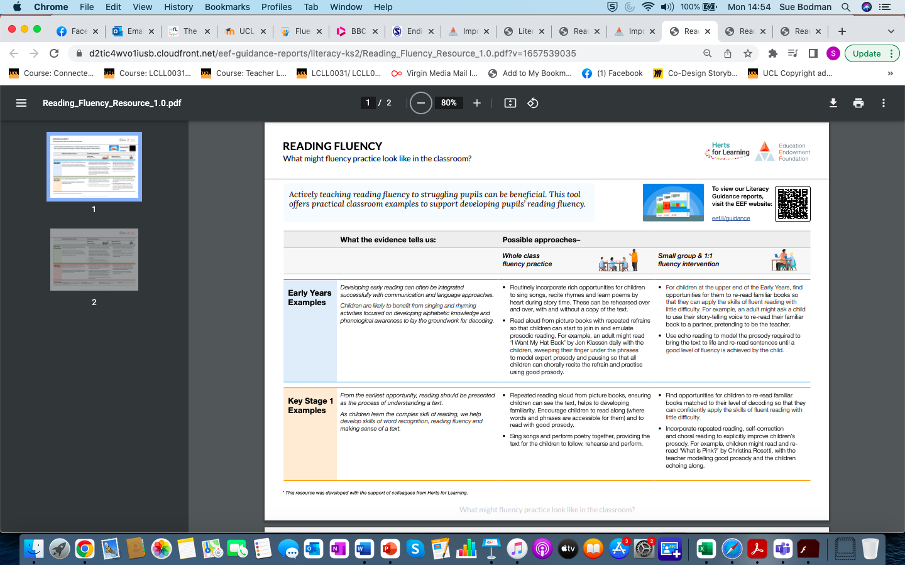
Ready Respectful Safe

