Slide 1


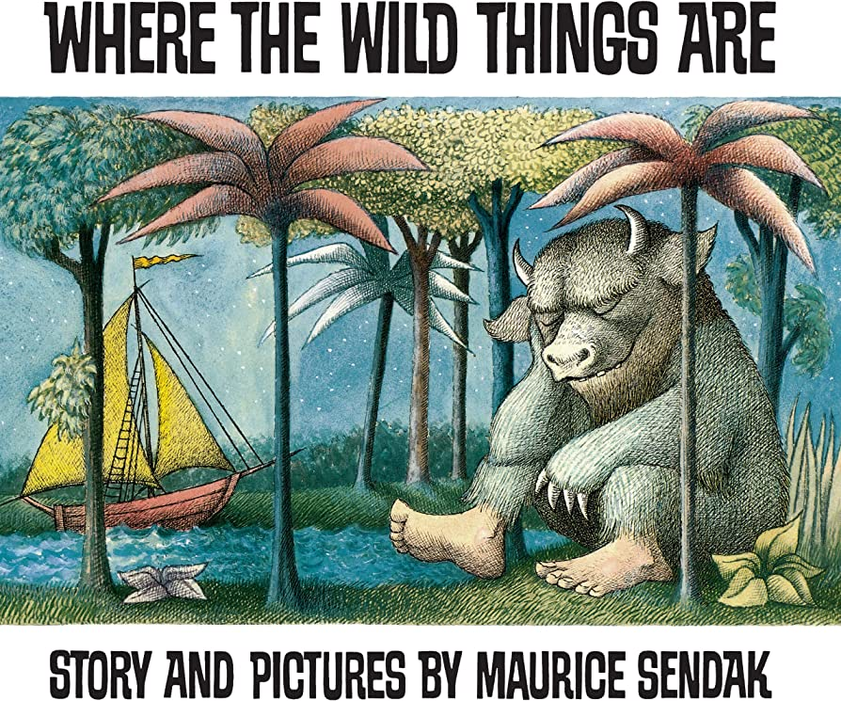

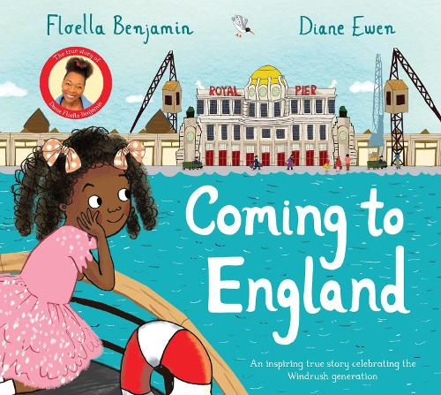
Year 1
Summer
2
Ready Respectful Safe
Where in the World?
Why these particular books and not something else?
What a beautiful range of books we offer our Year 1 children this half term!
Curiosity is our key theme during this unit and we have chosen these books to prompt the children to think about what’s out there beyond Muscliff. We wanted to present the children with books that would not only provide them with information about faraway places, but books that would inspire them to ask questions about the big, wide, world.
A personal favourite here, Maurice Sendak’s ‘Where the Wild Things Are’ is celebrating its 6oth anniversary since its first publication. How many of you enjoyed this children’s classic as a youngster yourself? The illustrations are delightful! Blown Away and Poles Apart whisk Y1 away to exotic locations before Floella Benjamin brings us back closer to home. By the end of this unit, we hope to develop the children’s curiosity about different locations.
Key Question:
I wonder what is different about each of the places in these books…
I wonder what is the same about each of these book…
Who helps to keep us safe?

Slide 2





Year 1
Summer term
2
Ready Respectful Safe
English Skills
Composing accurate simple sentences will continue to be our focus this half term. It is so important that the children secure these fundamental skills that form the solid foundations for their future as efficient writers. As always, we continue to encourage children to orally rehearse their sentences and say their ideas aloud before attempting to write their sentence. Children should use their phonic knowledge to attempt to write new words. Finger spaces are always helpful! We check our sentences carefully for full stops and capital letters. Throughout the unit, we will enrich Y1 children’s vocabulary with words associated with contrasting locations.
As we will be writing for different purposes, children will be shown the features of a postcard and a fact file as we consider what our readers need to know.
Writing Composition in school:
Non-fiction fact files (about a different country)
Postcards
A story about a visit to a strange new land that is far, far away
A description of themselves for their new teacher
Help at Home:
Where in the world would you like to visit? Choose one of the countries from our new book (Poles Apart). Write down why you would like to travel to that country. Could it be to meet polar bears in Antarctica or to ride an elephant in India?
Imagine Mr White and the penguins arrived in Bournemouth! What would they do and who could they meet? If you want to, you could try to write some sentences about their time in Bournemouth. Maybe they spent a day at the beach or found their way to Muscliff Park.
What does your weekend routine look like? Just like in our classroom timetable, can you draw pictures to show your weekend timetable? You could even write some sentences to explain each picture. For example, I go football training.
Just like Floella, imagine you were going to meet The King! What questions would you like to ask him? Write down your favourite questions.
Penguin Blue is pulled up to the sky by a ‘brand new kite’. If you could have a brand-new kite, what would it look like? Can you draw a picture of your new kite and use labels to describe your design. For example, bright green stripes.
Try and remember the events in the story ‘Where the Wild Things are’. Retell the story to an adult at home and have a go at writing some sentences to show the beginning, middle and end of the story.

Slide 3
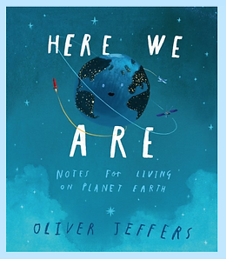
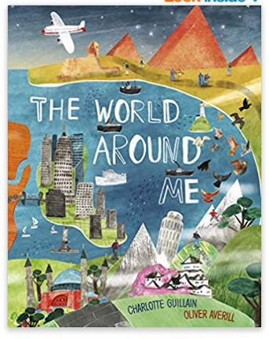
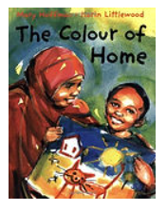

Year 1
Summer term
2
Ready Respectful Safe
Our Extended Book Spine
We call it Earth. Our world can be a bewildering place, especially if you've only just got here. Your head will be filled with questions, so let's explore what makes our planet and how we live on it.
From land and sky, to people and time, these notes can be your guide and start you on your journey. And you'll figure lots of things out for yourself. Just remember to leave notes for everyone else...
Some things about our planet are pretty complicated, but things can be simple, too: you've just got to be kind. Here We Are is the utterly heartfelt new book from Oliver Jeffers.
With so much to explore on this globetrotting adventure, it’s a good thing the book stretches to an incredible 2.5 meters long – you’ll get halfway around the world before you even have to turn the page!
Stretch out the book's accordion-fold pages and take in the wonders of the world's cities and landmarks – traveling through over 60 countries. Then turn it over and explore the amazing diversity of creatures and landscapes on planet Earth. What can you spot on your travels?
A topical story about a boy called Hassan who has fled to England from Mogadishu in Somalia. He feels that his new home is cold and grey, but colour and hope soon begin to return to his life as he settles in. This is a good text to use to encourage compassion for children who have been forced to travel away from their homes in difficult circumstances.
A lift-the-flap information text that details homes from all around the world, including Bedouin tents, Thai river houses, brick apartments and Dutch barges.

