Slide 1

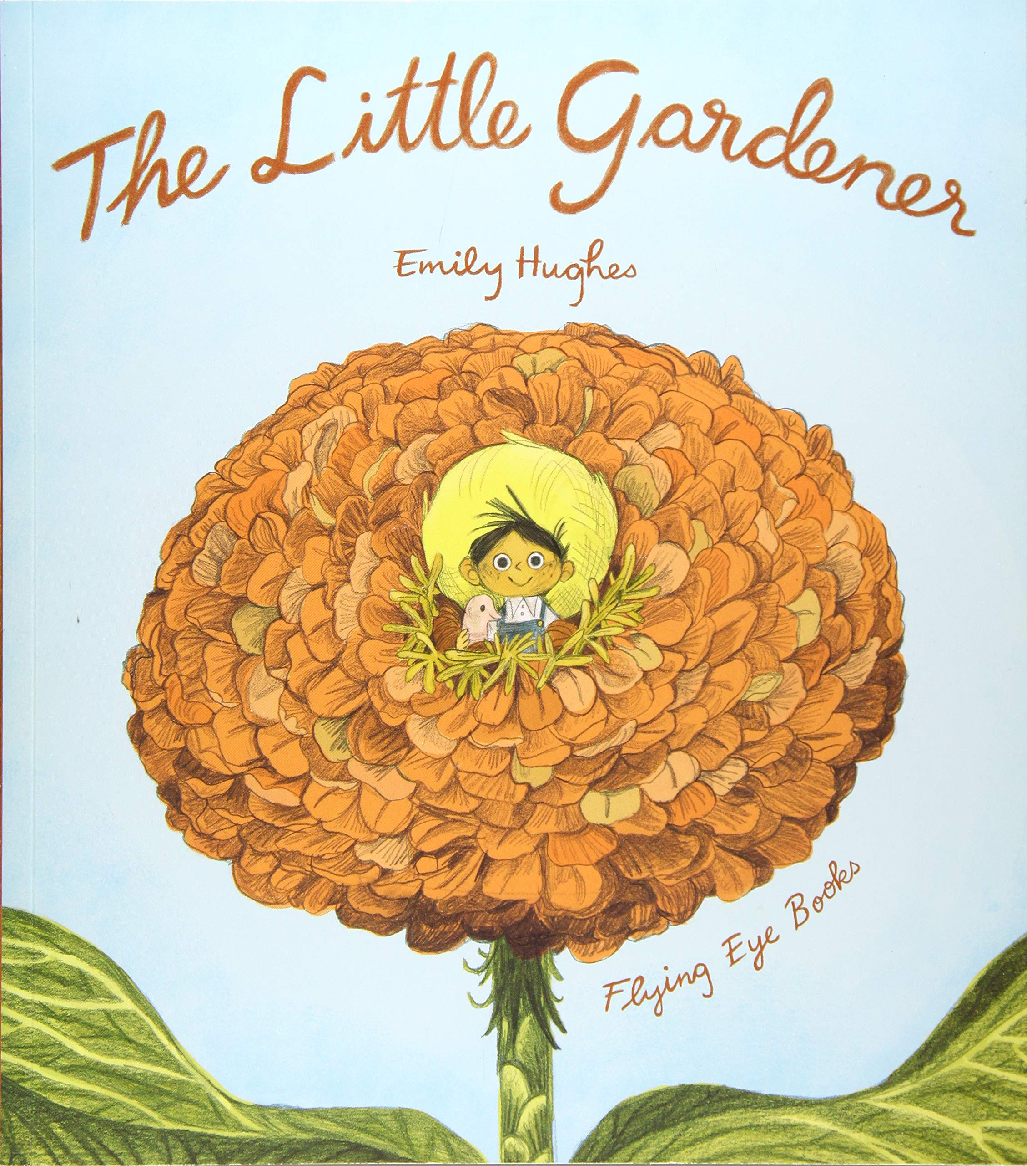
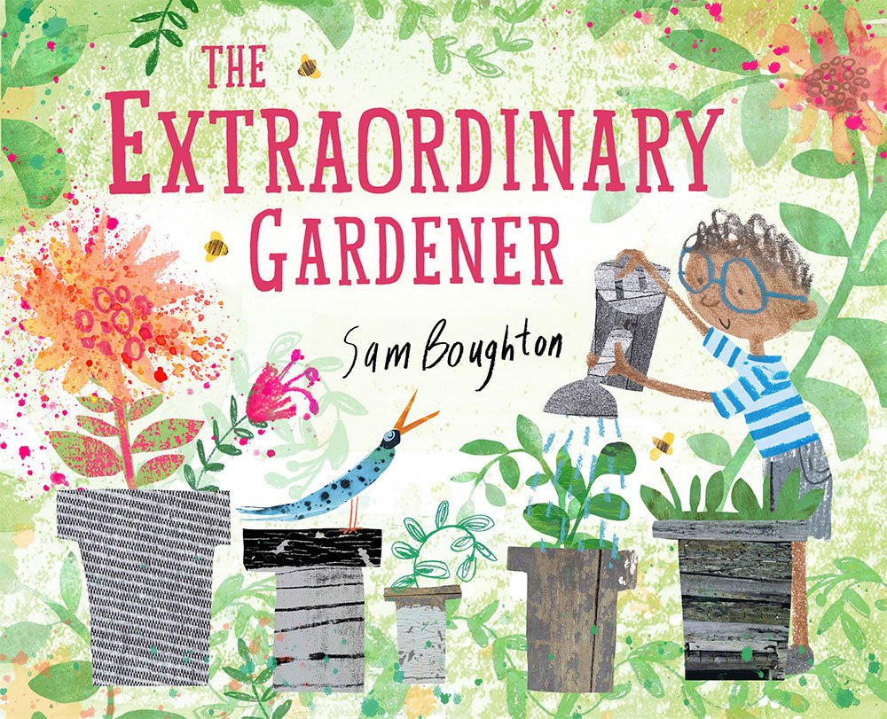
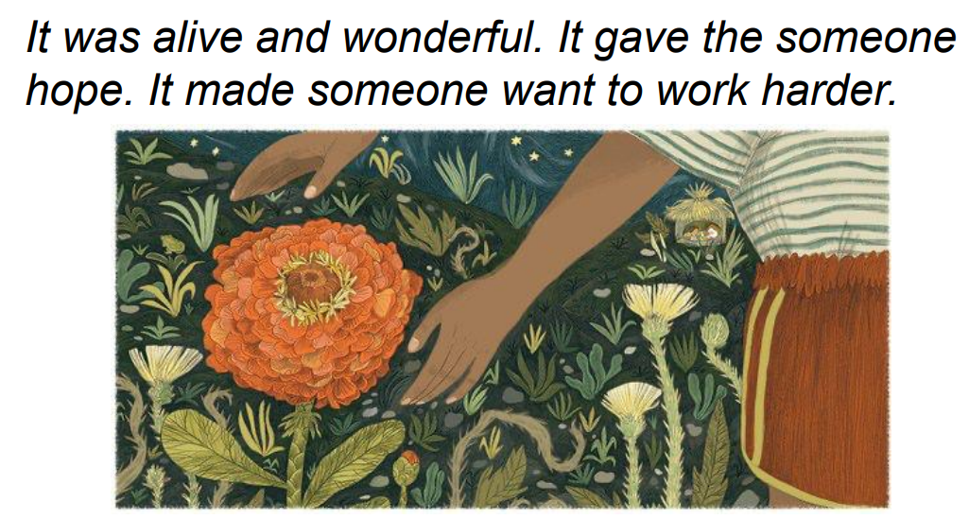
Year 1
Summer
1
Ready Respectful Safe
The Little Gardener
Why these particular books and not something else?
As the warmer weather approaches, Year 1 will be exploring growing plants… Many children’s books have been written about gardens, so why have we chosen these books when we have the freedom to read any other book with our children? Well, as soon as you pick up The Little Gardener and The Extraordinary Gardener, you’ll recognise how they resonate with our school ethos. The main character, the little gardener himself, represents us all… and the concept of feeling so little in the face of a challenge is something that we can all relate to. Sometimes we feel overwhelmed when a task in front of us is seemingly so big, particularly when we experience little progress in achieving that goal. The Little Gardener helps children to recognise that this feeling is perfectly normal. It is natural to feel overwhelmed but what is important is to tap into our positive growth mindset to carefully consider our next steps. Year 1 use this text to explore our school value, Resilience. Resilience stands out clearly for the children as the Little Gardener needs to work hard every morning, every afternoon and every evening. We prompt our Year 1 children to consider when they have needed to show resilience and perseverance and how this developed their mindset.
Key Question:
When have you had to keep trying? How was it worth the effort?

Slide 2





Year 1
Summer term
1
Ready Respectful Safe
English Skills
There are plenty of English Skills that will be developed through this unit. Specifically, we will be encouraging children to ‘really look’ in order to create more detail in their descriptions. They will be considering how things change over time too and make comparisons.
identifying nouns, adjectives and verbs
Noun = flower. Adjective = beautiful. Verb = is growing. I wonder how many nouns we can see in a garden…
suffix spellings we explore are: ing, ed
comparing adjectives using _er and _ est
orally presenting to an audience is another feature of our unit
children will rehearse reading their sentences aloud
we consider the features of a diary, including the perspective (writing in first person) and we explain our feelings
retelling an already familiar story
Writing Composition in school:
Children will write a setting description and will describe how a garden changes over time.
They will write a diary in first person using ‘I.’ They will need to write from the perspective of the Little Gardener.
Children will keep a seed diary. This will be a little different from the diary above as it is non-fiction. It will us close observation skills and we want children to look at the small details.
Help at Home:
Get outside in your garden or the park! Spot the signs of growth. Look at the trees – how are they changing? Orally rehearse sentences: “I can see…” “I can hear…” “I feel…” Feel free to write some sentences too.
2) Help your child to recall a time when they have had to try and try again to succeed. How did it feel at the time and how did it feel when you had achieved the task/goal?
3) Find two plants or flowers to compare. Start off by orally comparing them in a sentence. You’ll probably notice that you use ‘but.’ It’s likely that your child will use _er suffix and _est suffixes too. “The daffodil is dying but the rose is still growing.”
4) Keep a diary about your weekend. Write some sentences about what you got up to.
5) Take a walk around the area. Have a nosey at people’s gardens! Which garden do you like the most and why? You could rate the gardens out of 10.
A fantastic experience would be to take your child to a garden centre. Have a stroll around and look at the different plants and seeds that they stock. Which plants are colourful? Which plants are large? Which plants are delicate?

Slide 3
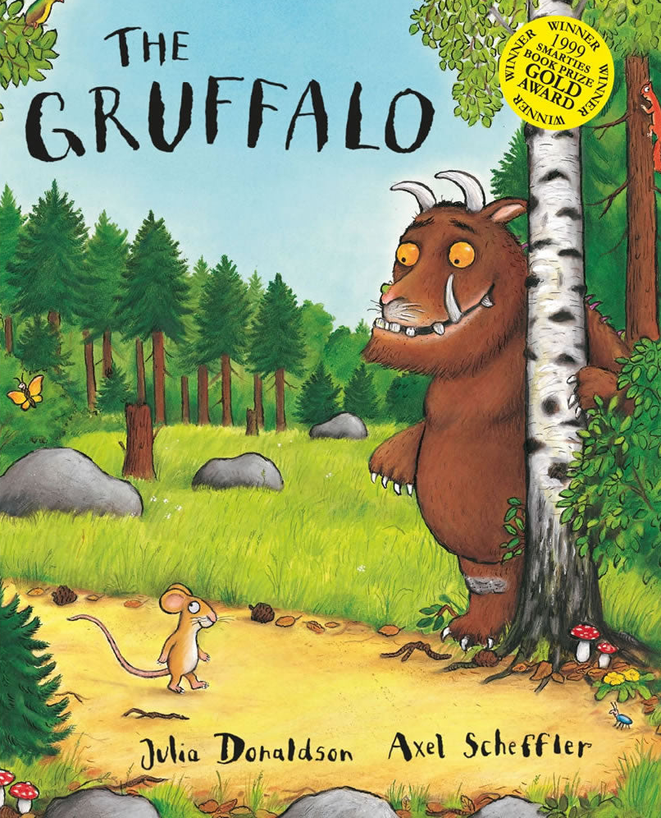
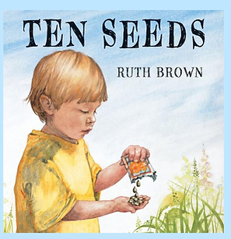
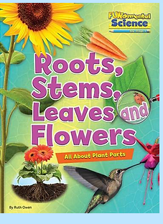
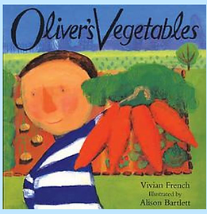
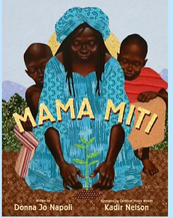
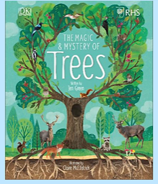
Year 1
Summer term
1
Ready Respectful Safe
Our Extended Book Spine
A simple story to introduce the idea of seed dispersal and life cycles. It tells the story of ten seeds, only one of which survives to grow into a lovely sunflower and produces new seeds to start the cycle again. The illustrations are full of detail and the text is an accessible introduction to seed science for young children.
This non-fiction book introduces the parts of a plant for KS1 readers. Learn all about common wild and garden plants, including flowering plants, vegetables and trees. Investigate the basic structure of plants (including roots, stems, trunks, branches, leaves, flowers, petals and fruit). This series covers the National Curriculum programme of study for science at Key Stage 1.
This popular picture book tells the story of fussy eater Oliver, who will not eat anything but chips. One day Grandpa sets him a challenge that helps him to learn to try new foods from the vegetable patch and Oliver is surprised by what he finds out.
A picture book telling the true story of Wangari Maathai, who who encouraged Kenyan women to plant trees to improve their lives and their environment.
Did you know that trees send underground messages? Have you heard that they take care of their families? A tree is so much more than it seems. Produced in collaboration with the Royal Horticultural Society (RHS), this illustrated information book is the perfect introduction to the world of trees - above and below ground. Combining stunning photography with beautiful illustrations, turn the pages to find out how trees help prevent soil erosion, mark the seasons, and provide a habitat for wildlife. When you get to know these silent giants, you'll never look at trees the same way again.

