Slide 1


Ready Respectful Safe
Welcome to Year R
We are so pleased to warmly welcome you to Muscliff and to our Reception Base.
This is the school where you will feel that you belong.
This is the school where you will feel happy and safe.
This is the school that will get to know you as an individual. You will be able to grow and thrive as we will learn about everything you need; we will nurture your development.
Our Reception Team are the very best gardeners!

Slide 2

Ready Respectful Safe
Year R: Our Aims
Belonging: we recognise how important it is to feel that children belong to YR, to our whole school and to the local community. Our school culture ensures this key priority. Our youngest children feel proud to wear their school uniform as we use every opportunity to reinforce The Muscliff Way.
Relationships: we aim to foster relationships and support every child to develop relational behaviours. Friendship is a priority and children in Reception soon make friends and learn about kindness.
Love of Learning: we ignite a love of learning, fuelled by exciting topics, captivating provocations and invitations, and endless possibilities within our carefully planned indoor and outdoor spaces.
Happy and confident learners: our nurturing environment celebrates individuality and builds self-esteem. Children feel safe to take risks, express themselves freely, learn from mistakes, and build their resilience, fostering a love of learning.
Curious minds that thrive: an engaging bespoke curriculum, open-ended provocations, and high-quality continuous provision provide the right conditions for healthy growth. Children become natural explorers, asking questions, investigating their interests, and building a deep understanding of the world around them.
Language and oracy: we recognise how significant language. We want all of our children in Reception to feel confident to express themselves and their ideas and have a rich vocabulary to do so effectively. We are good speakers. We are even better listeners.

Slide 3
Ready Respectful Safe
Year R: How we achieve our aims
Language-rich environments: Every corner is an opportunity to communicate and expand vocabulary. Through our carefully selected ‘beautiful texts’, songs, rhymes, and meaningful interactions, language comes alive, empowering children to express themselves with confidence and fostering a love of books and reading. We choose the best books to get the children talking.
Highly skilled staff: Our passionate and dedicated team guides and supports children's aspirational learning journey. They are experts in play-based learning, skilled in observation and assessment, and committed to moving every child’s learning forward. Our curriculum is delivered using a careful balance between child initiated and teacher led learning activities.
Learning through high-quality play and meaningful interactions: We believe play is the foundation for all learning in the Early Years. Through carefully planned activities and rich interactions, children develop essential skills in literacy, numeracy, communication, and social-emotional development, preparing children for the next stage of their learning journey into Year One and beyond.
Outdoor learning: We understand and appreciate the importance of the outdoor environment for our children. We provide our children with opportunities to develop their gross motor skills and deepen their imaginations. We value the necessity of children managing their own risks and developing their own narratives therefore, the resources and staff support this.
A strong foundation for the future: By mastering the basic skills of reading, writing, and maths children are equipped with the confidence and knowledge they need to excel in the next stage of their Muscliff journey.to do so effectively. We are good speakers. We are even better listeners.

Slide 4
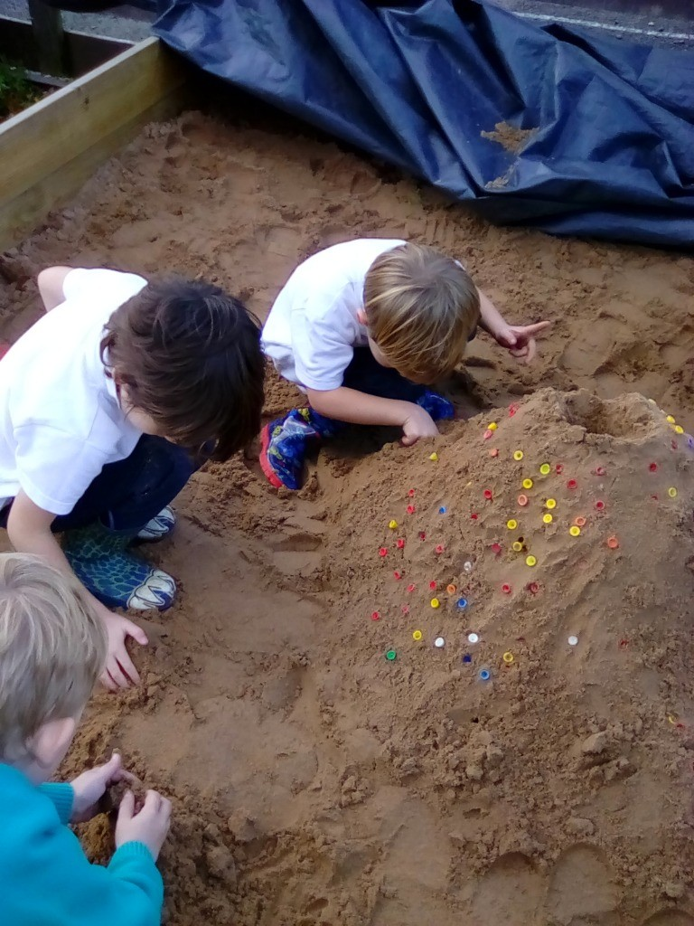
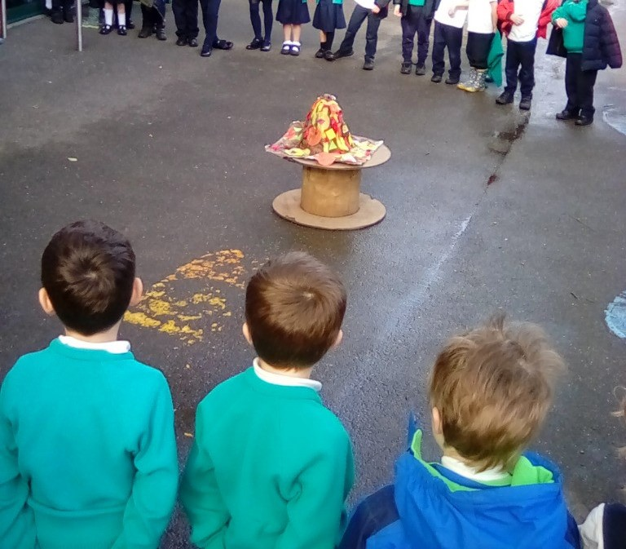
Ready Respectful Safe
Providing Foundations
Our reception year prepares our youngest pupils for what’s to come throughout their school years at Muscliff Primary. We strive to instill joy and confidence and positive attitudes towards learning, supporting children to feel a sense of belonging to our school.
They play all day, don’t they?
Ofsted guidance recognises that play is a very important part of every child’s development and most learning will be introduced through a mixture of carefully planned play and some adult-led focused activities.’
Muscliff offers a balance of adult-led and guided learning as well as child-initiated learning. If your child says that they have been playing all day – it means that they have been lucky enough to have experienced staff who have made their learning fun and enjoyable!
Through play, children can think creatively and imaginatively, following their own lines of enquiry and interests. We take time to explore children’s own ideas and interests and our staff tune-in to develop this further, using children’s ideas as a springboard for deeper learning. We listen to what the children want to learn about and use this spark to ignite more learning.
For example, when a child asked a question ‘how do volcanoes erupt?’ the adults supported the child to find out more information. This led to making giant sand volcanos in the sand and a class volcano which we erupted in the playground!

Slide 5
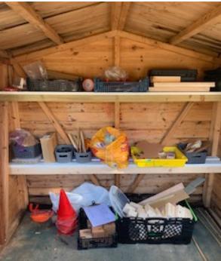
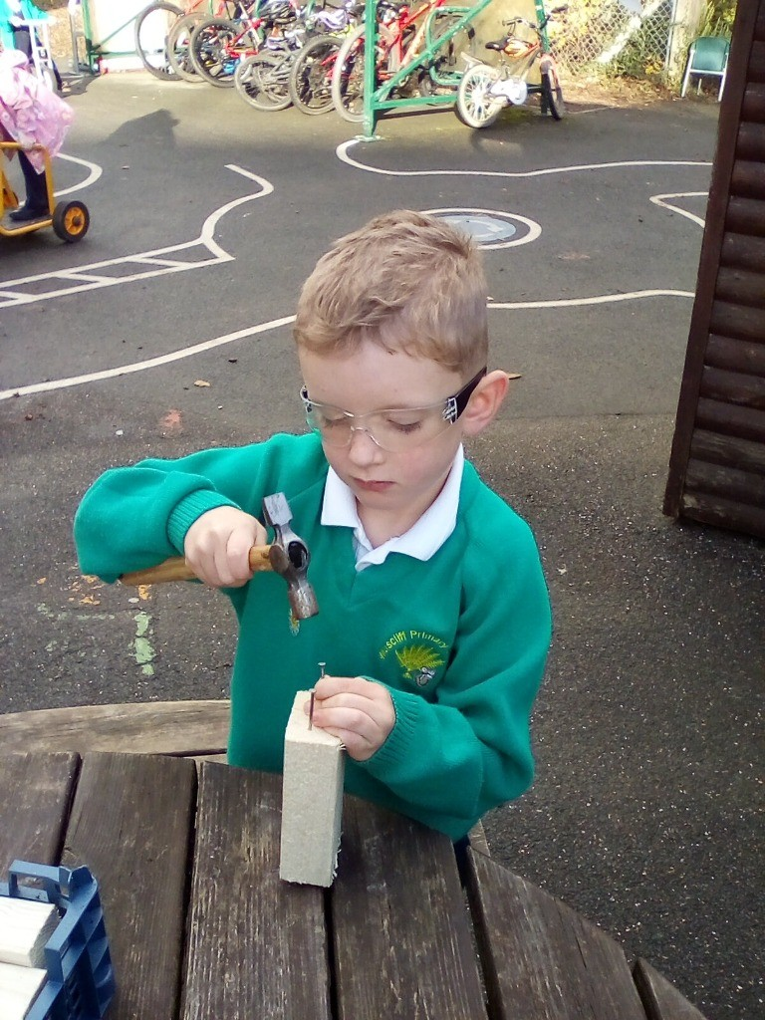
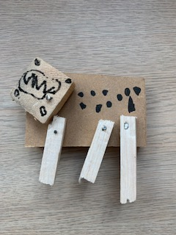
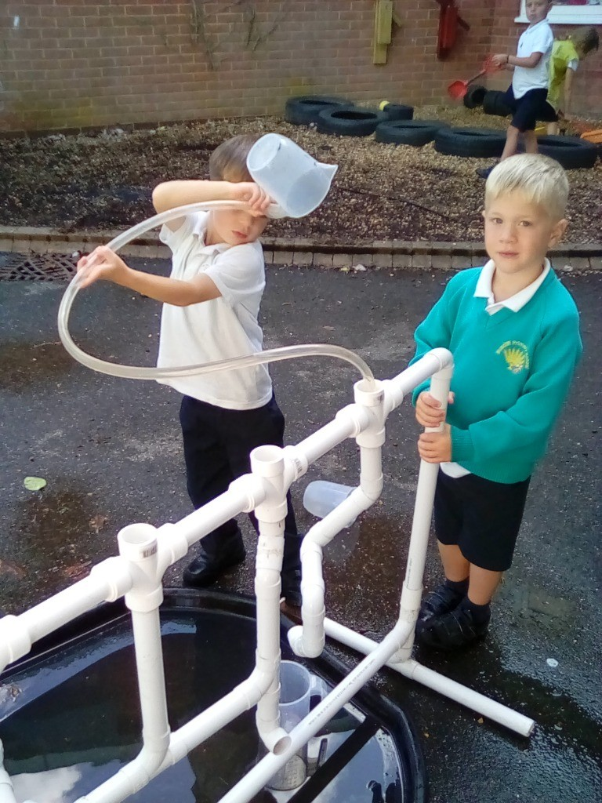
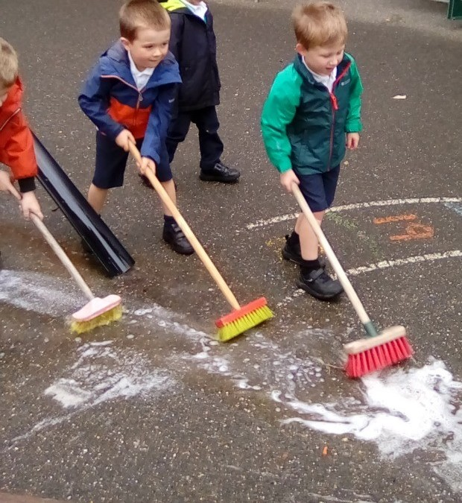
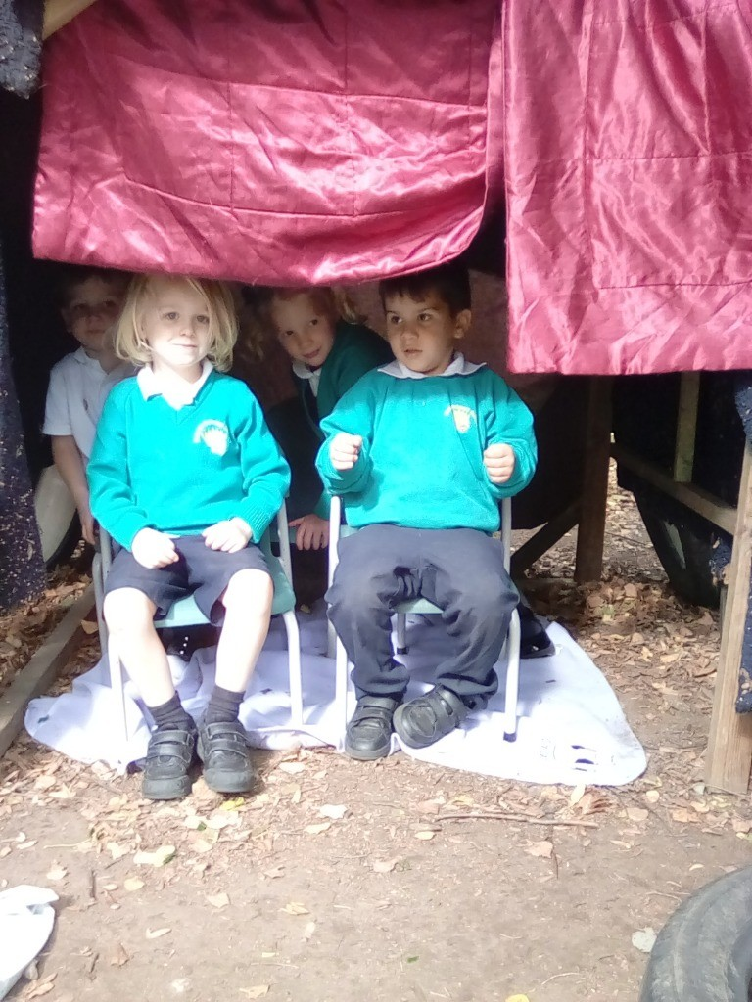
Ready Respectful Safe
Outside Learning
We are very lucky to have a huge amount of outside space for the children to enjoy. So we take full advantage of this and spend much of our time outside. Rain or shine, Reception are making the most of outdoor provision.
Here is our wood-work shed and an example of our handy work. Yes – we use real hammers and real nails!
Water play is always a favourite. This provision continually changes but using water in some way is continuous.
We are very lucky to have a magical garden. We learn all about the world around us in here, responding to the changing seasons and weather. We love den building too!

Slide 6
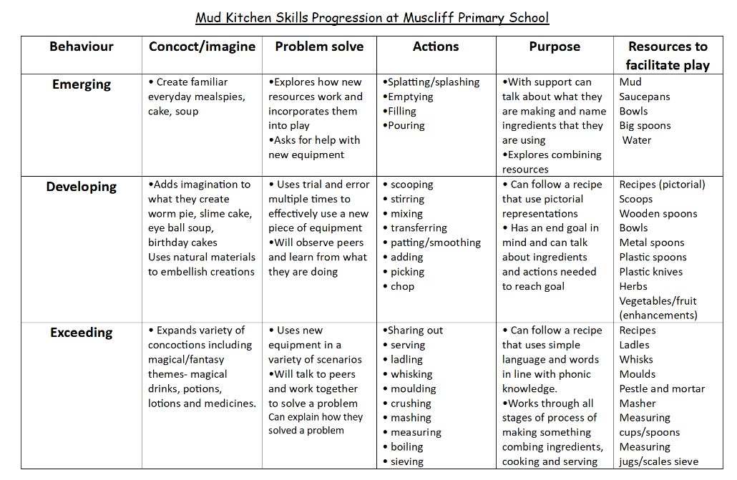
Ready Respectful Safe
Progressive Provision
Through careful planning we ensure that our continuous provision is progressive. We provide a range of resources and high-quality adult interactions to move support the children in moving towards the next stage of their learning in whatever they are doing.

Slide 7
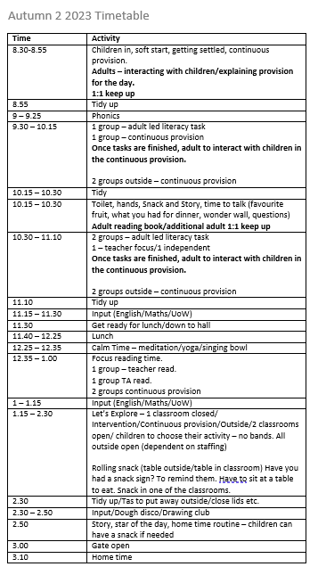
Ready Respectful Safe
What a day looks like:
It’s a busy but fun day in Reception. The timetable presented here is from the start of the year.
As the Reception year progresses, the learning adapts in a way that is appropriate in preparing the children for Year 1 and the National Curriculum.

Slide 8
Ready Respectful Safe
Transition Time-Line
Starting at school is an important time. Much thought goes into the transition period, which actually begins in the summer term before your child starts at Muscliif.
April: Families hear that they have been allocated a place at Muscliff Primary School. Families accept the offer.
May: Teachers, alongside our school SENCO, begin to liaise with other external professionals with a focus on children with additional needs. Initial plans for specific provision are drafted. Nursery schools will also be asked to offer significant information that would support us in allocating classes.
June: Our team begin their nursery visits or meet with providers to talk about the children. It is helpful for the teachers to see the children in a setting that is familiar to the child. We ask lots of questions of the adults in the children’s current provision. We draft our class lists.
June: All parents will be invited to attend a Welcome Evening. In this meeting, parents will meet the Reception Team and find out which class their child will be in. Parents will receive a welcome pack with plenty of information. Key information will be shared through a presentation from the team. You’ll get to see the classrooms and the base.
July: Families will be invited to attend a ‘stay and play’ session in the year base. Here your child will be free to explore their new environment with the support of their grown-ups. Grown-ups will be encouraged to begin to meet other families too – we recognise that it’s not just the children who will be making friends. Parents will also begin to forge friendships with other parents.
July: Families will be invited to our annual school fayre. Play opportunities will be arranged.
September Week 1: Each family will arrange an appointment with their child’s class teacher. This is a 1:1 session. You’ll be given time to pass on the information that you think we will need to know. We will listen. We will ask questions too.
September Week 2: This week is half days only. Half the class come in for the morning and half the class come in for the afternoon.
September Week 3: we are full time.

Slide 9
Ready Respectful Safe
EYFS Assessment
The purpose of the reception baseline assessment is to provide an on-entry assessment of pupil attainment to be used as a starting point from which a cohort-level progress measure to the end of key stage 2 (KS2) can be created.
The Early Years Foundation Stage is a statutory framework which sets out the standards for learning, development, and care of children from 0-5 years. The Early Learning Goals guide children’s overall learning and development. At the end of the academic year, every child is assessed against the Early Learning Goals before transitioning into Year One.
The Early Years Foundation Stage is split into 7 areas and 17 strands of learning within these 7 areas.
The 3 PRIME areas are essential. They support development in all areas of learning.
Personal, Social and Emotional Development – self-regulation; managing self; and building relationships.
Physical Development – fine motor; and gross motor.
Communication and Language – listening, attention and understanding; and speaking.
The 4 SPECIFIC areas teach the children essential skills and knowledge.
Literacy – comprehension; word reading; and writing.
Mathematics – number; and numerical patterns.
Understanding the World – past and present; people, culture, and community; and the natural world.
Expressive Arts and Design – creating with materials; and being imaginative and expressive.
The Characteristics of Effective Learning – playing and exploring, active learning and creating and thinking critically are vital in underpinning all learning and development. They help to develop the unique child and are present in all areas of learning.

Slide 10
Ready Respectful Safe
Questions and Answers
What do you do on that very first morning/afternoon session in September?
Literally the very first thing we do is get them inside the classroom as soon as possible where there is an range of inviting of toys to play with and activities to do. An adult will be in every classroom helping any child that may need some encouragement to find something they love or who just wants to talk or to watch others until they are ready. There will also be an adult at the door of course with a big welcoming smile ready to help them get into the classroom.
We let the children play and explore the setting whilst we talk to them and help them to feel happy and settled. We will practise tidying up and sitting on the carpet for some short teacher led sessions, which will consist of some maths or phonics games or singing. After that we take a trip to the toilet and then go and explore our outside areas. We wash our hands/ go to the toilet again and then have our fruit snack; we sit in a circle, chat and eat together... and then we have more 'Let's Explore' time in our classroom. By that time it is almost home time so we sit down for a story, a song and a chat about what we've loved the most about our very first morning/afternoon. We get ready for home time, collecting our water bottles, snack pots, book bag, coat, jumpers and our many stickers and we line up ready to be called to go to our grown up. We will know your child's name and a fair bit about them by the time you pick them up that first time although forgive us if we don't yet instantly match you to your child for a bit!
The next few days go in the same vein with a few more 'learning moments' along the way such as Wonderful Walking, Super 6 Sitting, what does 'safe' look like in school, what is 'star of the day' etc until we have a start of a routine that makes the children feel secure and happy.
What do I (and you) do if my child is crying when I drop them off?
We're used to it! Many children will cry at dropping off time at some point in the year as tiredness gets to them or they realise they have to keep coming to this school thing every day!
We will ask you to try to release yourself from them asap and we will help you with this by trying to distract your child with stickers etc in the classroom so you can get out of view quickly. We promise you they will be settled within minutes. We will call as soon as we can to let you know. We do understand how upsetting this can be for all concerned (we deal with it confidently and compassionately but we are not 'hardened' to it and cannot see a time when we will ever be).
Interestingly, we have found it much more settling for children now they leave you at the gate instead of the classroom door. Maybe because they are used to this from pre-school experiences or maybe because this is the routine from day 1?
What happens if they have a toilet accident?
Wet ones will be dealt with as soon as we know about it and we will discreetly hand you the wet clothes at the end of the day.
Dirty ones may need you to come and clean your child up (for safeguarding and staffing reasons).
We then ask you to wash and return the spare clothes as soon as possible as we have a limited supply of spare pants/trousers/socks etc.

Slide 11
Ready Respectful Safe
Questions and Answers
How much contact will my child in the Rainbows have with other year groups?
We have our own playground area that no other year groups go into; our own classroom base 'wing' that no other year group passes through and our own entry/exit gate. We work up to venturing outside the base for PE in the hall during our part time week and we walk past two of the Year 1 classrooms and cloakroom. We believe in small steps make for great self-confidence in their immediate world.
Later in the year, your child will have a Year 5 'buddy'. We set up a range of fun activities to do with their buddies throughout the year. We will also start going to the hall for celebration assemblies in the summer term.
How can I be a part of my child's education as much as possible? School is so important!
Indeed it is! From a teacher's point of view we would love it if every parent did the following:
Provide school routine in a morning so children are not late or hungry.
Make sure your child knows who is picking them up on that particular day.
Read to your child every evening. Never stop! (well maybe in their teens if you have to.)
Read with your child for about 10mins every day.
Show interest in their sounds of the week.
Count on and back from 30 when you're in the car, in the bath, walking home, eating peas...
Keep updated with the web page for information and attend any curriculum workshops if you can.
Read and write in the new Reading Record each week (at least 5 times per week to work towards a reading star).
Talk to them as much as you can. If they can't say it, they won't read, write, explain for themselves.
Make friends within the year group community.

Slide 12
Ready Respectful Safe
How do we teach phonics?
We love Little Wandle! When researching which phonics scheme to follow in school, we found that Little Wandle was THE programme that stood out for us: the expectations set out by Little Wandle are high. And expectations should be high! We want all children to achieve well in phonics as a springboard to their future success as readers. LW supports families and teachers to help children read to a high standard and reach their potential in reading. Little Wandle Letters and Sounds Revised also draws on the latest research into how children learn best; how to ensure learning stays in children’s long term memory and how best to enable children to apply their learning to become highly competent readers.
Reception and Year 1 (and Year 2 upwards where appropriate) are fully resourced with the latest books from to support their phonics learning (both in school and at home) so that all children read the books that are appropriately matched to their phonic knowledge.
Little Wandle exceeds the expectations of the national curriculum and the early learning goals.
The impact is that we have a high quality, government approved, phonics programme that sets high expectations.
 | Muscliff 2023 | National 2023 | Difference | Muscliff 2022 | National 2022 | Difference
EYFS GLD | 78% | 67% | +11% above National | 75% | 65% | + 10% above National
EYFS Word Reading | 81% | 77% | +4% above National
EYFS Comp | 94% | 83% | +9% above National
Y1 Phonics | 89% | 79% | +10% above National | 79% | 75% | +4% above National
Y2 Phonics | 93% | 89% | +4% above National | 93% | 87% | +6% above National

Slide 13
Ready Respectful Safe
Who teaches my child phonics?
Any adult who teaches phonics at Muscliff (including our TAs, HLTAs and even our regular supply teachers) have undertaken full training to teach phonics. We ensure all of our Muscliff staff keep up-to-date with Little Wandle training.
Once you child is segmenting and blending words successfully, they will read with an adult three times a week in a small group.
What does a Little Wandle reading session look like here?
The sequence of our reading books shows a cumulative progression in phonics knowledge that is matched closely to our school’s phonics programme, Little Wandle.
Children read three times every week with an adult once they have learnt the initial sounds and can segment and blend these confidently.
The three sessions:
Session 1: Decoding
In this session, the focus is purely on phonic strategies to ‘break the code’ in order to read the word. We look at GPCs also, specific words or tricky words that need additional practice.
Session 2: Prosody
We challenge the children to use an expressive voice. We discuss how our voices change depending on what we want our listener to understand from our reading.
Session 3: Comprehension
Our talk around the text supports the children’s understanding. We ask simple questions about the main ideas. In this session, we use the pictures to support our reading experience.

Slide 14
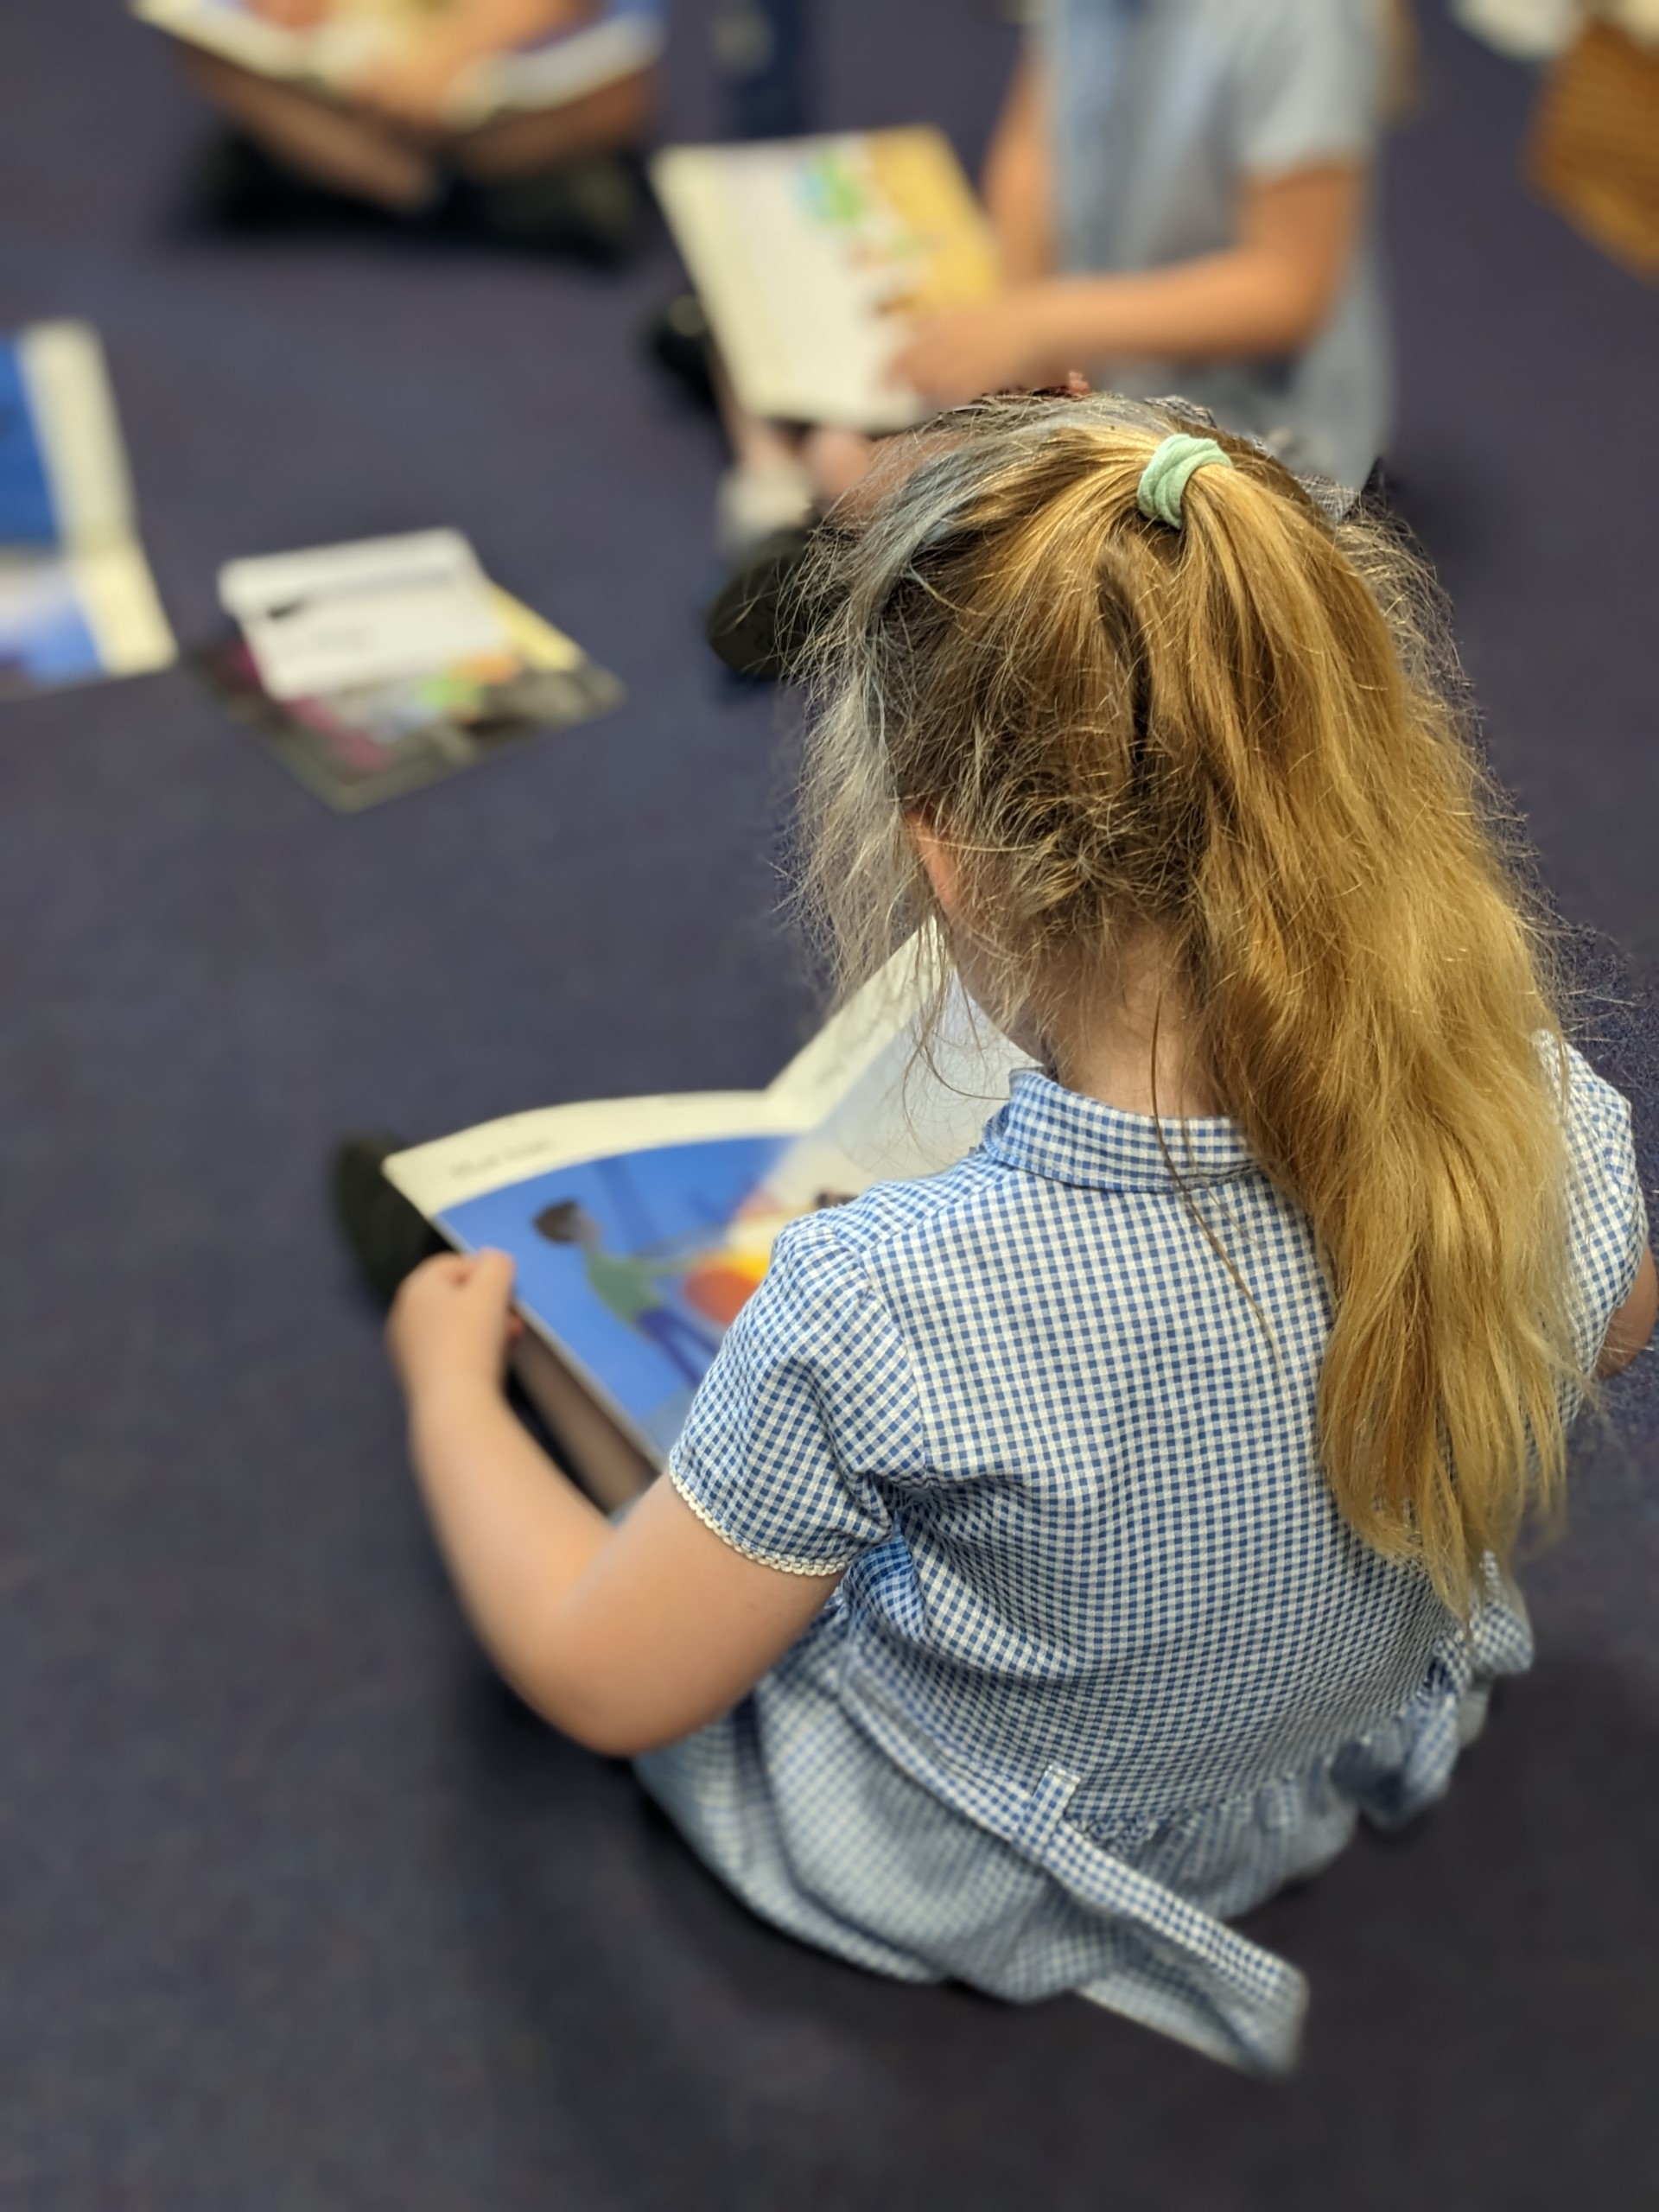
Ready Respectful Safe
What happens if children aren’t ‘getting it’?
We complete half termly assessments to see who has retained the sounds we have learnt. Our heat map assessments identify any children who need some extra support to secure and embed the sounds we have been learning.
From this, we provide children with small group or 1:1 catch up sessions everyday based on their need.
Our phonics tracking and intervention provision shows how well we know our children.
We aim for all children to be reading by Christmas in Reception.
A YR teacher or teaching assistant is released every afternoon to facilitate same day intervention in phonics.
Supporting Children Working Below the Age-Related Expectations in Reading:
At Muscliff, we whole heartedly believe that every pupil will learn to read, regardless of background, needs or abilities. As a school that loves reading and is proud of the engaging and bespoke curriculum that we have created, rooted in the ‘Beautiful Text’, we feel that it is every child’s right to be able to read and develop a love of books. To this end, a robust and clear approach to supporting those pupils who are working below the age-related expectations in phonics and reading is integral.
Remember all children are individual and have their own strengths and talents They all develop at different rates, and some take more time than others to grasp these skills than others.t expertise in the
The information within this document teaching directly links to our phonics and reading policies. of phonics and reading.

