Slide 1

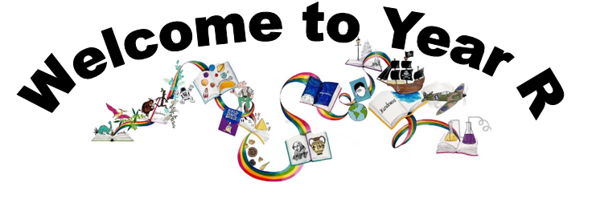
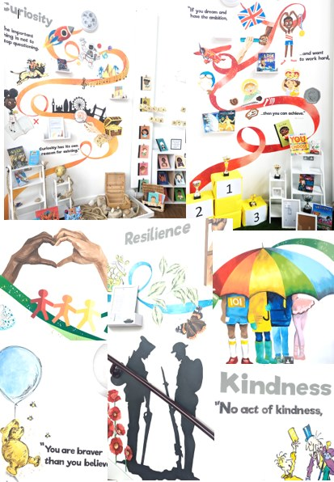
Ready Respectful Safe
We are proud to present our carefully crafted curriculum – it is the essence that makes us Muscliff Primary School; it reflects our unique identity as a community school and it is OURS. Our curriculum is bespoke. It is designed by us, for us.
When schools have the freedom to choose how the content of the National Curriculum is delivered, it is our belief that a) we make use of that opportunity as a vehicle to promote our school's culture and root our teaching and learning in Muscliff’s vision and values b) we create the best possible curriculum – one that is stimulating and enables our children to thrive and achieve because it reflects our community.
The purpose of this folder is to outline our curriculum ‘package’ in Year R but also to explain why we do what we do here! We feel that it is important for everyone at our school to understand the rationale behind this ‘carefully crafted’ curriculum.

Slide 2
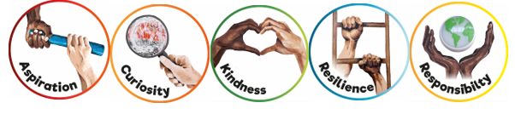
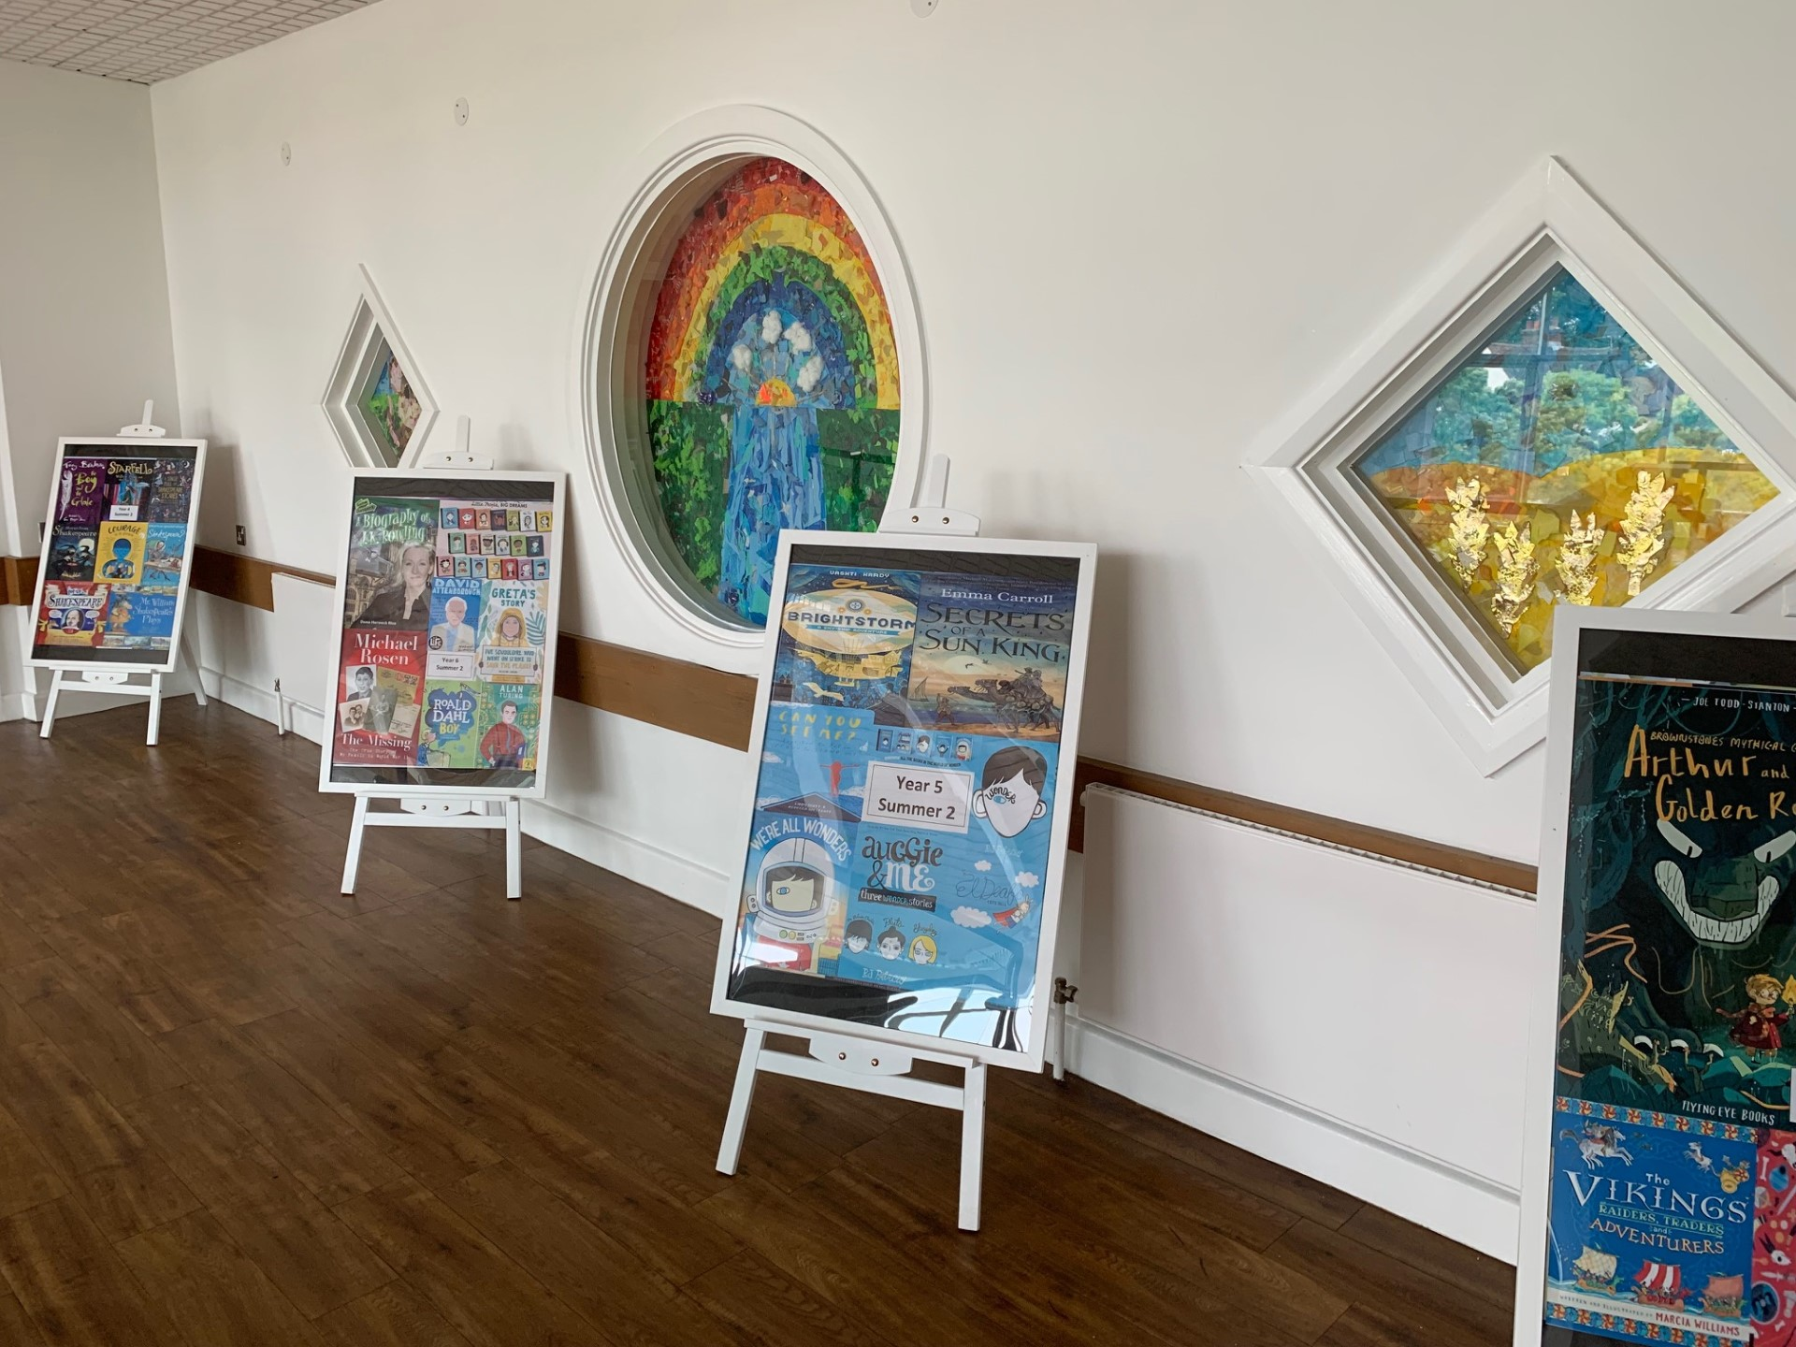
Ready Respectful Safe
Progression maps have been included in this folder. These maps help to track what is taught throughout the year, key objectives and signposts and assessment opportunities.
This particular folder is for tracking progression within YR. Whole school progression maps are available for each subject (including a progression map for each of our 5 values) to show how we ensure children’s skills and knowledge develop well.
Our curriculum continues to evolve. And we recognise that it will perpetually change and be reshaped and remolded so that it reflects our ever-changing world and local community. Not only does our curriculum teach Resilience, Curiosity, Aspiration, Responsibility and Kindness, its very creation is derived through these five values.
The impact is that everyone at our school is passionate about learning: our children experience high quality provision and our teachers grow pedagogy and passion for the content they teach.
Muscliff is a school with a clear vision and identity that has created our culture.

Slide 3

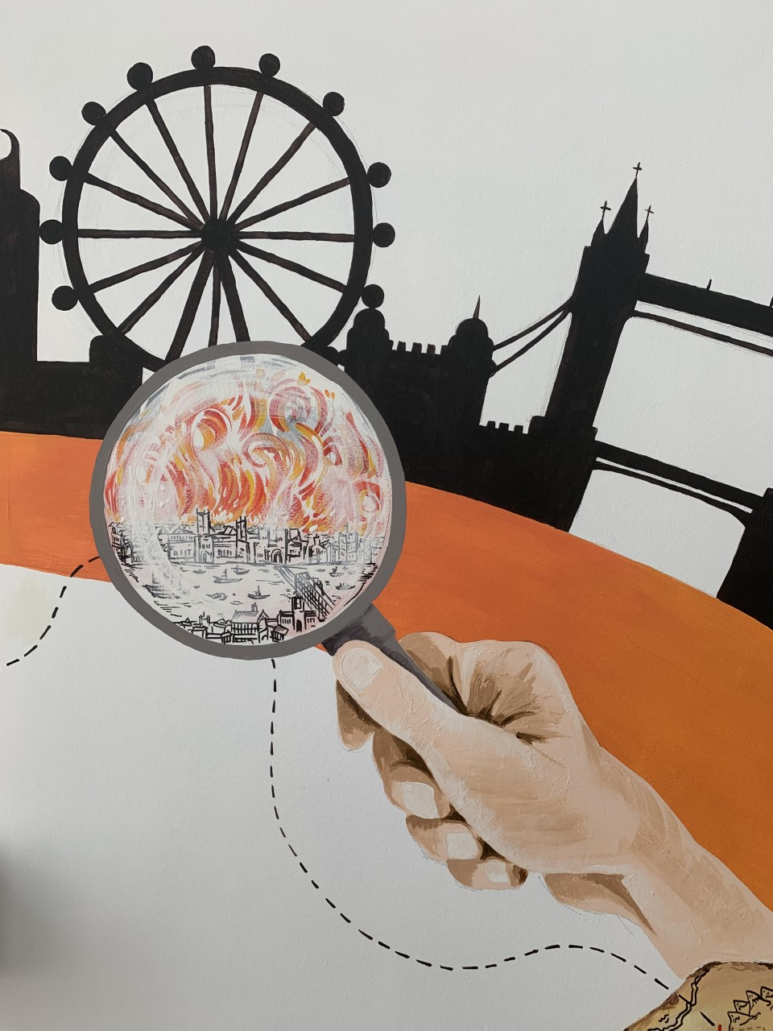
Ready Respectful Safe
Curiosity
I can ask a knowledge based question using:
What? When? Where? Why? Who? How? Do?
I ask questions about what I see in the environment around me.
I can begin to answer my own questions.
I can change my mind when new information is revealed.
I can use a variety of resources in an imaginative way.
My interest is often maintained for several days.
I interact with others in role play.
I am involved in group planning and organisation.
Progress check:
I wonder why the mini-beasts in these books seem so busy… What do you think they are doing?
Curiosity is an inspiring journey to enrich imagination and find that there is no wrong way… just a different way.
What makes children want to learn? We believe it's the joy of exploration - a hidden force that drives learning, critical thinking, and reasoning. We call this ability curiosity, and we recognise it in children when we see them exploring their environment, devouring books and information, asking questions, investigating concepts, manipulating data, searching for meaning, connecting with people and nature, and seeking new learning experiences.
“The important thing is not to stop questioning. Curiosity has its own reason for existing.” (Albert Einstein)

Slide 4
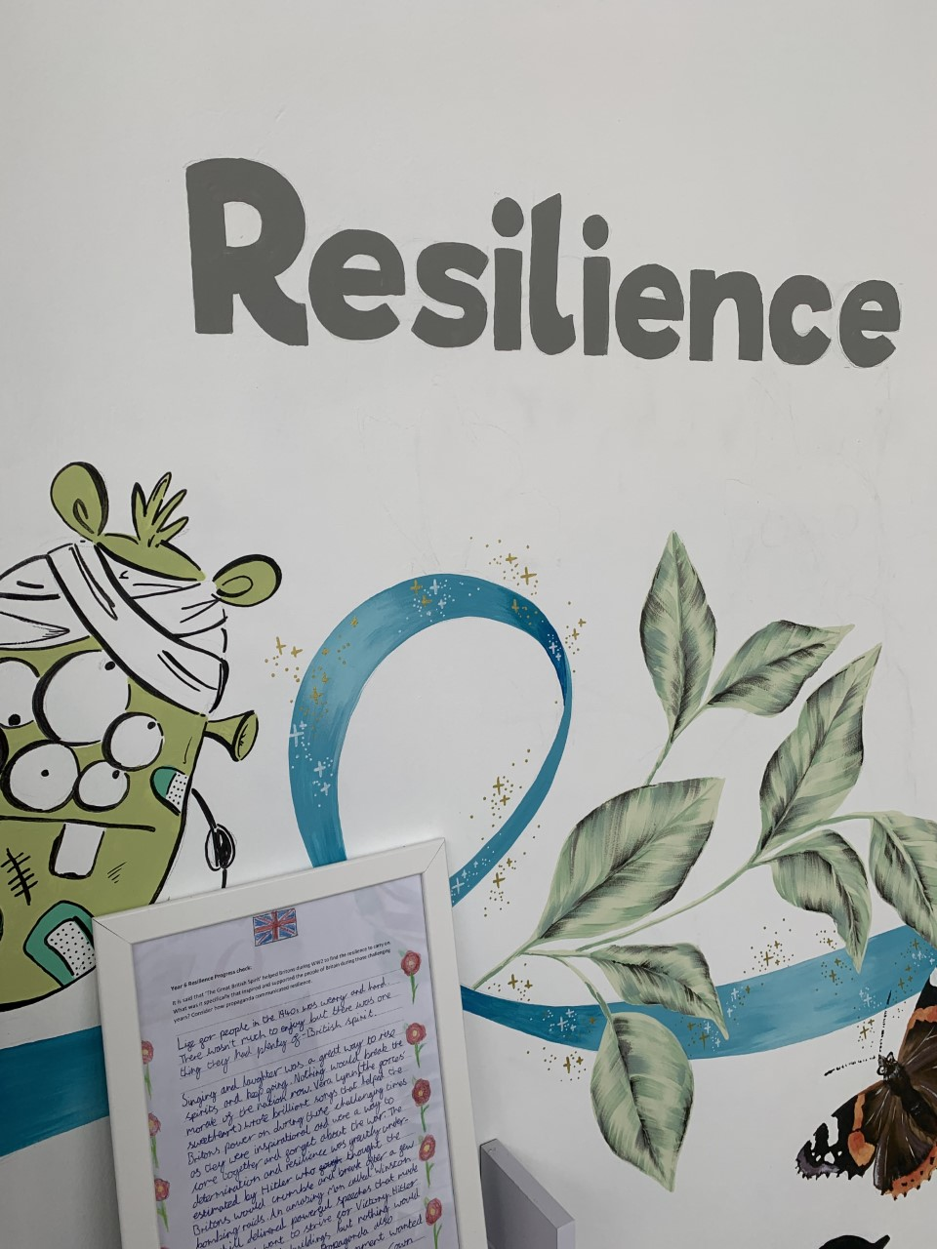

Ready Respectful Safe
Resilience supports us to work through challenges. Having resilience means that when we face a challenge, we use our inner voice and our body to overcome it. To thrive, Muscliff children are shown how to make the transition from the negative, “I can’t,” to the proactive, “How can I?” To do this, we support children to think about their own thinking (metacognition), to talk about their mental well-being and articulate their feelings towards a challenge and adapt their growth mindset. Reflecting on our own thoughts is how we gain insight into our feelings, needs, and behaviours — and how we learn, manage, and adapt to new experiences, challenges, and emotional set backs. We aim for all Muscliff children to grow in resilience so that they are prepared for life beyond Muscliff.
“You are braver than you believe, stronger than you seem, and smarter than you think.” (A.A. Milne)
I can keep coming back if I find something hard but a grown-up thinks I can do it.
I can cope with ‘no’.
I try new things within a structured routine.
I can be independent from familiar adults at teacher-selected times.
I can sometimes evaluate my choices.
I can focus on a set activity for an acceptable period of time.
I can socialise with others and accept their responses.
I can take turns.
I can develop new relationships with adults.
I know that the Muscliff Way means to try my best.
Resilience
Progress check:
Who helps you when you find something hard?
Who helped in these stories?

Slide 5
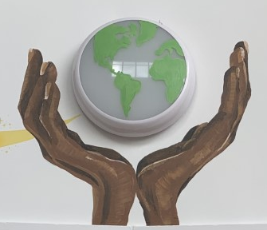
Ready Respectful Safe
Responsibility
Responsibility is doing the things we are expected to do and accepting the consequences (results) of your actions
We have a few different ways that we talk about responsibility at our school. There’s being responsible, taking responsibility, acting responsibly, and having responsibilities. They are all related to doing the things we are supposed to do, and accepting the positive or negative outcome of our actions. We are responsible for ourselves, our responses, our relationships, our mistakes, our education and careers, our health and well-being. But our overarching goal is to teach the pupils at Muscliff to be responsible for themselves.
"You are never too small to make a difference." Greta Thunberg
I know that our school rules are Ready, Respectful, Safe and can recite this phrase.
I am beginning to manage my self-routine – I put my snack box and book bag in the correct place when I arrive.
I can self-register.
When told to do so by an adult, I can apologise when I’ve done something wrong.
I tidy the classroom, including items that might not be mine.
I use the role play area respectfully.
I understand the expression, ‘kind hands.’
I move around the school in the ‘Muscliff Way.’
I hold the doors open for adults.
Progress check:
Why would we like Titch to be part of Muscliff Primary School?

Slide 6
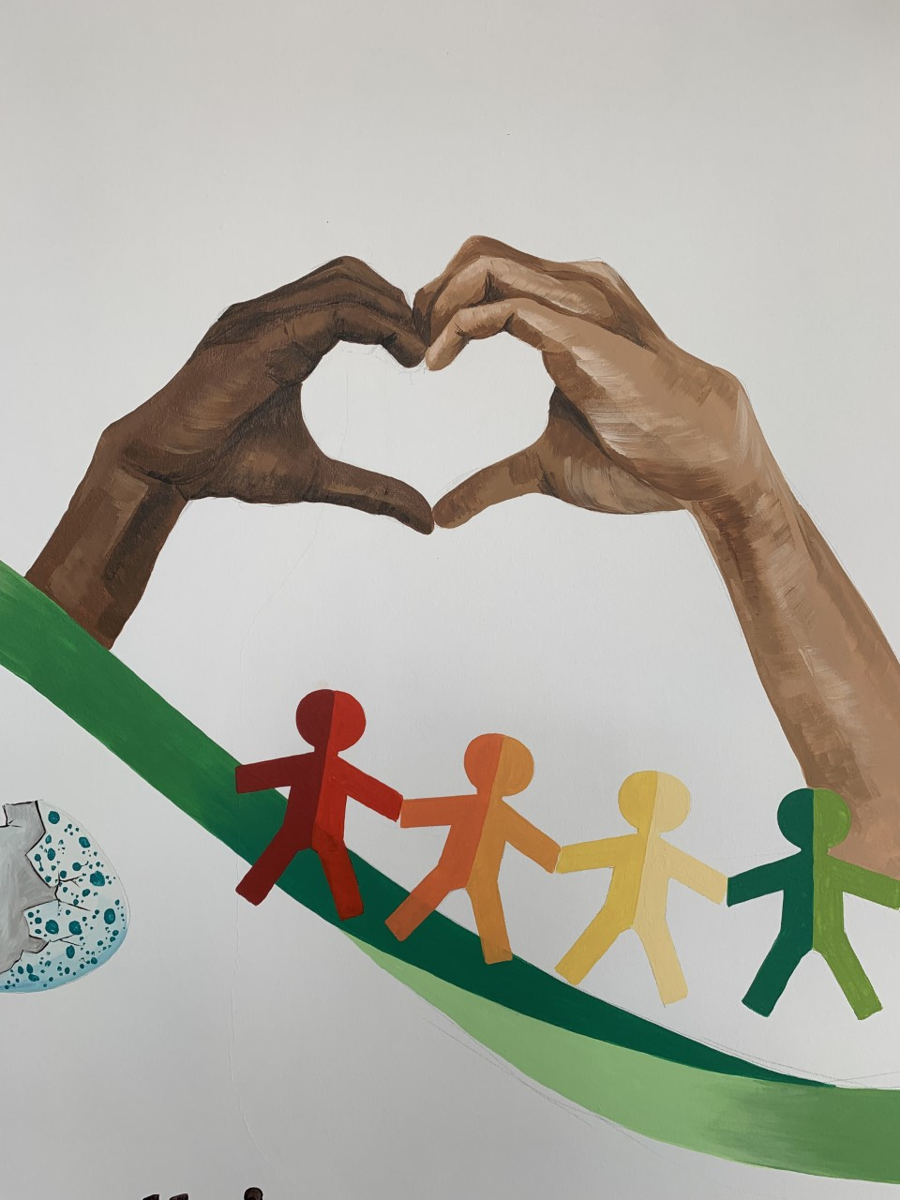

Ready Respectful Safe
Kindness
At Muscliff, we teach our children to choose kindness because it is the right choice to make... Kindness is the ability to understand how someone else is feeling or to understand the situation they are in. Kindness is at the root of all healthy relationships. It helps us know how our actions affect others, what actions are needed to be taken to be a good friend or teammate, and it helps us to understand more about the people and the world around us.
“No act of kindness, no matter how small, is ever wasted.” (Aesop)
When told to do so by an adult, I can apologise when I’ve done something wrong.
I say please and thank you although sometimes this will need reminding.
I realise that kind words/ actions have an effect on others.
I am able to share and take turns.
I tidy up taking collective responsibility.
Progress check:
How did Jack show kindness when Jill fell over?
What would you do if someone in Rainbows fell over in the playground?

Slide 7
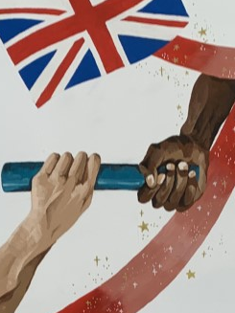
Ready Respectful Safe
The idea of aspiration has a positive, upward connotation. Our aspirations create powerful emotions and are deeply embedded within us; they are aligned with our values, and the very core of who we are. It is important that we all aspire to be or to become something that is seen as better than what or where we currently are (the best version of ourself). We can have social aspirations, career aspirations, and personal aspirations.
These days, children spend more time online and it’s easy for children to confuse short-lived celebrity status with achievement; sometimes children can be influenced by social media trends, confusing the number of ‘likes’ someone gains with success. At Muscliff, we want children to have a thorough understanding of aspirations and goals so that they can aspire to be the best version of themselves rather than a pale imitation of someone else.
Aspiration
“If you dream and have the ambition and want to work hard, then you can achieve.” (Mo Farah)
I discuss my own star qualities;
I identify what a positive learning attitude is;
I can identify people who are special to me and who I would like to be like when I am older.
I talk about jobs I might do when I grow up;
I discuss what skills and interests are needed for different jobs;
Progress check:
How many different jobs can you talk about? What does it mean to have a job? What different jobs can you find in the books we read?

