Slide 1

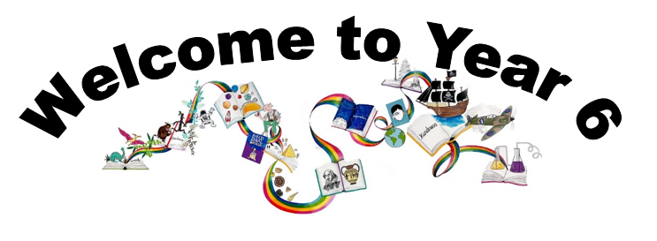
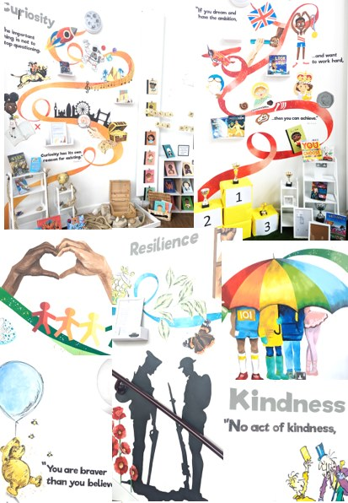
Ready Respectful Safe
We are proud to present our carefully crafted curriculum – it is the essence that makes us Muscliff Primary School; it reflects our unique identity as a community school and it is OURS. Our curriculum is bespoke. It is designed by us, for us.
When schools have the freedom to choose how the content of the National Curriculum is delivered, it is our belief that a) we make use of that opportunity as a vehicle to promote our school's culture and root our teaching and learning in Muscliff’s vision and values b) we create the best possible curriculum – one that is stimulating and enables our children to thrive and achieve because it reflects our community.
The purpose of this folder is to outline our curriculum ‘package’ in Year 6 but also to explain why we do what we do here! We feel that it is important for everyone at our school to understand the rationale behind this ‘carefully crafted’ curriculum.

Slide 2
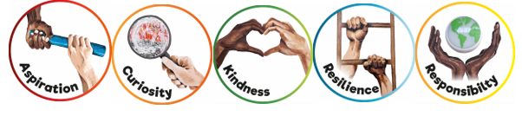
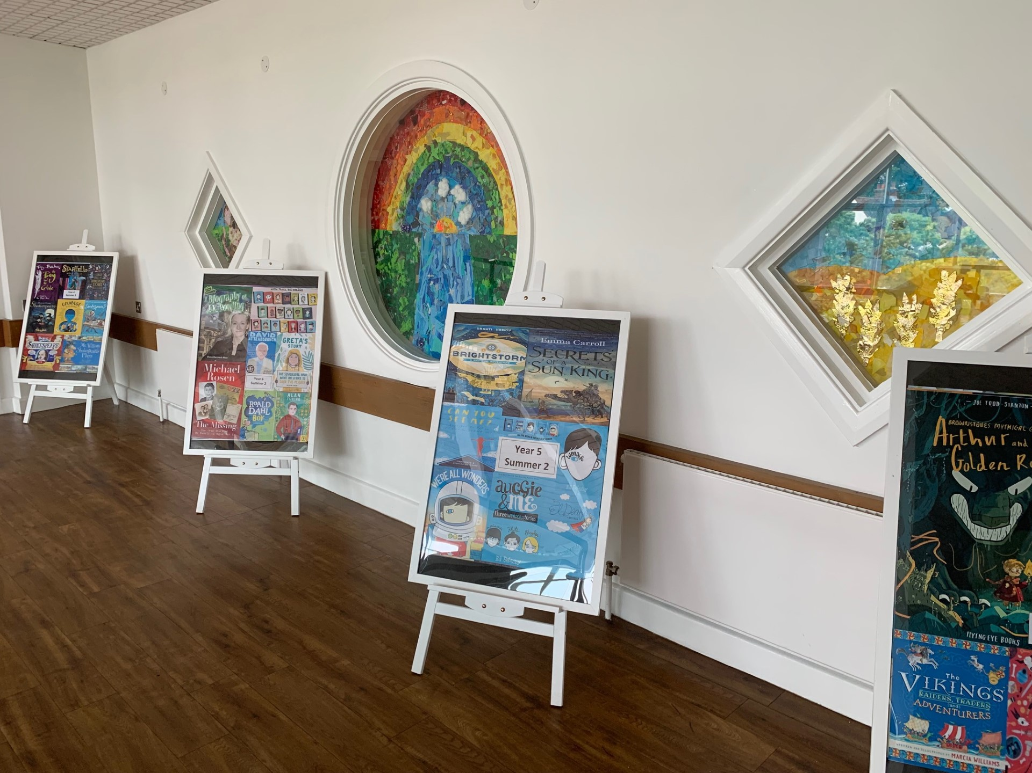
Ready Respectful Safe
Progression maps have been included in this folder. These maps help to track what is taught throughout the year, key objectives and signposts and assessment opportunities.
This particular folder is for tracking progression within Y6. Whole school progression maps are available for each subject (including a progression map for each of our 5 values) to show how we ensure children’s skills and knowledge develop well.
Our curriculum continues to evolve. And we recognise that it will perpetually change and be reshaped and remolded so that it reflects our ever-changing world and local community. Not only does our curriculum teach Resilience, Curiosity, Aspiration, Responsibility and Kindness, its very creation is derived through these five values.
The impact is that everyone at our school is passionate about learning: our children experience high quality provision and our teachers grow pedagogy and passion for the content they teach.
Muscliff is a school with a clear vision and identity that has created our culture.

Slide 3

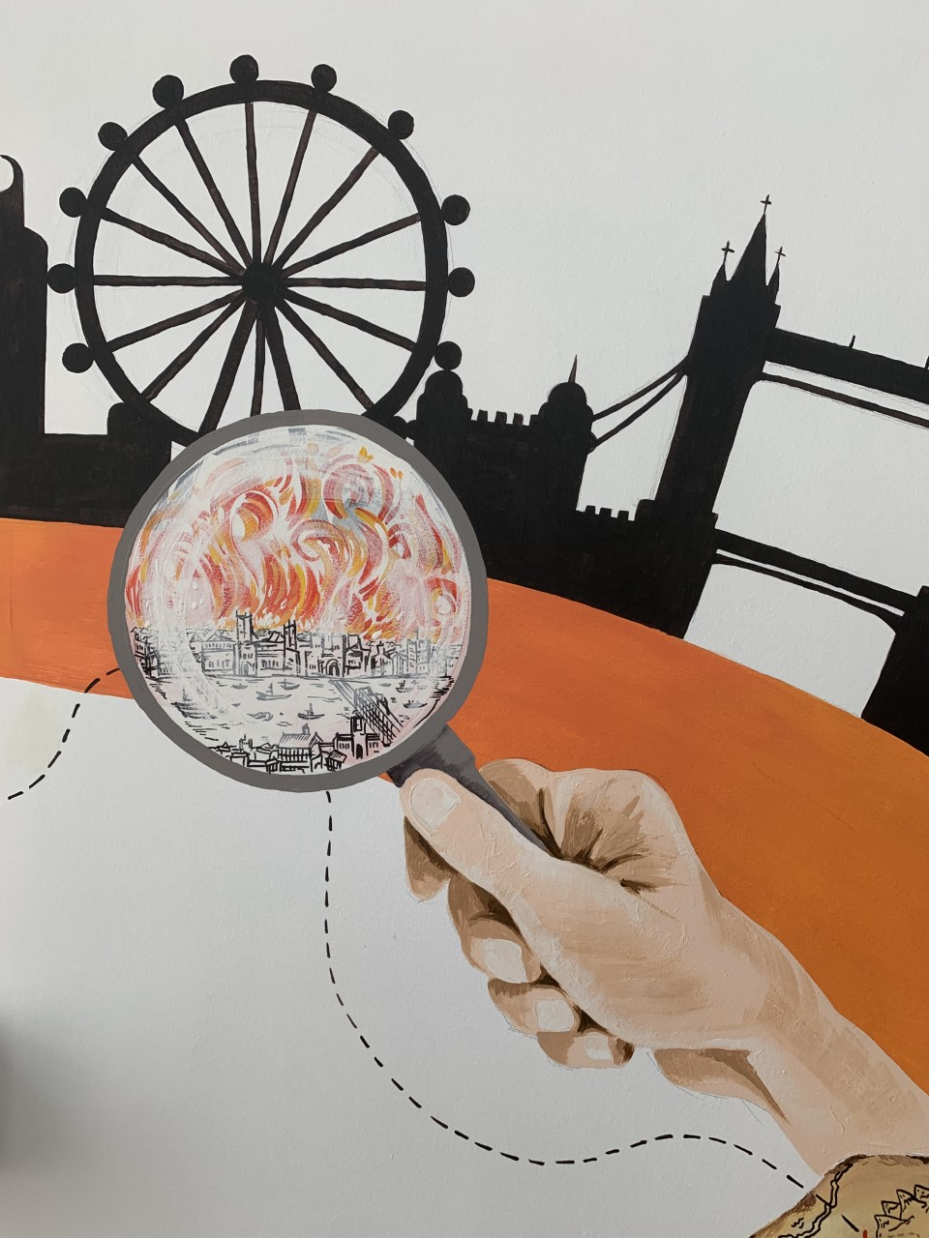
Ready Respectful Safe
Curiosity
I use independent research to satisfy my own curiosity.
I can use a range of sources available to me and can independently decide which is most appropriate to support me.
I know when a source is unreliable. I recognise bias and prejudice based on different perspectives. I understanding the meaning of ‘fake news.’
I can use the internet to create a key word search to find answers to my own questions.
I can identify gaps and/or misconceptions in my own learning.
I question what I know – I prove with evidence
I orally work through my decision making process,
I can critically support others by identifying misconceptions in other’s learning.
My curiosity is sparked by appreciating that there’s always more to find out.
Progress check:
Jim Hawkins was driven by his curiosity. But if Treasure Island were written and set in modern times, how might Jim’s curiosity be different? Would his adventure have been the same? If he used the internet to search key words, would he have gone on this adventure?
Was Jim’s relationship with Long John Silver healthy or unhealthy?
Curiosity is an inspiring journey to enrich imagination and find that there is no wrong way… just a different way.
What makes children want to learn? We believe it's the joy of exploration - a hidden force that drives learning, critical thinking, and reasoning. We call this ability curiosity, and we recognise it in children when we see them exploring their environment, devouring books and information, asking questions, investigating concepts, manipulating data, searching for meaning, connecting with people and nature, and seeking new learning experiences.
“The important thing is not to stop questioning. Curiosity has its own reason for existing.” (Albert Einstein)

Slide 4
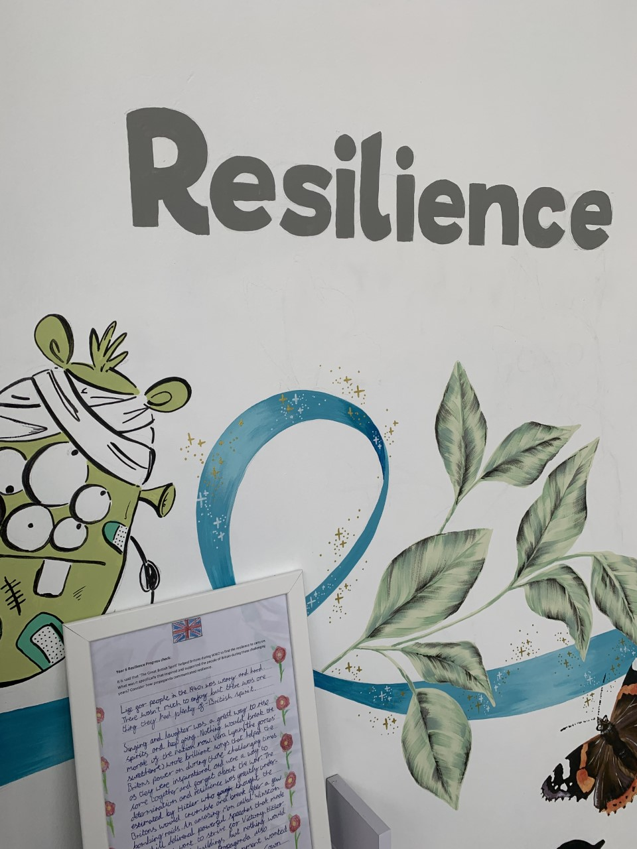

Ready Respectful Safe
Resilience supports us to work through challenges. Having resilience means that when we face a challenge, we use our inner voice and our body to overcome it. To thrive, Muscliff children are shown how to make the transition from the negative, “I can’t,” to the proactive, “How can I?” To do this, we support children to think about their own thinking (metacognition), to talk about their mental well-being and articulate their feelings towards a challenge and adapt their growth mindset. Reflecting on our own thoughts is how we gain insight into our feelings, needs, and behaviours — and how we learn, manage, and adapt to new experiences, challenges, and emotional set backs. We aim for all Muscliff children to grow in resilience so that they are prepared for life beyond Muscliff.
“You are braver than you believe, stronger than you seem, and smarter than you think.” (A.A. Milne)
Resilience
I cope with ‘no’ from authority even when I don’t agree.
I show my best resilience in SATs and new and stressful situations.
I view change as inevitability and embrace it.
I show self reflection and can talk about how I might have done things differently, looking for multiple solutions to the same challenge.
I know my strengths and weaknesses and work on them. I ‘own my errors.’
I less frequently compare myself to others.
Progress check:
It is said that ‘The Great British Spirit’ helped Britons during WW2 to find the resilience to carry on. What was it specifically that inspired and supported the people of Britain during those challenging years? Consider how propaganda communicated resilience.

Slide 5
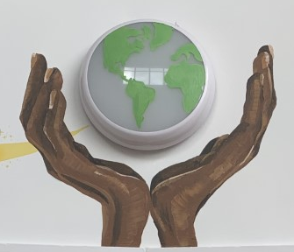

Ready Respectful Safe
Responsibility
Responsibility is doing the things we are expected to do and accepting the consequences (results) of your actions
We have a few different ways that we talk about responsibility at our school. There’s being responsible, taking responsibility, acting responsibly, and having responsibilities. They are all related to doing the things we are supposed to do, and accepting the positive or negative outcome of our actions. We are responsible for ourselves, our responses, our relationships, our mistakes, our education and careers, our health and well-being. But our overarching goal is to teach the pupils at Muscliff to be responsible for themselves.
"You are never too small to make a difference." Greta Thunberg
I can relate Ready, Respectful, Safe to democracy and freedom in the wider world.
I begin to understand that learning/ homework is an investment in myself.
I have self-motivation.
I might become a House Captain.
I care for my own personal hygiene.
I chose healthy lifestyles if I make my own lunchbox choices.
I walk home/ to school/ to shops safely on my own.
I make the right friendship choices.
I show sensitively towards changes of opposite sex during puberty.
I actively seek out more information of current affairs
I have a growing awareness of politics.
I understand the permanence of what I create online.
I use social media responsibly. I recognise that my behaviour online is a reflection of me.
Progress check:
How was Victor responsible for the deaths of all of his loved ones?
Did Victor ultimately accept responsibility for his actions?
Who was more of a monster – Victor or the creation?
Victor’s lifestyle, caused by his obsession by science, was unhealthy and led to a deterioration in his mental health. Identify in the story when he needed to show responsibility and ask for help. Was Henry a responsible friend?

Slide 6
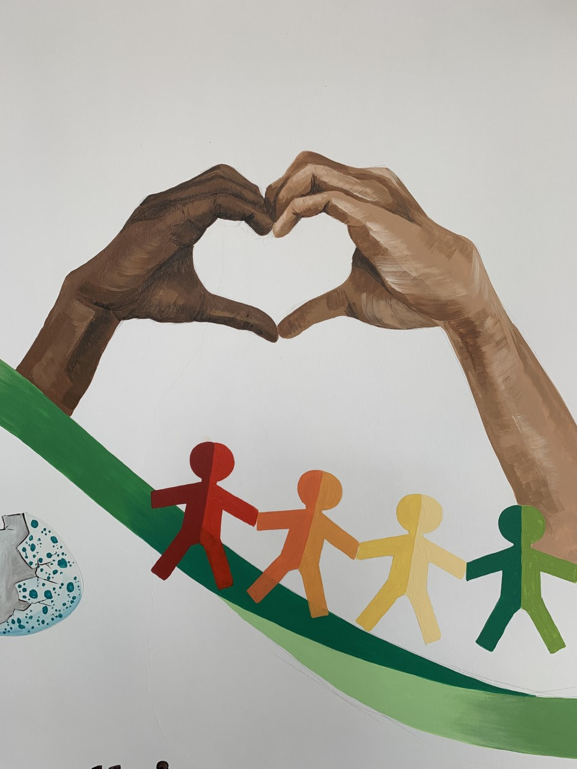

Ready Respectful Safe
Kindness
At Muscliff, we teach our children to choose kindness because it is the right choice to make... Kindness is the ability to understand how someone else is feeling or to understand the situation they are in. Kindness is at the root of all healthy relationships. It helps us know how our actions affect others, what actions are needed to be taken to be a good friend or teammate, and it helps us to understand more about the people and the world around us.
“No act of kindness, no matter how small, is ever wasted.” (Aesop)
I use social media responsibly and my activity online always reflects my kind character.
I always use non-derogatory language.
I have a good understanding of inclusion and my interaction with others reflects this.
I understand charitable acts and my role in the world/ in school.
I recognise that being kind to myself is important to my own mental health.
I can turn the other cheek and not retaliate.
I volunteer my time outside of school.
I choose not to be a bystander and will do the right thing when I need to.
I can make small sacrifices when someone else’s needs are greater than mine – even if this means I go without.
Progress check:
Is someone born to be kind or unkind? What influences someone’s conscience?

Slide 7
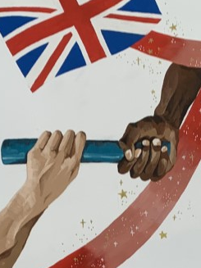

Ready Respectful Safe
The idea of aspiration has a positive, upward connotation. Our aspirations create powerful emotions and are deeply embedded within us; they are aligned with our values, and the very core of who we are. It is important that we all aspire to be or to become something that is seen as better than what or where we currently are (the best version of ourself). We can have social aspirations, career aspirations, and personal aspirations.
These days, children spend more time online and it’s easy for children to confuse short-lived celebrity status with achievement; sometimes children can be influenced by social media trends, confusing the number of ‘likes’ someone gains with success. At Muscliff, we want children to have a thorough understanding of aspirations and goals so that they can aspire to be the best version of themselves rather than a pale imitation of someone else.
“If you dream and have the ambition and want to work hard, then you can achieve.” (Mo Farah)
Aspiration
I can talk about how inspirational people from history have shaped our future (entrepreneurs).
I explain what is meant by innovation and enterprise;
I consider ways to develop their innovation and enterprise skills;
I understand how to use the knowledge of my learning style to further my learning;
I discuss the impact a growth mindset can have on achieving my goals;
I understand that our goals can change and explain why this might happen;
I appreciate the importance of seizing opportunities;
I explain the impact of stereotypes and why they need to be challenged;
I apply core skills when working within a team;
I identify limitations to achieving goals and discuss how challenges can be overcome.
Progress check:
In this biography, J.K Rowling is called a phenomenal, “Rowling is a writer whose work has impacted the world far beyond the content of her books”. What does this quote mean to you? What does it take to be a role model?

