Slide 1

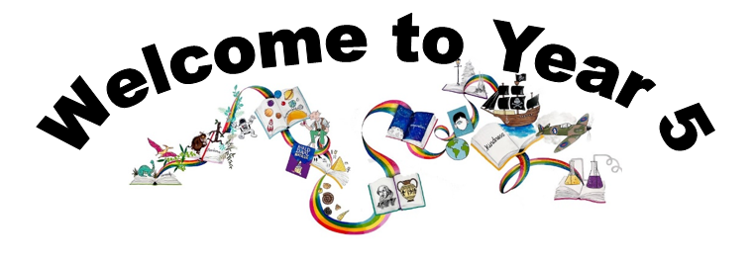
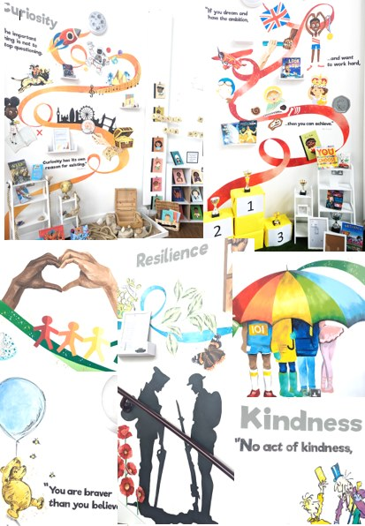
Ready Respectful Safe
We are proud to present our carefully crafted curriculum – it is the essence that makes us Muscliff Primary School; it reflects our unique identity as a community school and it is OURS. Our curriculum is bespoke. It is designed by us, for us.
When schools have the freedom to choose how the content of the National Curriculum is delivered, it is our belief that a) we make use of that opportunity as a vehicle to promote our school's culture and root our teaching and learning in Muscliff’s vision and values b) we create the best possible curriculum – one that is stimulating and enables our children to thrive and achieve because it reflects our community.
The purpose of this folder is to outline our curriculum ‘package’ in Year 5 but also to explain why we do what we do here! We feel that it is important for everyone at our school to understand the rationale behind this ‘carefully crafted’ curriculum.

Slide 2
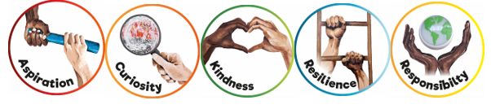
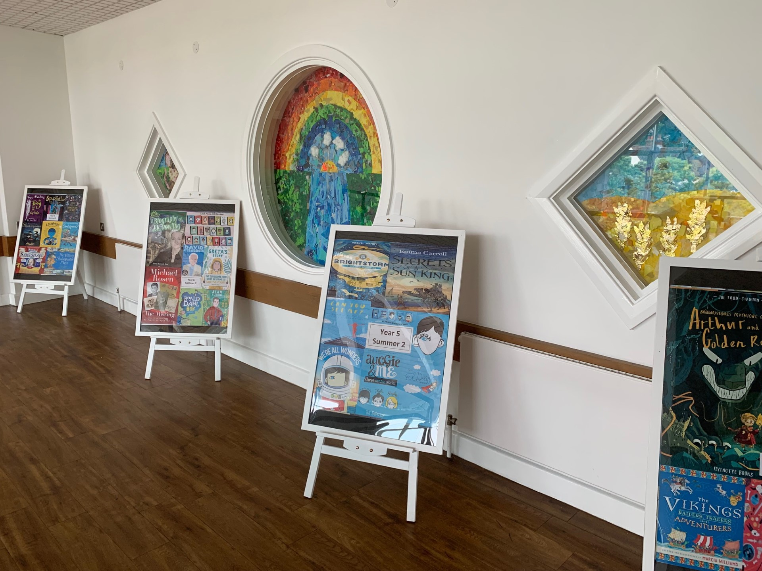
Ready Respectful Safe
Progression maps have been included in this folder. These maps help to track what is taught throughout the year, key objectives and signposts and assessment opportunities.
This particular folder is for tracking progression within Y5. Whole school progression maps are available for each subject (including a progression map for each of our 5 values) to show how we ensure children’s skills and knowledge develop well.
Our curriculum continues to evolve. And we recognise that it will perpetually change and be reshaped and remolded so that it reflects our ever-changing world and local community. Not only does our curriculum teach Resilience, Curiosity, Aspiration, Responsibility and Kindness, its very creation is derived through these five values.
The impact is that everyone at our school is passionate about learning: our children experience high quality provision and our teachers grow pedagogy and passion for the content they teach.
Muscliff is a school with a clear vision and identity that has created our culture.

Slide 3

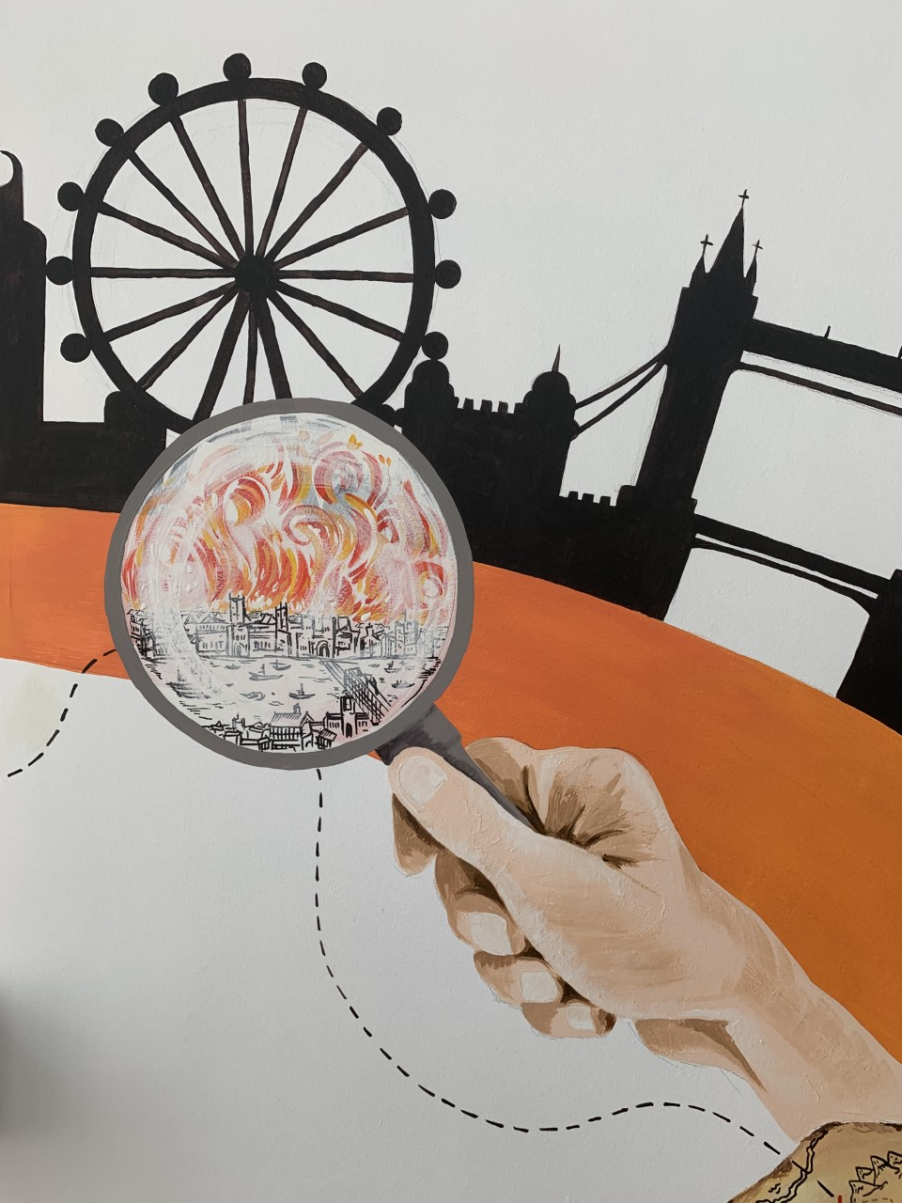
Ready Respectful Safe
Curiosity
I can begin to use independent research to satisfy my own curiosity.
I can use the internet to create a key word search to find answers to my own questions.
I recognise when a source is unreliable, particularly when researching using the internet. I am curious but wary of internet sources.
I can begin to identify gaps and/or misconceptions in my own learning.
I am starting to critically support others by identifying misconceptions in other’s learning.
The more I know about something, the more I want to find out.
Progress check:
Which character in The Chronicles of Narnia shows the most curiosity?
When Lucy enters the wardrobe for the first time, she steps on snow. Prove that this is impossible.
Curiosity is an inspiring journey to enrich imagination and find that there is no wrong way… just a different way.
What makes children want to learn? We believe it's the joy of exploration - a hidden force that drives learning, critical thinking, and reasoning. We call this ability curiosity, and we recognise it in children when we see them exploring their environment, devouring books and information, asking questions, investigating concepts, manipulating data, searching for meaning, connecting with people and nature, and seeking new learning experiences.
“The important thing is not to stop questioning. Curiosity has its own reason for existing.” (Albert Einstein)

Slide 4
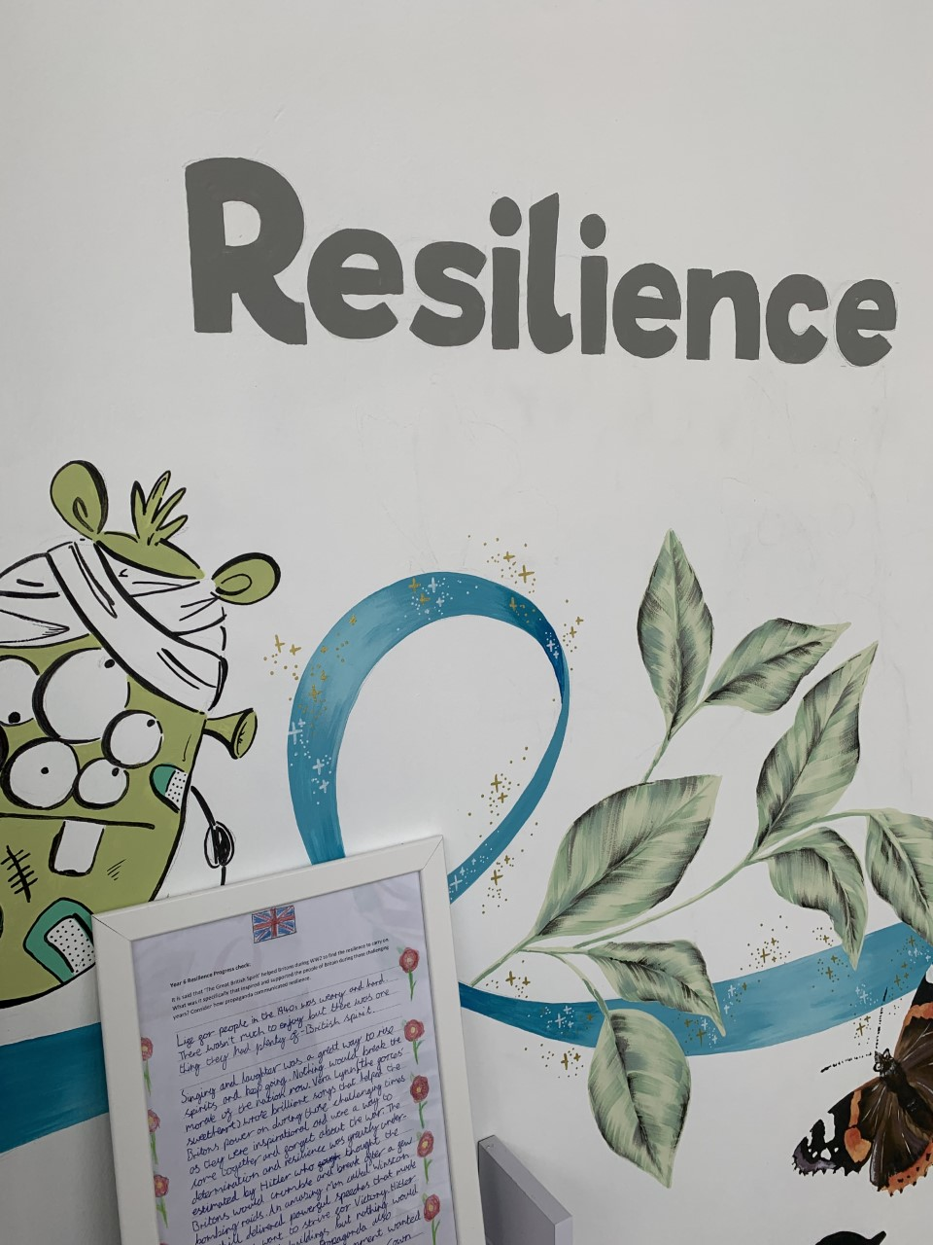

Ready Respectful Safe
Resilience supports us to work through challenges. Having resilience means that when we face a challenge, we use our inner voice and our body to overcome it. To thrive, Muscliff children are shown how to make the transition from the negative, “I can’t,” to the proactive, “How can I?” To do this, we support children to think about their own thinking (metacognition), to talk about their mental well-being and articulate their feelings towards a challenge and adapt their growth mindset. Reflecting on our own thoughts is how we gain insight into our feelings, needs, and behaviours — and how we learn, manage, and adapt to new experiences, challenges, and emotional set backs. We aim for all Muscliff children to grow in resilience so that they are prepared for life beyond Muscliff.
“You are braver than you believe, stronger than you seem, and smarter than you think.” (A.A. Milne)
I exploit the mistakes of others as a springboard for further learning. I can assess when the mistake was made and relate this to my own learning.
I show social resilience in and outside of school, including using social media responsibly.
I am aware of individual identity and that different people have a different level of resilience to me.
I am developing confidence to be different.
I am aware of how much pressure, knowing when to stop and I can apply myself and independently challenge myself by taking myself out of my comfort zone.
Resilience
Progress check:
Rank the characters in Who Let the Gods Out by their level of resilience. Is their level of resilience changed by the events in the book? In your own family, who is the most resilient and why? What characteristics does a resilient person have?

Slide 5
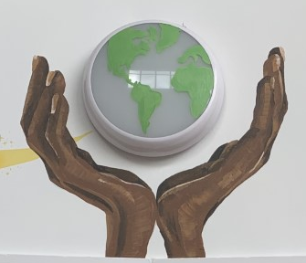

Ready Respectful Safe
Responsibility
Responsibility is doing the things we are expected to do and accepting the consequences (results) of your actions
We have a few different ways that we talk about responsibility at our school. There’s being responsible, taking responsibility, acting responsibly, and having responsibilities. They are all related to doing the things we are supposed to do, and accepting the positive or negative outcome of our actions. We are responsible for ourselves, our responses, our relationships, our mistakes, our education and careers, our health and well-being. But our overarching goal is to teach the pupils at Muscliff to be responsible for themselves.
"You are never too small to make a difference." Greta Thunberg
I fully understand Ready, Respectful, Safe and I understand that our school rules emulate the rules of society.
Homework is my responsibility.
I accept and understand consequences with growing maturity.
I can change for swimming and manage my belongings.
I manage my feelings and can deal with complex emotions through puberty
I can walk home/ cross roads/ and have stranger awareness
I am aware of peer pressure and what this means.
Mental health –I begin to understand when help is needed.
I show sportsmanship at break time – football.
I am a role model for my buddy in YR.
I set an example with uniform by wearing a tie.
I ask questions about current affairs, e.g Newsround
Safeguarding – I know when to tell a teacher if I have a concern about a friend.
I am honest and open on subjects such as e-safety: YouTube, online gaming, social media.
Progress check:
The Iron Man was responsible for stealing and destroying all the metal so he should accept the consequences of his actions. The people decided the punishment together and that punishment was right as the Iron Man broke the rules and laws. Do you agree?

Slide 6
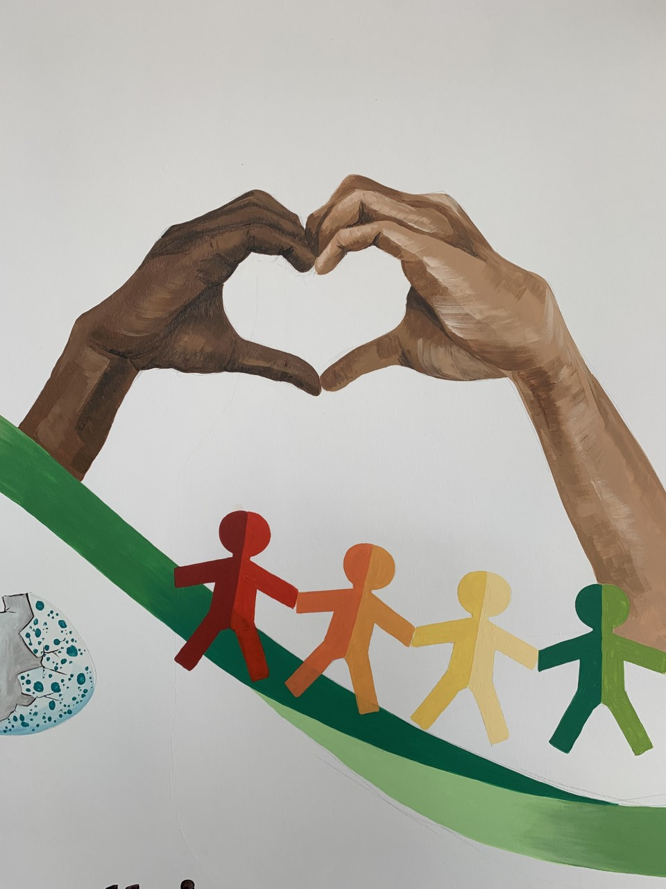

Ready Respectful Safe
Kindness
At Muscliff, we teach our children to choose kindness because it is the right choice to make... Kindness is the ability to understand how someone else is feeling or to understand the situation they are in. Kindness is at the root of all healthy relationships. It helps us know how our actions affect others, what actions are needed to be taken to be a good friend or teammate, and it helps us to understand more about the people and the world around us.
“No act of kindness, no matter how small, is ever wasted.” (Aesop)
I understand that kindness includes ‘virtual’ situations using social media.
I am a responsible buddy and show kindness to younger children.
I reach out when it is less likely others will.
I am able to compliment someone else recognising it will make them feel good.
I am confident to initiate a conversation with grown-ups in school and ask how they are feeling when I greet them.
I can share by putting others before myself.
Progress check:
Imagine that the children in Charlie and the Chocolate Factory shared their exciting news of finding a ticket on social media. How would Charlie’s WhatsApp messages look different to those from the other children?
Progress check:
The important quote in Wonder is: “If you have a choice between being right and being kind, choose kind.“
Can you put Palacio’s words into your own words? What would this look like in your classroom?

Slide 7
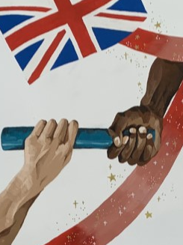

Ready Respectful Safe
The idea of aspiration has a positive, upward connotation. Our aspirations create powerful emotions and are deeply embedded within us; they are aligned with our values, and the very core of who we are. It is important that we all aspire to be or to become something that is seen as better than what or where we currently are (the best version of ourself). We can have social aspirations, career aspirations, and personal aspirations.
These days, children spend more time online and it’s easy for children to confuse short-lived celebrity status with achievement; sometimes children can be influenced by social media trends, confusing the number of ‘likes’ someone gains with success. At Muscliff, we want children to have a thorough understanding of aspirations and goals so that they can aspire to be the best version of themselves rather than a pale imitation of someone else.
“If you dream and have the ambition and want to work hard, then you can achieve.” (Mo Farah)
Aspiration
I can identify skills and attributes that are useful in many roles;
I can identify how I learn best;
I identify potential barriers to success;
I identify opportunities that might be available to me in the future;
I identify and challenge stereotypes;
I discuss goals they could set to work towards their ambitions;
I understand the different roles within a team;
I discuss challenges many people face and how some people overcome these.
Progress check:
“You can’t blend in when you’re born to stand out.”
Looking beyond Auggie’s facial deformity, how does he stand out? Where does he succeed? What are his strengths?
Why do you think the author Palacio chose Auggie’s mask to be an astronaut helmet?

