Slide 1

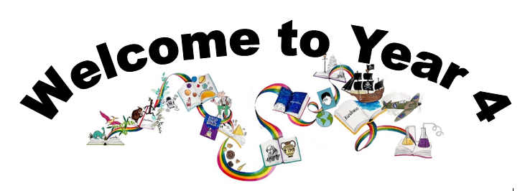
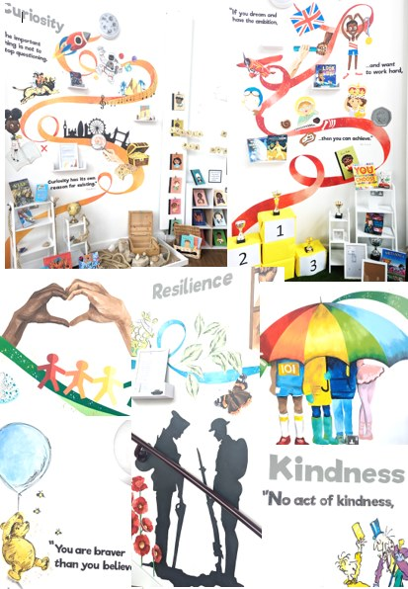
Ready Respectful Safe
We are proud to present our carefully crafted curriculum – it is the essence that makes us Muscliff Primary School; it reflects our unique identity as a community school and it is OURS. Our curriculum is bespoke. It is designed by us, for us.
When schools have the freedom to choose how the content of the National Curriculum is delivered, it is our belief that a) we make use of that opportunity as a vehicle to promote our school's culture and root our teaching and learning in Muscliff’s vision and values b) we create the best possible curriculum – one that is stimulating and enables our children to thrive and achieve because it reflects our community.
The purpose of this folder is to outline our curriculum ‘package’ in Year 4 but also to explain why we do what we do here! We feel that it is important for everyone at our school to understand the rationale behind this ‘carefully crafted’ curriculum.

Slide 2
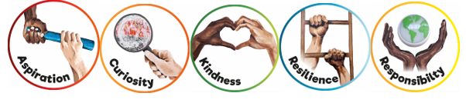
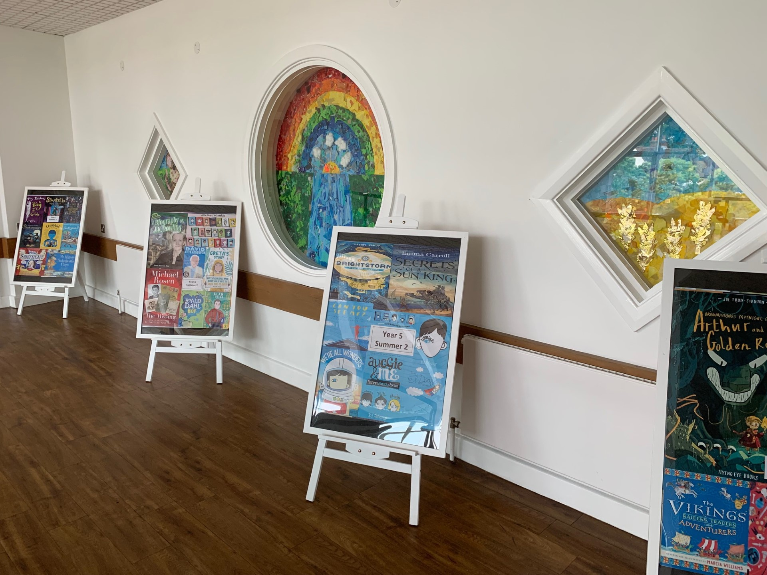
Ready Respectful Safe
Progression maps have been included in this folder. These maps help to track what is taught throughout the year, key objectives and signposts and assessment opportunities.
This particular folder is for tracking progression within Y4. Whole school progression maps are available for each subject (including a progression map for each of our 5 values) to show how we ensure children’s skills and knowledge develop well.
Our curriculum continues to evolve. And we recognise that it will perpetually change and be reshaped and remolded so that it reflects our ever-changing world and local community. Not only does our curriculum teach Resilience, Curiosity, Aspiration, Responsibility and Kindness, its very creation is derived through these five values.
The impact is that everyone at our school is passionate about learning: our children experience high quality provision and our teachers grow pedagogy and passion for the content they teach.
Muscliff is a school with a clear vision and identity that has created our culture.

Slide 3

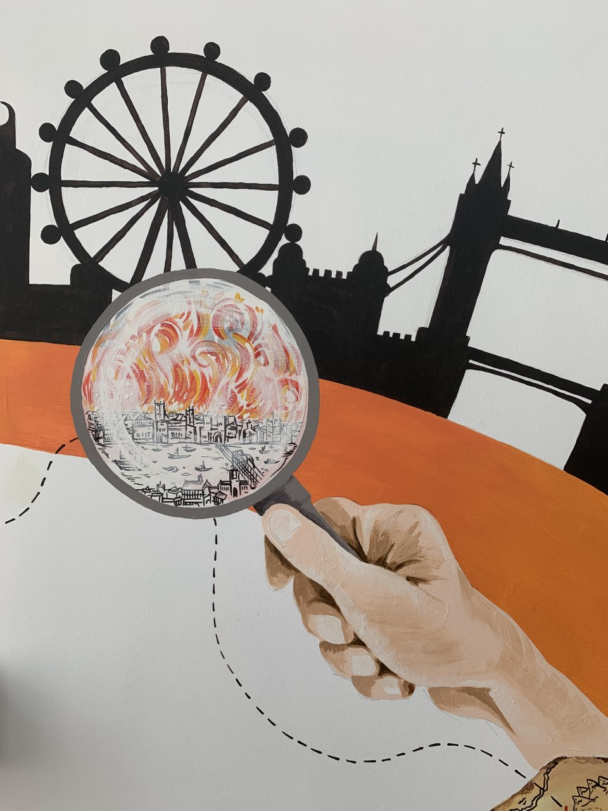
Ready Respectful Safe
Curiosity
I can use provided sources of information to help me find out more.
I can recognise how useful/reliable or a source is.
I don’t always believe / accept first answers.
I am comfortable with silence while allowing a person to respond to a question.
I form my own questions based on my own interests.
I ask more open questions that begin with words like “What if...”
Progress check:
Escape from Pompeii is a fiction text. How useful is this story in helping us to understand life in Ancient Rome?
Curiosity is an inspiring journey to enrich imagination and find that there is no wrong way… just a different way.
What makes children want to learn? We believe it's the joy of exploration - a hidden force that drives learning, critical thinking, and reasoning. We call this ability curiosity, and we recognise it in children when we see them exploring their environment, devouring books and information, asking questions, investigating concepts, manipulating data, searching for meaning, connecting with people and nature, and seeking new learning experiences.
“The important thing is not to stop questioning. Curiosity has its own reason for existing.” (Albert Einstein)

Slide 4
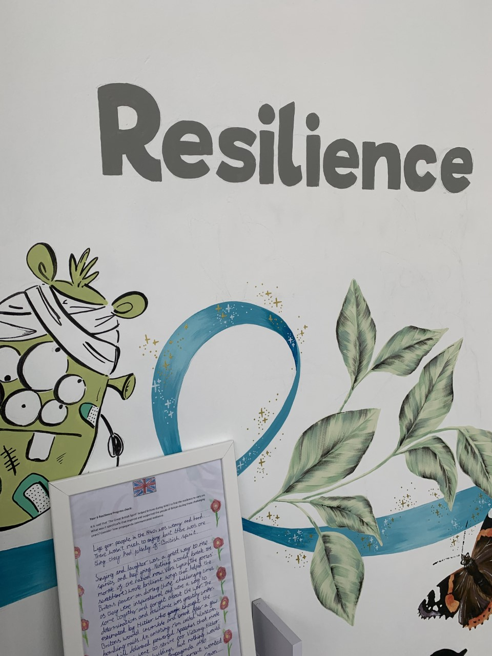

Ready Respectful Safe
Resilience supports us to work through challenges. Having resilience means that when we face a challenge, we use our inner voice and our body to overcome it. To thrive, Muscliff children are shown how to make the transition from the negative, “I can’t,” to the proactive, “How can I?” To do this, we support children to think about their own thinking (metacognition), to talk about their mental well-being and articulate their feelings towards a challenge and adapt their growth mindset. Reflecting on our own thoughts is how we gain insight into our feelings, needs, and behaviours — and how we learn, manage, and adapt to new experiences, challenges, and emotional set backs. We aim for all Muscliff children to grow in resilience so that they are prepared for life beyond Muscliff.
“You are braver than you believe, stronger than you seem, and smarter than you think.” (A.A. Milne)
I use my mistakes as a springboard for further learning. I welcome growing green.
I cope with higher expectations (approach to work load).
I problem solve – socially and in my learning and can talk about the steps I need to make.
I recognise when I need to seek help and when I can keep going myself.
I begin to know when I’ve had enough and can cope with (and decide for myself) when it is time to stop.
Resilience
Progress check:
The Seven Skills of Jalal that Varjak Paw learns are ALL rooted in resilience and metacognition. How would each of these seven skills be useful for a child at Muscliff Primary School? For example, how would ‘Trust Yourself’ support someone to be a successful learner in the classroom?

Slide 5
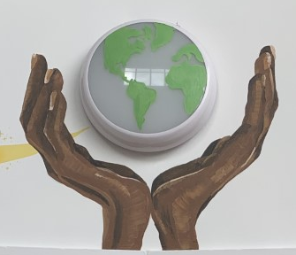

Ready Respectful Safe
Responsibility
Responsibility is doing the things we are expected to do and accepting the consequences (results) of your actions
We have a few different ways that we talk about responsibility at our school. There’s being responsible, taking responsibility, acting responsibly, and having responsibilities. They are all related to doing the things we are supposed to do, and accepting the positive or negative outcome of our actions. We are responsible for ourselves, our responses, our relationships, our mistakes, our education and careers, our health and well-being. But our overarching goal is to teach the pupils at Muscliff to be responsible for themselves.
"You are never too small to make a difference." Greta Thunberg
My understanding of Ready, Respectful, Safe is developed and I can talk about our school rules with a good understanding. I appreciate why Ready, Respectful, Safe is important.
I seek help when needed in lessons.
I can edit my work and use a dictionary/ thesaurus.
I can use classroom resources without being prompted.
I am responsible for homework, including reading.
I can respond to verbal feedback and make changes to my work.
I have an understanding (rather than tolerance) that some children behave differently and this may affect them and me.
I have an awareness that children in school come from different social/ economic backgrounds.
Progress check:
Britain is built on freedom and equality where everyone is aware of their rights and responsibilities. How do the facts in The Big Book of the UK help us to understand that the people of Britain can be different in many ways?

Slide 6
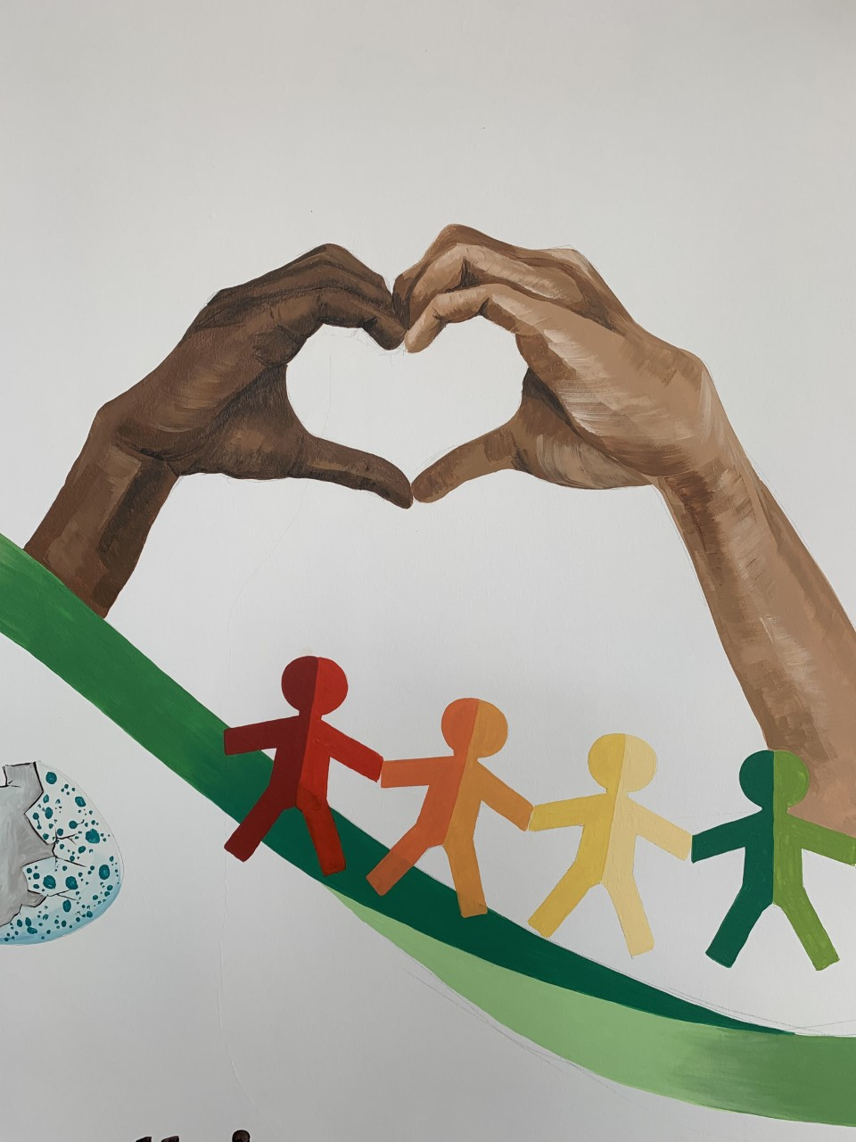

Ready Respectful Safe
Kindness
At Muscliff, we teach our children to choose kindness because it is the right choice to make... Kindness is the ability to understand how someone else is feeling or to understand the situation they are in. Kindness is at the root of all healthy relationships. It helps us know how our actions affect others, what actions are needed to be taken to be a good friend or teammate, and it helps us to understand more about the people and the world around us.
“No act of kindness, no matter how small, is ever wasted.” (Aesop)
I can consider kindness before I speak.
I don’t criticise the efforts of others.
I support and am tolerant of my classmates by recognising their visible/ invisible needs.
I have ownership of friendship issues and am starting to resolve friendship problems without an adult.
I am able to compliment someone else.
I am a good listener.
I convey my support to someone I believe in
I set an example to younger pupils.
I can share – even when I want it, recognising when someone else’s needs are greater than mine.
Progress check:
What does it mean to be loyal?
Have you ever put someone else before yourself?
How did Bertie put the needs of the lion before his own?
How did Millie put Bertie’s needs before her own?

Slide 7
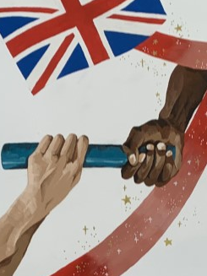

Ready Respectful Safe
The idea of aspiration has a positive, upward connotation. Our aspirations create powerful emotions and are deeply embedded within us; they are aligned with our values, and the very core of who we are. It is important that we all aspire to be or to become something that is seen as better than what or where we currently are (the best version of ourself). We can have social aspirations, career aspirations, and personal aspirations.
These days, children spend more time online and it’s easy for children to confuse short-lived celebrity status with achievement; sometimes children can be influenced by social media trends, confusing the number of ‘likes’ someone gains with success. At Muscliff, we want children to have a thorough understanding of aspirations and goals so that they can aspire to be the best version of themselves rather than a pale imitation of someone else.
“If you dream and have the ambition and want to work hard, then you can achieve.” (Mo Farah)
Aspiration
I talk about role models and define them by what they have achieved rather than their celebrity status.
I can discuss different learning styles;
I can identify what a positive learning attitude is;
I talk about the range of jobs that people do;
I understand what a gender stereotype is;
I talk about skills employers look for in employees;
I work with others in a team;
I discuss the skills everyone needs to succeed.
I discuss my personal achievements and skills;
Progress check:
If we were looking for a new teacher at our school and William Shakespeare applied for this job, should we give him the job?

