Slide 1

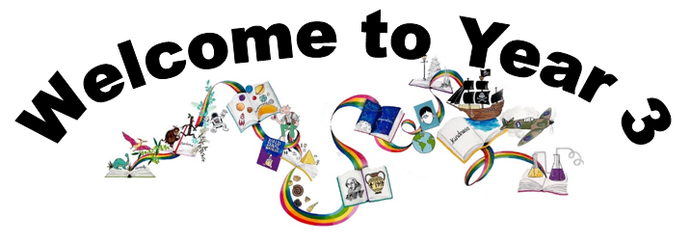
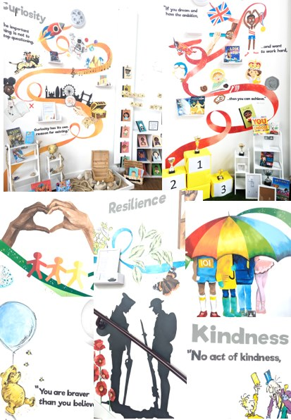
Ready Respectful Safe
We are proud to present our carefully crafted curriculum – it is the essence that makes us Muscliff Primary School; it reflects our unique identity as a community school and it is OURS. Our curriculum is bespoke. It is designed by us, for us.
When schools have the freedom to choose how the content of the National Curriculum is delivered, it is our belief that a) we make use of that opportunity as a vehicle to promote our school's culture and root our teaching and learning in Muscliff’s vision and values b) we create the best possible curriculum – one that is stimulating and enables our children to thrive and achieve because it reflects our community.
The purpose of this folder is to outline our curriculum ‘package’ in Year 3 but also to explain why we do what we do here! We feel that it is important for everyone at our school to understand the rationale behind this ‘carefully crafted’ curriculum.

Slide 2
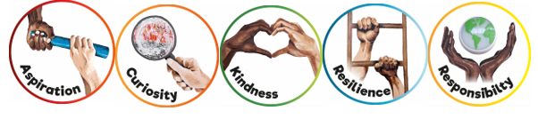
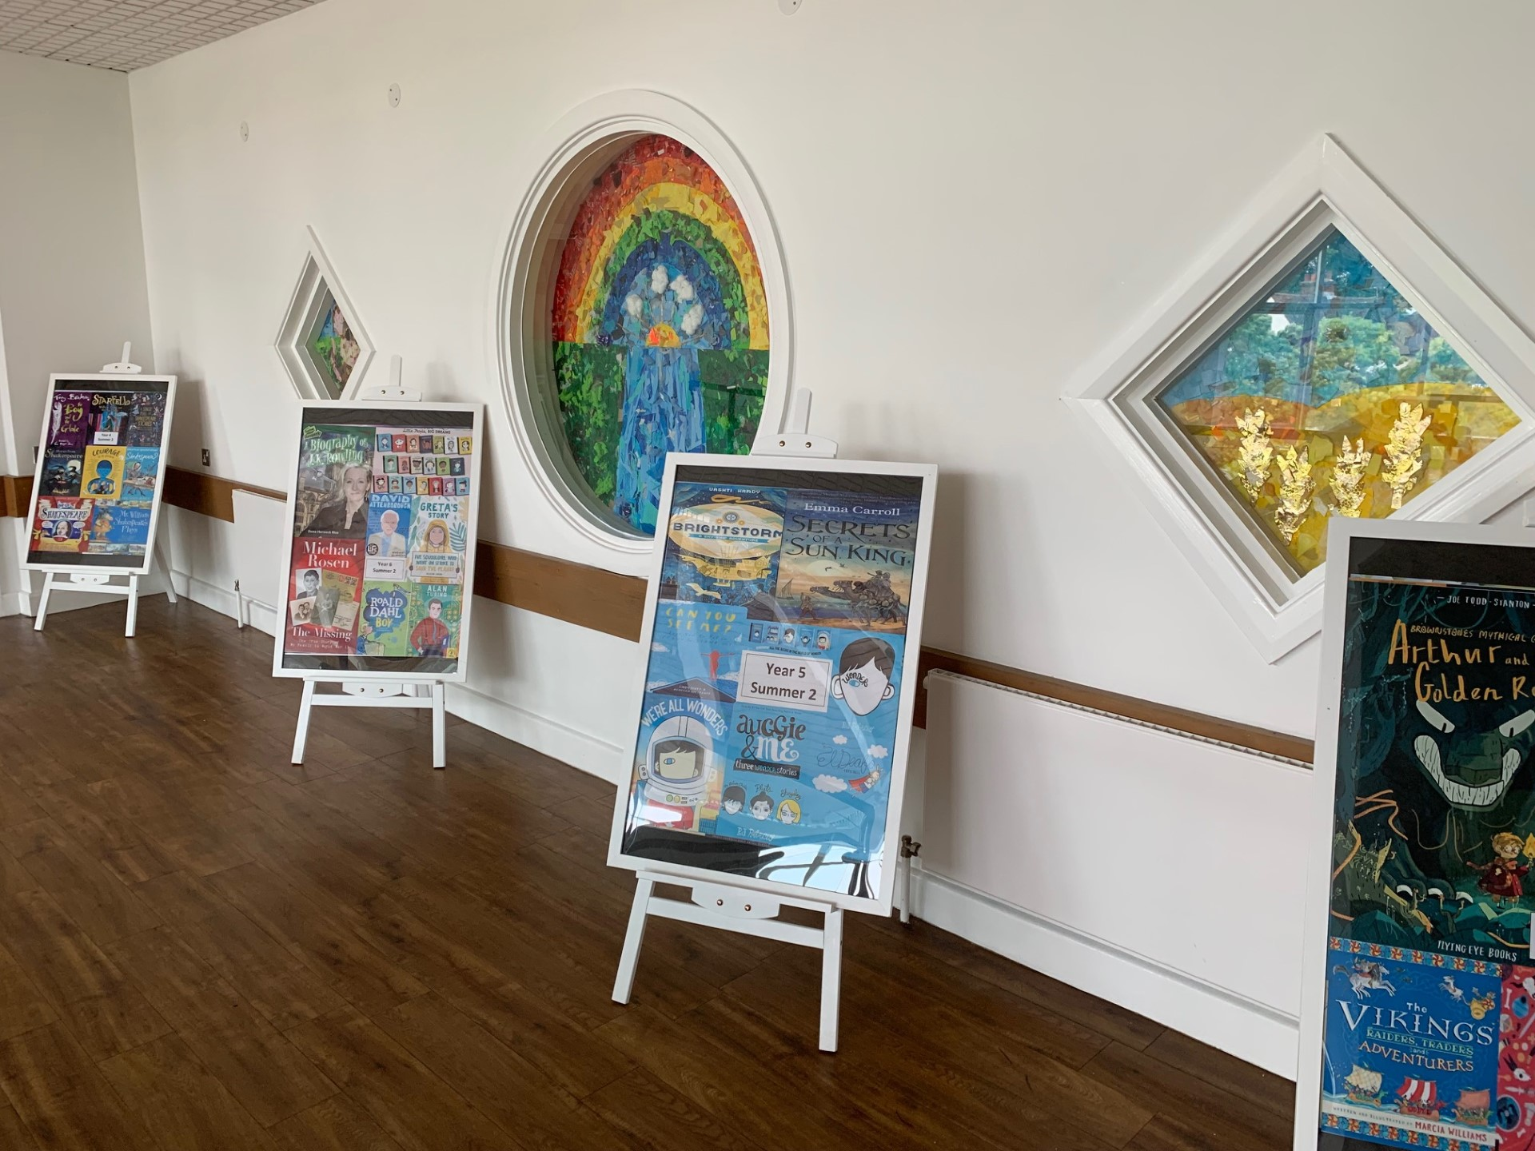
Ready Respectful Safe
Progression maps have been included in this folder. These maps help to track what is taught throughout the year, key objectives and signposts and assessment opportunities.
This particular folder is for tracking progression within Y3. Whole school progression maps are available for each subject (including a progression map for each of our 5 values) to show how we ensure children’s skills and knowledge develop well.
Our curriculum continues to evolve. And we recognise that it will perpetually change and be reshaped and remolded so that it reflects our ever-changing world and local community. Not only does our curriculum teach Resilience, Curiosity, Aspiration, Responsibility and Kindness, its very creation is derived through these five values.
The impact is that everyone at our school is passionate about learning: our children experience high quality provision and our teachers grow pedagogy and passion for the content they teach.
Muscliff is a school with a clear vision and identity that has created our culture.

Slide 3

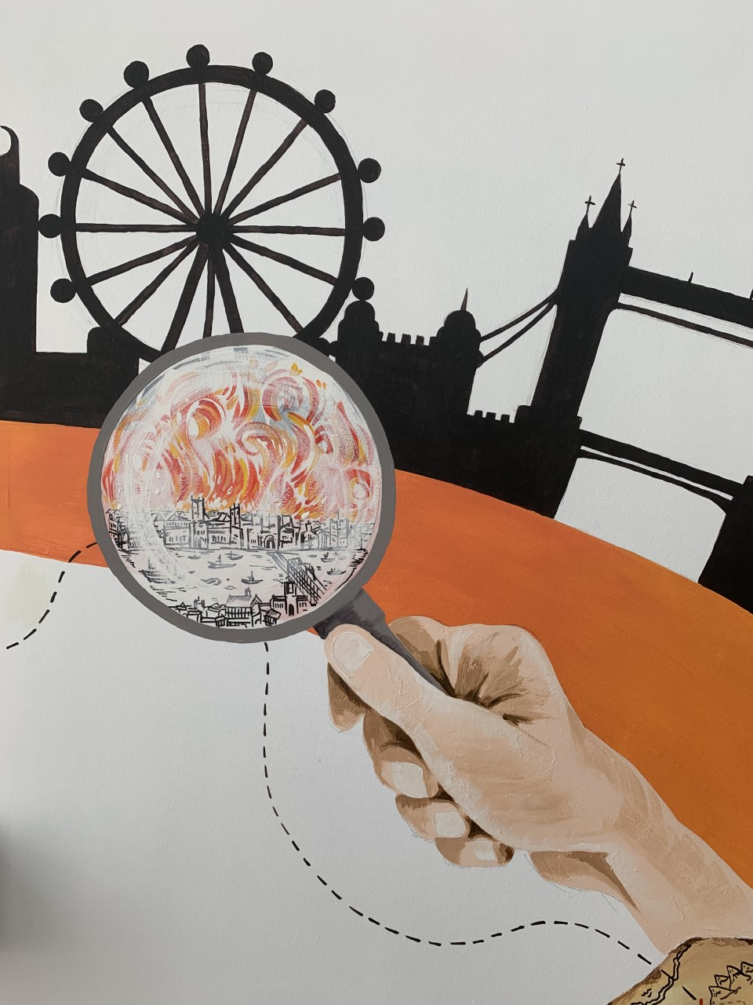
Ready Respectful Safe
Curiosity
I can use provided sources of information to help me find out more.
I can recognise how useful/reliable or a source is.
I don’t always believe / accept first answers.
I am comfortable with silence while allowing a person to respond to a question.
I form my own questions based on my own interests.
I ask more open questions that begin with words like “What if...”
Progress check:
How is The Street Beneath My Feet organised in a different way to most books? How does the author’s choice of this organisation help the reader to be curious?
Curiosity is an inspiring journey to enrich imagination and find that there is no wrong way… just a different way.
What makes children want to learn? We believe it's the joy of exploration - a hidden force that drives learning, critical thinking, and reasoning. We call this ability curiosity, and we recognise it in children when we see them exploring their environment, devouring books and information, asking questions, investigating concepts, manipulating data, searching for meaning, connecting with people and nature, and seeking new learning experiences.
“The important thing is not to stop questioning. Curiosity has its own reason for existing.” (Albert Einstein)

Slide 4
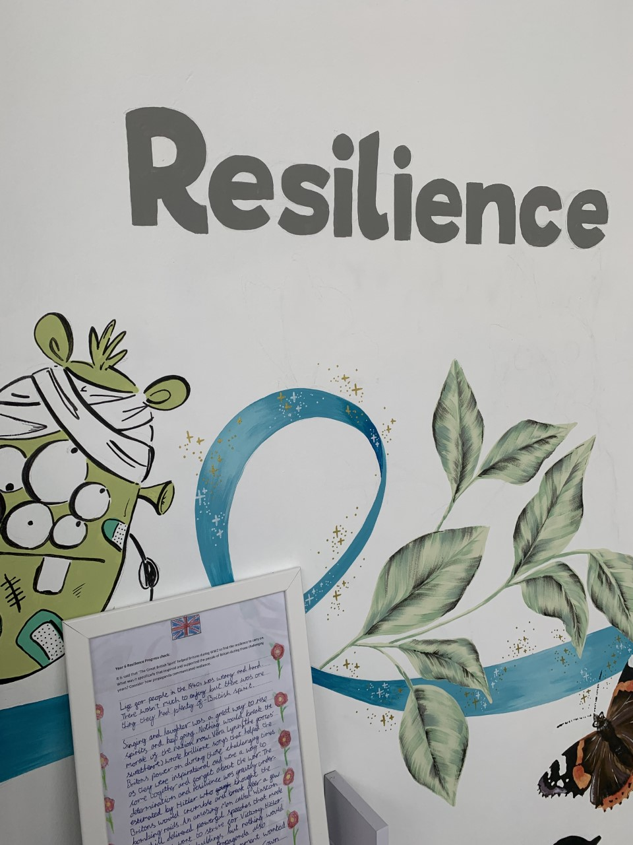

Ready Respectful Safe
Resilience supports us to work through challenges. Having resilience means that when we face a challenge, we use our inner voice and our body to overcome it. To thrive, Muscliff children are shown how to make the transition from the negative, “I can’t,” to the proactive, “How can I?” To do this, we support children to think about their own thinking (metacognition), to talk about their mental well-being and articulate their feelings towards a challenge and adapt their growth mindset. Reflecting on our own thoughts is how we gain insight into our feelings, needs, and behaviours — and how we learn, manage, and adapt to new experiences, challenges, and emotional set backs. We aim for all Muscliff children to grow in resilience so that they are prepared for life beyond Muscliff.
“You are braver than you believe, stronger than you seem, and smarter than you think.” (A.A. Milne)
Progress check:
How did Sohal cope with his worries? Can you identify how he shared his worries in the story?
Resilience
I efficiently use classroom strategies before asking an adult for help.
I am able to ask for help/ reassurance when needed.
I am increasingly independent during work time.
I can cope with longer mornings when we switch to KS2 timetable.
I both expect and welcome making mistakes.
I listen to verbal feedback.
I can move around the school on my own, coping with using the stairs.
I am able to share my mistakes with others.

Slide 5
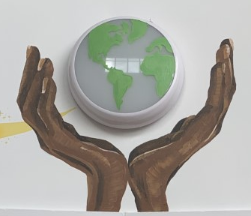
Ready Respectful Safe
Responsibility
Responsibility is doing the things we are expected to do and accepting the consequences (results) of your actions
We have a few different ways that we talk about responsibility at our school. There’s being responsible, taking responsibility, acting responsibly, and having responsibilities. They are all related to doing the things we are supposed to do, and accepting the positive or negative outcome of our actions. We are responsible for ourselves, our responses, our relationships, our mistakes, our education and careers, our health and well-being. But our overarching goal is to teach the pupils at Muscliff to be responsible for themselves.
"You are never too small to make a difference." Greta Thunberg
My understanding of Ready, Respectful, Safe is developing and I can talk about our school rules with a growing understanding.
I remember when to bring my reading record to school.
With adults at home, I remember to complete my homework
The presentation in books is as good as I can make it.
I have my PE kit in school and am responsible for the contents of my PE bag.
I can always relay letters to and from home.
I use classroom resources and am beginning to select them on my own.
I can show self-regulation and work independently for short periods of time.
I begin to edit my work and use a dictionary/ thesaurus.
I freely offer peer support.
I can understand the feelings of others through their body language.
I begin to understand that how I act can affect other children.
I have an awareness that some children are different to me.
I have an awareness of what it means to live in the UK and that some children are not as fortunate as us.
Progress check:
How does The Great Kapok show the reader the beauty of the world and teach us how to preserve this beauty?

Slide 6
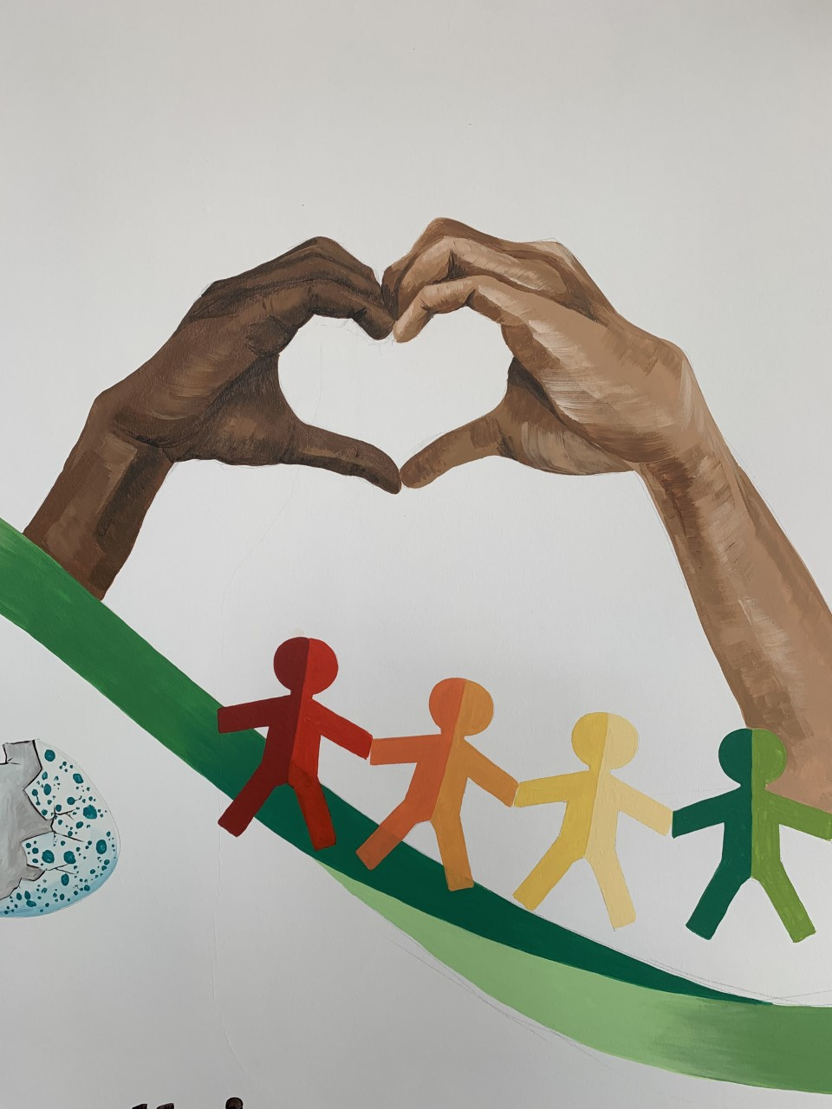

Ready Respectful Safe
Kindness
At Muscliff, we teach our children to choose kindness because it is the right choice to make... Kindness is the ability to understand how someone else is feeling or to understand the situation they are in. Kindness is at the root of all healthy relationships. It helps us know how our actions affect others, what actions are needed to be taken to be a good friend or teammate, and it helps us to understand more about the people and the world around us.
“No act of kindness, no matter how small, is ever wasted.” (Aesop)
I can consider kindness before I speak.
I don’t criticise the efforts of others.
I support and am tolerant of my classmates by recognising their visible/ invisible needs.
I have ownership of friendship issues and am starting to resolve friendship problems without an adult.
I am able to compliment someone else.
I am a good listener.
I convey my support to someone I believe in
I set an example to younger pupils.
I can share – even when I want it, recognising when someone else’s needs are greater than mine.

Slide 7
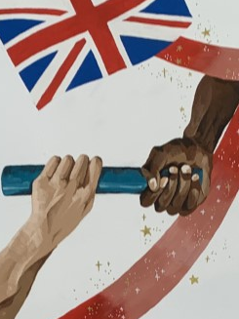

Ready Respectful Safe
The idea of aspiration has a positive, upward connotation. Our aspirations create powerful emotions and are deeply embedded within us; they are aligned with our values, and the very core of who we are. It is important that we all aspire to be or to become something that is seen as better than what or where we currently are (the best version of ourself). We can have social aspirations, career aspirations, and personal aspirations.
These days, children spend more time online and it’s easy for children to confuse short-lived celebrity status with achievement; sometimes children can be influenced by social media trends, confusing the number of ‘likes’ someone gains with success. At Muscliff, we want children to have a thorough understanding of aspirations and goals so that they can aspire to be the best version of themselves rather than a pale imitation of someone else.
“If you dream and have the ambition and want to work hard, then you can achieve.” (Mo Farah)
Aspiration
I explain why a positive learning attitude is helpful;
I explain what steps I can take to achieve future ambitions;
I explain why stereotypes need to be challenged;
I identify why routines and responsibilities might change as I go through school.
Progress check:
Is being rich, like Jasper in The Accidental Billionaire, a sign of success?
Is aspiring to have lots of money the best goal?

