Slide 1

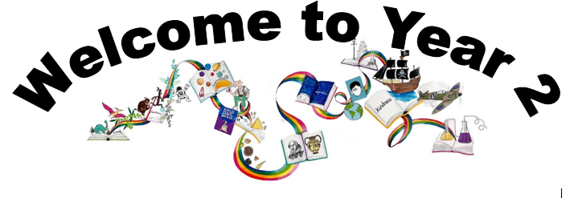
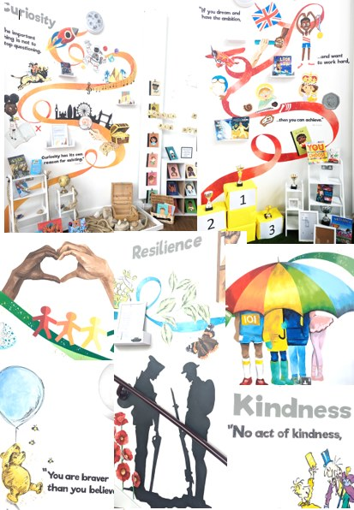
Ready Respectful Safe
We are proud to present our carefully crafted curriculum – it is the essence that makes us Muscliff Primary School; it reflects our unique identity as a community school and it is OURS. Our curriculum is bespoke. It is designed by us, for us.
When schools have the freedom to choose how the content of the National Curriculum is delivered, it is our belief that a) we make use of that opportunity as a vehicle to promote our school's culture and root our teaching and learning in Muscliff’s vision and values b) we create the best possible curriculum – one that is stimulating and enables our children to thrive and achieve because it reflects our community.
The purpose of this folder is to outline our curriculum ‘package’ in Year 2 but also to explain why we do what we do here! We feel that it is important for everyone at our school to understand the rationale behind this ‘carefully crafted’ curriculum.

Slide 2
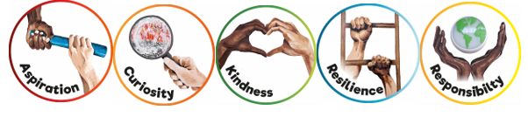
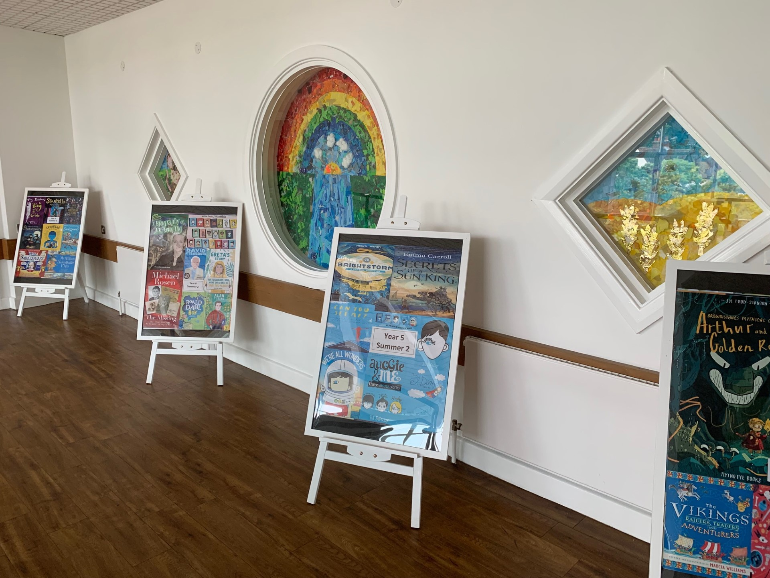
Ready Respectful Safe
Progression maps have been included in this folder. These maps help to track what is taught throughout the year, key objectives and signposts and assessment opportunities.
This particular folder is for tracking progression within Y2. Whole school progression maps are available for each subject (including a progression map for each of our 5 values) to show how we ensure children’s skills and knowledge develop well.
Our curriculum continues to evolve. And we recognise that it will perpetually change and be reshaped and remolded so that it reflects our ever-changing world and local community. Not only does our curriculum teach Resilience, Curiosity, Aspiration, Responsibility and Kindness, its very creation is derived through these five values.
The impact is that everyone at our school is passionate about learning: our children experience high quality provision and our teachers grow pedagogy and passion for the content they teach.
Muscliff is a school with a clear vision and identity that has created our culture.

Slide 3

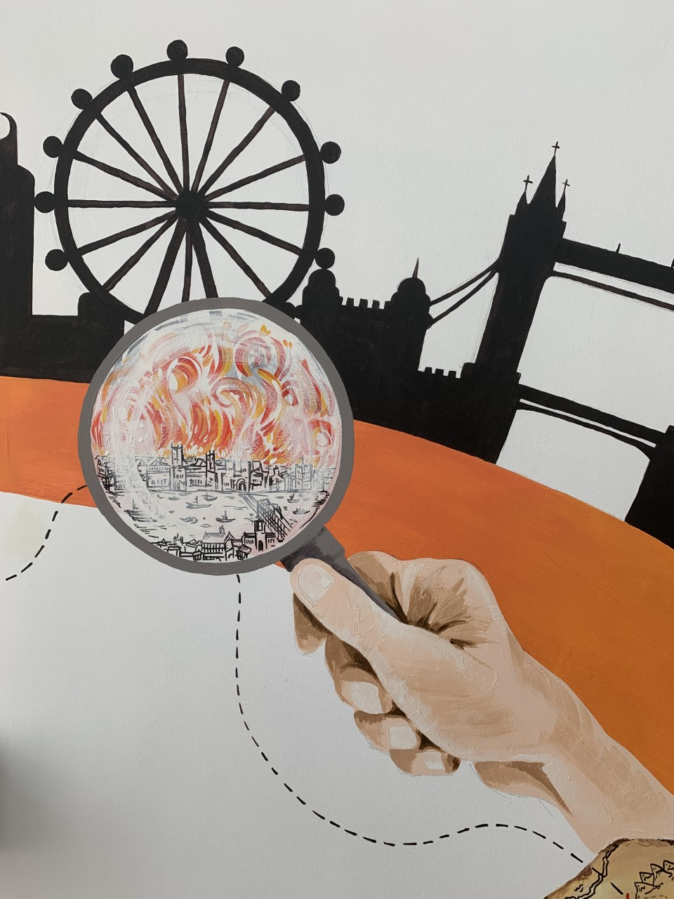
Ready Respectful Safe
Curiosity
I can list what I would like to know about the topic or subject first to stimulate interest and assess how much I already know about it.
I can make links from previous understanding to the current situation.
I can ask both closed and open questions.
I show resilience – not stopping with first answer but acknowledging that sometimes a question has more than one answer.
Progress check:
What facts does Vlad discover about the Great Fire of London during his adventure?
Curiosity is an inspiring journey to enrich imagination and find that there is no wrong way… just a different way.
What makes children want to learn? We believe it's the joy of exploration - a hidden force that drives learning, critical thinking, and reasoning. We call this ability curiosity, and we recognise it in children when we see them exploring their environment, devouring books and information, asking questions, investigating concepts, manipulating data, searching for meaning, connecting with people and nature, and seeking new learning experiences.
“The important thing is not to stop questioning. Curiosity has its own reason for existing.” (Albert Einstein)

Slide 4
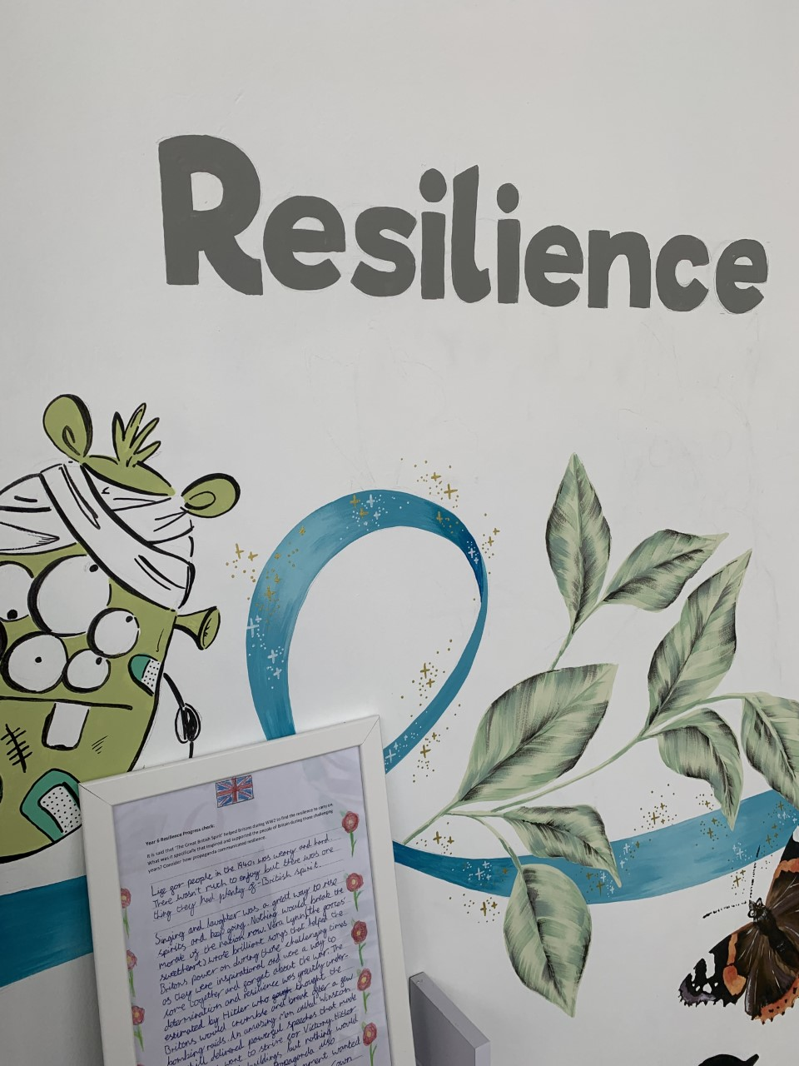

Ready Respectful Safe
Resilience supports us to work through challenges. Having resilience means that when we face a challenge, we use our inner voice and our body to overcome it. To thrive, Muscliff children are shown how to make the transition from the negative, “I can’t,” to the proactive, “How can I?” To do this, we support children to think about their own thinking (metacognition), to talk about their mental well-being and articulate their feelings towards a challenge and adapt their growth mindset. Reflecting on our own thoughts is how we gain insight into our feelings, needs, and behaviours — and how we learn, manage, and adapt to new experiences, challenges, and emotional set backs. We aim for all Muscliff children to grow in resilience so that they are prepared for life beyond Muscliff.
“You are braver than you believe, stronger than you seem, and smarter than you think.” (A.A. Milne)
Resilience
I try to use strategies before asking an adult for help.
I begin to prove knowledge and understanding with guidance and some adult support.
I am resilient in friendships when things don’t go how I wanted.
I am able to work with other children who I have not chosen to work with.
I show resilience towards ‘special jobs’.
I expect to get things wrong sometimes.
I can return to work that I found tricky after I’ve spoken to an adult.
Progress check:
When did Max show resilience in the Hodgeheg?
What things did Max get wrong?

Slide 5
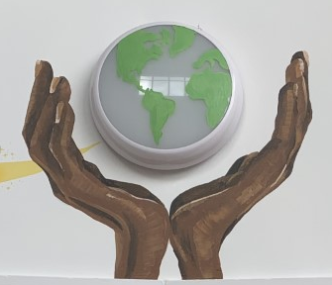
Ready Respectful Safe
Responsibility
Responsibility is doing the things we are expected to do and accepting the consequences (results) of your actions
We have a few different ways that we talk about responsibility at our school. There’s being responsible, taking responsibility, acting responsibly, and having responsibilities. They are all related to doing the things we are supposed to do, and accepting the positive or negative outcome of our actions. We are responsible for ourselves, our responses, our relationships, our mistakes, our education and careers, our health and well-being. But our overarching goal is to teach the pupils at Muscliff to be responsible for themselves.
"You are never too small to make a difference." Greta Thunberg
I can give examples that support Ready, Respectful, Safe.
I complete my morning jobs when I arrive.
Routines are established and I need very little reminders – book bags, changing colour-banded books, snack.
I apologise automatically when I know that I have made a mistake.
I am a considerate friend and treats others how I would like to be treated myself.
I can think about how I might help myself before going to an adult.
I can tidy the tables at the end of a session.
As I am the oldest in the playground/ assembly/lunch hall – I am able to set an example to younger children
I am aware of the environment – plastic in ocean and can say how I might help.
Progress check:
What does Somebody Swallowed Stanley teach us about looking after our school and the local area around Muscliff ?

Slide 6
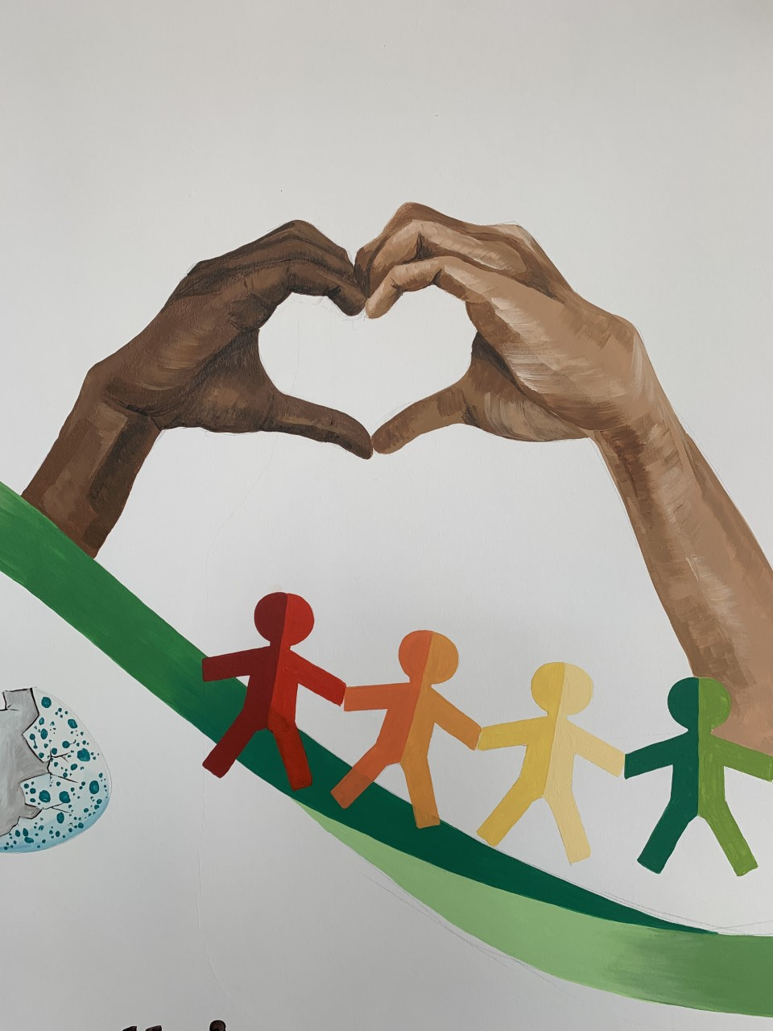

Ready Respectful Safe
Kindness
At Muscliff, we teach our children to choose kindness because it is the right choice to make... Kindness is the ability to understand how someone else is feeling or to understand the situation they are in. Kindness is at the root of all healthy relationships. It helps us know how our actions affect others, what actions are needed to be taken to be a good friend or teammate, and it helps us to understand more about the people and the world around us.
“No act of kindness, no matter how small, is ever wasted.” (Aesop)
I apologise automatically when I know that I have made a mistake.
I show an intrinsic kindness at home re. property/ words
I model kindness to others and know why I should be kind.
I show kindness to younger children by playing considerately in the playground.
I am mindful of how I treat others.
I volunteer my help when I see that it is needed.
I can share, pre-empting when someone will be in need.
Progress check:
Friendships can often be tricky! There are often times in friendships when you disagree with a friend.
“The course of true love never did run smooth.”
How can you solve a situation so that both you and your friend are happy when there’s something you don’t agree about?

Slide 7
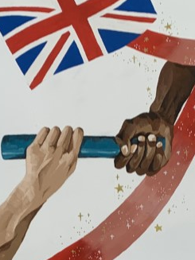
Ready Respectful Safe
The idea of aspiration has a positive, upward connotation. Our aspirations create powerful emotions and are deeply embedded within us; they are aligned with our values, and the very core of who we are. It is important that we all aspire to be or to become something that is seen as better than what or where we currently are (the best version of ourself). We can have social aspirations, career aspirations, and personal aspirations.
These days, children spend more time online and it’s easy for children to confuse short-lived celebrity status with achievement; sometimes children can be influenced by social media trends, confusing the number of ‘likes’ someone gains with success. At Muscliff, we want children to have a thorough understanding of aspirations and goals so that they can aspire to be the best version of themselves rather than a pale imitation of someone else.
Aspiration
“If you dream and have the ambition and want to work hard, then you can achieve.” (Mo Farah)
I explain why a positive learning attitude is helpful;
I explain what steps I can take to achieve future ambitions;
I explain why stereotypes need to be challenged;
I identify why routines and responsibilities might change as I go through school.
I can talk about a studied inspirational person from history (for example, William Shakespeare).
I can set a realistic goal
I can say what I want to happen and when there is a problem (set a goal).
I can predict and understand the consequences of reaching my goal.
I can choose a realistic goal.
I can sometimes plan to reach a goal
I can break a goal down into small steps.
I show persistence I can resist distractions.
I can work towards a reward or for the satisfaction of finishing a task.
I can recognise when I am becoming bored or frustrated.
Progress check:
Pick a fairy tale. How was the main character rewarded for their goodness?

