Slide 1

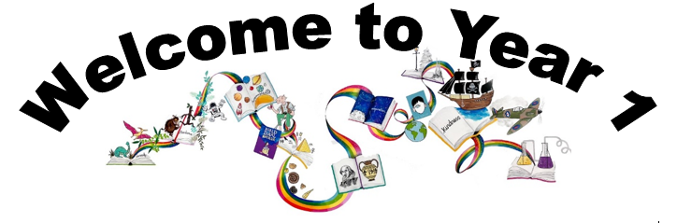
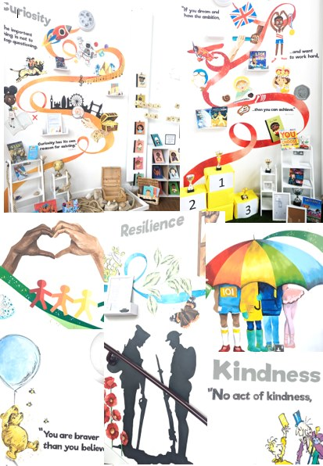
Ready Respectful Safe
We are proud to present our carefully crafted curriculum – it is the essence that makes us Muscliff Primary School; it reflects our unique identity as a community school and it is OURS. Our curriculum is bespoke. It is designed by us, for us.
When schools have the freedom to choose how the content of the National Curriculum is delivered, it is our belief that a) we make use of that opportunity as a vehicle to promote our school's culture and root our teaching and learning in Muscliff’s vision and values b) we create the best possible curriculum – one that is stimulating and enables our children to thrive and achieve because it reflects our community.
The purpose of this folder is to outline our curriculum ‘package’ in Year 1 but also to explain why we do what we do here! We feel that it is important for everyone at our school to understand the rationale behind this ‘carefully crafted’ curriculum.

Slide 2
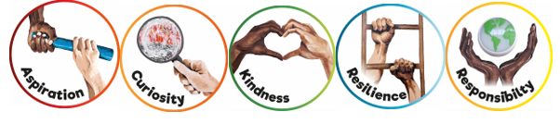
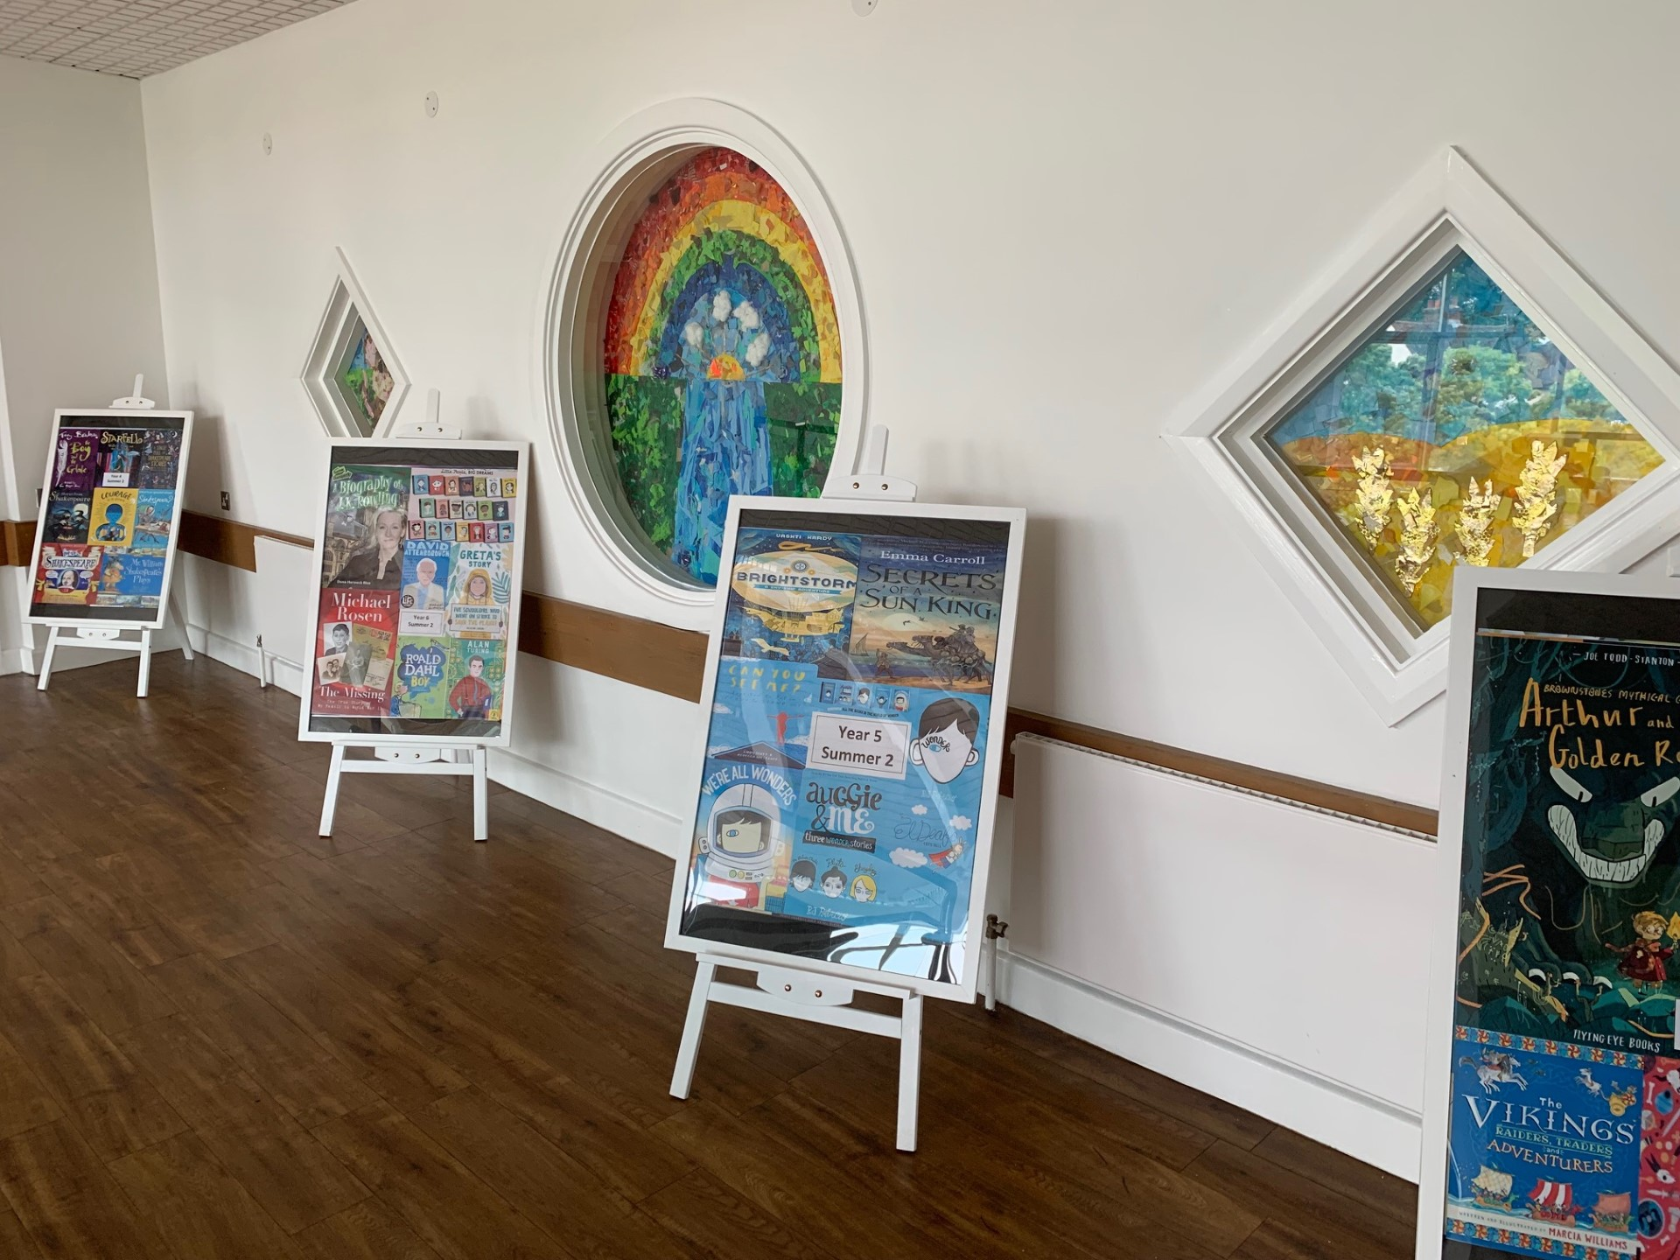
Ready Respectful Safe
Progression maps have been included in this folder. These maps help to track what is taught throughout the year, key objectives and signposts and assessment opportunities.
This particular folder is for tracking progression within Y1. Whole school progression maps are available for each subject (including a progression map for each of our 5 values) to show how we ensure children’s skills and knowledge develop well.
Our curriculum continues to evolve. And we recognise that it will perpetually change and be reshaped and remolded so that it reflects our ever-changing world and local community. Not only does our curriculum teach Resilience, Curiosity, Aspiration, Responsibility and Kindness, its very creation is derived through these five values.
The impact is that everyone at our school is passionate about learning: our children experience high quality provision and our teachers grow pedagogy and passion for the content they teach.
Muscliff is a school with a clear vision and identity that has created our culture.

Slide 3

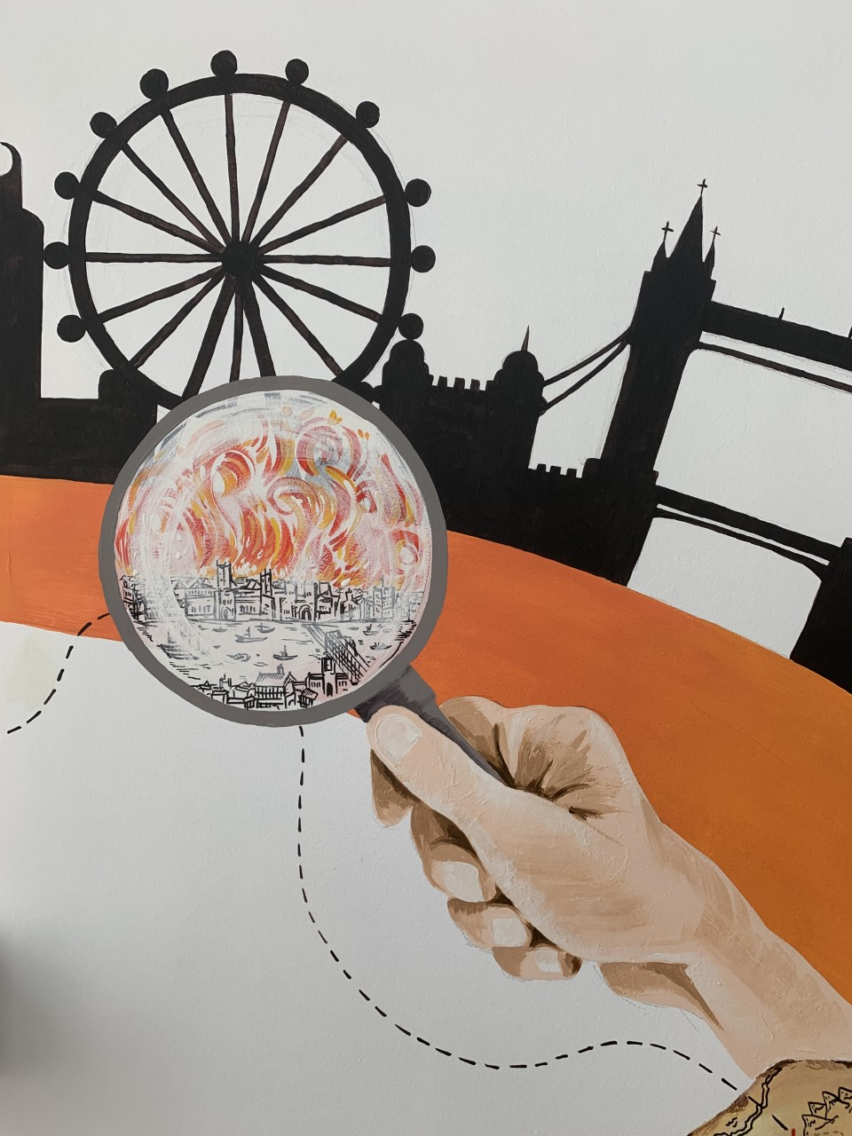
Ready Respectful Safe
Curiosity
I accept that mistakes develop my curiosity.
I look for clues and answers in the books I read.
I pose questions about the world beyond my locality and about things that I can’t ‘see’.
I discuss my answers first; this enables me to contribute more. I am comfortable to say ‘we thought’ rather than ‘I think’.
I can use talk partners to deepen critical thinking and questioning.
Progress check:
I wonder in which seasons our books are set. What clues are there in the books?
Curiosity is an inspiring journey to enrich imagination and find that there is no wrong way… just a different way.
What makes children want to learn? We believe it's the joy of exploration - a hidden force that drives learning, critical thinking, and reasoning. We call this ability curiosity, and we recognise it in children when we see them exploring their environment, devouring books and information, asking questions, investigating concepts, manipulating data, searching for meaning, connecting with people and nature, and seeking new learning experiences.
“The important thing is not to stop questioning. Curiosity has its own reason for existing.” (Albert Einstein)

Slide 4
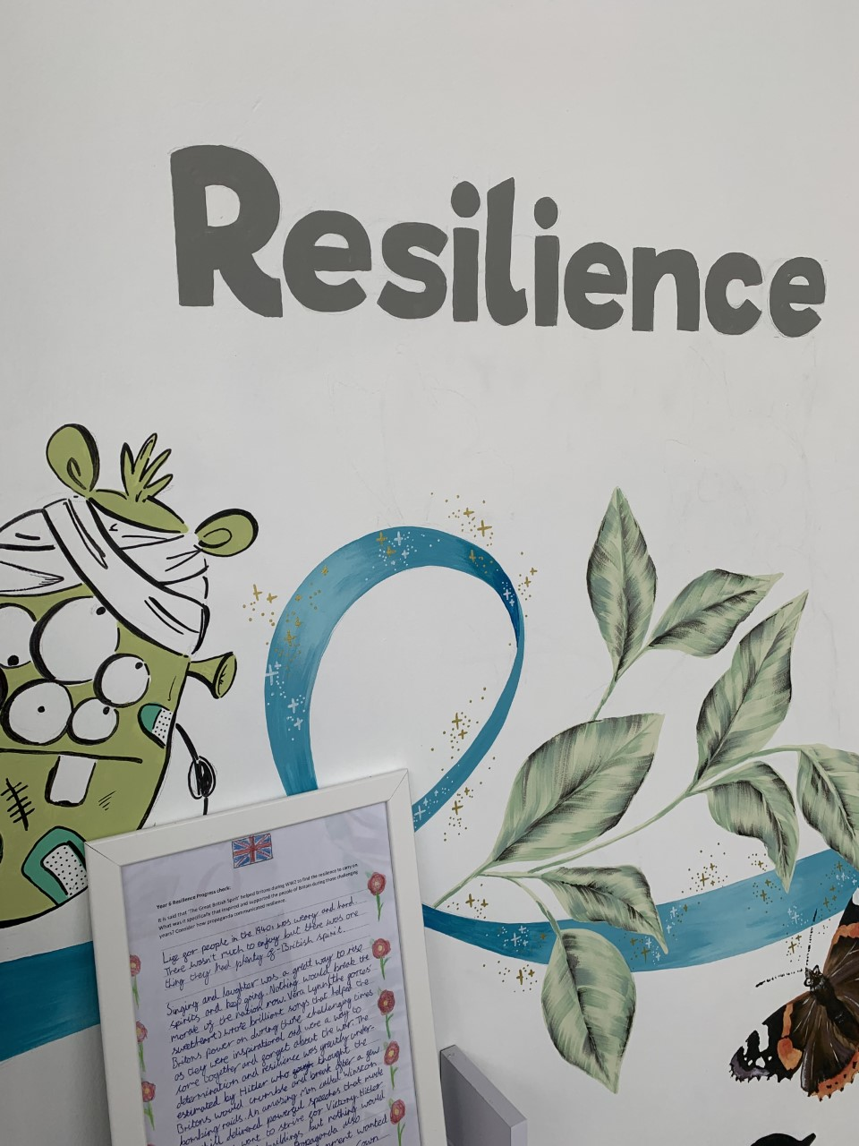

Ready Respectful Safe
Resilience supports us to work through challenges. Having resilience means that when we face a challenge, we use our inner voice and our body to overcome it. To thrive, Muscliff children are shown how to make the transition from the negative, “I can’t,” to the proactive, “How can I?” To do this, we support children to think about their own thinking (metacognition), to talk about their mental well-being and articulate their feelings towards a challenge and adapt their growth mindset. Reflecting on our own thoughts is how we gain insight into our feelings, needs, and behaviours — and how we learn, manage, and adapt to new experiences, challenges, and emotional set backs. We aim for all Muscliff children to grow in resilience so that they are prepared for life beyond Muscliff.
“You are braver than you believe, stronger than you seem, and smarter than you think.” (A.A. Milne)
Resilience
I can maintain my focus for longer periods as appropriate.
I am able to reflect and return to my work.
I can return to a task even if I find something hard and have another try.
I am independent from familiar adults for longer periods at teacher-selected times.
I am able to integrate into big school.
I can show empathy to others when they find something hard.
I am not afraid to have different answers/ideas to other children.
Progress check:
How did the teacher help Vashti in The Dot? How did Vashti help someone else?

Slide 5
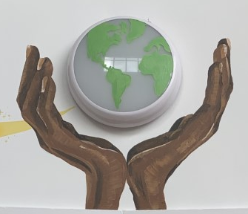
Ready Respectful Safe
Responsibility
Responsibility is doing the things we are expected to do and accepting the consequences (results) of your actions
We have a few different ways that we talk about responsibility at our school. There’s being responsible, taking responsibility, acting responsibly, and having responsibilities. They are all related to doing the things we are supposed to do, and accepting the positive or negative outcome of our actions. We are responsible for ourselves, our responses, our relationships, our mistakes, our education and careers, our health and well-being. But our overarching goal is to teach the pupils at Muscliff to be responsible for themselves.
"You are never too small to make a difference." Greta Thunberg
I can identify when I am and when I am not being Ready, Respectful, Safe.
I am responsible for putting letters in and taking letters out of my book bag.
I chose my own colour-banded book to take home.
I can use a cloakroom and toilet sensibly that is not situated in my classroom.
I change for PE by myself.
I go to first aid if I am hurt at playtime.
I apologise when prompted and sometimes without being told to.
I work with a learning partner.
I can tell a teacher if a friend needs help.
Progress check:
How does looking after someone or something show responsibility?

Slide 6
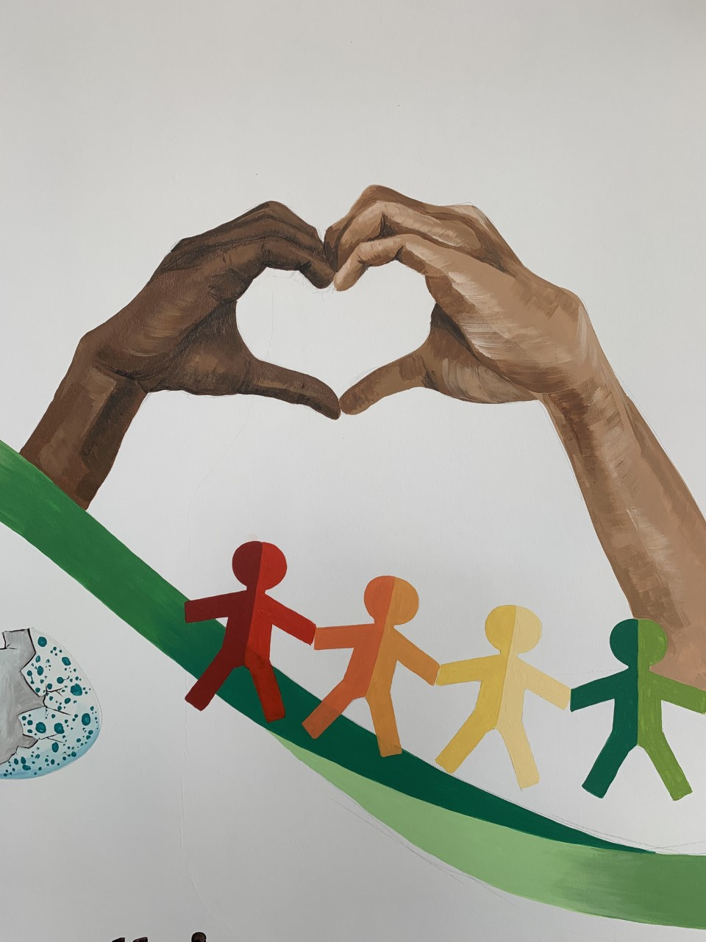

Ready Respectful Safe
Kindness
At Muscliff, we teach our children to choose kindness because it is the right choice to make... Kindness is the ability to understand how someone else is feeling or to understand the situation they are in. Kindness is at the root of all healthy relationships. It helps us know how our actions affect others, what actions are needed to be taken to be a good friend or teammate, and it helps us to understand more about the people and the world around us.
“No act of kindness, no matter how small, is ever wasted.” (Aesop)
I apologise when prompted and sometimes without being told to.
I say please and thank you.
I listen to my learning partners.
I open doors for any adult (without expecting a VIP).
I walk on the left.
I have a growing empathy and awareness of others.
I am keen to volunteer for classroom roles.
I can share, recognising when someone needs something that I am using.
Progress check:
How do unkind words hurt?
What does it mean to feel different?
Should the other ducklings apologise to the cygnet?

Slide 7
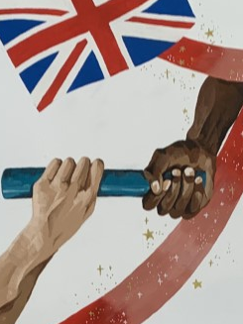
Ready Respectful Safe
The idea of aspiration has a positive, upward connotation. Our aspirations create powerful emotions and are deeply embedded within us; they are aligned with our values, and the very core of who we are. It is important that we all aspire to be or to become something that is seen as better than what or where we currently are (the best version of ourself). We can have social aspirations, career aspirations, and personal aspirations.
These days, children spend more time online and it’s easy for children to confuse short-lived celebrity status with achievement; sometimes children can be influenced by social media trends, confusing the number of ‘likes’ someone gains with success. At Muscliff, we want children to have a thorough understanding of aspirations and goals so that they can aspire to be the best version of themselves rather than a pale imitation of someone else.
Aspiration
“If you dream and have the ambition and want to work hard, then you can achieve.” (Mo Farah)
I can identify star qualities in others;
I talk about hopes I have for the future;
I discuss what I am looking forward to about next year.
I give examples of positive learning attitude statements;
I can identify attributes I have that would suit me to a desired job;
I challenge stereotypes;
I can discuss my ambitions;
I can identify ways next year will be different and explain why I think this.
I can name role models.
I can identify people in our community who provide a solid role model.
Progress check:
What would be your perfect job? Who do you know that has a job that they enjoy doing?

