Slide 1

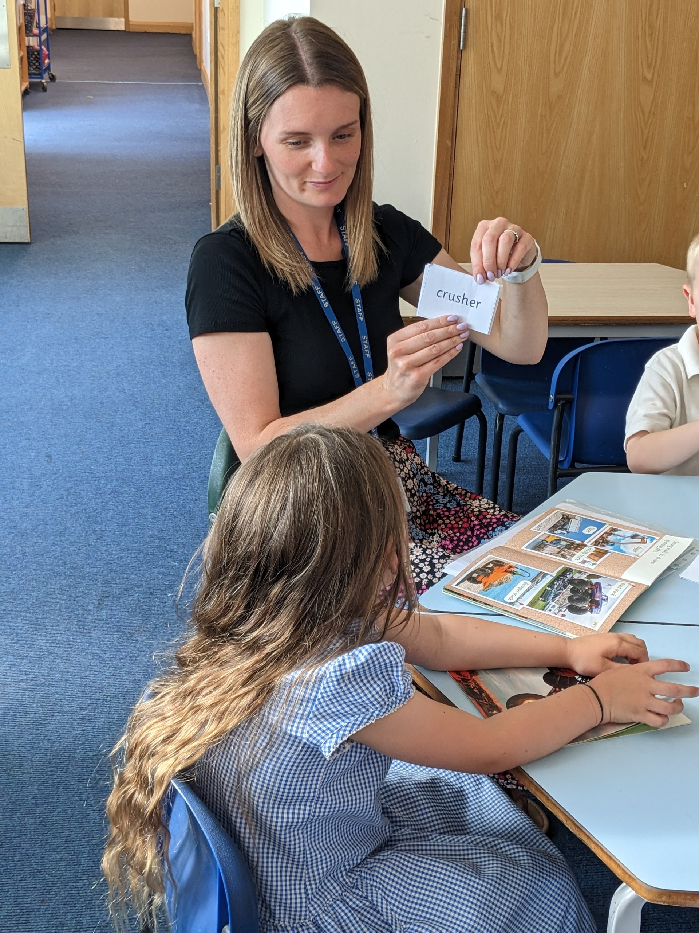
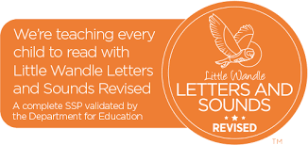
Ready Respectful Safe
Welcome to Year R Reading!
Our aims at Muscliff are to:
ensure that phonics is taught with fidelity
ensure pupils are supported to read aloud accurately those books that are consistent with their developing phonic knowledge and that do not require them to use other strategies to work out words.
ensure pupils who have learnt how to decode develop fluency through regular and monitored reading, and texts are read aloud to pupils who are unable to decode
develop pupils’ ability to read aloud with prosody to support the development of pupils’ language and vocabulary.
Which phonics programme do we follow?
We use Little Wandle, which is a DfE approved phonics programme.
We chose this particular programme after much research. We knew that part of the pathway to effectively developing reading involves a well-implemented approach to teaching phonics.
We read the Simple View of Reading (SVOR) by Gough and Tunmer and considered how we would approach phonics at our school. The SVOR informs the current government policy on this aspect of early reading teaching. We chose Little Wandle as our programme because it stood out: the expectations set out by Little Wandle are high. And expectations should be high! We want all children to achieve well in phonics as a springboard to their future success as readers.
The impact is that we have a high quality, government approved, phonics programme that sets high expectations.

Slide 2

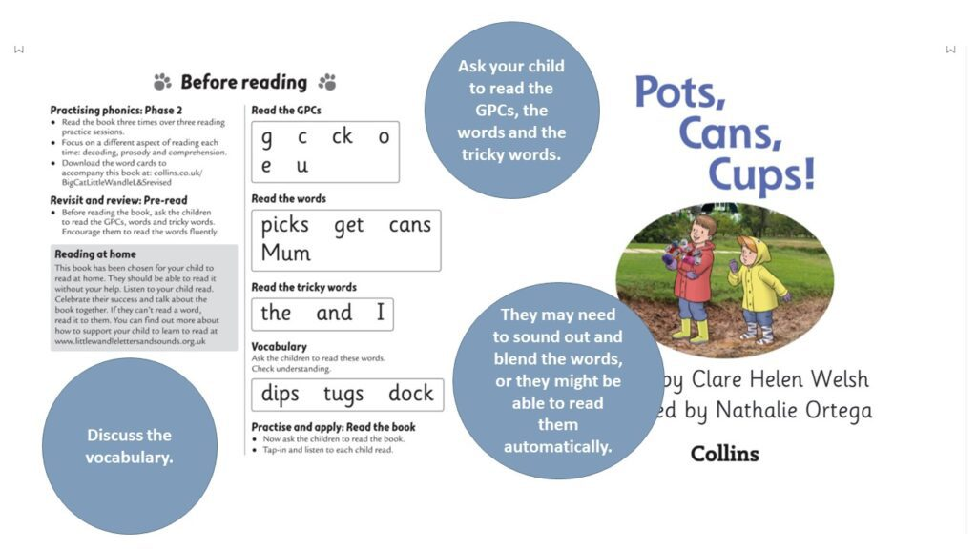
Ready Respectful Safe
But what is phonics?
Phonics is an approach to teaching how to read by focusing on the relationship between written symbols and speech sounds. This involves several skills: skills of hearing, identifying and using the patterns of sounds or phonemes to read written language. Systematic approaches are the most effective in teaching pupils the relationship between these sounds and the written spelling patterns, or graphemes, which represent them. Phonics emphasises the skills of decoding new words by sounding them out and combining or ​‘blending’ the sound-spelling patterns.
How and why we teach phonics:
1. Phonics has a positive impact overall (+5 months, according to EEF) with very extensive evidence and is an important component in the development of early reading skills, particularly for children from disadvantaged backgrounds.
2. The teaching of phonics should be explicit and systematic to support children in making connections between the sound patterns they hear in words and the way that these words are written.
3. The teaching of phonics should be matched to children’s current level of skill in terms of their phonemic awareness and their knowledge of letter sounds and patterns (graphemes).
4. Phonics improves the accuracy of the child’s reading but not necessarily their comprehension. It is important that children are successful in making progress in all aspects of reading including comprehension, the development of vocabulary and spelling, which should also be taught explicitly.

Slide 3
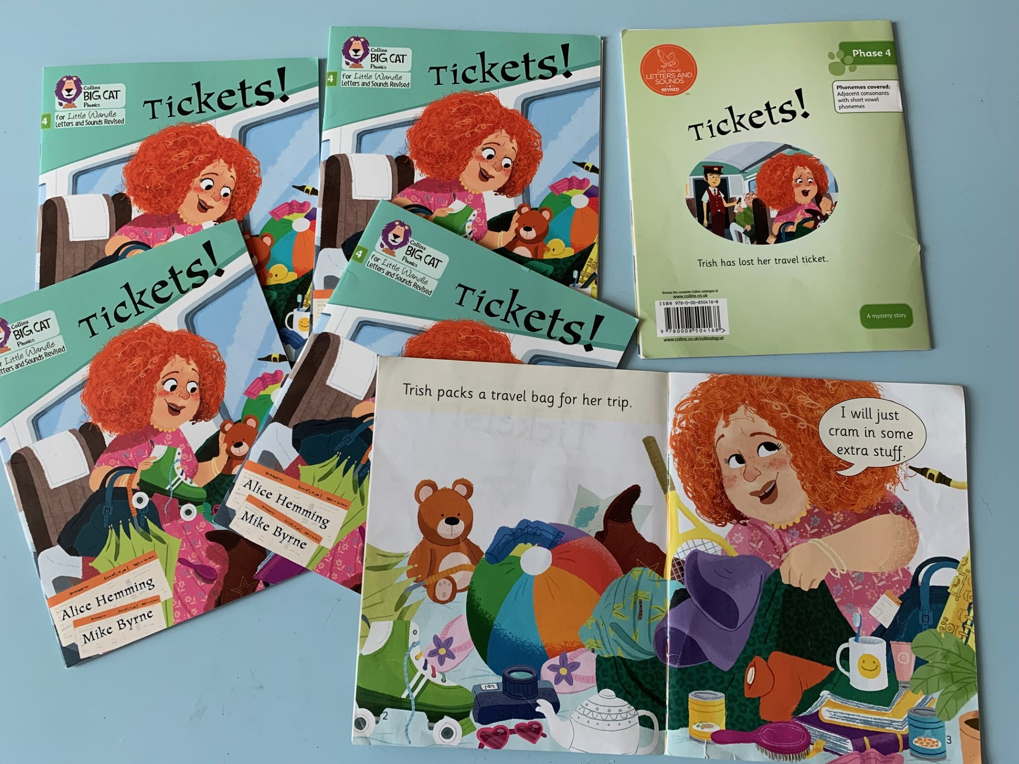
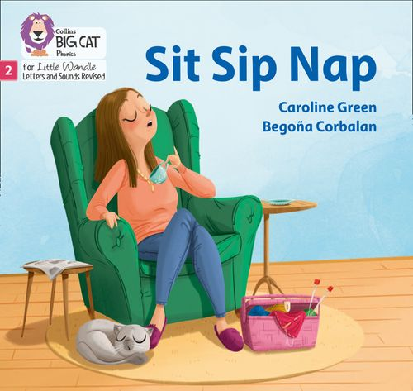
Ready Respectful Safe
Do we use other phonics programmes at Muscliff?
No.
Fidelity matters
Synthetic phonic programmes have one thing in common: they teach children GPCs, to blend phonemes into spoken words and segment spoken words into phonemes.
However, programmes use programme-specific systems and terminology such as actions, mnemonics, prompts, key words and routines to teach knowledge and skills.
It is important not to confuse children by mixing material from different programmes or across different classrooms – hence the phrase ‘fidelity to the programme’. For example, one programme might use the term ‘split digraph’, while another might refer to ‘magic e’ for the same vowel GPC in a word such as ‘late’.
At Muscliff, we ONLY use Little Wandle to teach phonics.
What is a decodable book?
Based on research by Hatcher, Hulme and Ellis (1994) and Mesmer (2000) providing absolute beginners with texts where they can work out the words based on the phonic rules they have learned could provide opportunities to apply those rules through reading.
The impact is that children’s confidence and ability increases as they are able to read a whole book using their phonics skills.

Slide 4
Ready Respectful Safe
Who teaches my child phonics?
Any adult who teaches phonics at Muscliff (including our TAs, HLTAs and even our regular supply teachers) have undertaken full training to teach phonics. We ensure all of our Muscliff staff keep up-to-date with Little Wandle training. Our Year Leader regularly leads the team’s training and directs the team to LW training videos and guidance. We consider it best practice to always keep on top of Little Wandle training.
Heat Mats and Grouping
Responsive grouping is a key factor in successful organisation. Regular assessment ensures that children move between groups as appropriate to their level of attainment. It is also important to make sure that children are taught by the teachers(s) as well as the teaching assistants as pedagogical knowledge is a significant factor for impact.
Texts involve the reinforcement and practice of taught phonemes only to ensure that children are developing automaticity in decoding GPCs to pronounce words.
What does a reading session look like here?
Children read three times every week with an adult once they have learnt the initial sounds and can segment and blend these confidently.
The three sessions:
Session 1: Decoding
In this session, the focus is purely on phonic strategies to ‘break the code’ in order to read the word. We look at GPCs also, specific words or tricky words that need additional practice.
Session 2: Prosody
We challenge the children to use an expressive voice. We discuss how our voices change depending on what we want our listener to understand from our reading.
Session 3: Comprehension
Our talk around the text supports the children’s understanding. We ask simple questions about the main ideas. In this session, we use the pictures to support our reading experience.

Slide 5
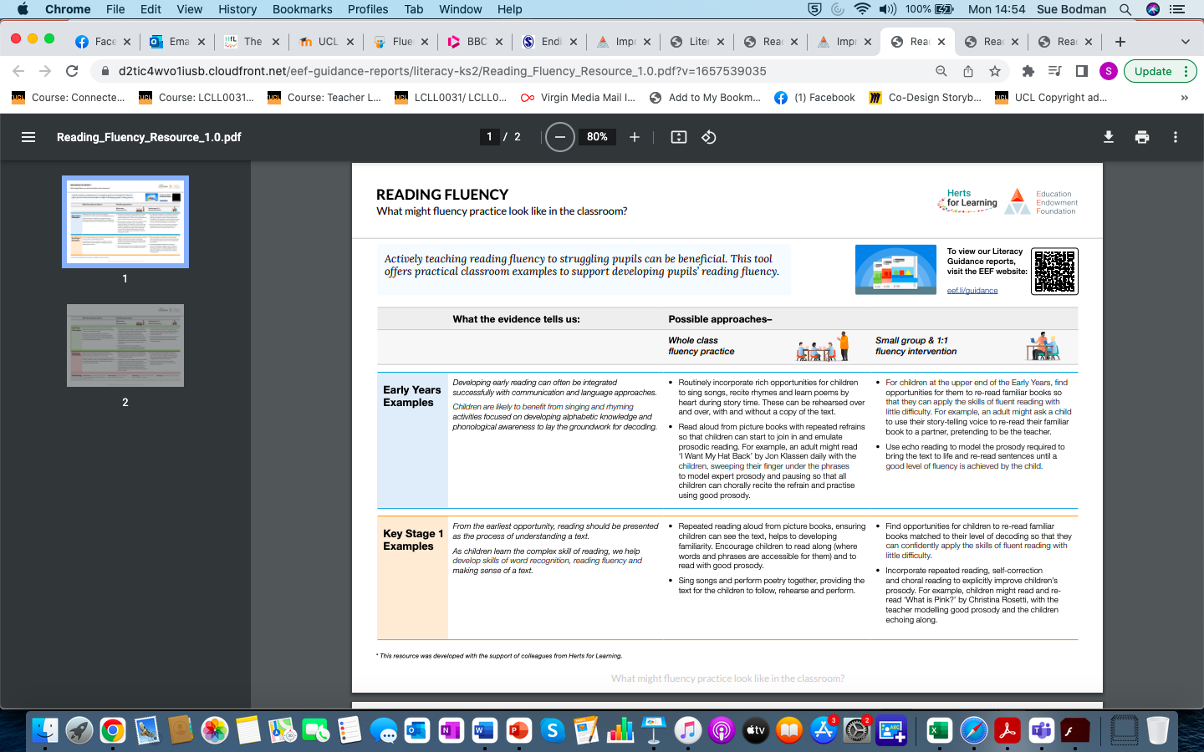
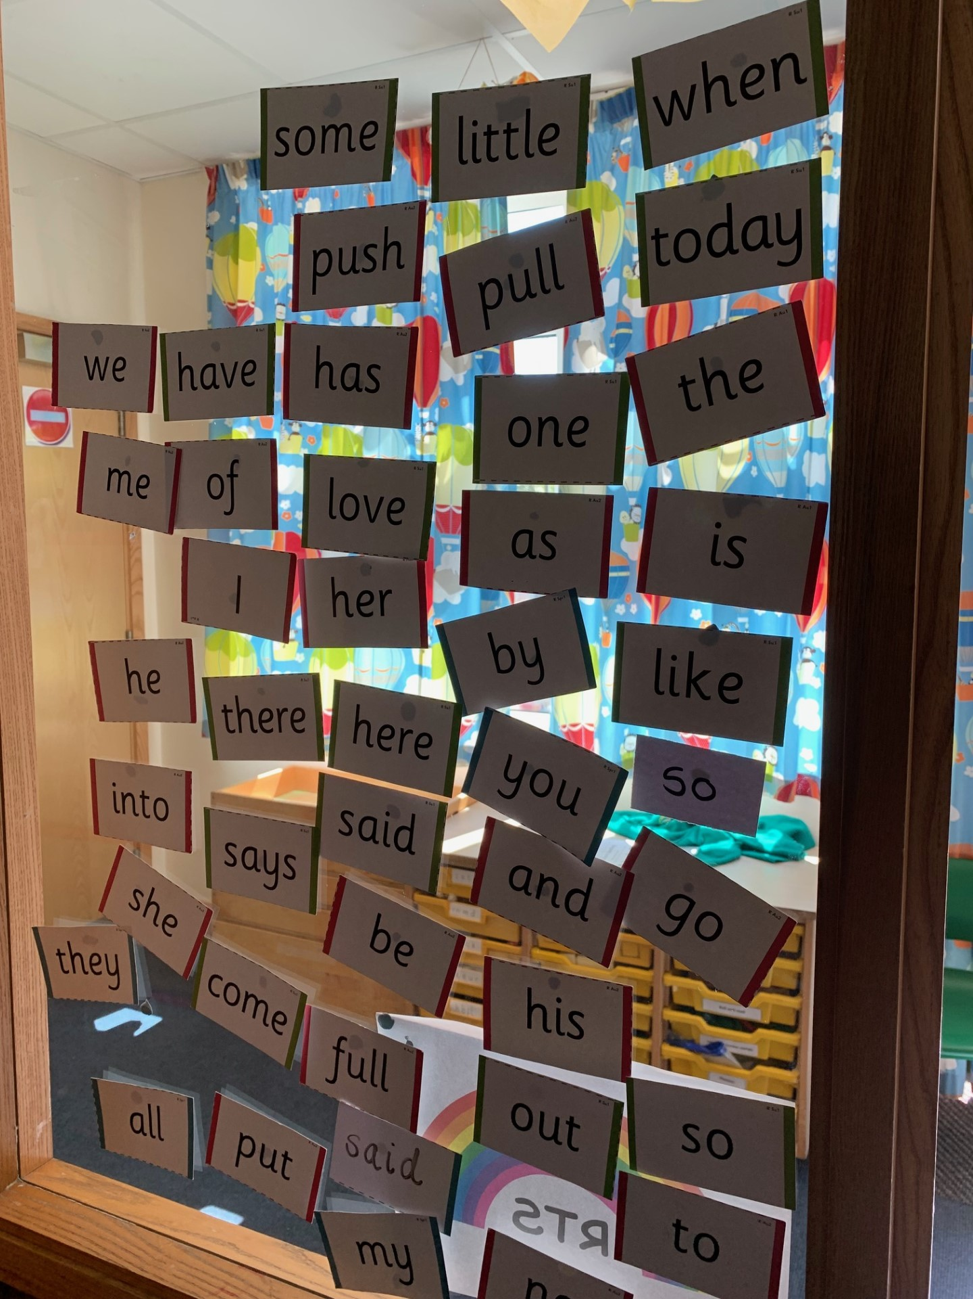
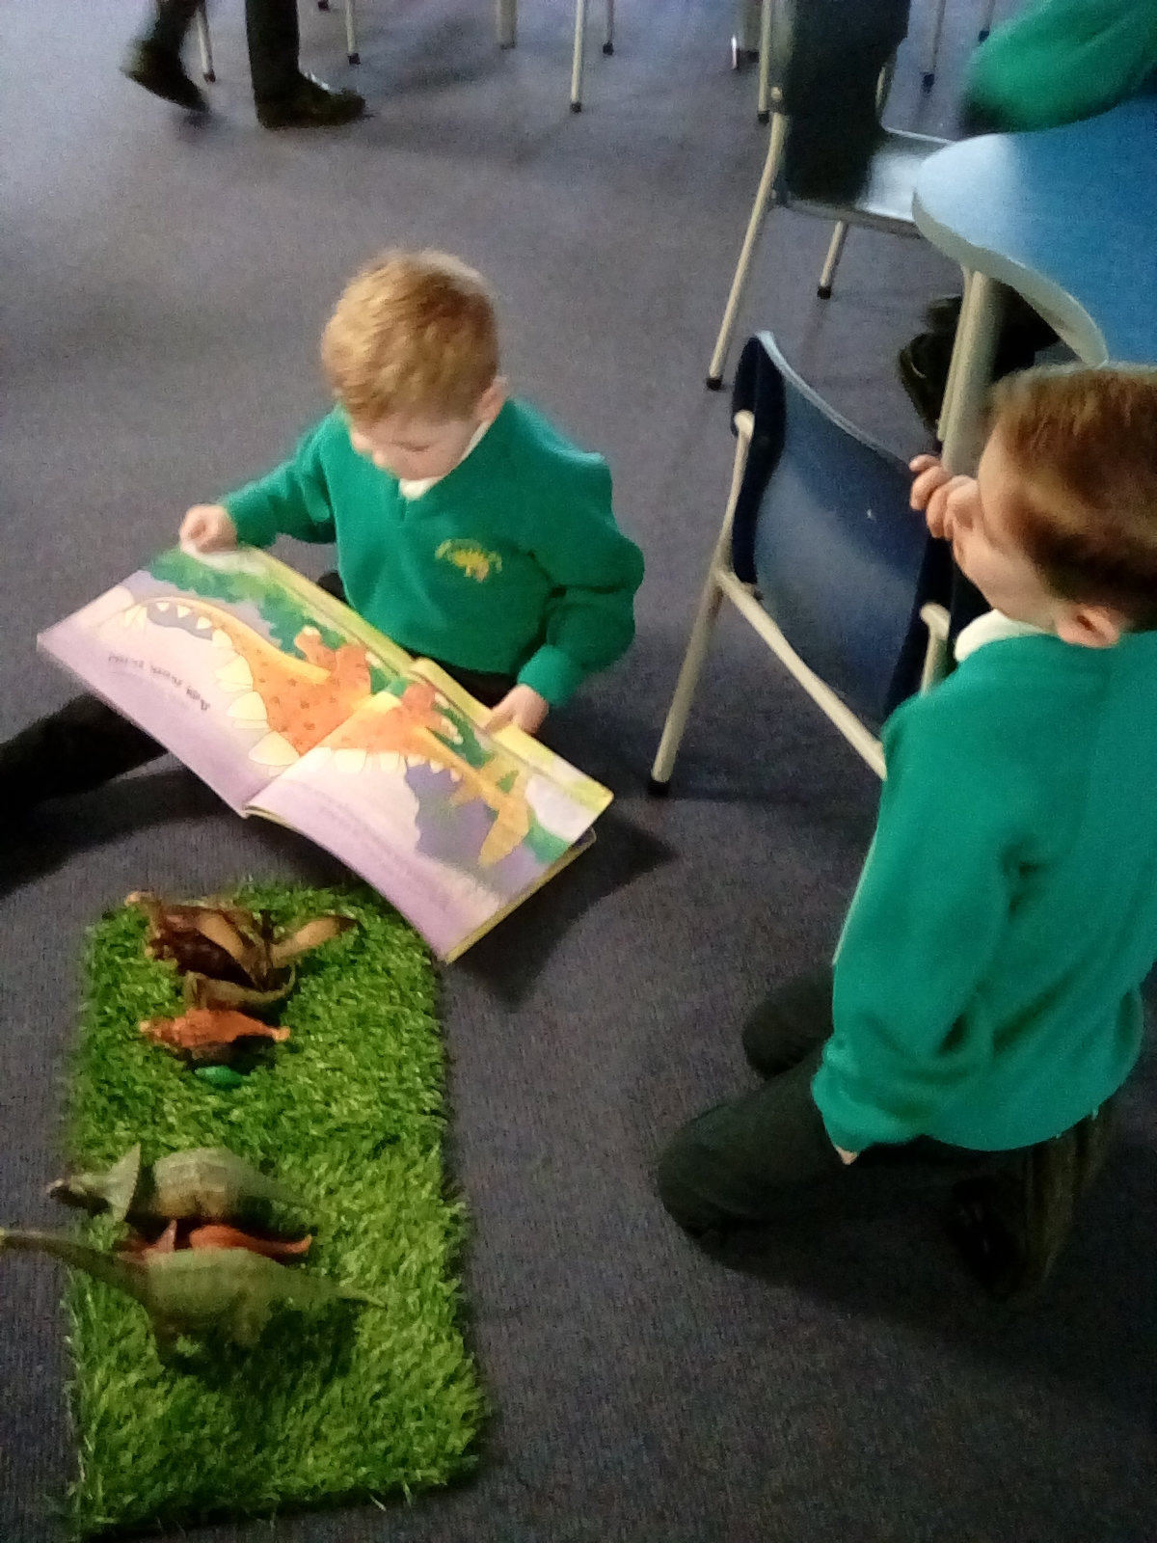
Ready Respectful Safe

Slide 6
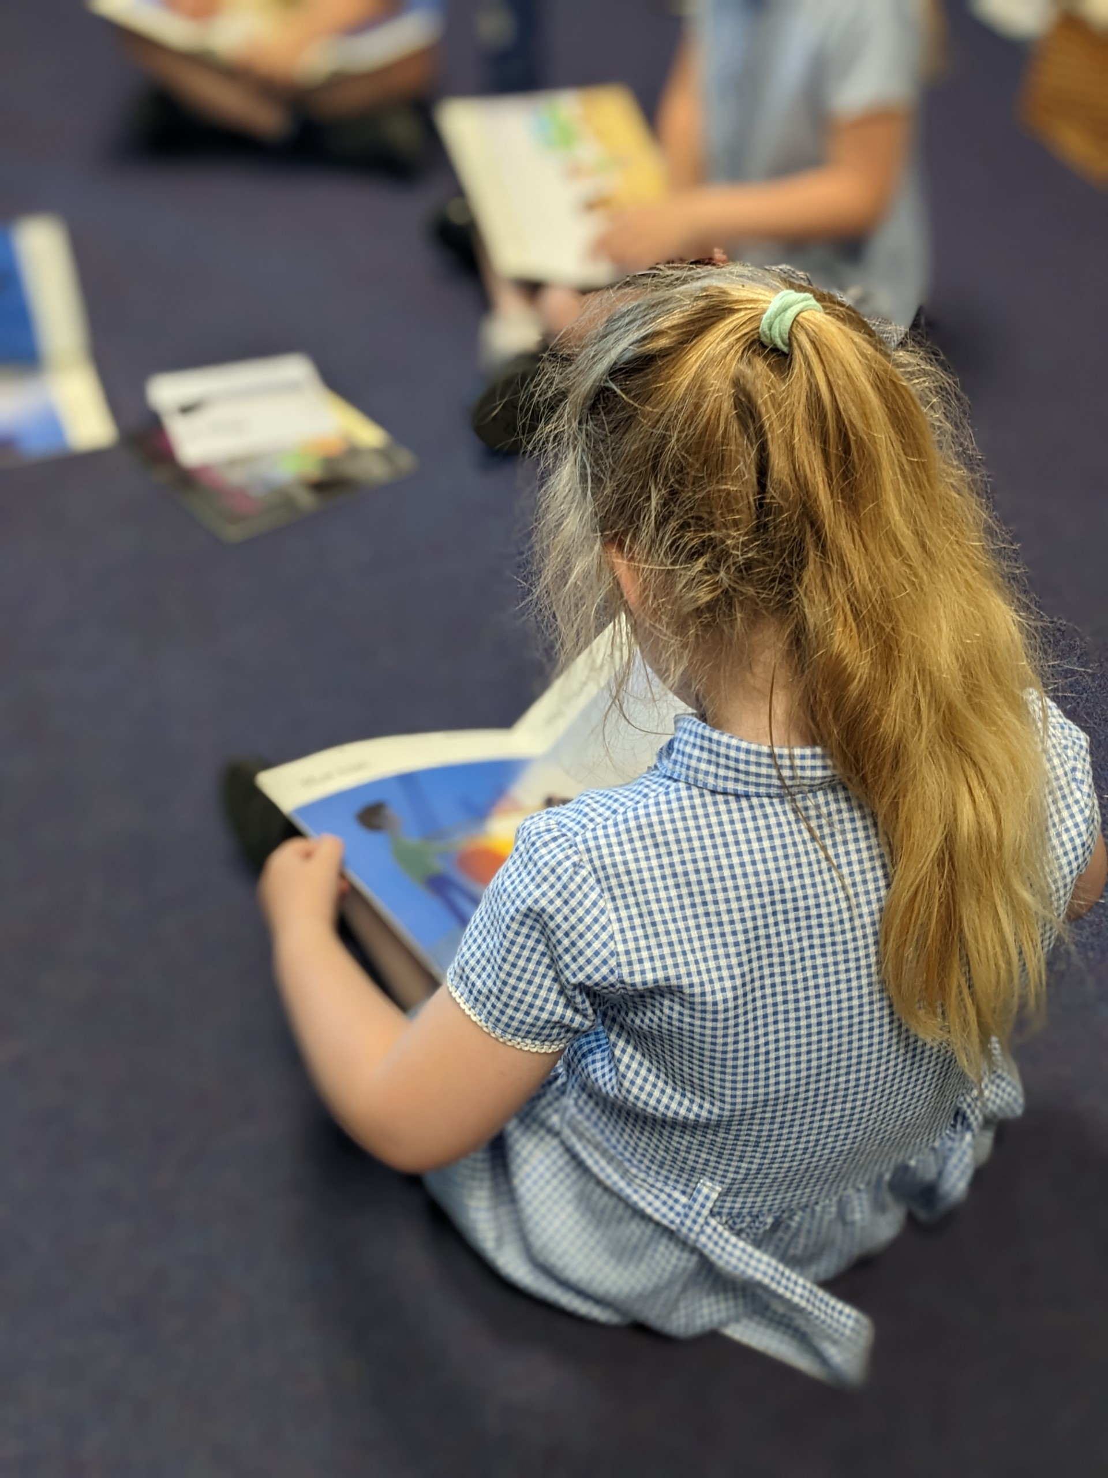
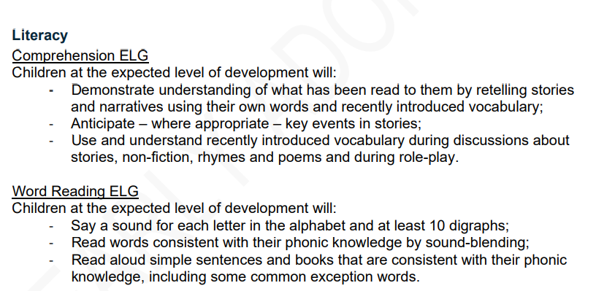
Ready Respectful Safe
What happens if children aren’t ‘getting it’?
Our heat mat assessments diagnose the exact strand the needs additional support; this could be the child’s knowledge of GPCs, word reading, blending, tricky words or automacity (their ability to read the word in their head or immediately by sight).
From this, we provide children with 1:1 catch up sessions each afternoon.
Our phonics tracking and intervention provision shows how well we know our children.
We aim for all children to be reading by Christmas.

