Slide 1

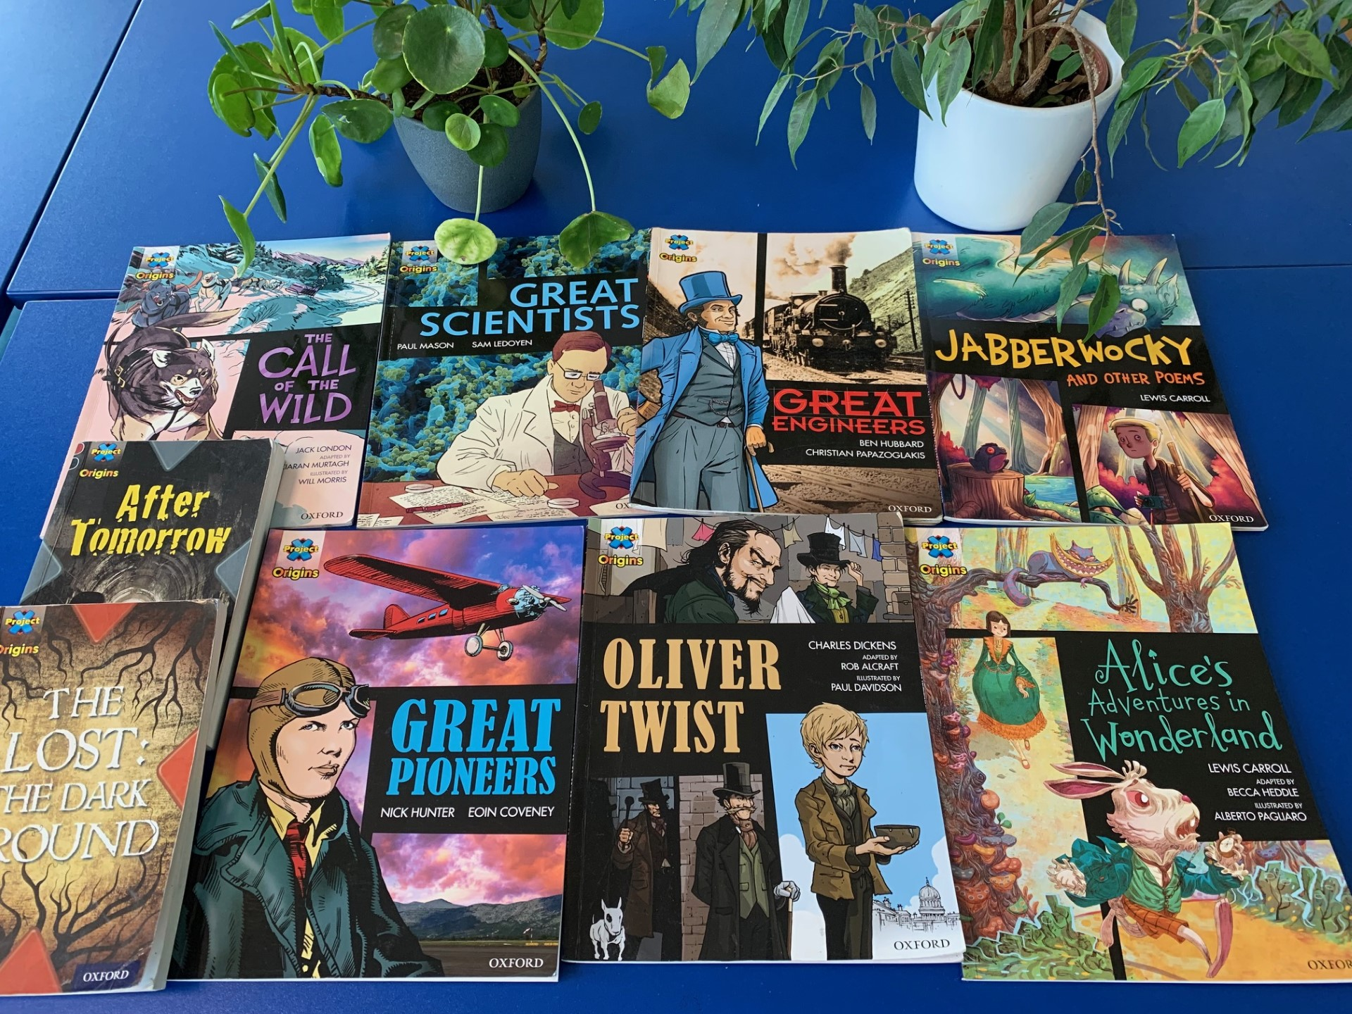
Ready Respectful Safe
Welcome to Reading in Year 6!
Our aim in Year 6 at Muscliff is to:
Instil lasting habits and a love for books (for children’s life beyond Muscliff)
support children to recognise the positive impact of reading on their mental health and well-being
develop children’s book talk as critical thinkers
recognise perspectives and motives in literature
instil curiosity for exploring a variety of reading material and for sources of research
recommend books and authors in our culture of reading
to support the development of pupils’ language and vocabulary.
In Year 6, we understand that:
critical thinking and book talk encourages children to become critical thinkers. It allows children to become thinkers, speakers and readers
developing reading habits in Y6 children will teach them to prioritise reading in their own lives after they leave Muscliff
reading regularly as a result of these habits will broaden their vocabularies, increase their empathy and introduce them to various perspectives and voices, so long as the reading is kept varied.

Slide 2

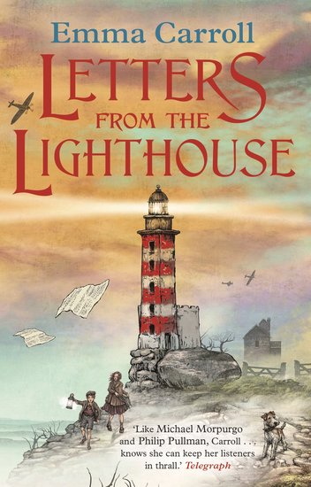
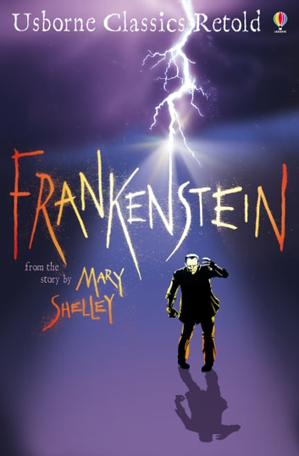
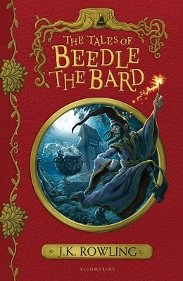

Ready Respectful Safe
Texts
Here is a reminder of our lead texts in Year 6, which we use for guided reading.
Year 6 End of Year Expectations Read age-appropriate books with confidence and fluency (including whole novels). Read aloud with intonation that shows understanding. Explain and discuss their understanding of what they have read, drawing inferences and justifying these with evidence. Summarise main ideas, identifying key details and using quotations for illustration. Evaluate how authors use language, including figurative language, considering the impact on the reader. Make comparisons within and across books and evaluate their usefulness.

Slide 3
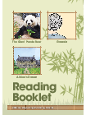
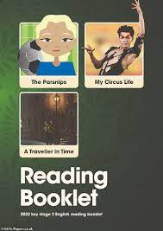
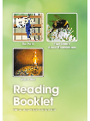
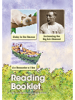
Ready Respectful Safe
What does a typical reading session look like in Y6?
Our primary source of high-quality guided reading texts is actually our lead English text. In studying our class text thoroughly, children become fully immersed in the style of literature and have the opportunity (and time) to explore the book fully with the supportive discussions led by the teacher. The impact is cohesion; children are able to develop their reading skills whilst also developing high quality book talk. Here’s where the quality book talk really shines through and it is evident the moment you step into a reading session! We spend plenty of time exploring how the author uses key features and the impact it has on us as the reader. We get to grips with characterisation and the devices the author uses to create this. We unpick the language and vocabulary carefully recognising that this is key to children’s development as readers. At Muscliff, we believe that reading should be developed within context.
Of course, let’s not forget the elephant in the room: SATs. We spend time familiarising Year 6 pupils with the format of SATs tests. SATs tests are dissimilar to our regular day to day reading practice. Whilst at Muscliff we prefer to fully immerse ourselves in one text for a number of weeks to allow time to fully explore themes, plots and characters, SATs presents children with 3 short texts to read, understand and answer in 1 hour! To this end, it is important that we also expose our Year 6 children to shorter, ‘bite-sized’ material that they need to digest in a short period of time. The text is then followed up with a wide range of comprehension questions that test all of the skills of comprehension.
We use CGP books and past SATs reading test papers as part of our daily reading practice at various points of the year (increasing as May approaches and then deceasing completely after test week). This data is used to support Y6s teaching

Slide 4
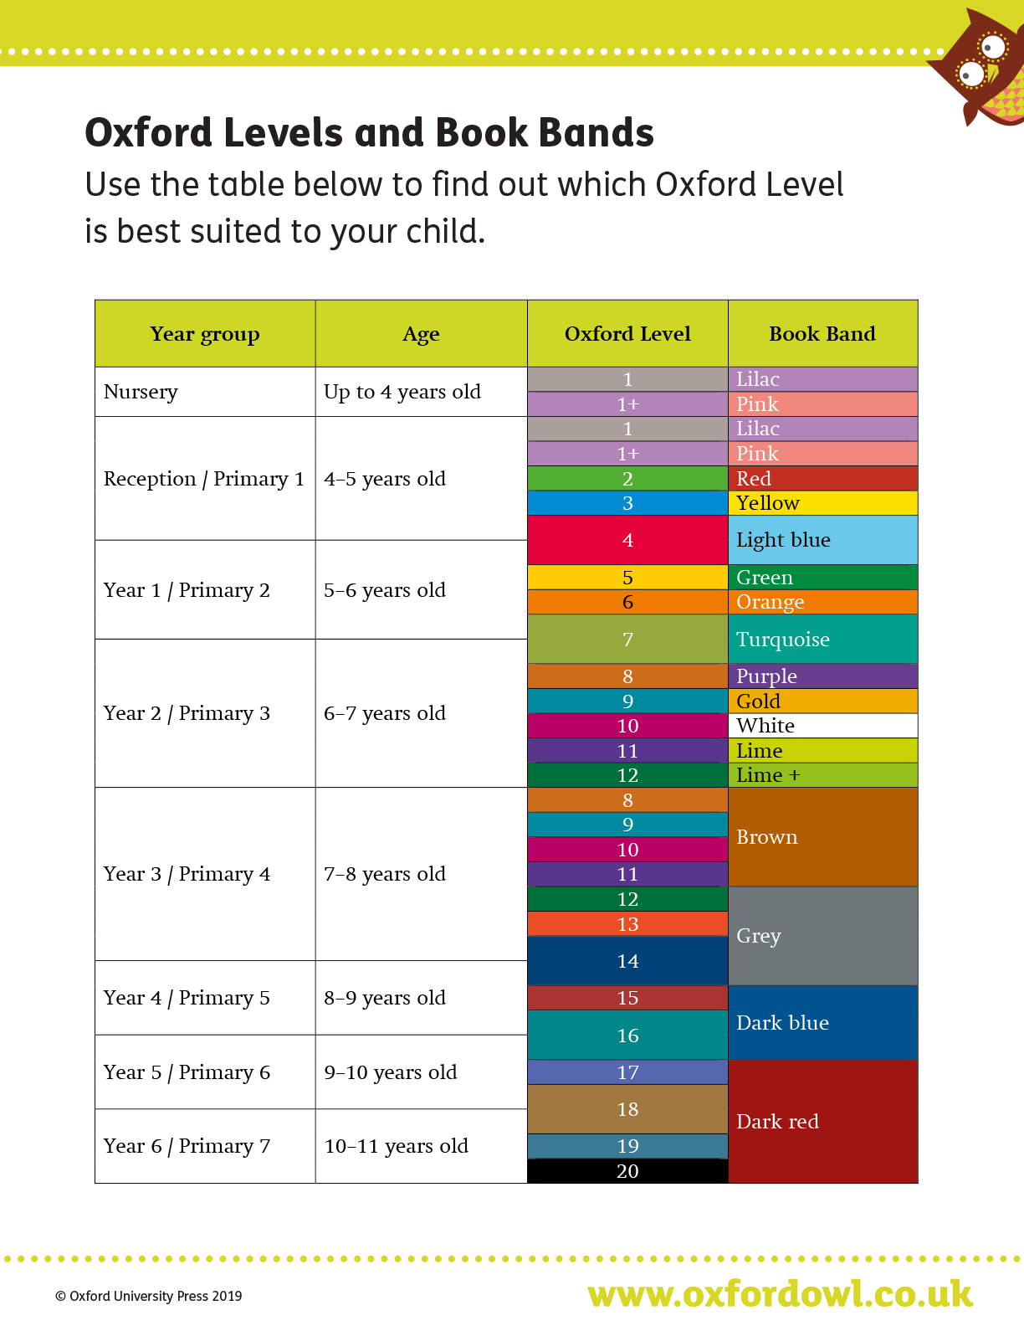
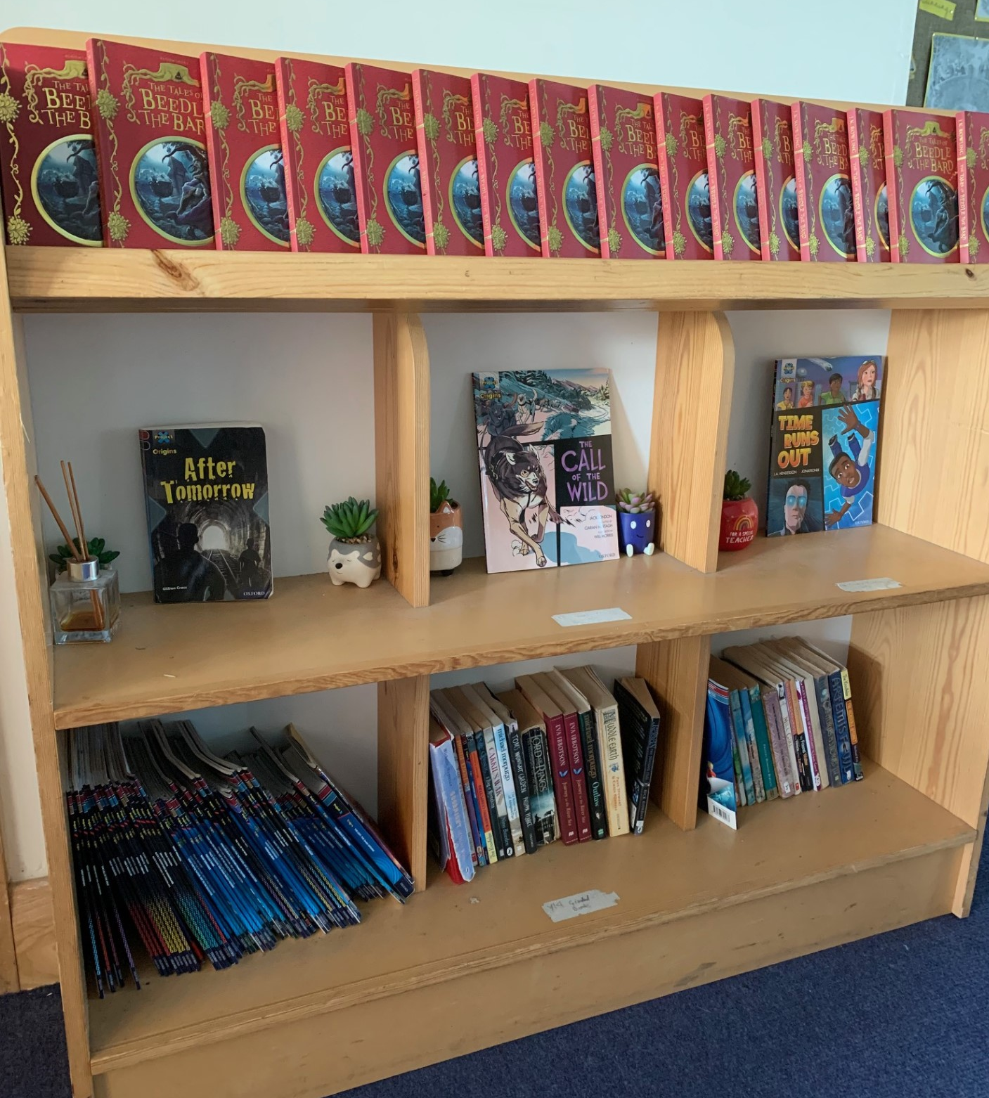
Ready Respectful Safe
Which books will my child read?
Although at this stage in their reading development, most children read a book that is of their choice, we still encourage children to choose a colour banded book. We have a wonderful selection of Dark Red and Dark Red + books to provide children with the right challenge.
Where children read their own ‘pleasure’ book, this is monitored carefully by the Year 6 staff to ensure that their choice of book is appropriate. Where children bring to school a book that is not challenging, we discuss healthy reading habits and support the child to choose a more appropriate book. Teachers tie together their knowledge of the child and their knowledge of children’s books to recommend the best books.
In practice, we find that our children are also experts at recommending books! Through their developing book talk and love of books, we find that it’s the children who are able to recommend new (and old) books to the class. We are proud of their skills at seeking out the best books and how their excitement for their book inspires their peers to give it a read!
Alongside our lead text, we have chosen further books that complement the unit - we call this our Reading Spine. This reading list is bespoke to us and each book has been chosen purposefully by our wonderful teachers. We encourage children to read books from this list (look out for the reading stars that the children wear on their jumpers) and we love to explore these books as a class book at the end of the day.

Slide 5
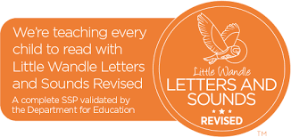
Ready Respectful Safe
Phonics and Intervention in Year 6
Older students struggling with reading may have gaps in their phonics knowledge and it is important to assess and establish what those gaps are. For example, although all of our Year 4 children have had comprehensive teaching of phonics in YR – Y2 following the Little Wandle programme, they may struggle to apply phonic knowledge when decoding new multi-syllable words. Showing them how to find the vowels and then the syllables may enable them to activate their existing phonic knowledge. On the other hand, the difficulties of an older struggling reader may involve the Language Comprehension continuum of the Simple View of Reading (SVoR). Phonics intervention may not be helpful for those students and instead they will need assistance with developing their understanding of vocabulary, how texts work and how to infer.
Year 6 use ongoing-assessment effectively to identify where pupils are struggling in word reading, reading fluency or language comprehension and when pupils require additional targeted support.
Where phonics is identified as the main barrier to progress (and using Year 2 phonics re-set test data), Year 6 use the Little Wandle rapid catch-up programme. This would be delivered as a small group intervention although is more likely to be 1:1 depending on the specific needs of the learners.
Dyslexia Intervention in Year 6
At Muscliff, we use Project X Code (Oxford) to support children with dyslexia. Project X CODE is a proven reading intervention programme and combines phonics and comprehension development. In each book, text 1 is 100% decodable to build confidence and develop vocabulary; Text 2 is 80% decodable to challenge children and deepen comprehension. We chose this intervention programme as is it dove-tailed well into our whole school reading scheme and was selected after teachers conducted research as part of a CPD programme of enquiry. Over the time, we have closely monitored the progress of the children using ‘code’ and their engagement in the books has remained high throughout. Steps of progress have been continually made, which keeps the children enthused and eager to read more. We regularly monitor the progress being made by the children and gain regular feedback from TAs supporting those children. We can see small steps being made daily (this really engaged and enthused the children) which contributes to progress across the year.

Slide 6
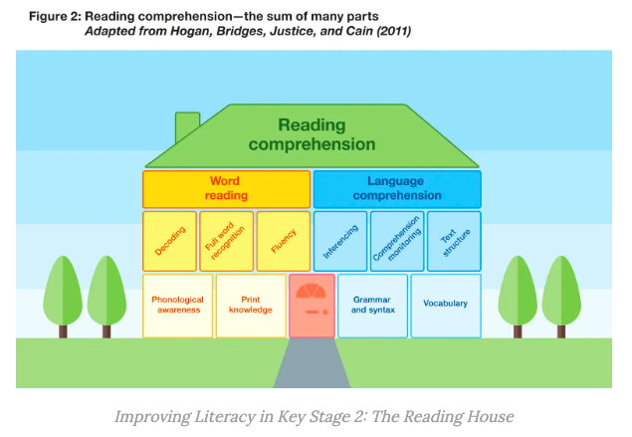
Ready Respectful Safe
Year 6’s Evidence-Based Research
The Reading Comprehension House (Hogan et al., 2011)is a visual concept that supports Y6 teachers in ensuring that the guided reading sessions are effective in supporting the reading process. The Reading Comprehension House concept suggests that the different elements develop in stages. The foundations of reading are considered to be phonological awareness (hearing and distinguishing sounds in speech), grammar and syntax (which develops as a child’s language grows) and vocabulary. With these elements in place, the next “floor” can be developed. This includes learning letter- sound correspondences, developing an understanding of inferencing, monitoring understanding of the text and learning about how texts are organised. The Reading House also illustrates the distinction between language comprehension (SVOR) and the product of both word reading and language comprehension in reading comprehension.
This visual concept reminds Y6 teachers that children may be at different stages of reading development.

Slide 7
Ready Respectful Safe
Year 6’s Evidence-Based Research (continued)
The goal of teaching reading is to enable children to comprehend written texts. To do this, pupils need to build both word reading and language comprehension skills. These two key components of reading are supported by a broad academic consensus and underpinned by research evidence. The ‘reading comprehension house’ below illustrates that word reading and language comprehension are underpinned by a number of other building blocks of reading. These component parts build on one another and connect together as children learn to read.
The left-hand side of the house illustrates that to become proficient at word reading, children need to build an awareness of the sound structures of language (phonological awareness) and knowledge of how language is represented in writing (print knowledge). This will support pupils to learn how to decode, translating written words into the sounds of spoken language. Skilled readers begin to recognise some full words automatically after repeated encounters with them and learn to read with fluency.
The right-hand side of the house illustrates that to build strong language comprehension skills, pupils need to develop an understanding of grammar and syntax and build up a wide-ranging vocabulary. They will also need to learn how to make inferences (using information in a text to understand things that are implied rather than explicitly stated) and monitor their own comprehension as they read. Additionally, pupils need to learn about different text structures and genres.

Slide 8
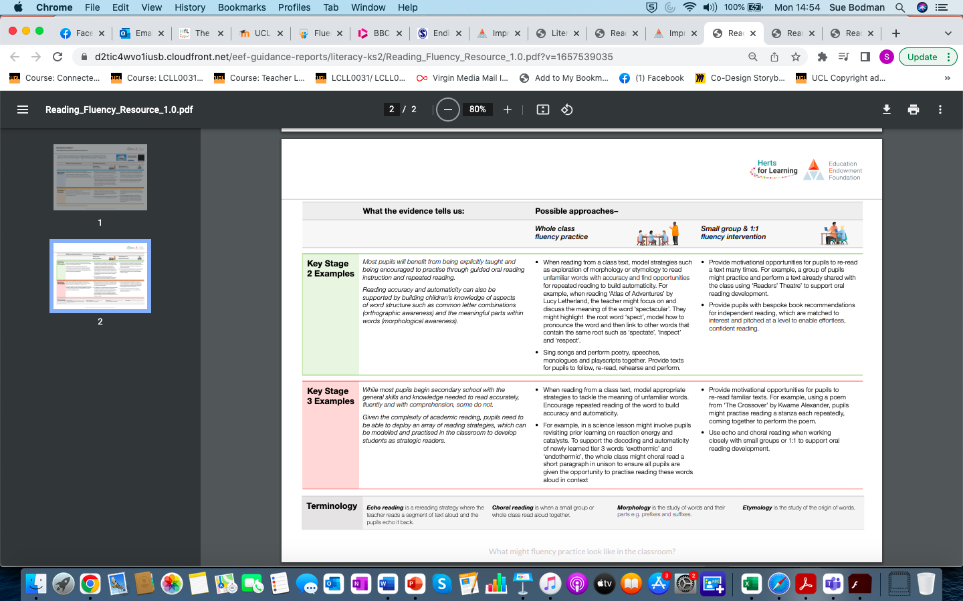
Ready Respectful Safe

