Slide 1

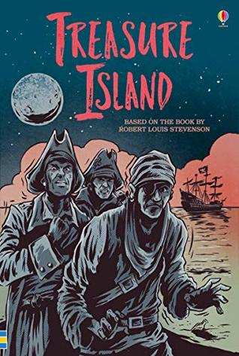
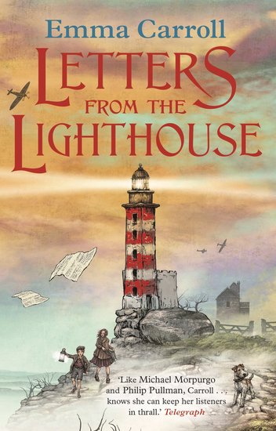
Ready Respectful Safe
Autumn 1
Lead Text: Treasure Island
Value: Curiosity
I identify, replicate and explore the author’s use of clause structure to develop my own sentence construction.
I use more complex and adventurous sentence construction and am confident to ‘play’ with my sentences by moving the order of clauses.
I can say what difference moving a clause makes to the reader’s experience.
I continue to become more secure with sentence punctuation.​
​I use modal verbs (and auxiliary verbs) for simple and progressive tenses as well as sentences of possibility (would, could, should, might, must…)​.
​I spell patterns _Ible/_able, _Ibly/_ably and spellings containing _fer​.
Progress Check:
Children will develop skills in extended story writing with a focus on how authors use clause construction to add detail; little added details help to engage their reader. We will also aim to enrich the children’s vocabulary so that their written language sounds correct to the task and the genre. It sounds so much better to say, ‘Jim heaved himself up the rigging,’ than ‘Jim went up the rope’!
A diary extract will be written by the children to show the correct use of tenses. Diaries are naturally written in different tenses, including past, present and conditional tenses and this task presents the perfect opportunity to unpick our use of verbs.
Autumn 2
Letters from the Lighthouse
Value: Resilience
I can copy and correctly use some of the specific vocabulary in the book that is relevant to the 1940s.
I absorb and can use figurative phrases from the book that help show that the book is set in the 1940s. For example, ‘the bee’s knees.
I can use metaphors, alliteration, repetition, personification and onomatopoeia.​
I correctly use possessive apostrophes and consider irregular plurals alongside possessive apostrophe. For example, the difference in meaning between ‘the babies’ toys’ and ‘the baby’s toys’.
I use speech punctuation to add to the narrative. ​
Progress Check:
By the end of the unit, children will have developed the skills to be able to describe an air-raid in realistic detail. The children’s character might be sat in the red velour seats of their local cinema. Perhaps they are watching Judy Garland in The Wizard of Oz. Suddenly, the lights come on and the familiar sound of the air-raid siren begins… ​ This piece of writing will be successful if it sounds like it is set in the 1940s.

Slide 2
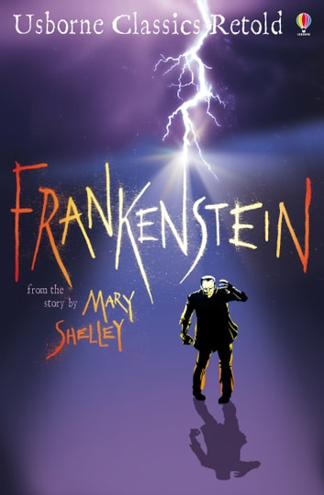
Ready Respectful Safe
Spring 1
Frankenstein (part 1)
Value: Responsibility
I can use more advanced punctuation techniques, such as the ellipsis and dash as a way of supporting the intent of my sentence.
I use an ellipsis to trail off but a dash to be more abrupt.
I enhance direct speech using dashes and ellipses.
I can imitate Mary Shelley’s sentence construction.
I can change the pace of my sentence by controlling clause structure.
I can identify the passive voice.
Progress Check:
At the end of the half term, Y6 will produce a cross-genre piece: on one side of the page, they will write a non-fiction scientific report about the heart and describe how it functions; on the other side of the page, they will write a very tense narrative that showcases all of their skills and describes how Victor dissected the heart for his scientific experiment as he fights his moral compass with his thirst for knowledge.
I can use apostrophes for possession, including irregular plurals: In the following example, both are correct but have different meanings: the city’s buildings are big, the cities’ buildings are big.
I can use modal verbs to suggest what Victor could have done differently
I can write in a formal tone, using the correct level of formality, avoiding contractions and using the appropriate vocabulary.
I can begin to use the subjunctive voice: If I were Victor, I would have…
I can understand and use the passive voice: the creation was corrupted by a prejudice society.
I use reported speech: the creation said that he was neglected.
Spring 2
Frankenstein (part 2)
Value: Kindness
Progress Check:
Children write a letter of complaint from Victor’s neighbours; they are concerned about the noise and disturbance during unsociable hours. This is a formal piece of writing so the style and language need to be fitting.
Children write a newspaper report; some children choose to write about the giant spotted in the woods, some children write about the lightning storm, some children choose to write about William’s tragic death. Whatever the children choose to write about, they must organise their work correctly and use the correct style and tone associated with reports.

Slide 3
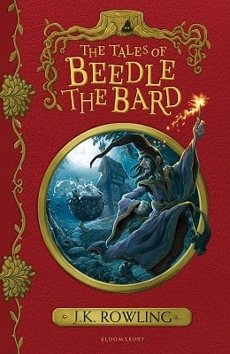
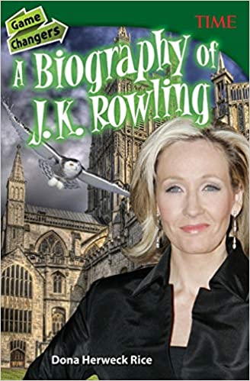
Ready Respectful Safe
Year 6
The Tales of Beedle the Bard
Value: Aspiration
I use vivid description to create tension and atmosphere
I use nature as a tool to signpost the mood of the story.
I can use direct speech (including speech punctuation and a reported clause) to show characterisation
I talk about etymology and can understand where words come from, exploring prefixes and suffixes.
I can edit my description to add to the reader’s experience.
Progress Check:
Children will write a short story. Description, description, description! This piece is always one of our favourites and the children get an opportunity to put into practice all of their story telling skills as they lead three characters from safety to uncertainty.
Year 6
A Biography of JK Rowling
Value: Aspiration
I write in the correct style associated with biographies (for example chronological order).
I can use paragraphing to organise relevant information.
I choose vocabulary that is appropriate to the person.
I can create empathy with the reader by describing feelings and moods.
I confidently use conjunctions of cause and effect.
I create cohesion in and across paragraphs by making links.
Progress Check:
Children will write an autobiography. They will look back at their many success and achievements over their years at school and attempt to capture emotion in their words. Autobiographies will be shared at their Leavers’ Assembly.

