Slide 1

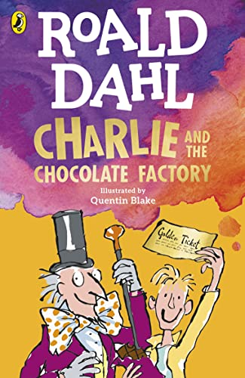
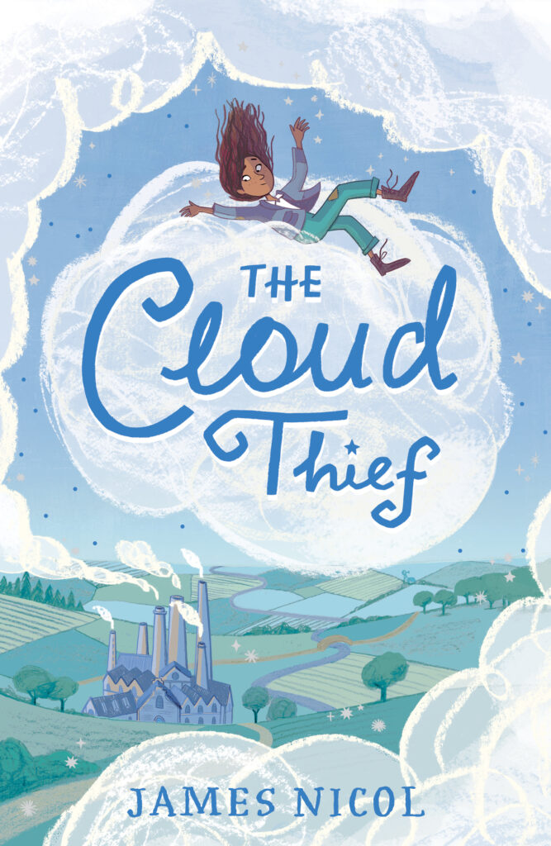
Ready Respectful Safe
Autumn 1
Lead Text: Charlie and the Chocolate Factory
Value: Kindness
I understand that the starting point to a well-developed sentence must be an accurate basic sentence.
I consider the choice of verb as an important building block.
I use a more ‘grown-up’ thesaurus to support language development.
I use full speech punctuation in developing my characters.
I avoid a speech ‘tennis match’ between characters and only use speech when it is purposeful and has an impact on the narrative.
I create a powerful reported clause to add value to the direct speech.
Progress Check:
Throughout this English unit, a key focus will be to understand how Dahl makes his character descriptions so successful. To assess the children’s writing skills children will be write a developed piece of work that describes Charlie’s reaction to the glass elevator at the end of the story. Your child will try to capture the awe and wonder of this scene and describe in great detail Charlie’s reaction. The direct speech and interaction between characters that develops the scene should be a key feature of this piece of work.
Autumn 2
Lead Text: The Cloud Thief
Value: Responsibility
​
I use figurative language, including simile/metaphor and personification.​
I can consider manipulating sentences by reordering and understand the changes this has on my reader’s experience.​
I use relative clauses to provide extra detail.​
I am confident in using adverbials of time, manner and place.​
Progress Check:
Towards the end of this unit children will re-write a descriptive scene . Using the skills mentioned above, children will describe the awe and wonder of amazement at seeing this world for the first time. Children’s work will be assessed using the skills taught within this unit as well as previously taught skills.​

Slide 2
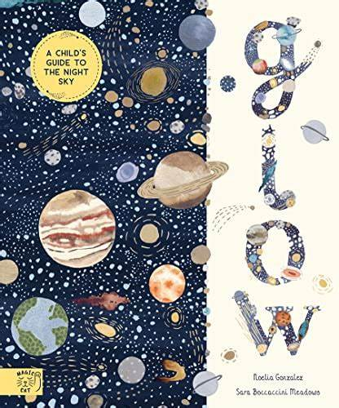

Ready Respectful Safe
Spring 1
Lead Text: Glow
Value: Curiosity
I can use a range of clause types within varied structures.
I write parenthesis using brackets and dashes.
I use adverbial and prepositional phrases to support cohesion.
I can use a semi-colon.
I recognise the difference between formal and informal.
I can use a thesaurus to select more formal vocabulary.
I have a secure knowledge of a wider range of tenses, and the different verb forms of ‘to be’.
Progress Check:
Throughout this unit, Year 5 will develop their formal, non-fiction writing skills based around our beautiful text. They will also develop our skills of recall and accuracy when writing a recount of our visit to Winchester Science museum.
Spring 2
Lead Text: Who Let the Gods Out
Value: Kindness
I can use humour to develop characters.
I can describe emotions to develop characteristion.
I use speech (and associated punctuation) to bring the characters to life, including a reported clause.
I use figurative language – alliteration, similes and metaphors into my writing.
Progress Check:
As perspectives are an important feature of the text, children write a letter of complaint to show different points of view. (Of course, making the complaints as ridiculously funny as possible is important!)
Diaries allow another opportunity to consider perspectives and view points.

Slide 3

Ready Respectful Safe
Summer 1
Lead Text: Wonder
Value: Kindness
Perspective is a key skill to unpick this half term. The book is presented from different view points, sometimes retelling the same event but from someone else’s perspective. Being an efficient writer means that you are able to write purposefully from a range of perspectives. When we write from the viewpoint of someone else, it is necessary to adapt our style so that the writing ‘feels’ like it has been written by that person. But how do we do this? In this unit, Year 5 consider how Palacio writes to give each character their own voice.
I can identify formal and informal style in writing
I can use parenthesis and vocabulary to add informality
I can infer the meaning of language from a text
I can identify and use the passive voice
Progress Check:
Y5 children will be challenged to write from different perspectives.
Children will all write a letter to the school but from various perspectives. Some children will write to the teacher from Auggie explaining how he feels about starting a new school. Some children will write a formal letter from mum to school to explain her son’s (Auggie) needs and apply for a place for Auggie. Other children will write a formal children from the headteacher to Auggie’s mum to reassure her that Auggie will succeed at his new school
Summer 2
Lead Text: Wonder
Value: Aspiration
It’s all about editing! When Year 5 edit their work, the process goes beyond simply spotting and correcting errors. It even goes beyond using a thesaurus to improve word choices. By the end of Year 5, we want children to develop the confidence and ability to make more significant changes to their written work through drafting and redrafting.
I can plan my work in a variety of ways, suggesting which planning method is best suited to the needs of the task and my own personal preference.
I can draft initial ideas and group these in potential paragraphs.
I can use words and phrases from my wider reading and stitch these into my own work.
I can spot errors and correct these myself.
I can identify potential to improve my writing based on my knowledge of the Year 5 skills.
I can make changes to my work based on feedback.
Progress Check:
Y5 children will be challenged to use their descriptive skills in a more mindful way. Would a setting description be different if written from the perspectives of different people? How might the ideas of a person with a hearing impairment be different to that of someone who is blind?
Children will write a setting description of a forest with some senses removed.

