Slide 1


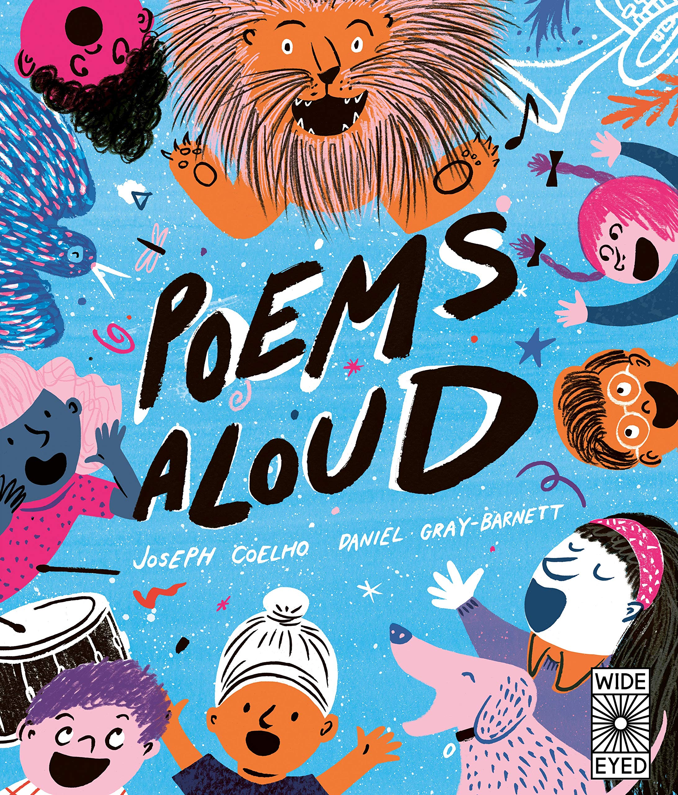
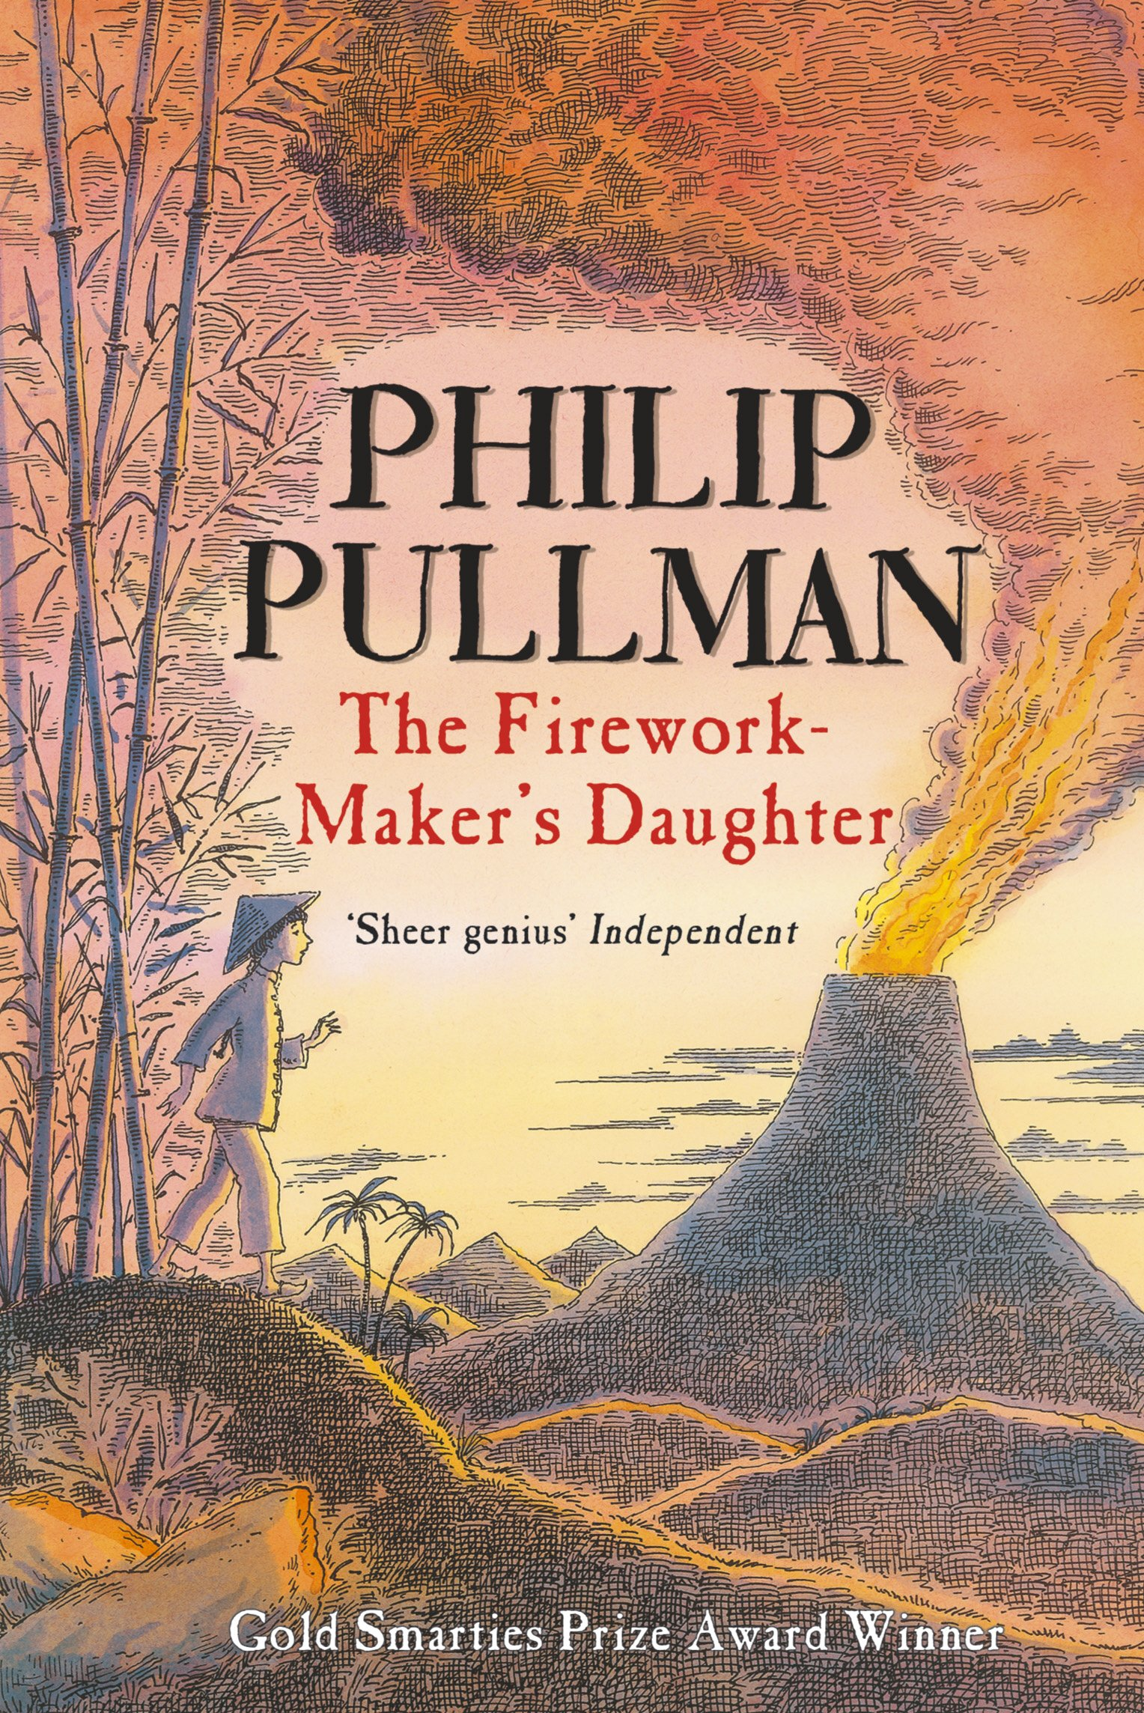
Ready Respectful Safe
Autumn 1
Lead Text: The Butterfly Lion
Value: Kindness
I use a range of phrases to enhance my sentences (noun phrases, prepositional phrases and adverbial phrases).
I begin to be more specific in my identification of pronouns.
I recognise and use a range of tenses, including past progressive (was playing) and past perfect (had played). ​
I am increasingly more specific in my language choices.
I replicate Morpurgo's vocabulary choices on two levels: firstly, I use very carefully chosen language to create vivid images. Secondly, with support, I can use some old-fashioned words to help set my work in a different period of time to today.
Progress Check:
Re-writing the scene where Bertie says goodbye to his lion gives the children an opportunity to use all of the skills mentioned above. Teachers will be assessing the child’s level of basic accuracy first and their use of phrases. Teachers will consider how the children have absorbed our key vocabulary and the active language choices they have made as well as the topic-specific language discussed in the unit.
Autumn 2
Lead Text: Poems Aloud, The Firework Maker’s Daughter
Value: Resilience
I can recite poems using various techniques, such as: rhythm, volume, pace, building to a crescendo or reducing to a diminuendo.
I match techniques to the style and tone of the poem.
I can follow a set pattern to write a new poem that follows the same structure.
I can talk the common structure of fairy tales.
I identify common characteristics of heroes and villains and unpick the moral element of any fairy tale, regardless of its cultural origin.
I can build on my story telling skills so that I can replicate a story that demonstrates a moral.
Progress Check:
Children write a fairy tale, similar to a traditional tale, but based within a different culture.

Slide 2
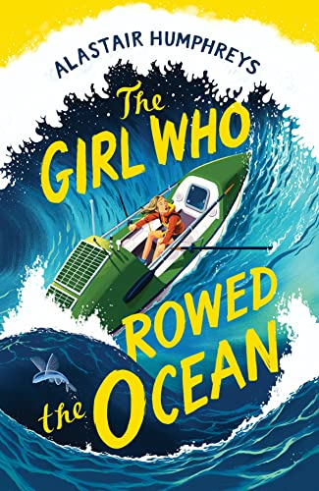
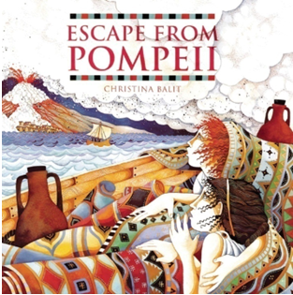
Ready Respectful Safe
​
I can plan my writing using a range of planning methods.
I can choose a planning method that suits the task and suits me.
I can group similar ideas into a paragraph.
I can develop one idea in sufficient detail for the reader.
I use full speech punctuation, including a reported clause.
I can write in different styles and successfully use techniques for a specific style of writing. For example, I write in first person for a diary.
Spring 1
Lead Text: The Girl who Rowed the Ocean
Value: Resilience
Progress Check:
Extended writing opportunities this half term include a dairy that aims to be personal and reflective in the style of the author. In this, we write informally and create a chatty tone. We are open and honest and talk about our feelings. We write about experiences that our reader might also have experienced.
Children also write a telephone conversation that uses full speech punctuation. This includes reported clauses, synonyms for ‘said’ and extra information that adds to the speech.
Spring 2
Lead Text: Escape from Pompeii
Value: Curiosity
I can carefully selecting the best verb for the job and make active choices. I make sure the basic sentence is accurate before I build on my sentence.
I use subject specific vocabulary about Ancient Rome to make my writing sound like it is written by a historian.
I understand how the author uses adverbial phrases of time, manner and place to add another layer of description and replicate these structures.
I use paragraphs.
I develop one idea fully before moving on to a new paragraph.
I can move between paragraphs and make links.
Progress Check:
As descriptive skills are the focus of this unit, the tasks children write will provide opportunities to show-case that learning specifically. Children will describe a busy scene, full of hustle and bustle. They will describe a vibrant scene full of energy. Their end piece will then pull their history knowledge together through a contrasting page; on one side, a highly detailed fictional description of the streets of Pompeii and on the other, a non-fiction set of facts about the same scene.

Slide 3
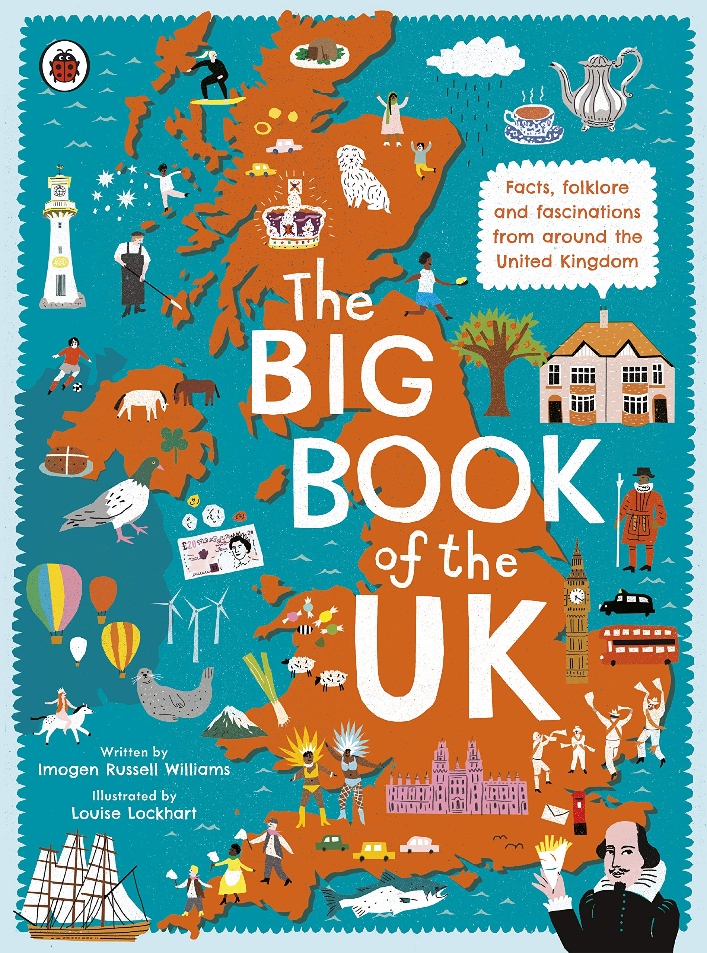
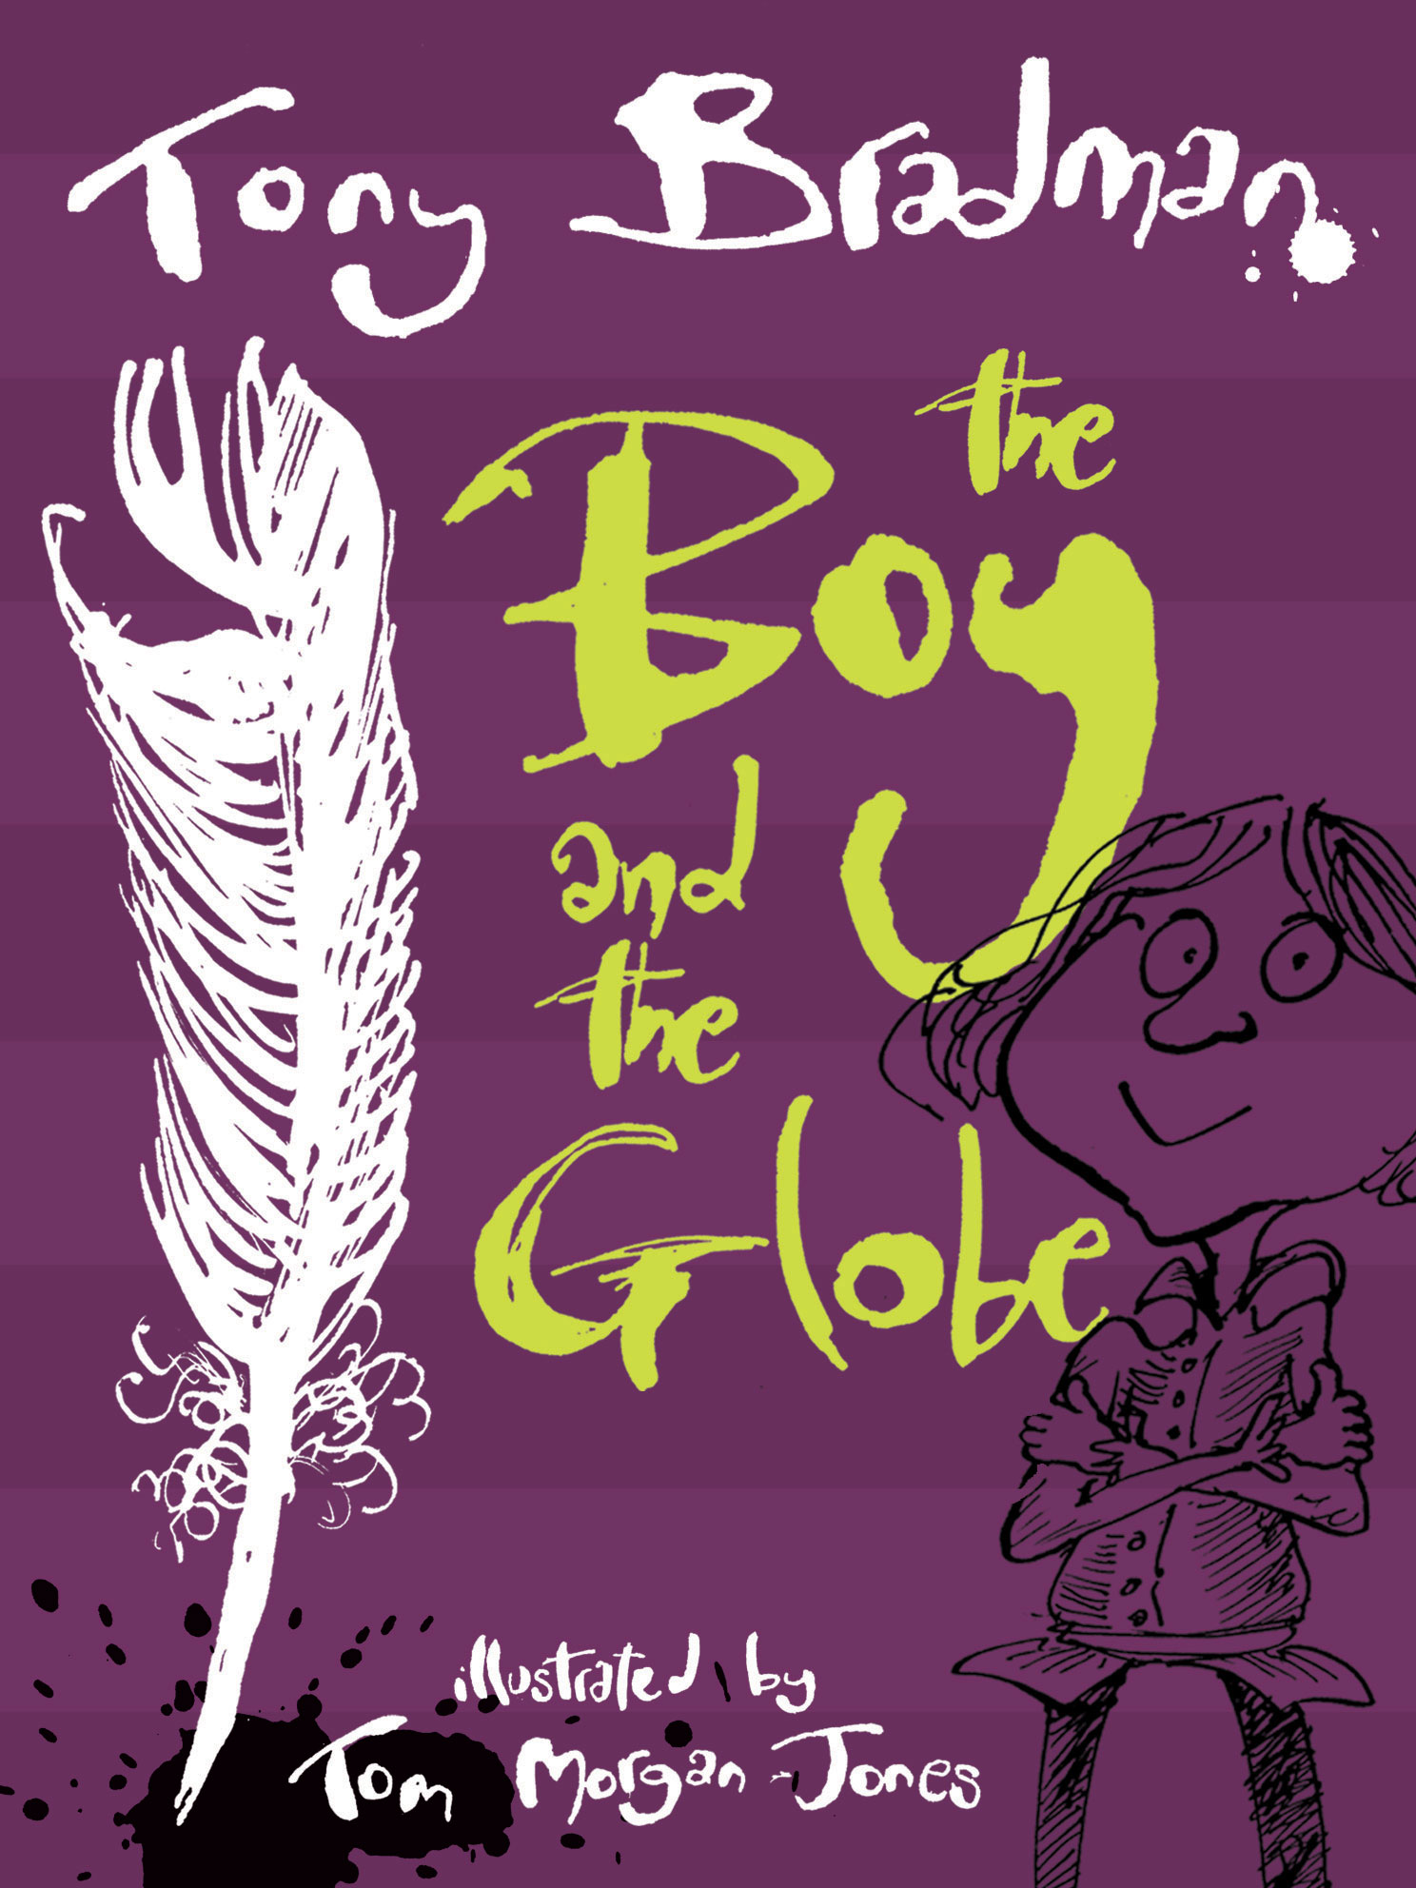
Ready Respectful Safe
Summer 1
Lead Text: The Big Book of the UK
Value: Responsibility
In the Big Book of the UK, the factual information is presented in a way to make the reader want to find out more and even visit the feature being described. Y4 create leaflets using persuasive features; they make their writing appealing so that their reader wants to visit.
I write enticing noun phrases
I can expand a sentence to add appeal to the reader
I read my own writing with intonation to entice the reader
I can link ideas through paragraphing
I use specific vocabulary – sounding like an expert
I use description to support my reader’s understanding
Progress Check:
Hubble, bubble, toil and trouble! Year 4 will describe the three witches’ performance on stage. They make the description so vivid that the reader would want to visit the theatre for themselves.
Year 4 create a leaflet inviting their reader to visit an attraction in the UK. But can Y4 write in a style that entices their reader enough to make them want to visit
Summer 2
Lead Text: The Boy in the Globe
Value: Aspiration
I can use multiple techniques to build characterisation, including: speech, stage directions, body language.
I can adapt speech to show accents, using punctuation to support the informality.
I can research the origin of idioms and sayings and figurative language.
I can use idioms and sayings in my own work appropriately.
I can plan ideas for and against in a balanced argument.
I can group ideas logically to ensure cohesion for my reader.
I can write in the correct style, using the correct level of formality.
Progress Check:
Children will write playscripts using characterisation. They will use stage directions to support the reader in understanding mood.
A balanced argument will give the children a chance to reflect on aspirations: should they sabotage the Rose theatre to make the Globe theatre more successful? Children will explore this idea and construct their answer using the correct style and level of formality associated with arguments.

