Slide 1

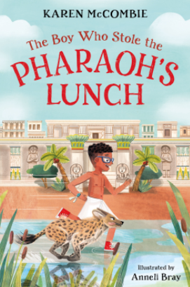
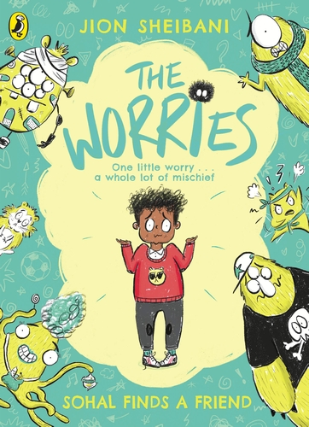
Ready Respectful Safe
Autumn 1
Lead Text: The Boy Who Stole The Pharoah’s Lunch
Value: Curiosity
I create vivid images in my reader’s mind by drawing on the senses.
I am confident with the 4 sentence types: statements, exclamations, questions and commands and consider how these can have an impact on the engaging the reader.
I use the 4 sentence types to invite the reader into my description.​
I use a dictionary and thesaurus to help me make adventurous language choices and acquire new vocabulary.​
I know how different past and present tenses are formed.​
Progress Check:
Using the skills listed above, children will create their own Egyptian Adventure story.
They will also recount their trip to the museum.
Autumn 2
Lead Text: The Worries
Value: Resilience
I can identify the common characteristics of the villains in the book.
I can identify patterns and key themes and replicate these in my own writing.
I can design my own book characters by imitating then innovating ideas.
I can use speech to show how a character behaves.
I can describe a character’s behaviour to show how the character feels.​
I use well-chosen similes.
I use subordination to add information.
I can use modal verbs.
I can write sentences that offer advice, “When you feel like this, you could….” “If you begin to feel…., you might try….”​
​
Progress Check:
Children will create a non-fiction explanation text that details emotions, possible triggers that cause this emotion and then advice on how to manage these feelings.​
Our end piece of work will be a characterisation of a worry. How will the worry act, speak and interact with Sohal?

Slide 2
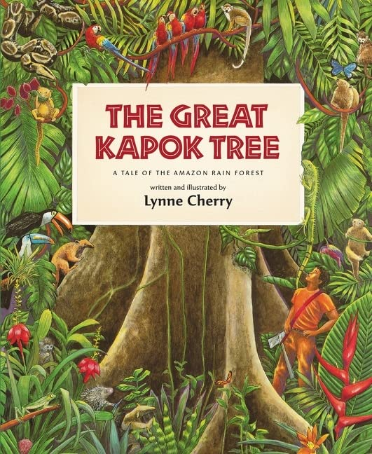
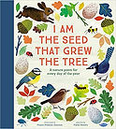
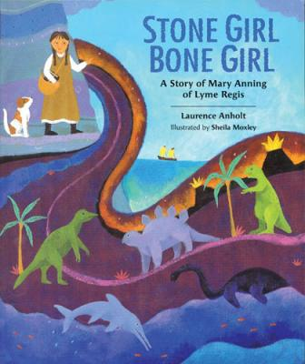
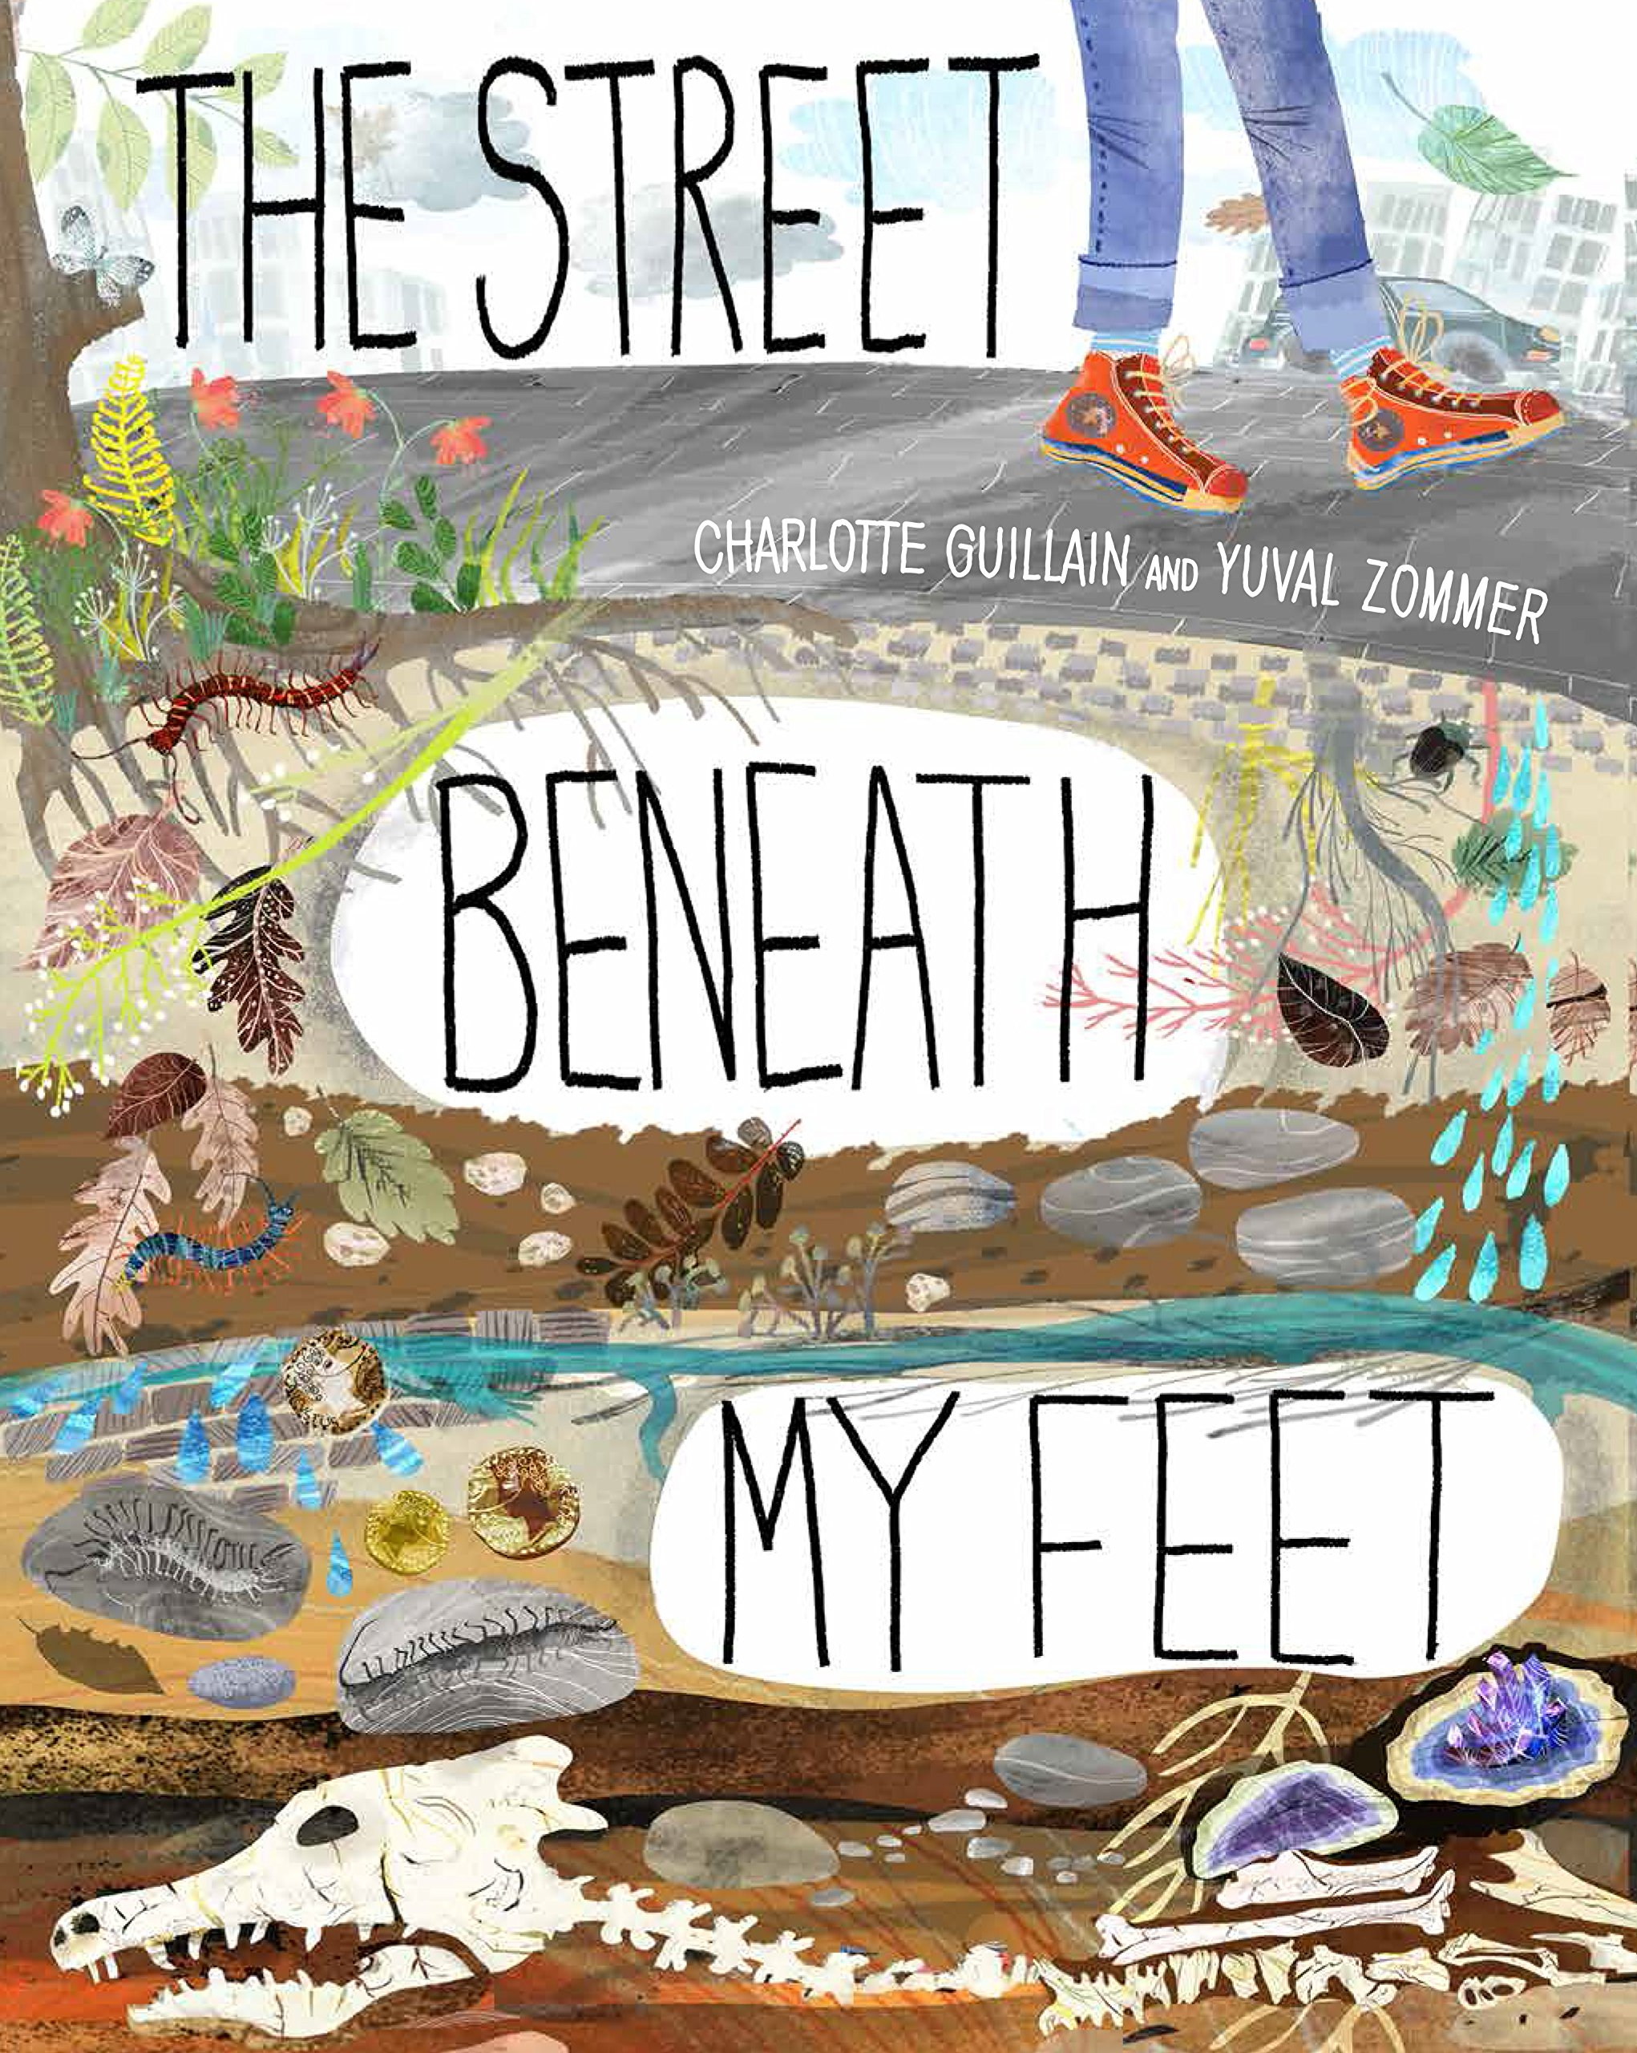
Ready Respectful Safe
Spring 1
Lead Text: The Great Kapok Tree, I am the Seed that Grew the Tree
Value: Responsibility
I can spot patterns and structures in poetry – I can say what stays the same in each verse.
I can replicate structures in poems and say which ideas can be changed in a poem.
I use imagery, similes and metaphors to bring the description to life.
I choose powerful verbs to support the image I want to plant in my reader’s mind. For example, if I said ‘the wind howled’, why is this better than ‘the wind blew’?
I use oun phrases alongside prepositional phrases.
I can perform poems aloud using my voice, body and actions to bring the poem to life.
Progress Check:
Children will imitate a given poem about wild weather. Using that poem as a modelled structure, they will adapt the poem by introducing and adding their own ideas and imagery.
They will write a description of a rain forest, rich in active language choices; children will be asked to use the language they have picked up from the poetry sessions to make their settings burst with imagery for their reader.
Finally, Y3 will create a non-fiction information page about what can be found in the rain forest.
Spring 2
Lead Text:
The Street Beneath my Feet,
Stone Girl Bone Girl
Value: Curiosity
I can use adverbials for chronology.
I use prepositional phrases for clarity.
I use subordination to support the sequence of ideas: ‘When Mary was young,’ ‘As the world was beginning.’
I use possessive apostrophe.
I use commas for a list
I confidently use a range of sentence types (command, question, exclamation, statement)’
Progress Check:
Creation of a set of instructions that are crystal clear for the reader to follow.
An explanation page that is in chronological order.

Slide 3
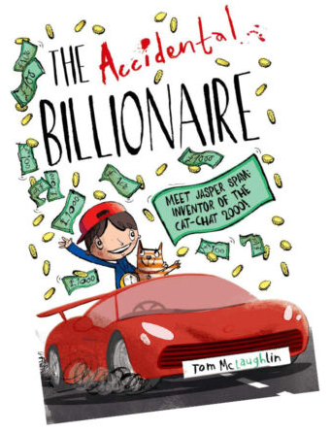
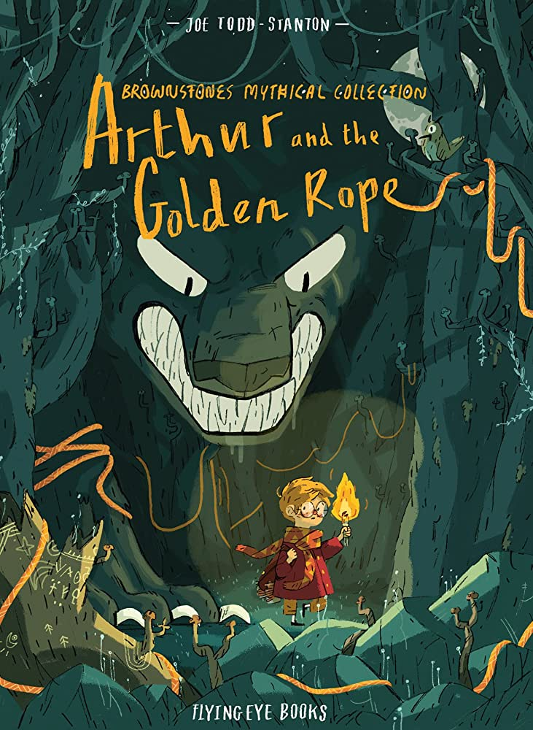
Ready Respectful Safe
Summer 1
Lead Text:
The Accidental Billionaire
Value: Aspiration
We use this book to unpick successful story structures. Stories tend to follow a set formula in that the reader is introduced to a main character, there will be a dilemma, the problem will get worse and then there will be a resolution and the main character will learn an important moral lesson.
I can unpick how the author builds a character that the reader can relate to and like.
I can create a character profile which leads to innovating my own character.
I learn how to plan a story using a range of story maps and plans.
I innovate a problem and an invention
I develop my use of direct speech.
Progress Check:
Children will build a character profile which will make the character’s moral values obvious to the reader – of course, their character will show aspiration and curiosity.
We look forward to the Year 3 children inventing a crazy machine… which goes wrong! This will give a perfect opportunity to describe the dilemma and the outcome.
Summer 2
Lead Text:
Arthur and the Golden Rope
Value: Kindness
I can identify the author’s choices in their text layout.
I can suggest how certain text presentation enhances meaning and supports the reader.
I can explore layout and text organisation to have an effect on my reader.
I can identify the structure of a poem and comment on its rhythm.
I can identify what stays the same and what changes in a poem between verses.
I can make suggestions to replace variables in a poem.
I can create my own poem that follows a set structure.
I can orally perform my poem.
Progress Check:
Year 3 children create a page for a key part of the adventure that shows unusual and purposeful organization. They explore how different text layouts engage the reader and will experiment with this interesting technique themselves to enhance their story telling.
Children will also modify a poem (that follows a specific structure) which they will orally perform.

