Slide 1

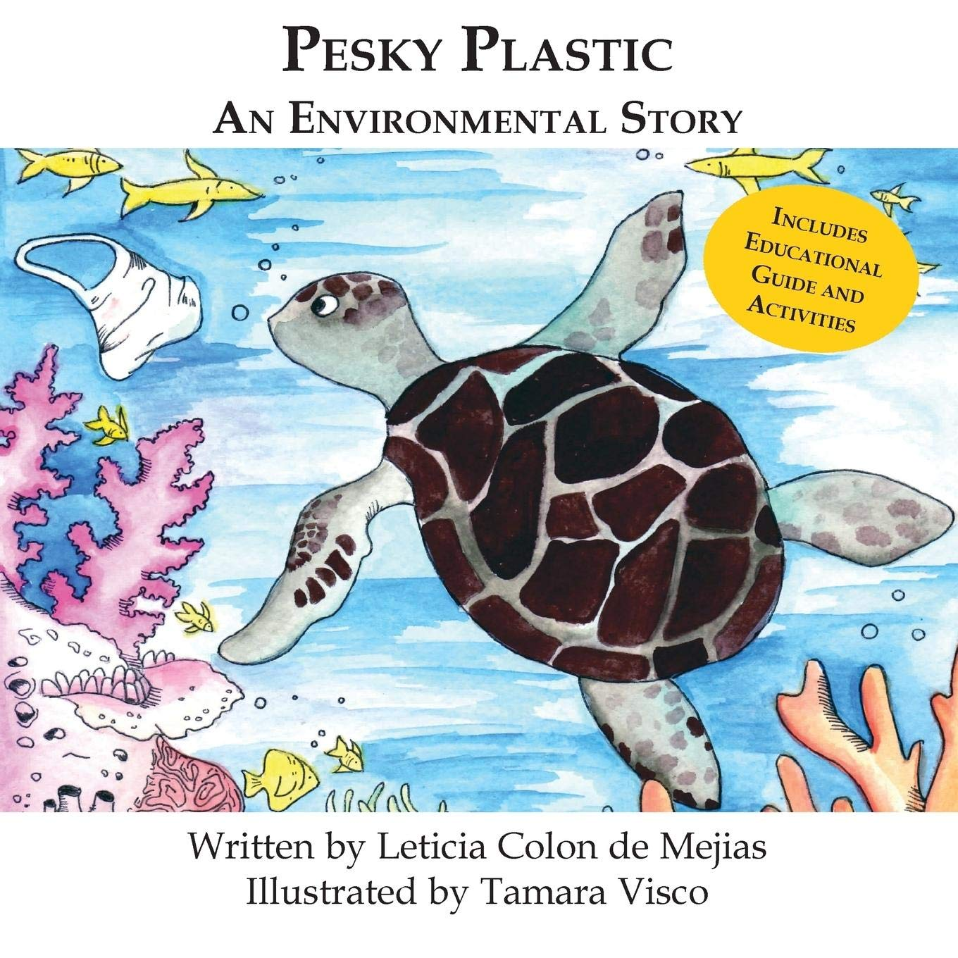
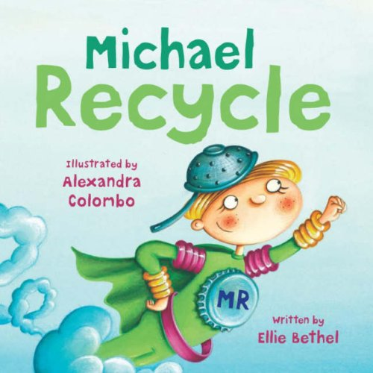
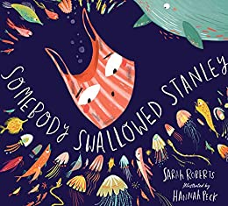
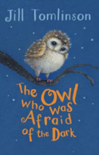
Ready Respectful Safe
Autumn 1
Lead Text: Somebody Swallowed Stanley
Value: Responsibility
I can identify nouns ​and adjectives and then create my own noun phrases.​
I can consistently identify the verb in each sentence to help me understand if my sentence makes sense.
I can sort sentences into past tense and present tense and begin to spot patterns.
I can spell the -ed suffix and link this to past simple tense.
I can write commands ​and questions.​
I use conjunctions (co-ordinating and subordinating).​
Progress Check:
Using all of the key skills listed above, the children work towards creating an information page about how we should look after our school. This will provide them with an opportunity to use the 4 sentence types (statements, commands, exclamations and questions) to engage their reader and use these constructions to help their reader to also understand how important it is to take responsibility. Children will also be required to use vocabulary that they have acquired throughout the unit.
Autumn 2
Lead Text: The Owl who was Afraid of the Dark
Value: Resilence
I use adverbs of time to help the reader understand how the sentence fits into the bigger piece.
I can develop cohesion by staying on one idea and developing several sentences on one idea before moving on to a different idea.
I can plan, draft and then edit a piece of writing making sure that I keep the needs of my reader as the main influence in any decisions that I make.
I make good vocabulary choices so I sound like an expert.
Progress Check:
There are three main writing genres that we tackle this half term.
1) Recounts: children will need to write in first person (I) and retell a real life event. They will write in the past tense and be encouraged to use adverbs of time to sequence the events.
2) Contrasting description: we aim to not only use exciting vocabulary but also use our suffixes _er and _est.
3) Instructions: how to make a toy owl OR an information page about weaving.

Slide 2
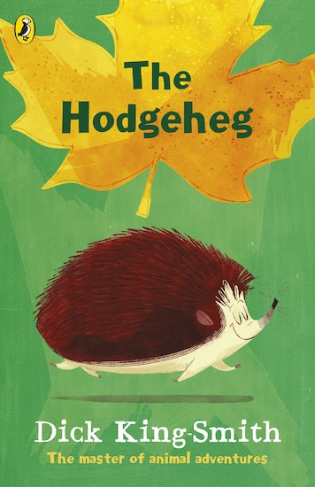
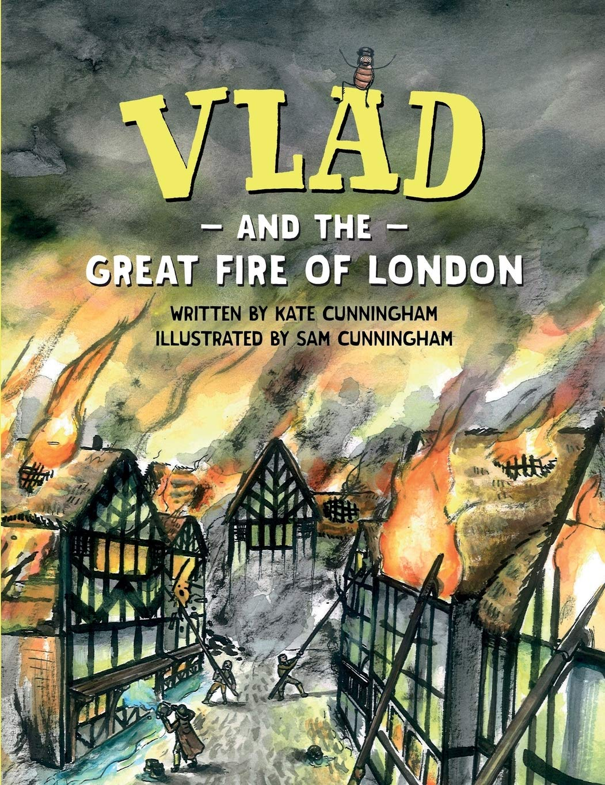
Ready Respectful Safe
Spring 1
Lead Text: The Hodgeheg
Value: Resilence
I can formulate questions (remembering a question mark and how to spell the ‘wh’ words: what, when, where, why)
I confidently use all 4 sentence types (questions, commands, statements and exclamations).
I can suggest synonyms to improve my vocabulary for the reader. “Never sprint across a road.”​
I spell the _ing suffix correctly when we explore present tense.​
I can use adjectives to compare using _er and _est.​
I can use a wider range of conjunctions (because, so, when, and).​
Progress Check:
Can we write in a variety of genres? We write letters and begin to understand how letter writing style is different to story writing style. We assess children’s written instructions on how to cross a road safely. There’s also fact writing about animal habitats. Finally, the children adapt Max’s story and use their imaginations to create their own stories about a hedgehog’s adventures.
Spring 2
Lead Text: Vlad and the Great Fire of London
Value: Curiosity
I consistently use capital letters and full stops to punctuate sentences.​
​I write using past and present tenses accurately through comparing past events to the present.
I use _ed suffixes (such as play_ed, jump_ed) as well verbs that do not follow the _ed pattern, such as ‘think – thought, bring – brought.’
I can understand patterns when I add the _ed to words that need more thought, such as ‘skipped.’
I use the 5 senses to describe a setting.
I can create noun phrases with carefully chosen vocabulary.
I enrich my writing with adjectives.
Progress Check:
Children will work towards creating a diary of the Great Fire of London as if they were there themselves. They will write in first person and use the past present and past progressive tense. Their descriptions will draw on the senses and they will use expanded noun phrases.

Slide 3
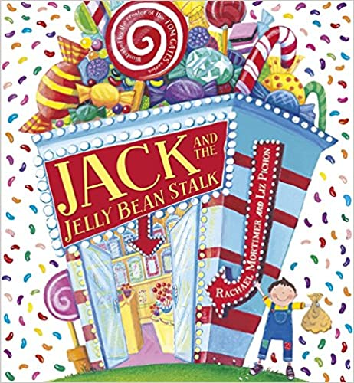
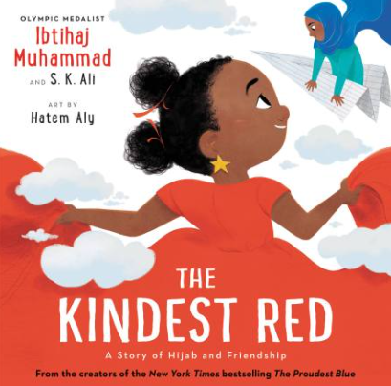
Ready Respectful Safe
Summer 1
Lead Text: Jack and the Jelly Bean Stalk
Value: Aspiration
I can retell a known fairy tale and understand its structure and message
I can sequence events and recognise integral parts of the story
I discuss which events are dependent on each other
I can dentify parts of a story that cannot be changed
Once children are confident in analysing the structure of existing fairy tales, they will develop skills of imitation and then innovation. They will need to identify parts of a story that can change and then be able to follow up so that their proposed changes ‘fit’ into the story as a whole.
I can develop a story plan
I can suggest ‘variables’ that could possibly change in a book
I understand how changes might impact the outcome
I link ideas across a whole piece
Progress Check:
hildren will be assessed on 3 pieces of writing:
A postcard from Jack, a character description of a giant, and of course a short story that is presented as a fractured fairy tale.
Summer 2
Lead Text: The Kindest Red
Value: Kindness
I can use the suffixes _y, _er and _est to compare adjectives.
I can use the suffixes _ful and _less to describe the characters.
I use expanded noun phrases when building a description.
I use a wider range of conjunctions to ‘expand’ my sentences.
I can edit work: I look at how to spot and correct errors and then look for opportunities to make more significant changes to the content of my writing.
I can orally perform my work and present it to my friends in class.
Progress Check:
Children will write a setting description of a kind world and in a separate piece, a busy market; a persuasive piece of writing for The Kindest Person Award; a thank you letter; a poem.

