Slide 1



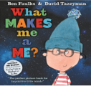


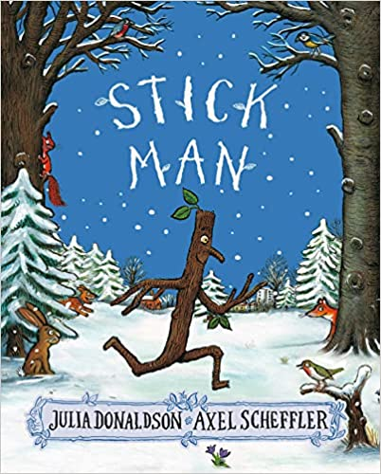



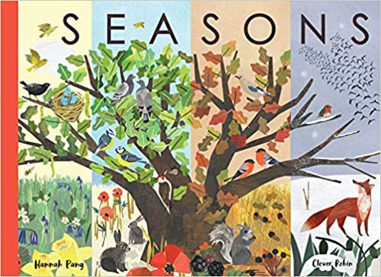
Ready Respectful Safe
Autumn 1
Lead Texts:
What I Like About Me
You Choose
Feelings
What Makes Me
Brilliant Bodies
Funny Bones
Value: Aspiration
I can construct full sentences orally – I can say my sentence aloud and make sure that it is a full idea.​
​I continue to ‘Grow the Code,’ continuing to acquire new sounds using Little Wandle.
I match sounds to new topic specific words.​
​I use capital letters to start simple sentences and capital letters for names (proper nouns).​
I identify the subject and verb in my sentence.
I can underline a subject in green and a verb in red.
Progress Check:
Creating a story start for Funny Bones, is a piece of writing that gives children the opportunity to be proud of the skills that they have developed.
Autumn 2
Stick Man​
Seasons
Man on the Moon​
Zoom to the Moon​
Celebrations around the World
Value: Curiosity
I can begin to use full stops, capital letters.
I increase my knowledge of ‘tricky words’ in spelling.
I can explore the features of a non-fiction text and can tell the difference between fiction and non-fiction.​
I talk about fact and opinion.
I expand ideas using ‘and’ whilst ensuring my full stops and capital letters remain solid.​
I use adjectives to describe the seasons.​
I can sequence my ideas using ‘time words.’
Progress Check:
I can retell stories that I know in the correct sequence.

Slide 2


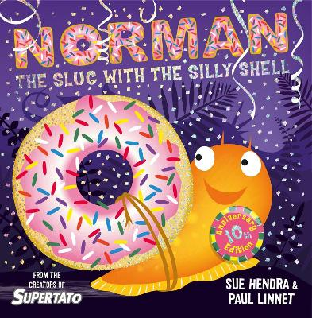

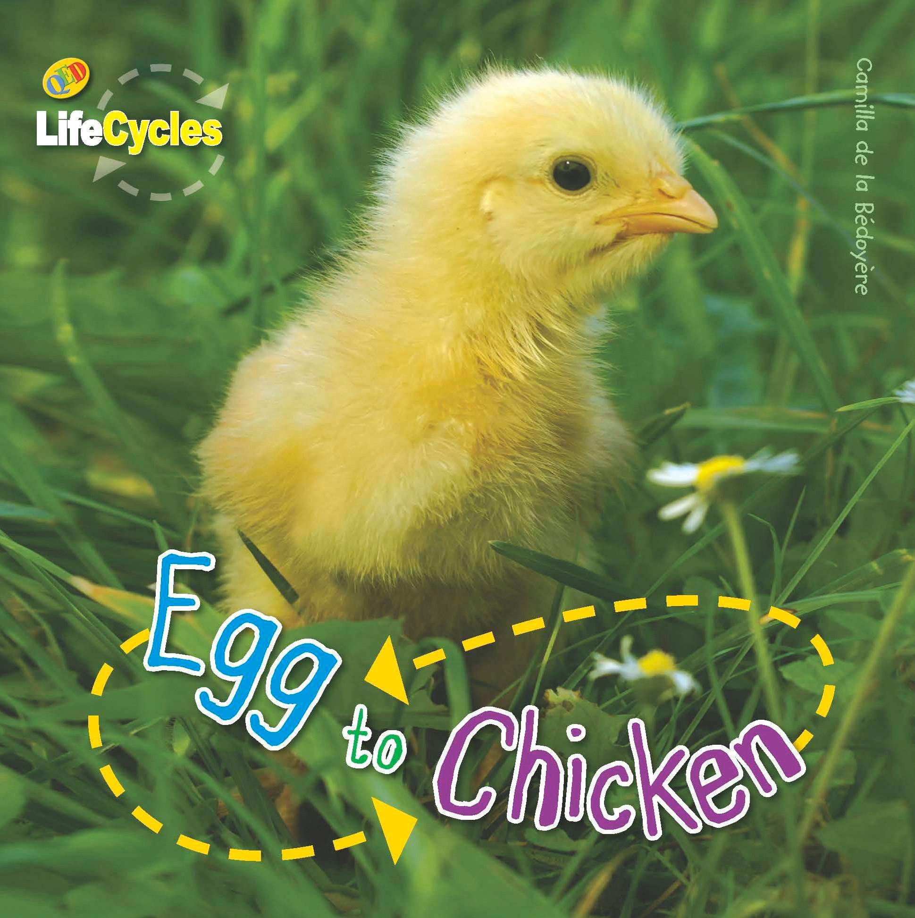
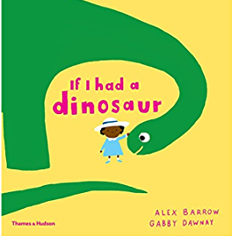
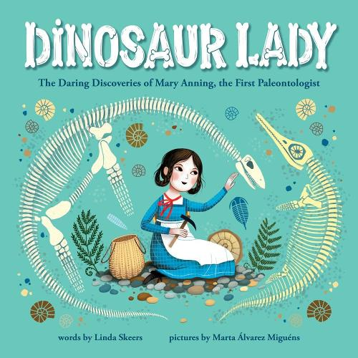
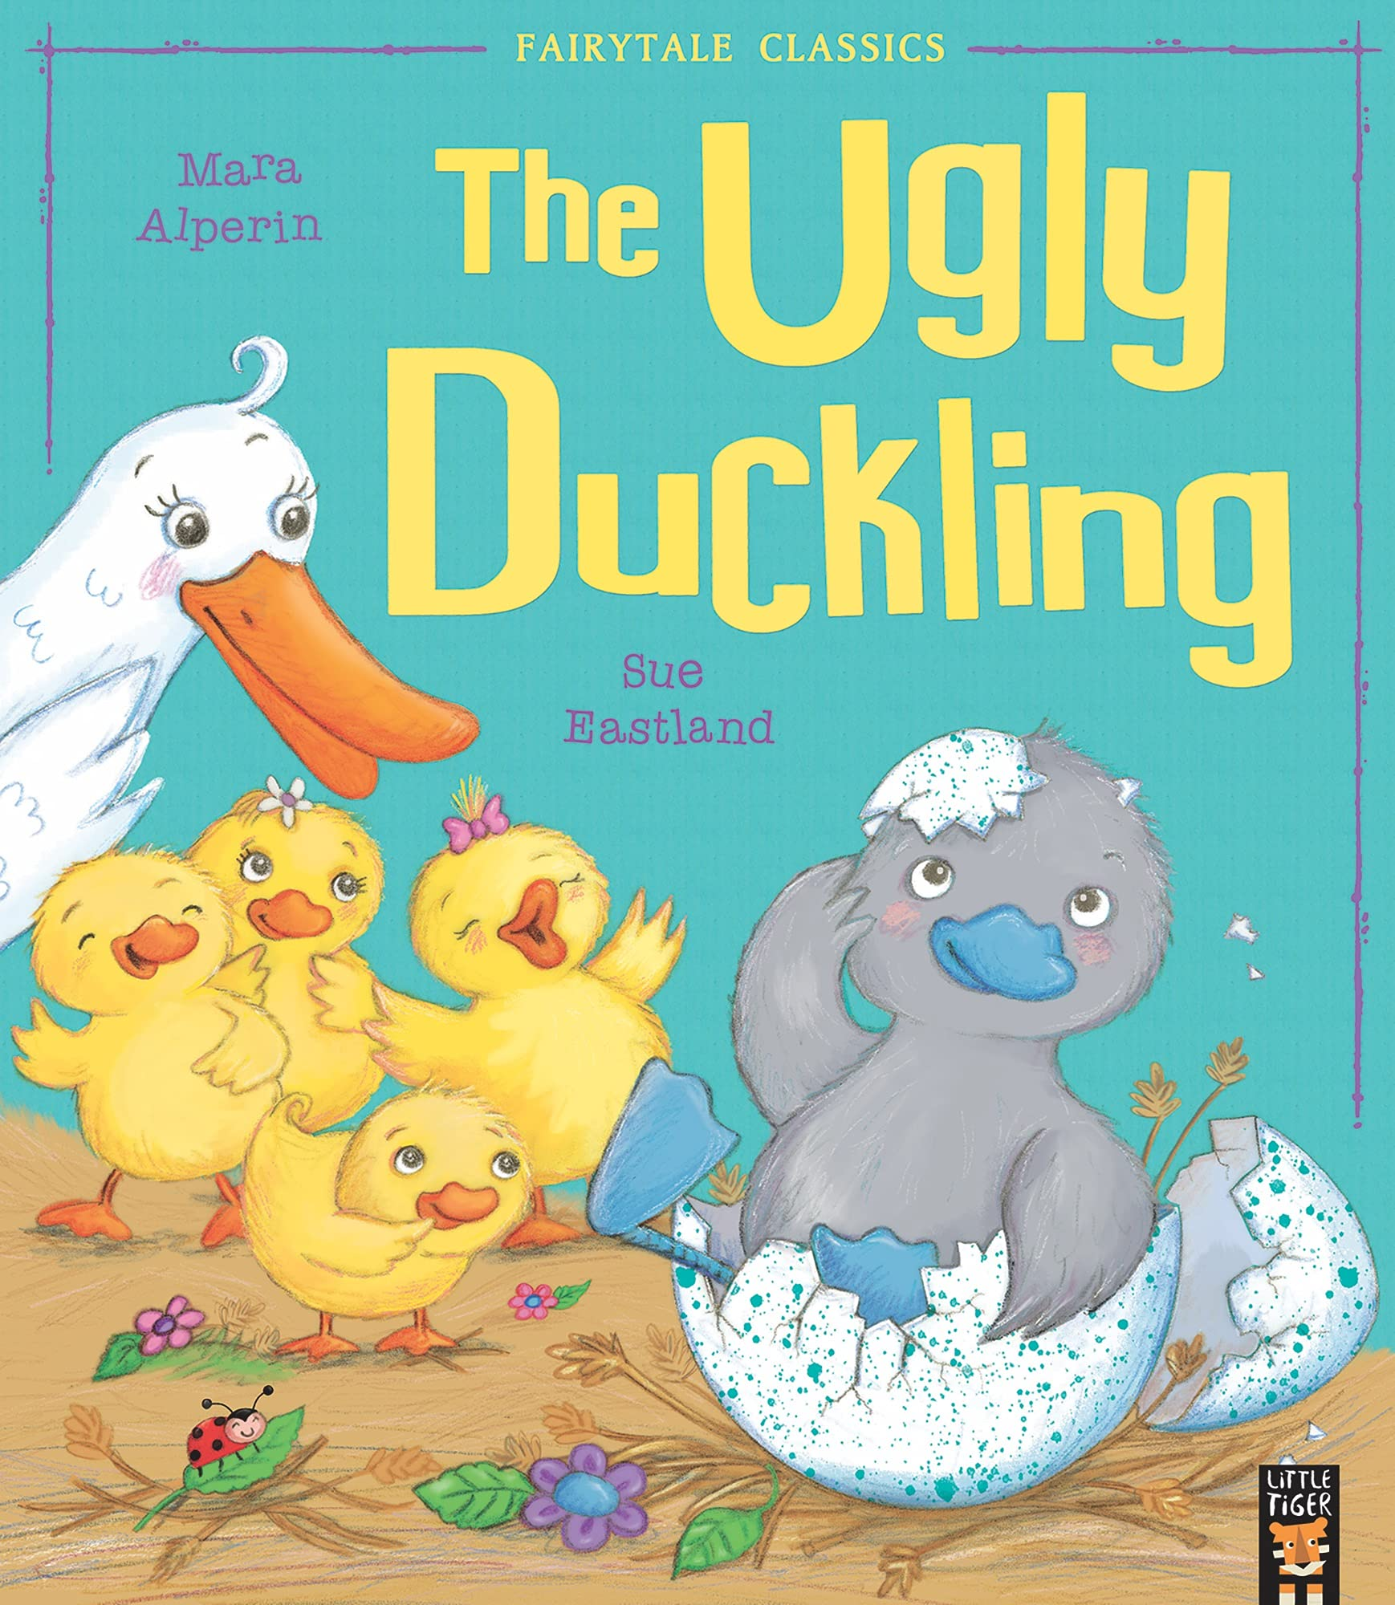
Ready Respectful Safe
Spring 1
The author Sue Hendra
Value: Responsibility
I can begin to use full stops, capital letters.
I increase my knowledge of ‘tricky words’ in spelling.
I can explore the features of a non-fiction text and can tell the difference between fiction and non-fiction.​
I talk about fact and opinion.
I expand ideas using ‘and’ whilst ensuring my full stops and capital letters remain solid.​
I use adjectives to describe the seasons.​
I can sequence my ideas using ‘time words.’
Progress Check:
I can create my own story based on a superhero vegetable just like Supertato. I will recognize and replicate the same sequence of events so that my hero has a problem to solve and wins the day.
Spring 2
The Ugly Ducking
Value: Kindness
I can show my understanding of basic punctuation including full stops, capital letters and finger spaces.
I can retell familiar stories using actions.
I can order and use sequencing words.
I can write sentences that are sequenced in the correct order.
I can talk about a story dilemma (the problem in a story) and begin to consider how I can add to or change a problem in a story to put my own stamp on our writing.
I can use diagrams and pictures in non-fiction writing.
I can talk about the features of a non-fiction text.
Progress Check:
Children will adapt the problem in The Ugly Duckling and will come up with their own ideas of problems that he might face that would fit with the existing story.
Children will create an information booklet, complete with diagrams, to explain the lifecycle of animals.
Children will write facts about dinosaurs and then explore fiction writing where they can create and describe their own dinosaur.

Slide 3


Ready Respectful Safe
Summer 1
Lead Text: The Little Gardner
Value: Resilience
I can identify nouns, adjectives and verbs
I can use the suffix for spelling word ending in _ ing and _ ed
I can make comparisons using adjectives ending _er and _ est
I orally present to an audience
I can rehearse reading my sentences aloud
I talk about the features of a diary, including the perspective (writing in first person) and can explain my feelings
I can retell an already familiar story
Progress Check:
Children will write a setting description and will describe how a garden changes over time.
They will write a diary in first person using ‘I.’ They will need to write from the perspective of the Little Gardener.
Children will keep a seed diary. This will be a little different from the diary above as it is non-fiction. It will us close observation skills and we want children to look at the small details.
Summer 2
Lead Text: Blown Away
Value: Curiosity
Securing the fundamental skills that form the solid foundations for their future as efficient writers continues to be the Year 1 focus.
I can orally compose a full sentence aloud.
I can rehearse reading my sentences aloud.
I check my sentences carefully for full stops and capital letters.
I can begin to spot and correct simple errors in my work.
I can retell an already familiar story
I can use my phonic knowledge to attempt to write new words.
I can use words associated with contrasting locations.
Progress Check:
What does the reader need to know? As we will be writing for different purposes, children will be shown the features of a postcard and a fact file as we consider what our readers need to know.
Non-fiction fact files (about a different country)
Postcards
A story about a visit to a strange new land that is far, far away
A description of themselves for their new teacher

Slide 4
Ready Respectful Safe
Lesson Structure
“If they can’t say it, they can’t write it.”
We believe that words empower children to make sense of the world around them. A wide vocabulary helps them to put their emotions into words, socialise with people, imagine and wonder. Time spent in articulate and lively oral discussion using flexible and sophisticated language builds rich vocabulary. To this end, In Year 1, you’ll see plenty of talk in our English sessions. Oral rehearsal is fundamental. We love retelling known stories (with actions), singing songs and rhymes and making predictions about the books we read.
Phonics is key. Using Little Wandle’s ‘Grow the Code,’ children are encouraged to segment and blend new words and
These are the skills that children will be assessed against at the end of Year 1:
Features of writing | Sequences sentences to form short narratives.
 | Leaves spaces between words.
 | Joins words and joins clauses using ‘and.’
Punctuation | Begins to punctuate sentences using a capital letter and a full stop, question mark or exclamation mark.
 | Uses a capital letter for names of people, places, the days of the week and the personal pronoun ‘I.’
Spelling | Uses words containing each of the 40+ phonemes already taught.
 | Uses common exception words.
 | Knows the days of the week.
 | Uses the spelling rule for adding _s or _es as the plural marker for nouns and the third person singular marker for verbs.
 | Uses the prefix un_
 | Uses _ing, _ed, _er, and _est where no change is needed in the spelling of root words.
 | Applies simple spelling rules and guidance as listed in English Appendix.
Handwriting | Sits correctly at a table, and holds a pencil comfortably and correctly.
 | Begins to form lower-case letters in the correct direction, starting and finishing in the right place.
 | Forms capital letters.
 | Forms digits 0-9.
 | Understands which letters belong to which handwriting ‘families’ and practises these.

