Slide 1

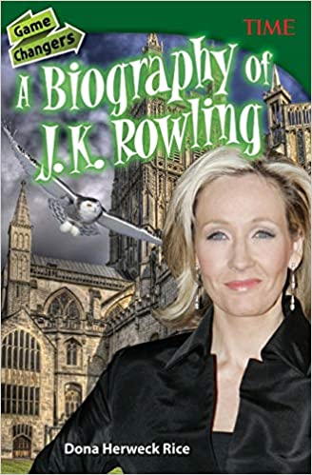





Year 6
Summer
2
Ready Respectful Safe
A Biography of J.K. Rowling
Why this book and not something else?
As Y6 children embark on their final chapter at Muscliff, it’s a good opportunity to reflect and look back on their many accomplishments over the years. To this end, it is helpful for us to consider the style of writing that should be adopted to communicate our memories to our reader: a biography is our model for this. And with so many biographies on the shelves of book shops, it was a tough challenge to find the biography that would provide the best written model for Year 6. And we believe this is the book…
We use this biography, not because we hold up J.K Rowling as a role model, but because we appreciate how the author composes and writes with passion about J.K Rowling’s successes and considers the struggles that she overcame to achieve this success. We love how the book has been written – the author clearly holds J.K Rowling in high regard and we unpick how this is communicated. We understand this from the emotive language and carefully structured sentences. We also love the layout choices made by the author. Layout and organisation is a key feature of a text and we can easily overlook this skill.
This unit is, of course, complemented with work on aspirations and role models.
We leave the children to analyse the evidence in front of them and decide if J.K Rowling is a role model to them.
Real role models don’t necessarily have to be important public figures. Through their character, accomplishments, and behaviour, role models inspire us to be better versions of ourselves. True role models are focused on supporting the community and always try to help others.
As children spend more time online, it’s easy for them to confuse short-lived celebrity status with achievement; sometimes children can be influenced by social media trends, confusing the number of ‘likes’ someone gains with success. At Muscliff, we want children to have a thorough understanding of aspirations and goals so that they can aspire to be the best version of themselves rather than a pale imitation of someone else.
Key Questions:
What makes a role model?
In this biography, J.K Rowling is called phenomenal, “Rowling is a writer whose work has impacted the world far beyond the content of her books”. Do you agree?
Writing Composition in school:
Children will write an autobiography. They will look back at their many success and achievements over their years at school.

Slide 2
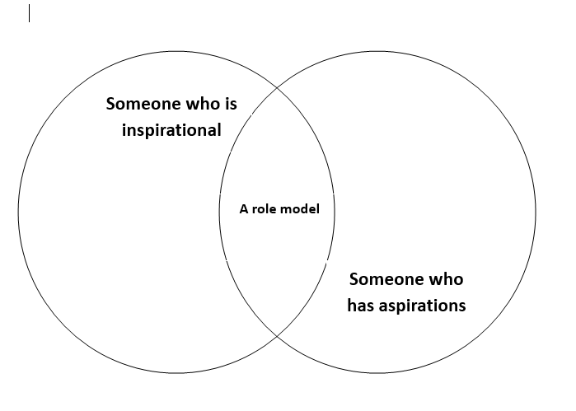
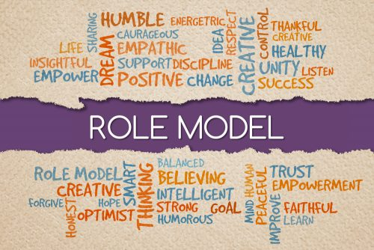
Year 6
Summer term
2
Ready Respectful Safe
English Skills that will be developed through this unit:
What makes you want to read a biography? When we read a biography, of course we would want to find out more about that specific person… so relevant information is crucial. But in addition to this the author’s job is to also support the reader to make links to that person. You need to make a connection! This means that style to create some empathy is important too.
Write in the correct style associated with biographies (for example chronological order).
Paragraphing to organise relevant information.
Vocabulary that is appropriate to the person.
Creating empathy with the reader by describing feelings and moods.
Conjunctions cause and effect.
Cohesion in and across paragraphs by making links.
At the end of this unit, children will write an autobiography. This will track their time at Muscliff over the years and will feature information about significant events during their time at Muscliff as well as the adults and peers who have inspired them.
What is the difference between being aspirational and inspirational?
Help at Home:
As our focus this half term is biographies, why not visit the library to find a biography of someone who interests you? (Parents – please make sure that the biography that your child chooses is of an appropriate adult).
We would love to hear more about what you do outside of school. Write a paragraph about what ‘drives you’ or about what enthuses you outside of school. In other words, what do you like doing and what does it give you?
Your writing task this week could be to reflect on an adult who has influences you. Write them a thank you letter. (This could be used in your Leavers’ Assembly.)
If you could invite 3 people (alive now or from the past) to attend a party with you, who would you choose and why?
What is your favourite memory of Muscliff?
Write a paragraph about a friend who you have really appreciated during your time at Muscliff.

Slide 3
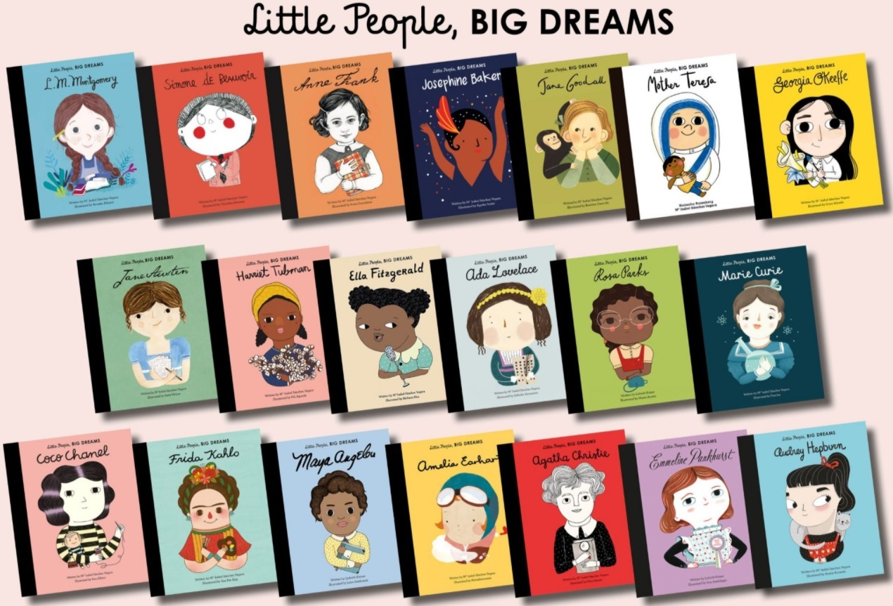
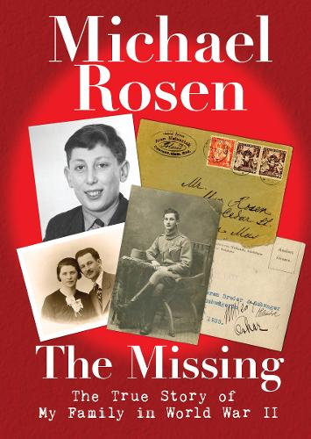
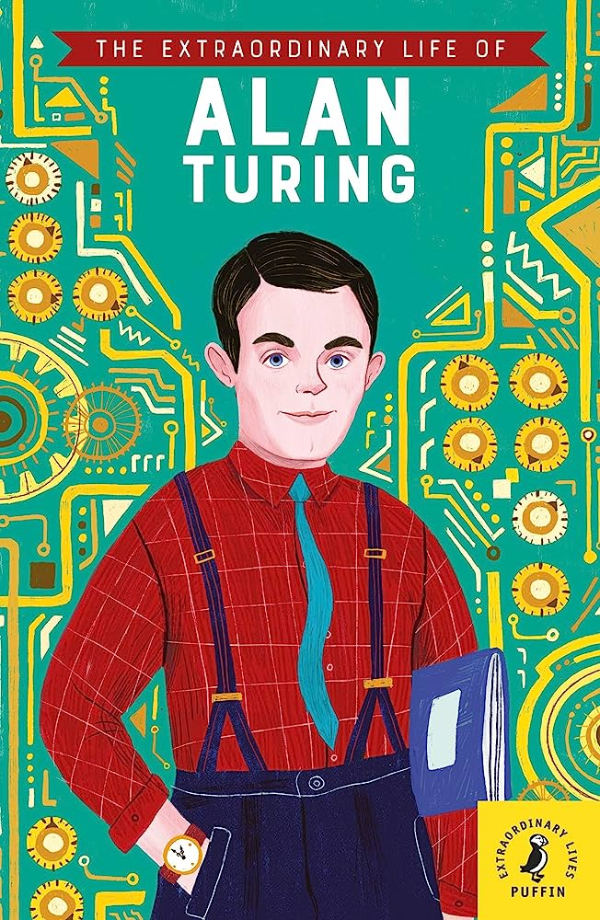

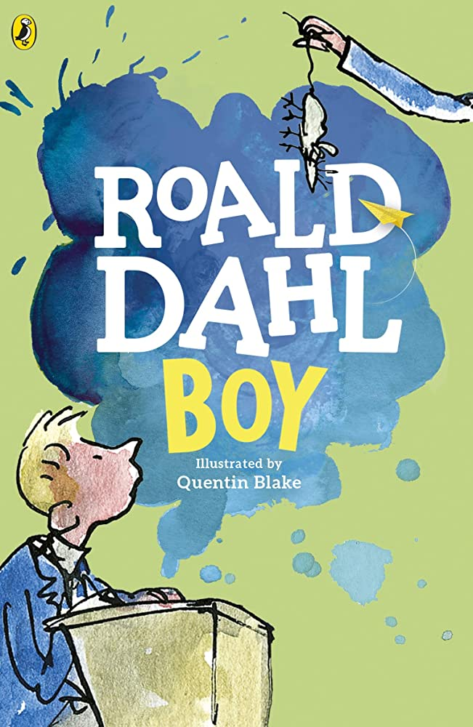
Year 6
Summer term
2
Our Extended Book Spine
Ready Respectful Safe
We highly recommend all of the books in the Little People, Big Dreams series.
All of these can be found in the Curriculum Tower.
Whilst many Roald Dahl books are enjoyed by younger children, Roald Dahl did also write books aimed at a more mature audience. Boy is his biography and it’s brilliant. The description of his teacher, Captain Hardcastle, is well worth a read.

