Slide 1

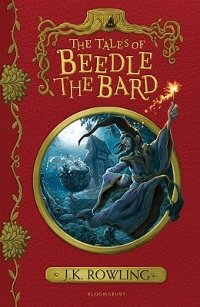





Year 6
Summer
1
Ready Respectful Safe
The Tales of Beedle the Bard
Why this particular book and not something else?
Year 6 focus on one of the tales within this J.K.Rowling text: The Tale of the Three Brothers. There are so many reasons why this tale deserves a spot in our school’s curriculum and why we consider this tale to be a ‘Beautiful Text.’
Firstly, no one can deny that J.K. Rowling’s books (which have been translated into 85 languages, won multiple awards, and sold more than 600 million copies worldwide) should be explored by Y6. This short story provides children with an opportunity to access J.K.Rowling’s style of literacy so that they can unpick the reason why her books have proved to be so popular. Children can then make an informed decision on J.K.Rowling’s authorcraft.
We love the language presented in this book – its quirky, fairy-tale vocabulary make it stand out and her language choices help the reader to recognise that the story is set hundreds of years ago. It’s a great opportunity to enrich the children’s vocabulary with unfamiliar terms. We have a try at replicating this language (and even have a go at slipping a bit of Latin into our work).
The characters are very distinct and contrast each other. They are predictable. In this way, it becomes very simple for Y6 to understand the messages within the book. Just like in the fairy tales that Y6 read when they were younger, the outcomes in this story are predictable – hard work and goodness is rewarded whilst selfishness and greed result in consequences.
School values this book reinforces:
Aspiration is our key value within this unit and children consider what ‘success’ looks like. The successful character in our story shows humility – what does this teach us about how we should respond to success?
Key Question:
How does society measure success?
What shared characteristics do all successful people have in common?
Can someone be humble and aspirational at the same time?

Slide 2
Year 6
Summer term
1
Ready Respectful Safe
English Skills that will be developed through this unit:
Narrative skills are fully developed in this unit and Y6 carefully unpick how J.K.Rowling does this so well:
Children use vivid description to create tension and atmosphere – this includes using a ‘descriptosaurus’ as a visual dictionary. Children use personification and imagery to enhance their descriptions. We use nature as a tool to signpost the mood of the story. The sun is welcoming but the night brings insecurity. Y6 really bring the scary forest to life! The gnarled twisted trees will certainly aim to impede the brothers on their journey!
We use direct speech (including speech punctuation and a reported clause) to show characterisation and work hard to show that the humble character is indeed reflective and the arrogant brother is selfish and self-absorbed.
Etymology is a hot-topic of conversation – children talk about where words come from, exploring prefixes and suffixes.
Finally we edit our description to add to the reader’s experience.
Writing Composition in school:
Children will write a short story. Description, description, description! This piece is always one of our favourites and the children get an opportunity to put into practice all of their story telling skills as they lead three characters from safety to uncertainty.
Help at Home:
Discussions about moral messages in children’s literature would be very helpful. There’s no harm in revisiting some stories from your child’s earlier years, such as fairy tales… What is the actual message in the fairy tale? Can your child explain why fairy tales are told to young children? Why do we use books in assembly?
Take Little Red Riding Hood for example. What is the message in this story and is that message still relevant to modern times? Could a version of Little Red Riding Hood be rewritten to suit problems that children face today?
Why are fairy tales sometimes frightening?

Slide 3
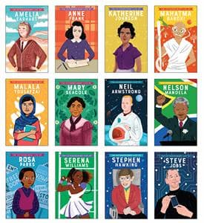
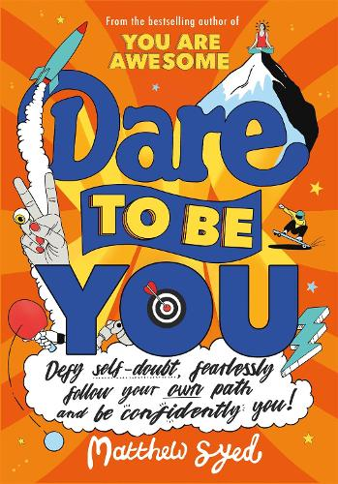
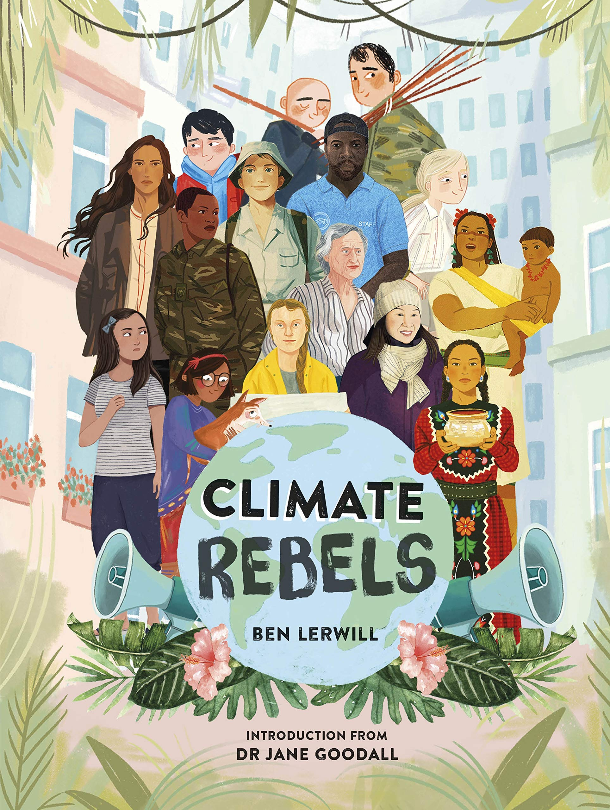
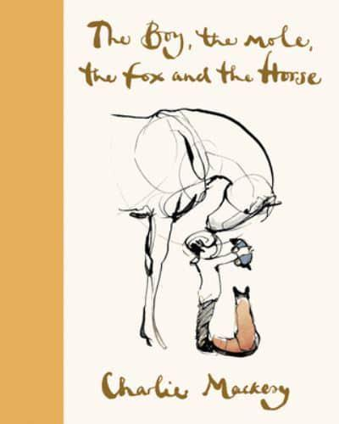
Year 6
Summer term
1
Our Extended Book Spine
Ready Respectful Safe
If you enjoy the ‘Little People, Big Dreams’ series of books, you’ll love these. These books are ‘The extraordinary life of…’ There are plenty of inspirational people to explore in this series.
What would you dare to try if you stopped worrying about fitting in? If you're the kind of person who thinks: I don't like standing out from the crowd ... I wish I could be more like the cool kids ... There's no point trying to change things ... then this book is for you. Because guess what? There's no such thing as normal.
Dare to Be You empowers young readers to follow their own path, love what makes them different and question the world around them. This groundbreaking, practical and positive book will help kids develop the inner confidence to grow into happy adults who know - and, more importantly, LIKE - themselves.
On the outskirts of the Milky Way, floating slowly through space, there hangs a planet unlike any other. It has oceans, deserts, jungles and mountains. It has life that swims, life that soars and life that swings through the trees. It is a place of dazzling variety and infinite wonder - and it's the only world we've got. Climate change is happening, now. But it's not too late to change the story.
Meet the humans, from around the world, who are fighting to save our planet. This is your call to arms. This book will transport you from the poles, to the oceans, to the rainforests, with iconic illustration. These 25 true stories make you think, make you cry, make you hope - and these are stories to make us all stand together and protect our home. These stories are the proof that one person's small changes can grow into something big, and powerful, and world-changing.
A book of hope for uncertain times - enter the world of Charlie's four unlikely friends, discover their story and their most important life lessons.
Here, you will find them together in this book of Charlie's most-loved drawings, adventuring into the Wild and exploring the thoughts and feelings that unite us all.

