Slide 1

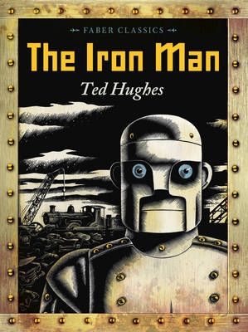





Year 5
Spring term
1
Ready Respectful Safe
The Iron Man
Why this particular book and not something else?
Space inherently feeds children’s fascination – you simply cannot help but be in awe of the infinite, always evolving space and this Year 5 unit on space and our solar system is sure to captivate our children’s imagination and curiosity. During this unit, Year 5 look at both fiction and non-fiction alongside each other to build their understanding and feed their imaginations further about the universe. Year 5 use The Iron Man to set the scene and Muscliff children enjoy Ted Hughes’ beautiful tale of understanding and tolerance; this book frames the space topic whilst also reinforcing our school values and our commitment to inclusion.
The Iron Man is a goldmine when it comes to developing English skills: story structure, drama, use of adjectives or simile, this book has it all. And, of course, it also features one of the greatest modern fairytale characters ever created. We enjoy the descriptions within this book and appreciate how Ted Hughes uses repetition, imagery and figurative language to bring this metal man to life.
Writing Composition in school:
Throughout this unit, Year 5 will develop their formal, non-fiction writing skills based around our beautiful text. Using key events from the text, we will write a persuasive letter to the government complaining about Iron Man, and then write a report on the damage caused. We will also develop our skills of recall and accuracy when writing a recount of our visit to Winchester Science museum. Key structural elements such as paragraphing, using a range of clauses and key vocabulary will be essential for this.
English Skills that will be developed through this unit:
During this term, we will focus on building on the skills we developed in the Autumn term – we will continue looking at a range of clause types, introducing parenthesis using brackets and dashes. We will recap figurative language, and how this can be used in conjunction with other phrases, such as adverbial and prepositional phrases. We will focus on creating good quality setting descriptions, as well as developing characters in detail when looking forward to our next text.
This will also be combined with high-quality structural aspects, such as the use of semi-colons and the impact of this on both descriptive and formal writing. We will also secure our knowledge of a wider range of tenses, and the different verb forms of ‘to be’.

Slide 2
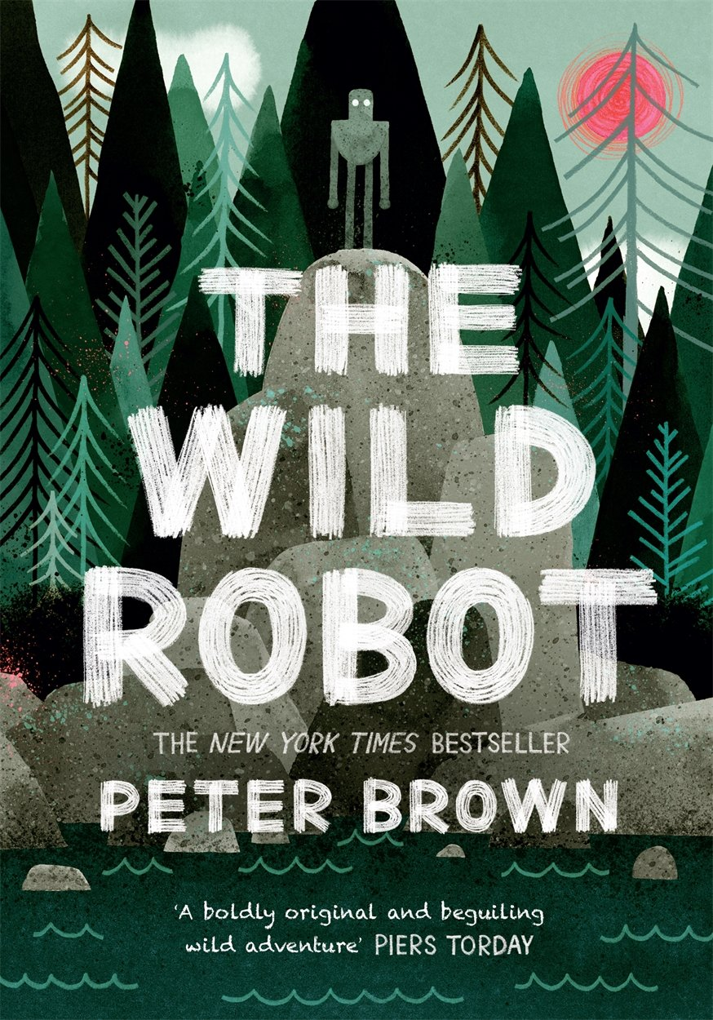
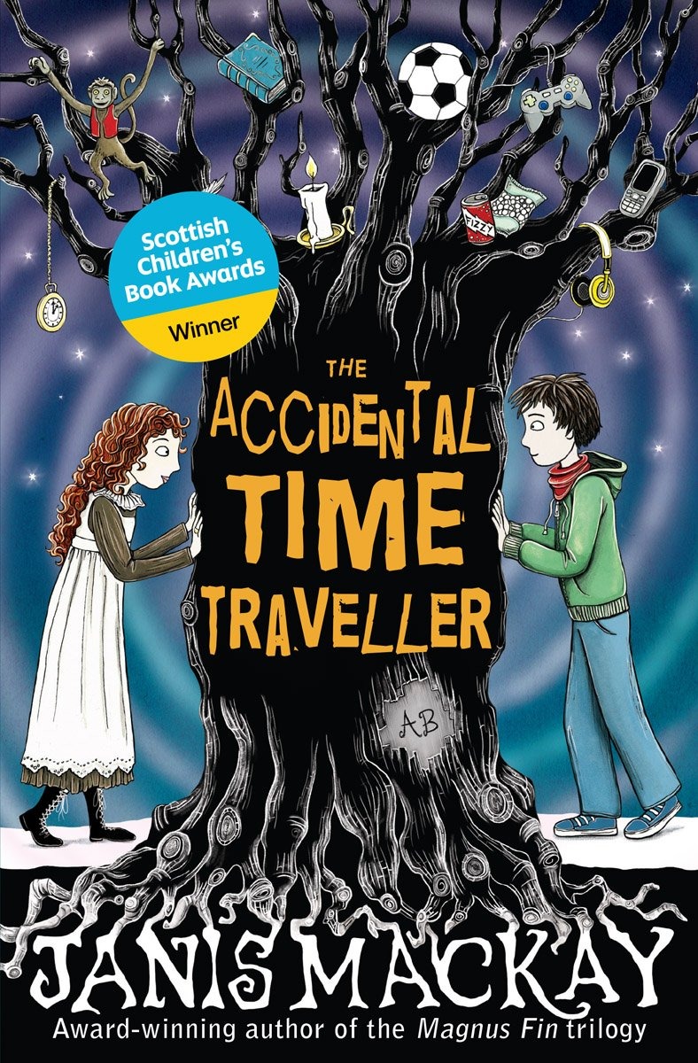
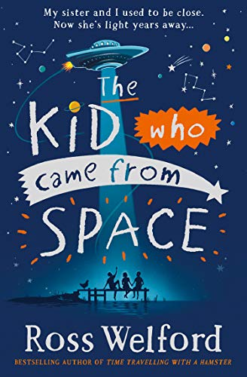
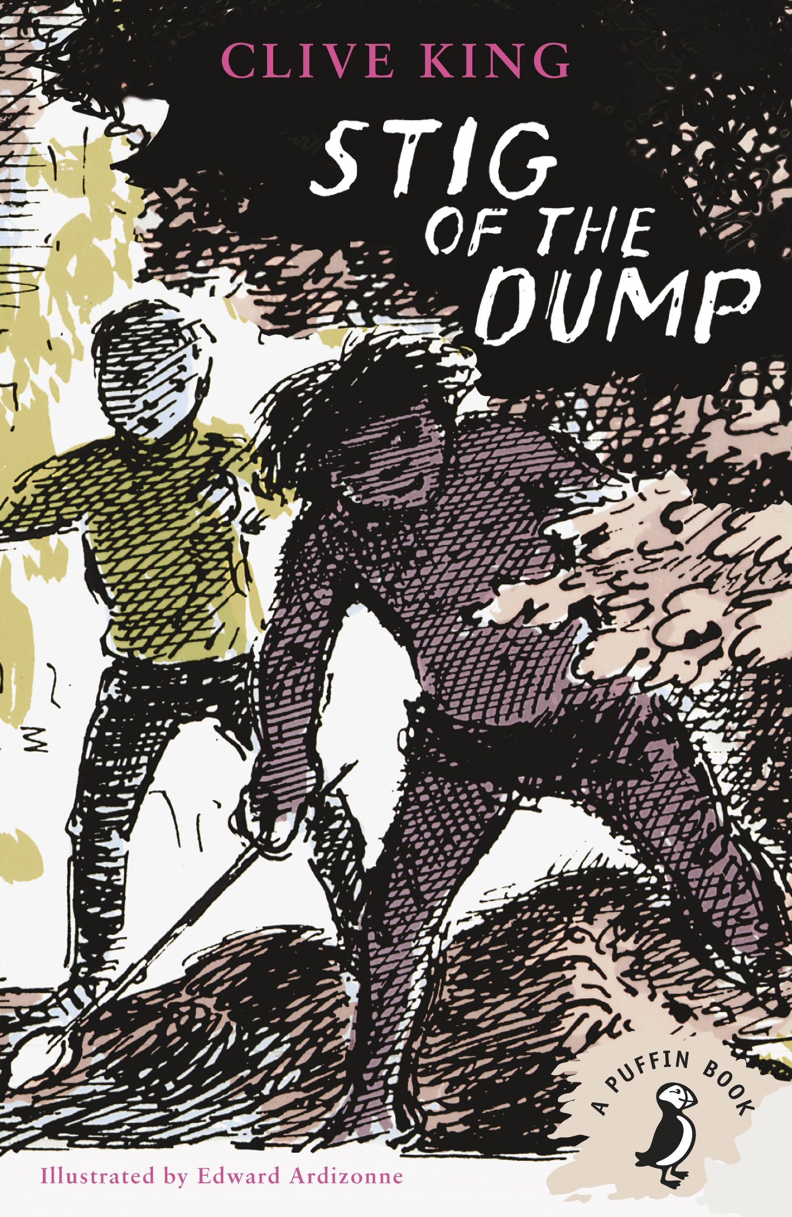
Year 5
Spring term
1
Ready Respectful Safe
Writing Homework
Here are the writing tasks that will appear each week this half term on the homework sheet in the red folder. The tasks here mirror the children’s learning in class. As always, the task is secondary to the conversation you have with your child about their learning. It’s that chat that will support your child most with their progress and understanding!
Draw a mechanical giant from your own imagination. It doesn’t have to be an iron man – it could be a mechanical beast, an iron dog or a metal moggy. Which key features would you label and what would these be made from?
What was the best part of Winchester Science Museum? Pick one feature that you enjoyed a write a short advert for that part of the museum so that other children would be persuaded to visit.
Research one planet in the Solar System. What is special about that one planet and how does it compare to Earth? You could write a paragraph or could create a non-fiction page. Invest as much time and effort as she feel fit.
We have had another look at parenthesis recently in school. Write 8 sentences, one for of the different planets but use parenthesis in each sentence. For example, Mars, which is the fourth planet from the sun, is known as a cold and dusty world.
Imagine you are an astronaut on the moon. Write a diary about a moon walk you had! How did it feel to walk without gravity? What did Earth look like? We want you to really go for description in this task.
Soon we will be finding out about the Greeks. Find out about where the planets in our solar system got their names. Are there any other features of the night sky that link to the Greeks?
Our Extended Book Spine
To complement n, our school can thoroughly recommend these texts for this half term:
Please turn over to find out more about these recommended books.

Slide 3
Year 5
Spring term
1
Ready Respectful Safe
Our Extended Book Spine
To complement Treasure Island, our school can thoroughly recommend these texts for this half term:
Book Title | What is it about? | Why it’s chosen?
The accidental time traveler (James MacKay) | One ordinary day, Saul is on his way to the corner shop when a girl appears suddenly in the middle of the road. She doesn't understand traffic, or the things in shops, and she's wearing a long dress with ruffled sleeves. Her name is Agatha Black. Agatha Black is from 1812, and Saul needs to find a way to get her back there. With help from his mates Will and Robbie, he tries to work out how to make time travel happen. | Funny, action adventure
Stig of the dump by (Clive King) | Barney is a solitary little boy, given to wandering off by himself. One day he is lying on the edge of a disused chalk-pit when it gives way and he lands in a sort of cave. Here he meets 'somebody with a lot of shaggy hair and two bright black eyes' wearing a rabbit skin and speaking in grunts. He names him Stig. Of course nobody believes Barney when he tells his family all about Stig, but for Barney cave-man Stig is totally real. They become great friends, learning each others ways and embarking on a series of unforgettable adventures. | Modern classic, adventure,
The Wild Robot (Peter Brown) | When robot Roz crash lands on an island, she's forced to fight for survival. The only way Roz can live is by learning about her new environment from the island's hostile animal inhabitants. But when she finds herself taking care of a baby goose, all the animals pitch in and teach Roz how to thrive in this new world. | Robot like key text, rich language, short chapters, develops inference skills
The kid who came from space (Ross Welford) | A small village in the wilds of Northumberland is rocked by the disappearance of twelve-year-old Tammy. Only her twin brother, Ethan, knows she is safe – and the extraordinary truth of where she is. It is a secret he must keep, or risk never seeing her again. But that doesn’t mean he’s going to give up. Together with his friend Iggy and the mysterious (and very hairy) Hellyann, Ethan teams up with a spaceship called Philip, and Suzy the trained chicken, for a nail-biting chase to get his sister back… that will take him further than anyone has ever been before. | sibling connection, friendship and interstellar adventure, witty, space themelinked to topic

