Slide 1

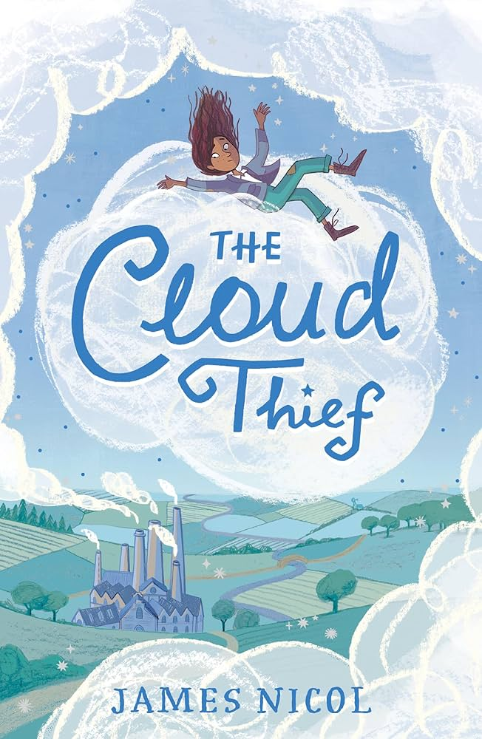
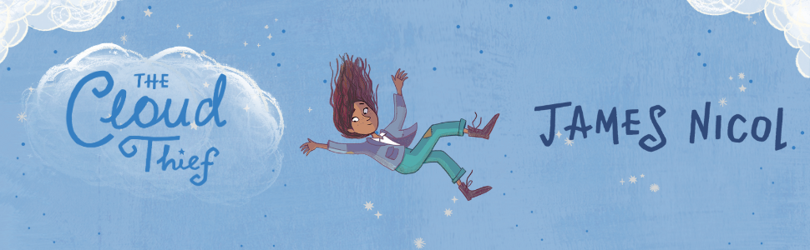
Year 5
Autumn term
2
Ready Respectful Safe
The Cloud Thief
Why this particular book and not something else?
The grown-ups in school read children’s books too! We are always on the look-out for different books so that we can share the best texts to get our children talking. That’s what makes our curriculum so special – the fact that we can change it so that it always reflects our school. Now, this book – The Cloud Thief – was one book that many teachers were reading over the summer holidays. We loved it! It got us talking! And we are confident that Year 5 children will share our enthusiasm.
The Cloud Thief is set in a society where water is scarce. There has been a climate ‘shift.’ Communities have to pay a private company to deliver clouds to produce rain.
Of course, this is an excellent opportunity to learn about the water cycle (in science) and about evaporation and changing states. Children will understand how vital water is to life.
From an English perspective, we think this book is something a little bit different! It will present the question, ‘What if?’
The plot very much reminded us of a story that the children will likely be familiar with already – The Lorax (Dr Seuss). Reading the rhyming story of The Lorax (it’s very short) and watching the film of The Lorax at home might be a good way to get talking about The Cloud Thief.
School values this book reinforces:
The Cloud Thief will prompt the children to consider their responsibility as global citizens. On a much smaller scale, we are responsible for our school and ensuring that we look after it well. But in a wider context, they will be more aware of climate-friendly decisions they can make in their daily lives.

Slide 2
Year 5
Autumn term
2
Ready Respectful Safe
Skills that will be developed through this unit:
The Cloud Thief will introduce the term ‘dystopia.’ The purpose of dystopian fiction is to serve as a warning about how things could go wrong if we don't change.
In our previous unit before the half term break, children created engaging descriptions using Charlie and the Chocolate Factory. In this unit, we explore the skills that the author uses to not only engage and entertain but to warn, to persuade and to prompt a change. This book provides us with a good opportunity to create dystopian setting description of a scorched earth. We will create vivid descriptions of a land deprived of rain and will place these within some free-verse poetry.
Alongside our study of The Cloud Thief, we will also look at explanation texts and how information is organised so that a process is made clear to a reader. We will use this to support in our explanation of the water cycle.
Writing Homework
Here is a brief summary of all of the written homework tasks that will be set this half term. Each task will be explained in more detail each week in the red homework folder. The homework closely mirrors the skills that the children will learn in English.
Week 1: a character description that suggests mystery and makes the reader inquisitive. Using a thesaurus would support this.
Week 2: find relative clauses and understand how they give extra information to a noun.
Week 3: explore how the order of a sentence changes how the reader emphasises each sentence part in a different way.
Week 4: explore similes and metaphors in a description of an autumn night.
Week 5: personification as a skill to enhance descriptions. Nouns take on human characteristics. For example, ‘the leaves danced across the playground.’
Week 6: idioms and figurative language, such as ‘it’s raining cats and dogs.’
Week 7: a setting description using the skills of adverbs of time, manner and place.

Slide 3
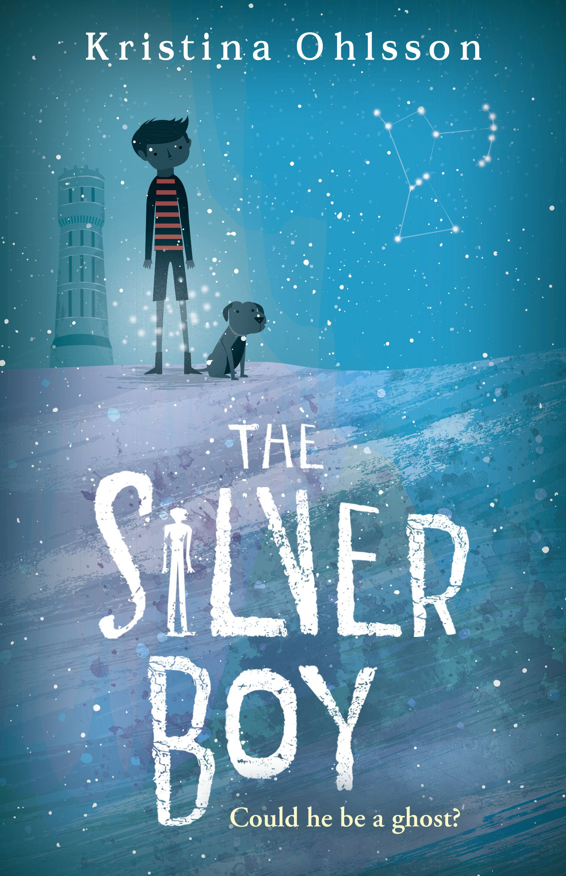
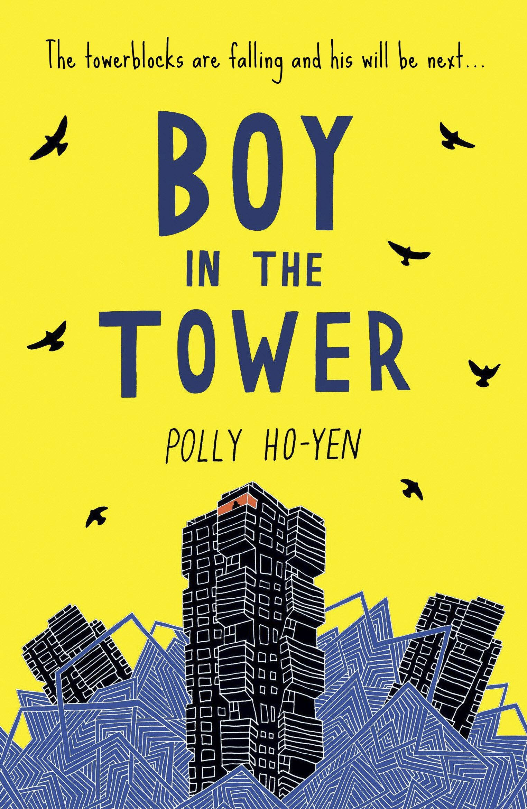
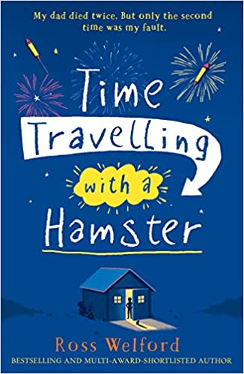
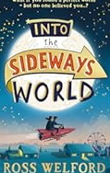
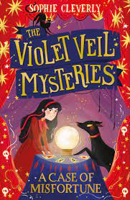
Year 5
Autumn term
2
Ready Respectful Safe
Our Extended Book Spine

Slide 4





Year 5
Autumn term
2
Ready Respectful Safe
Our Extended Book Spine
To complement Treasure Island, our school can thoroughly recommend these texts for this half term:
Book Title | What is it about? | What my teachers think about this book…
The Silver Boy (Kristina Ohlsson) | They thought ghosts didn't exist . . . But when Aladdin’s parents discover food is being stolen from their restaurant, he and his friends decide to investigate. Soon, Aladdin notices a strange boy – dressed in short trousers, despite the freezing cold. But as hard as he tries to catch him, the boy always disappears – leaving no tracks in the fresh snow. Before long, Aladdin and his friends are pulled into a web of secrets and history, | I think I have found my book for the evenings as winter approaches! This book comes with fantastic reviews and would suit children who enjoy mysteries.
The Violet Veil Mysteries (Sophie Cleverly) | Violet Veil wants nothing more than to prove her worth and become her father’s apprentice at Veil & Sons Undertakers. And one rain-soaked night she gets her chance when she meets a boy, Oliver, who is wandering around the graveyard. Only, the last time Violet saw Oliver, he was indoors and very much dead, waiting to be buried. Violet has just found her first case, and it doesn’t get bigger than this: can she, with the help of her dog, Bones, help Oliver solve his own ‘murder’? | Parents might want to read this book themselves first as the story mentions death (she is the undertaker’s daughter). This book is fast paced and we think enticing. It has a strong female protagonist and may suit those children who enjoyed reading last year, The Firework Maker’s Daughter as there are similar themes.
Boy in the Tower (Polly Ho-Yen) | Ade loves living at the top of a tower block. From his window, he feels like he can see the whole world stretching out beneath him. His mum doesn't really like looking outside - but it's going outside that she hates. She prefers to sleep all day inside their tower, where it's safe. Except it isn't any more. Strange plants have started to take over and tower blocks are falling down around them. Now Ade and his mum are trapped and there's no way out... | This is a high quality text, full of tension written by a primary school teacher. The setting descriptions are very good. This would be a book for parents to enjoy alongside their child and would certainly support children’s writing skills.
Time Travelling with a Hamster (Ross Wellford) | “My dad died twice. Once when he was thirty nine and again four years later when he was twelve.” On Al Chaudhury’s twelfth birthday his beloved Grandpa Byron gives him a letter from Al’s late father. In it Al receives a mission: travel back to 1984 in a secret time machine and save his father’s life. Al soon discovers that time travel requires daring and imagination, all without losing his pet hamster. | Adventure! Time travel! Hamsters! We know what Mr Barton will be reading this half term at home!

