Slide 1

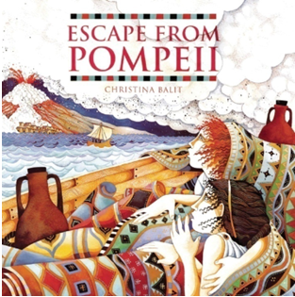





Year 4
Spring term
2
Ready Respectful Safe
Escape From Pompeii
School values this book reinforces:
A key characteristic of a historian is being curious. And the children’s curiosity certainly will be triggered in this unit of work. We aim for all of our children to say, “I wonder why…” and to be compelled to dig that little deeper. Our outcome will be to develop the desire to find out more about the Romans, matched with the skills to know how to find out more.
Why this particular book and not something else?
When the children pick this book up, they will be immediately pulled in by the outstanding illustrations – each picture is so carefully detailed and has been created to not only support the reader’s understanding of the text, but to also reveal more insight into everyday life in Ancient Rome. The illustrator’s attention to detail is wonderful. This attention to detail is then replicated by the wonderful descriptions that take the reader to the streets of Pompeii. In fact, this is exactly what we want children in Year 4 to replicate in their own writing. But how does the talented author achieve this? Once the children get into the story, their vocabulary will be enriched with language that is specific to this unit and we uncover the cohesive techniques that the author uses to pull the descriptions together.
In short, this book is very well-written and can be held up as an excellent example.

Slide 2
Year 4
Spring term
1
Ready Respectful Safe
English Skills that will be developed through this unit:
As our lead text, Escape from Pompeii, has been chosen for its highly descriptive style, our focus will be on the techniques that the author has used to achieve this.
Through unpicking the example text, Year 4 children will consider:
The power of the verb - The verb is the foundation of any sentence. By carefully selecting the best verb for the job we make the first steps in making active choices. It is so important that children understand that before we can elaborate and add detail to an idea, the basic sentence needs to be accurate.
Vocabulary is another key feature. That this book is so successful is down to the language choices of the author and her knowledge of subject specific vocabulary about Ancient Rome. Children will develop their vocabulary in history and will be expected to then apply this language to their writing.
We look at how the author uses adverbial phrases of time, manner and place to add another layer of description.
Year 4 also consider paragraphs and in particular how we develop one idea fully before moving on to a new paragraph. Then when we start a new paragraph, how do we make it flow?
Writing Composition in school:
As descriptive skills are the focus of this unit, the tasks children write will provide opportunities to show-case that learning specifically. Children will describe a busy scene, full of hustle and bustle. They will describe a vibrant scene full of energy. Their end piece will then pull their history knowledge together through a contrasting page; on one side, a highly detailed fictional description of the streets of Pompeii and on the other, a non-fiction set of facts about the same scene.
Writing Tasks:
Any independent research at home about Ancient Rome would benefit your child. Finding fun facts on the internet or borrowing Roman books from the library would have a huge impact.
What do you already know about the Romans? Before we start our unit and you begin any research, it’s good to know what your starting point is. Activate your prior knowledge by thinking about films, cartoons and books that are set in Roman Times. You might surprise yourself by how much you already understand. Record your knowledge on a mind-map or in a way of your choice.
On your homework sheet there will be 3 pictures of Roman artefacts (helmet, sword, pot) Choose one to describe. Here’s some sentence stems you might wish to use. I can see… When it was new, it might have looked… I believe that it was used to…
In your reading this week, look out for sentences in your reading book that you believe are great examples of description. Copy them out. To make this task better, consider why you’ve picked these sentences. Can you identify (and label) what it is that makes the sentence effective?
4) Choose one area of the topic of Romans that interests you the most. For example, gladiators. Find out some interesting facts about that specific area to wow your friends.

Slide 3
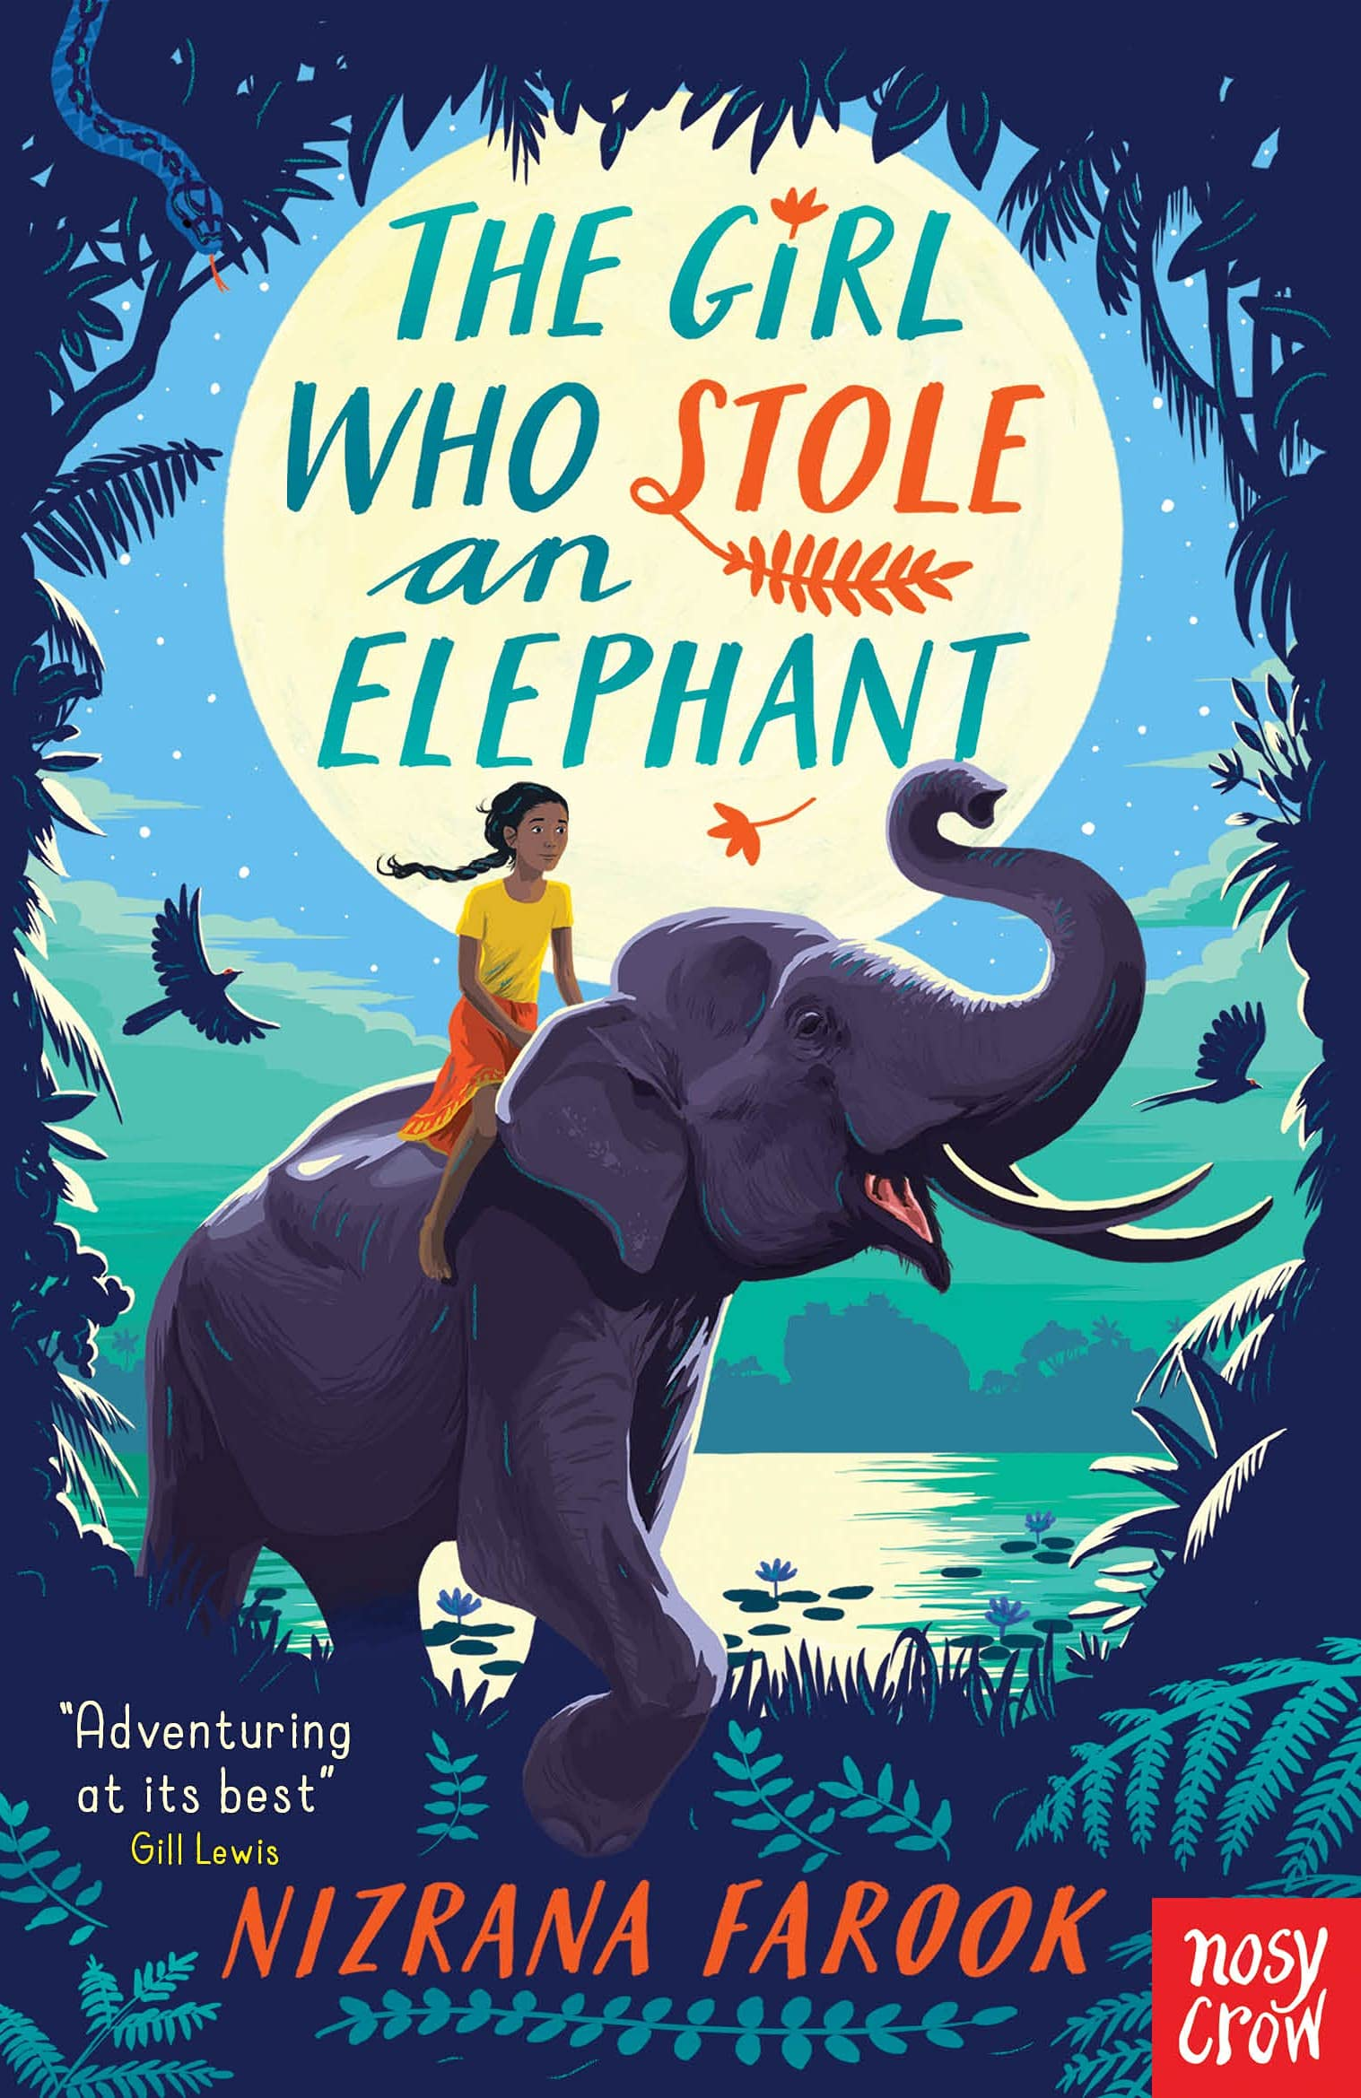
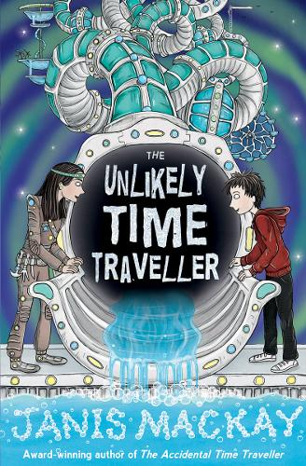
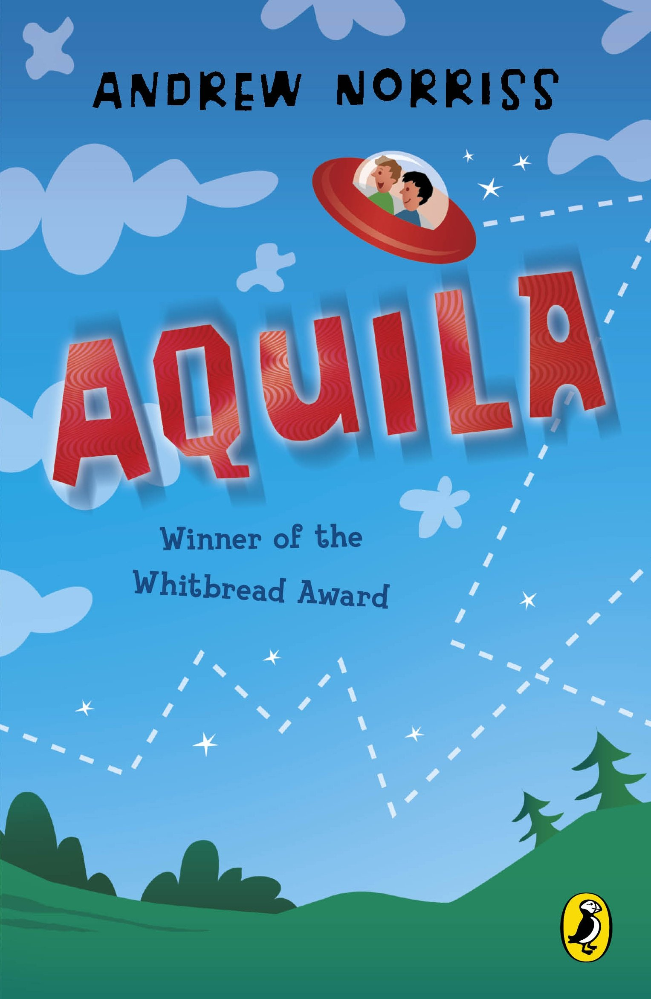
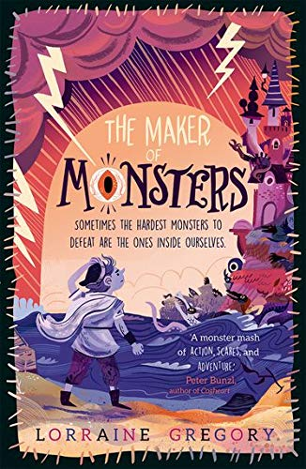
Year 4
Spring term
1
Ready Respectful Safe
Our Extended Book Spine
There are plenty of non-fiction books that we could list to support the history element of this unit and we urge families to head down to the library to borrow non-fiction books about the Romans. Any independent research at home about the Romans will have a positive impact on your child’s learning.
Chaya, a no-nonsense, outspoken hero, leads her friends and a gorgeous elephant on a noisy, fraught, joyous adventure through the jungle where revolution is stirring and leeches lurk. Will stealing the queen's jewels be the beginning or the end of everything for the intrepid gang? With cover illustration by David Dean.
Robbie has disappeared. And, since he'd been asking Saul a lot of questions about time travel, Saul has a good idea where he might have gone... At school they've been doing a project on the future: will it be full of robots and shiny technology? Or will the environment have been destroyed? The last thing Saul wants to do is go there and find out for sure -- but there's no way Robbie will manage on his own in the twenty-second century. What does the future hold in store, and can Saul get Robbie safely back to their own time?
Aquila has been found by boys bunking off a geography field trip. They have no idea where it came from or what it does. But Geoff's discovered that when you sit in it these little coloured lights come on, and if you push one of the big blue ones . . . WHOOSH!
Brat has always lived in the isolated castle on the island, taking care of the vicious creatures that his master creates, waiting in terror for the moment when they are ready to be put to use. But then the unthinkable happens. The monsters get out. Now Brat must overcome his fears, and venture into the world he has hidden from his whole life. For the fate of everyone rests on his shoulders alone. . . A thrilling new standalone adventure from Lorraine Gregory.

