Slide 1

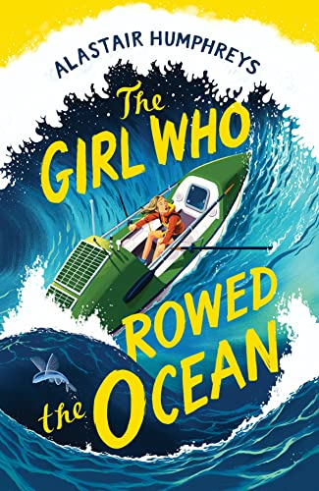
Year 4
Spring term
1
Ready Respectful Safe
The Girl Who Rowed the Ocean
Why this particular book?
It’s always exciting for us to introduce a new book! This book, by Alastair Humphreys, is not only new to Muscliff, it’s a brand new book. When the adults in school read this book, we loved it and recognised straight away that it was a book we wanted every child in Y4 to experience. It’s beautifully written and, of course, demonstrates all of the Y4 skills… but more than that, this book absolutely aligns to our school values and this book very much promotes the school’s identity.
We believe that this book presents the opportunity for purposeful book talk and will provide our Muscliff children with the best springboard to the wider curriculum outside of English.
School values these books reinforces:
Resilience is the key value than runs through this book. Through life, those around us can often have an impact on our feelings towards a task or a new situation. Positive words might empower us whilst negative words could be off-putting. Now, we can’t control the words of others… but we can control how we respond to them. Being resilient means that we have the strength of character to try something because we respect ourselves.
Here’s our favourite quotes from this book. These quotes will help you to understand why we chose this text.
“If you chip away at something little by little, mile by mile, then even a big goal is achievable, so long as you dare yourself to begin it.”
“The hardest part of the journey was getting started.”
“You just have to step outside your front door and be curious.”
“Bad times pass, good times return. Nothing lasts forever.”

Slide 2
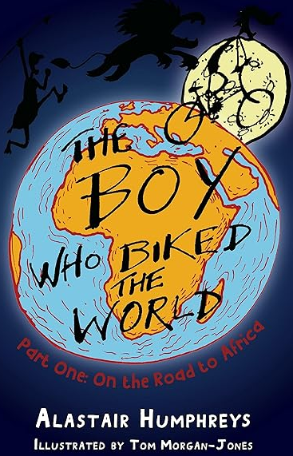
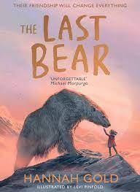
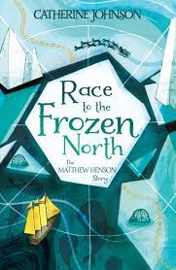
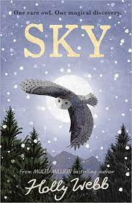
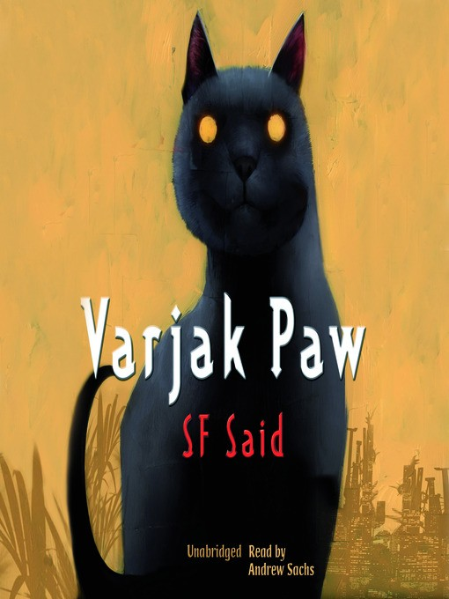





Year 4
Spring term
1
Ready Respectful Safe
Writing Composition in school:
Extended writing opportunities this half term include a dairy that aims to be personal and reflective in the style of the author. In this, we write informally and create a chatty tone. We are open and honest and talk about our feelings. We write about experiences that our reader might also have experienced.
Children also write a telephone conversation that uses full speech punctuation. This includes reported clauses, synonyms for ‘said’ and extra information that adds to the speech.
Writing Homework this half term…
Each week, we suggest a writing activity. Writing at home provides your child with extra opportunities to consolidate the skills that have been taught in class. Pick and choose from the suggested tasks – we look forward to seeing your child’s extra work.
Imagine you are packing for an adventure and you have just enough space to take along just one personal item that would support you, for example a family photograph. What would you take and why?
What makes you angry or bothered? Describe a time when you were hot and bothered – try to focus on your body language.
What makes you feel proud? Describe a time when you felt most proud – try to focus on your body language.
Do you know of anyone in history who has shown resilience? Write a short paragraph about them. The Little People, Big Dreams has many titles of people who have shown resilience.
Can you explain the meaning of this quote: “The hardest part of the journey was getting started.”
Our Extended Book Spine
To complement The Girl Who Rowed the Ocean, our school can thoroughly recommend these texts for this half term:

Slide 3
Year 4
Spring term
1
Ready Respectful Safe
Skills that will be developed through this unit:
Starting with a blank page can seem very daunting for some. In this unit, we teach children different strategies for planning and developing their ideas so that we can become more confident in knowing how to just get started!
Planning and developing paragraphs; full speech punctuation; key features of a diary and writing in a personal style are all taught during this sequence of learning.
Questions:
What techniques does the author use that make it so we ‘get’ the character and can empathise with her? What qualities does the lead character have? (Can anyone row the ocean?)
Why does this book also have diary extracts?
Key Question:
How can our words empower our friends? How might our words discourage our friends?
Our Extended Book Spine
To complement Butterfly Lion, our school can thoroughly recommend these texts for this half term:
Book Title | What is it about? | What your teachers think about this book
The Last Bear by Hannah Gold | There are no polar bears left on Bear Island. At least, that’s what April’s father tells her when his scientific research takes them to this remote Arctic outpost for six months. But one endless summer night, April meets one. He is starving, lonely and a long way from home. Determined to save him, April begins the most important journey of her life… | As this is a celebration of friendship and love it brings out our school values perfectly. It’s a beautiful tale and we are sure that you’d enjoy snuggling down to read this one with your child as the evenings get darker!
Race to the Frozen North: The Matthew Henson Story by Catherine Johnson | Matthew Henson was simply an ordinary man. That was, until Commander Robert E. Peary entered his life, and offered him a chance at true adventure. Henson would become navigator, craftsman, translator, and right-hand man on a treacherous journey to the North Pole. Defying the odds and the many prejudices that faced him to become a true pioneer. This is his incredible and often untold story. | Mystery, adventure, friendship, this book has it all. Apparently, it’s a true story!
Sky by Holly Webb | Staying with her grandparents in the Scottish Highlands, Lara is fascinated by the rare white snowy owl her grandad has spotted flying nearby. And when she follows the beautiful bird into the woods, it leads her on a magical adventure… Transported a century back in time, Lara befriends Amelia, who confides in Lara about her cruel cousin, who she’s sure is trying to hurt the baby owls nesting in the woods. When Lara discovers the hatchlings belong to her owl, Sky, she’s determined to help. But how can she protect them when she needs to return to her own time? | We all enjoyed seeing an owl when we had a visit from the Liberty Centre but that’s not why we wanted this book on the list… It is packed with action, adventure, magic and enchantment, which makes it the kind of book we would choose to read towards Christmas.

