Slide 1

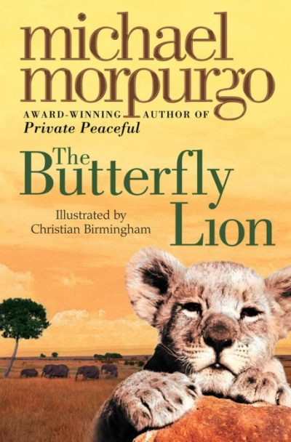





Year 4
Autumn term
1
Ready Respectful Safe
The Butterfly Lion
Why this particular book and not something else?
We have carefully chosen The Butterfly Lion as our lead text because this book is… well, just beautiful! We strongly urge all families to get hold of a copy of this book and read it with your child at bedtime as a shared experience – it is such an endearing story. The author, Michael Morpurgo, is renowned for his vivid descriptions. He is an expert writer for showing the reader rather than telling the reader and his vocabulary choices build a powerful image in the reader’s mind. At this stage of KS2, children need to develop their writing by justifying their choices and making active choices in their writing. Y4 children are expected to think more about their reader’s reading experience. The Butterfly Lion provides an excellent model, demonstrating to our Y4 children the craft of good writing and Michael Morpurgo is certainly the expert in the style we are wanting the children to create themselves.
School values this book reinforces:
Whilst this is truly a heart-warming tale of friendship, loyalty, overcoming adversities and resilience, the key value within the text is kindness. The symbol of the white lion becomes an emblem of kindness as well as a link across generations. Michael Morpurgo is skillful in weaving a story which wonderfully illustrates our Muscliff value, Kindness.
Writing Composition in school:
Re-writing the scene where Bertie says goodbye to his lion gives the children an opportunity to use all of the skills mentioned below. Teachers will be assessing your child’s level of basic accuracy first and their use of phrases. Teachers will consider how the children have absorbed our key vocabulary and the active language choices they have made as well as the topic-specific language discussed in the unit.
Skills that will be developed through this unit:
Before introducing new skills, Y4 spend some time reinforcing the basics to ensure that the children can maintain basic accuracy as their sentences become longer and more embellished with detail. We look at noun phrases (the sad, lonely lion), prepositional phrases (in the cage) and adverbial phrases (late last night) to enhance our sentences. Children learn about pronouns and we begin to be more specific in our identification of pronouns. For example, his/hers are pronouns but they are possessive pronouns. I and me are personal pronouns. In this half term, children also explore past and present tenses – again they need to be more specific and say if a sentence is past progressive (was playing) or past perfect (had played).
Throughout the unit, new vocabulary is introduced and Y4 children learn to be more specific in their language choices. Morpurgo challenges our vocabulary on two levels: firstly, he uses very carefully chosen language to create vivid images. Secondly, the book is set after WW1 so consequently children need to understand some old fashioned words. If your child comes home and asks for semolina pudding, then they’ve listened really well in class!

Slide 2
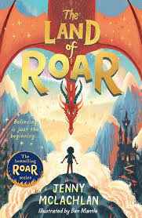
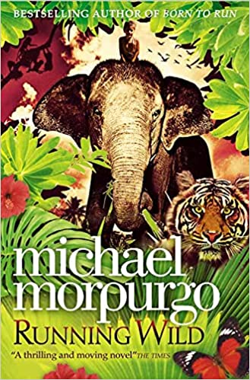
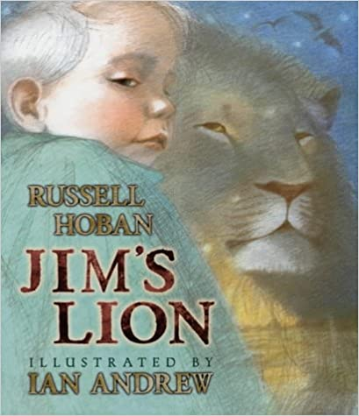
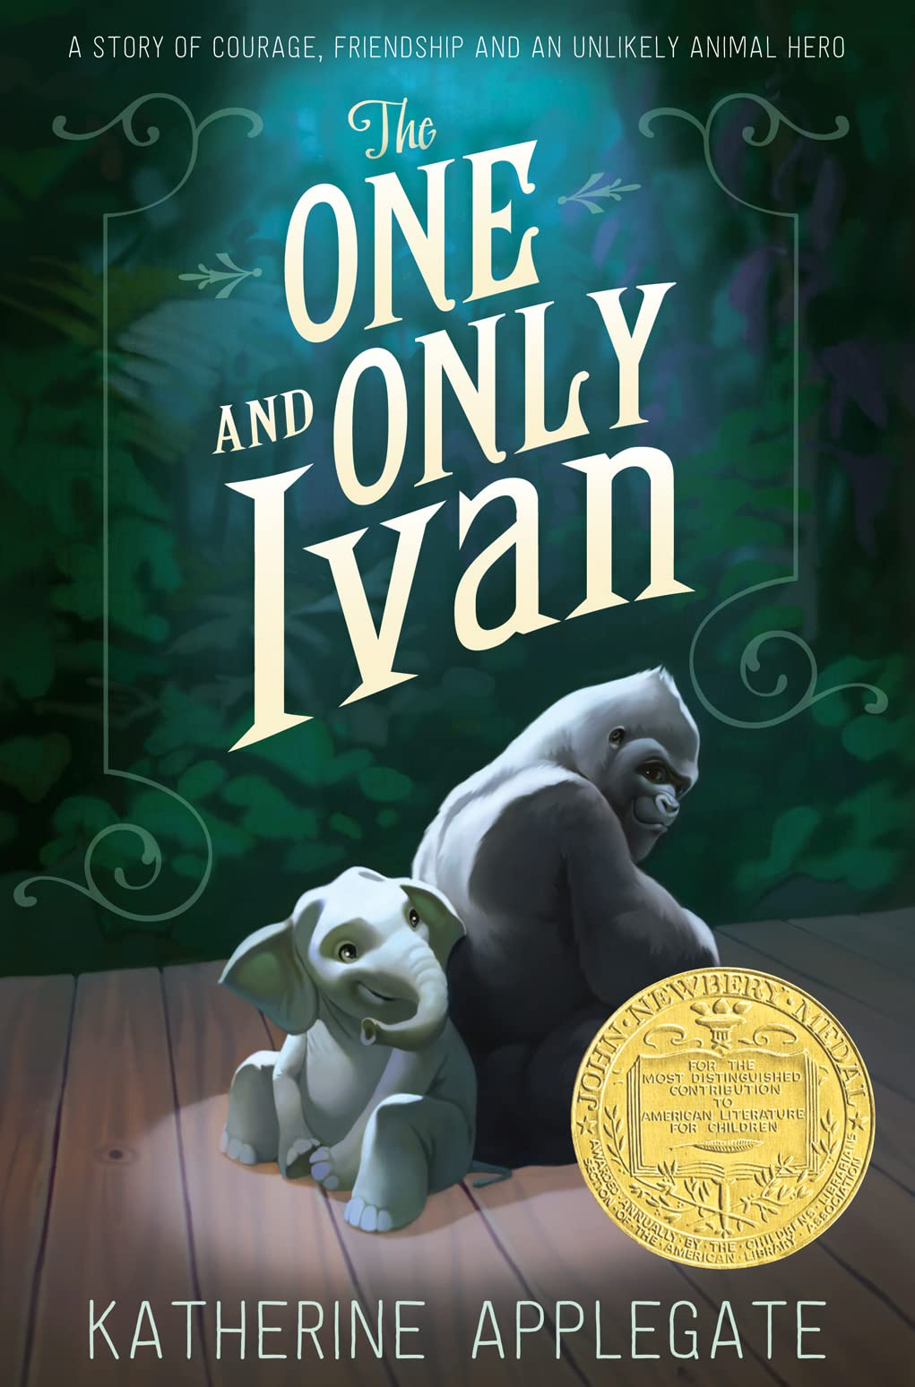
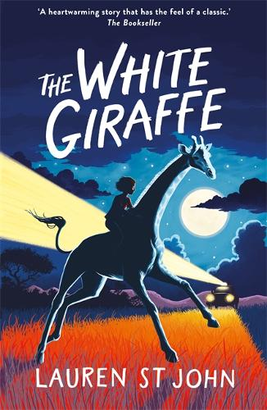
Year 4
Autumn term
1
Ready Respectful Safe
Writing Homework
Here is an overview of each written homework task for this half term. Over this half term, your child should aim to complete some writing at home each week. The time they invest in their written homework will vary from child to child – parental discretion is advised. Alternatively, you may wish to focus on just one or two of these activities and develop them over several weeks with your child.
The start of the story mentions a bully called Basher Beaumont who terrorised Bertie. What advice would you give to Bertie (or anyone else who is being bullied)? Write a short letter to tell Bertie what he should do to ‘speak out’ about bullying. For example, he should certainly tell his grown-ups.
Watch a BBC wildlife programme. Listen to what David Attenborough says exactly. Can you write his words down? Think carefully about where basic punctuation would go. You will probably need to keep rewinding the scene so that you can listen to it in manageable chunks. To expand this, you could write your own version of a wildlife documentary and choose your own animal. Try to imitate some of the language used in the BBC documentary.
Which animals might visit the waterhole in Timbavati, South Africa? Imagine you had just seen an African animal come for a drink in the waterhole. Write down your observations in a diary. Here’s an example to get you started. This evening was exciting! Just as the sun was setting, turning the sky golden, a herd of elephants made their way to the waterhole. I could see them coming from far away as they pushed through the long grass.
Create a fact-file about an African animal of your choice. You might want to look through some non-fiction books to see how they are organised. Think about which ‘sections’ you might want to include about your animal.
Complete some research about Michael Morpurgo. Has he written very many books?
Create a book review for Butterfly Lion. Search for different styles
of book reviews to choose the one the best suits what YOU want to write about this book.
Our Extended Book Spine
To complement The Butterfly Lion, our school can thoroughly recommend these texts for this half term:

Slide 3
Year 4
Autumn term
1
Ready Respectful Safe
Our Extended Book Spine
To complement Butterfly Lion, our school can thoroughly recommend these texts for this half term:
Book Title | What is it about? | What your teachers think about this book…
The Land of Roar by Jenny McLachlan | The new middle-grade fantasy that will make you believe in magic! When Arthur and Rose were little, they were heroes in the Land of Roar, an imaginary world that they found by climbing through the folding bed in their grandad’s attic. Roar was filled with things they loved – dragons, mermaids, ninja wizards and adventure – as well as things that scared them (including a very creepy scarecrow. . .) Now the twins are eleven, Roar is just a memory. But when they help Grandad clean out the attic, Arthur is horrified as Grandad is pulled into the folding bed and vanishes. Is he playing a joke? Or is Roar . . . real? | When we read this book, we liked the imaginative content. It’s magical, full of adventure, fantasy and some time travel too.
Running Wild By Micheal Morpurgo | The epic and heart-rending jungle adventure from the nation’s favourite storyteller Michael Morpurgo. For Will and his mother, going to Indonesia isn't just a holiday. It's an escape, a new start, a chance to put things behind them – things like the death of Will's father. And to begin with, it seems to be just what they both needed. But then Oona, the elephant Will is riding on the beach, begins acting strangely, shying away from the sea. And that's when the tsunami comes crashing in, and Oona begins to run. Except that when the tsunami is gone, Oona just keeps on running. With nothing on his back but a shirt and nothing to sustain him but a bottle of water, Will must learn to survive deep in the jungle. Luckily, though, he's not completely alone…He's got Oona. | Year 4 love Michael Morpurgo! He writes many books and if you were to read them all, you’d spend your whole year only reading his books (and we encourage children’s exploration of different authors rather than reading the same author – even if he is amazing!). However, this is one we would really recommend alongside Butterfly Lion.
Jim’s Lion By Russell Hoban | From the incomparable Russell Hoban comes a moving, unflinching tale of a boy who finds bravery during illness, beautifully re-imagined as a graphic-novel by award-winning illustrator Alexis Deacon. Asleep in his hospital bed, Jim dreams of a great lion with white teeth and amber eyes. This lion is Jim's finder. According to Nurse Bami, everyone has a finder, a creature who comes looking for us when we are lost. But when the time comes for Jim's operation, will his lion be able to find him and bring him safely home? With the inclusion of powerful dream sequences, and a triumphant message of facing one's fears, Russell Hoban's tale of a boy's search for strength and courage will resonate with any child dealing with adversity or sickness. | Facing your fears, search for strength and courage, adversity and sickness… We haven’t picked this just because it’s about a lion! We’ve suggested this book because it’s very well written and would appeal to Year 4 children.
The One and Only Ivan | Winner of the Newbery Medal 2013 Inspired by a true story, this is the beautifully written tale of how a mighty gorilla wins his freedom. A winning blend of humour and poignancy that will appeal to fans of Michael Morpurgo. Ivan is an easy-going gorilla who has spent his life performing for the crowds at the Exit 8 shopping mall. He rarely misses life in the jungle. In fact, he hardly thinks about it at all. But everything changes when a baby elephant called Ruby arrives and Ivan realises he must find a new life for them both. | Deals with issues of bullying, self-confidence and friendship. Good characters and plot, similar style to Michael Morpurgo. We give this a thumbs up!

