Slide 1

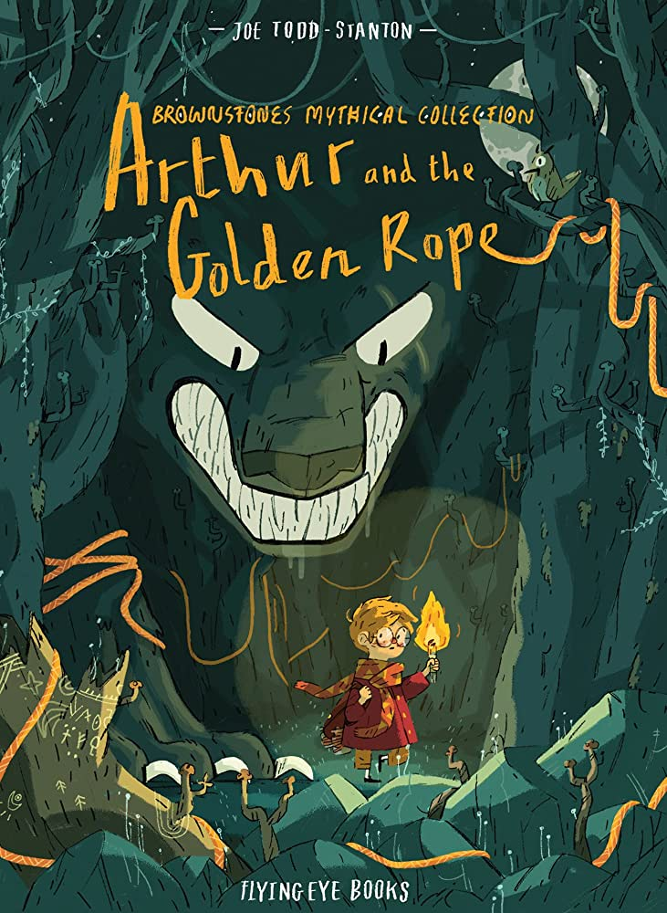





Year 3
Summer
2
Ready Respectful Safe
Arthur and the Golden Rope
Why this particular book and not something else?
This book is brand new to Muscliff this year (your children will be the first to enjoy it) and as soon as we came across Arthur and the Golden Rope, we fell in love with it! What makes it so special is its visual presentation… it is very unusual: the illustrations are exceptionally detailed and it is presented in a comic book style. It will certainly get the children talking and considering how books can be organised. Layout and organisation is a key feature of a text and we can easily overlook this skill. But organisation is actually fundamental in how we interpret the contents of any book. And of course, the content of the book is just wonderful. Arthur and the Golden Rope is an endearing story of adventure and kindness. Oh, and it’s about Viking mythology too, which is helpful!
School values this book reinforces:
Kindness is our final value this half term.
Whilst curiosity motivates Arthur to begin his adventure, it is his kindness that keeps him going. Although Arthur initially sees the dragon as an obstacle, he ultimately befriends it and works together to retrieve the golden rope’s final piece.
Key questions:
To be able to have such an amazing adventure, Arthur needs to rest and sleep. How would the adventure have been different if Arthur had no energy?
Do you think Vikings were healthier than people today?
Of all of the book characters that you have read about this year, which one do you think is the most kind and why?

Slide 2
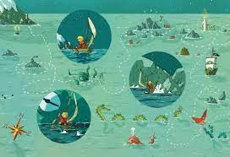
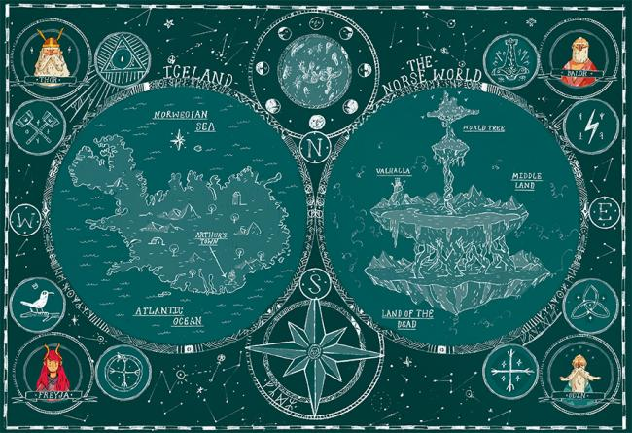
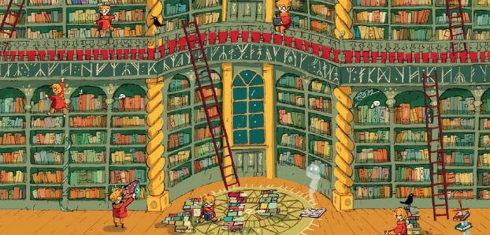
Year 3
Summer term
2
Ready Respectful Safe
English Skills that will be developed through this unit:
Understand a character through their actions – link personality to behaviour.
Use speech for characterisation – link what a character says to their personality.
Use the possessive apostrophe
Consider how to organise and group ideas so that it is not only clear for the reader, but exciting for the reader to see.
Identify the rhythm and rhyme in poems.
Use a thesaurus correctly, selecting appropriate words and giving a reason for my choices.
Writing Composition in school:
Create a page for a key part of the adventure that shows unusual and purposeful organization. Explore how different texts layouts engage the reader .
A comic book page.
Poem – oral performance.
Help at Home:
As this unit is centred around Viking myths, can you research Viking mythology? With support from a grown-up, use the internet to find names of characters and stories from Viking myths. You could even choose one myth and create a story board for it using pictures.
Arthur looks at artefacts in a Viking vault. What things might be found in a museum vault about Vikings?
Create a comic book strip! Here’s the scene – imagine Mrs Wood tells this joke (or a joke of your own choice) to Year 3. “Why did Mrs Frampton have to put on her sunglasses?” “I don’t know. Why did Mrs Frampton have to put on her sunglasses?” “Because the Year 3 children were so bright.” Use speech bubbles and drawings to create this comic strip.
What is the difference between comic books and more traditional story books? Which do you prefer and why? Would you rather read a comic or a story without pictures? Are comics just for people who don’t like reading much?
Find a short poem that you like. Can you read it and practise saying it aloud. Have a try at reciting it to your soft toys or family members. For an ‘Over and Above’ card, you could recite a verse to your teacher.
Do you think Vikings were healthier than people today? How were their lives healthy through exercise and the food they ate?
Persuade Mrs Fenby to have a picture of Arthur painted on the walls of the Curriculum Tower.

Slide 3
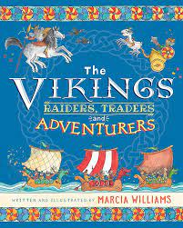
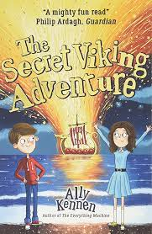
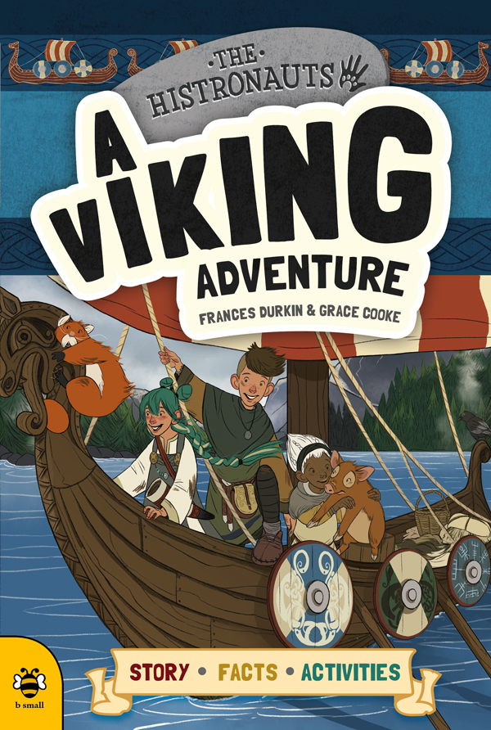
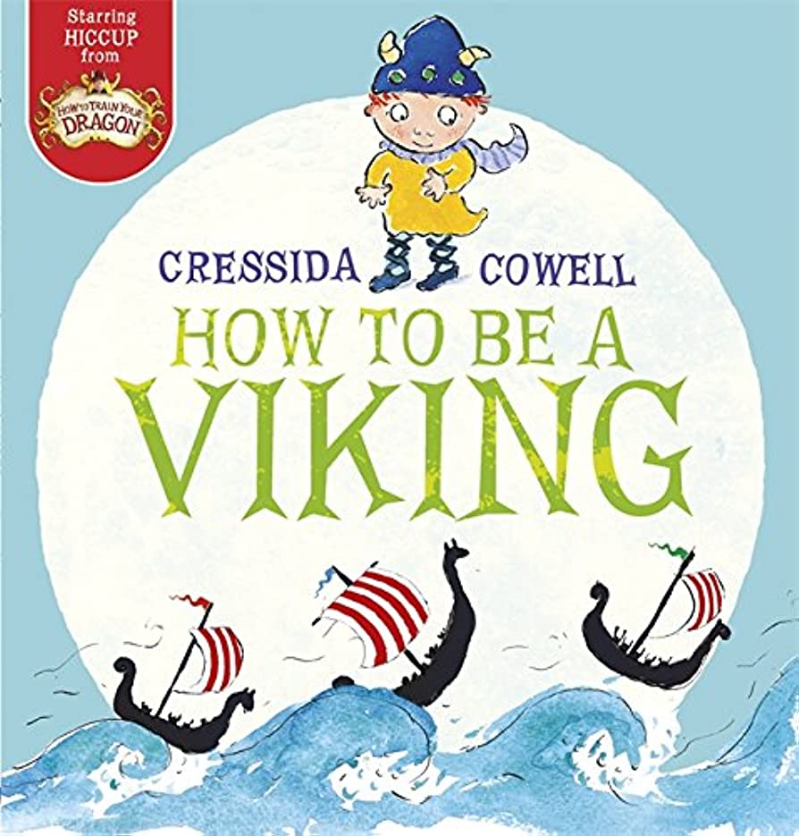
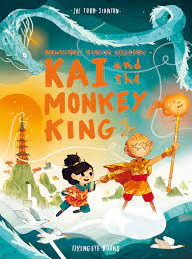
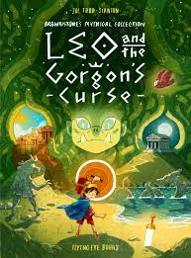
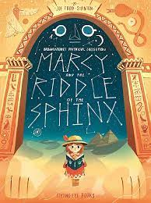
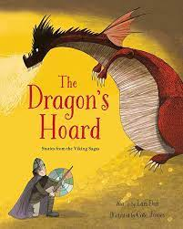
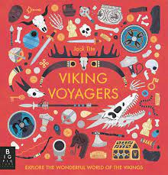
Year 3
Summer term
2
Ready Respectful Safe
Our Extended Book Spine

