Slide 1

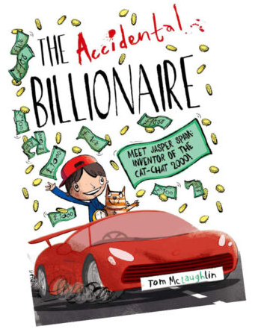





Year 3
Summer
1
Ready Respectful Safe
The Accidental Billionaire
Why this particular book and not something else?
This book aligns perfectly to our whole school value of aspiration. The Accidental Billionaire shows the children that success isn’t easy and that our goals should be driven by aspiring to improve ourselves. The lead character in this story, Jasper, shows Year 3 how his character is developed through overcoming difficulties and problems – the end result is that he is a better version of himself.
We love the structure of this story – children quickly relate to the main character, the dilemma of the story is very easy to identify and then the end moral is clear. Y3 deconstruct the sequence of the story and analyse how the author, Tom McLaughlin, tackled each part of his wonderful story.
School values this book reinforces:
Aspiration is our key value within this unit and we discuss how we should all aspire to be the best version of ourselves. – instead of measuring success by how much money we have, we should instead measure our success by happiness and the positive impact we have on others.
After creating an invention, Jasper has the wealth to buy anything he dreams of – mansions, cars, sports teams… But is it wealth that makes him happiest?
Key Question:
Is money always sign of success?
Is Jasper happier when he is rich?

Slide 2
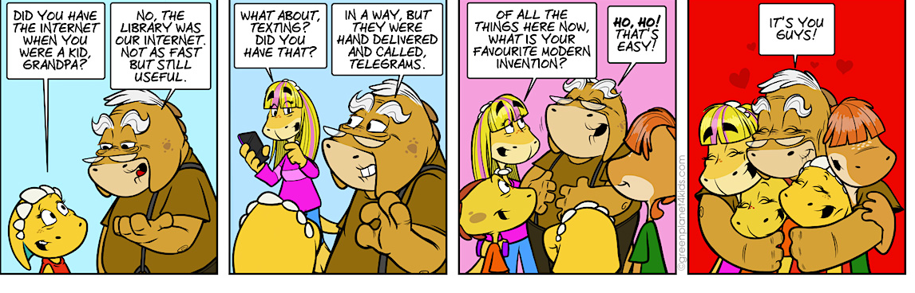
Year 3
Summer term
1
Ready Respectful Safe
English Skills that will be developed through this unit:
We use this book to unpick successful story structures. Stories tend to follow a set formula in that the reader is introduced to a main character, there will be a dilemma, the problem will get worse and then there will be a resolution and the main character will learn an important moral lesson.
Children unpick how the author builds a character that the reader can relate to and like.
Children create a character profile which leads to innovating their own character.
Children learn how to plan a story using a range of story maps and plans.
Children innovate a problem and an invention
Children develop direct speech.
Writing Composition in school:
Children will build a character profile which will make the character’s moral values obvious to the reader – of course, their character will show aspiration and curiosity.
We look forward to the Year 3 children inventing a crazy machine… which goes wrong! This will give a perfect opportunity to describe the dilemma and the outcome.
Help at Home:
1) Think about some of the things that help your everyday life. From a simple tin opener to a complex phone, there have been many inventions, each designed to make our lives easier. Draw a detailed diagram of an invention in your home. If you choose an electronic device (we expect many children to choose Xbox or Playstation or Nintendo Switch), try to find a diagram online of the inside of the machine rather than drawing just what it looks like on the outside.
2) Research a real inventor. Create a profile including where and when they were born and if they needed to overcome any difficulties to make their invention a success.
3) Thinking about aspiration… Can you think of any book characters that had dreams of success? What problems did they encounter along the way? Create a character profile of a fictional character, like Jasper in our story, who aimed high.
4) Turn this cartoon into direct speech. Remember to punctuate your speech accurately.
5) What would be your ideal job when you are an adult and why?
6) Would you rather have a talking cat or a dog that can fly?

Slide 3
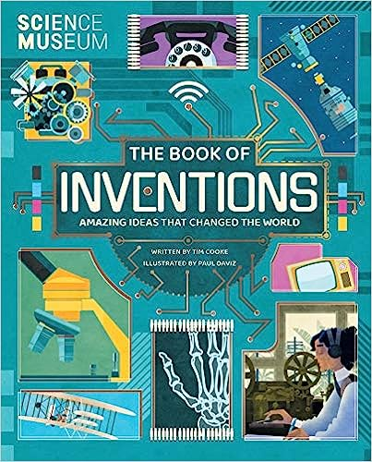
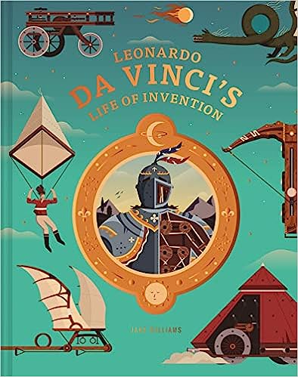
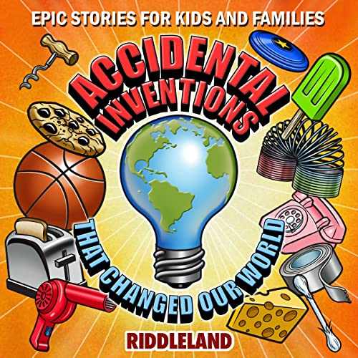
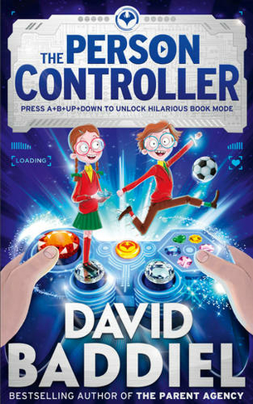
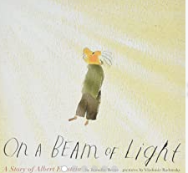
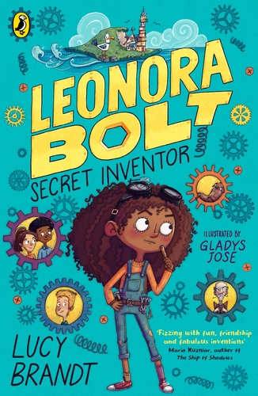
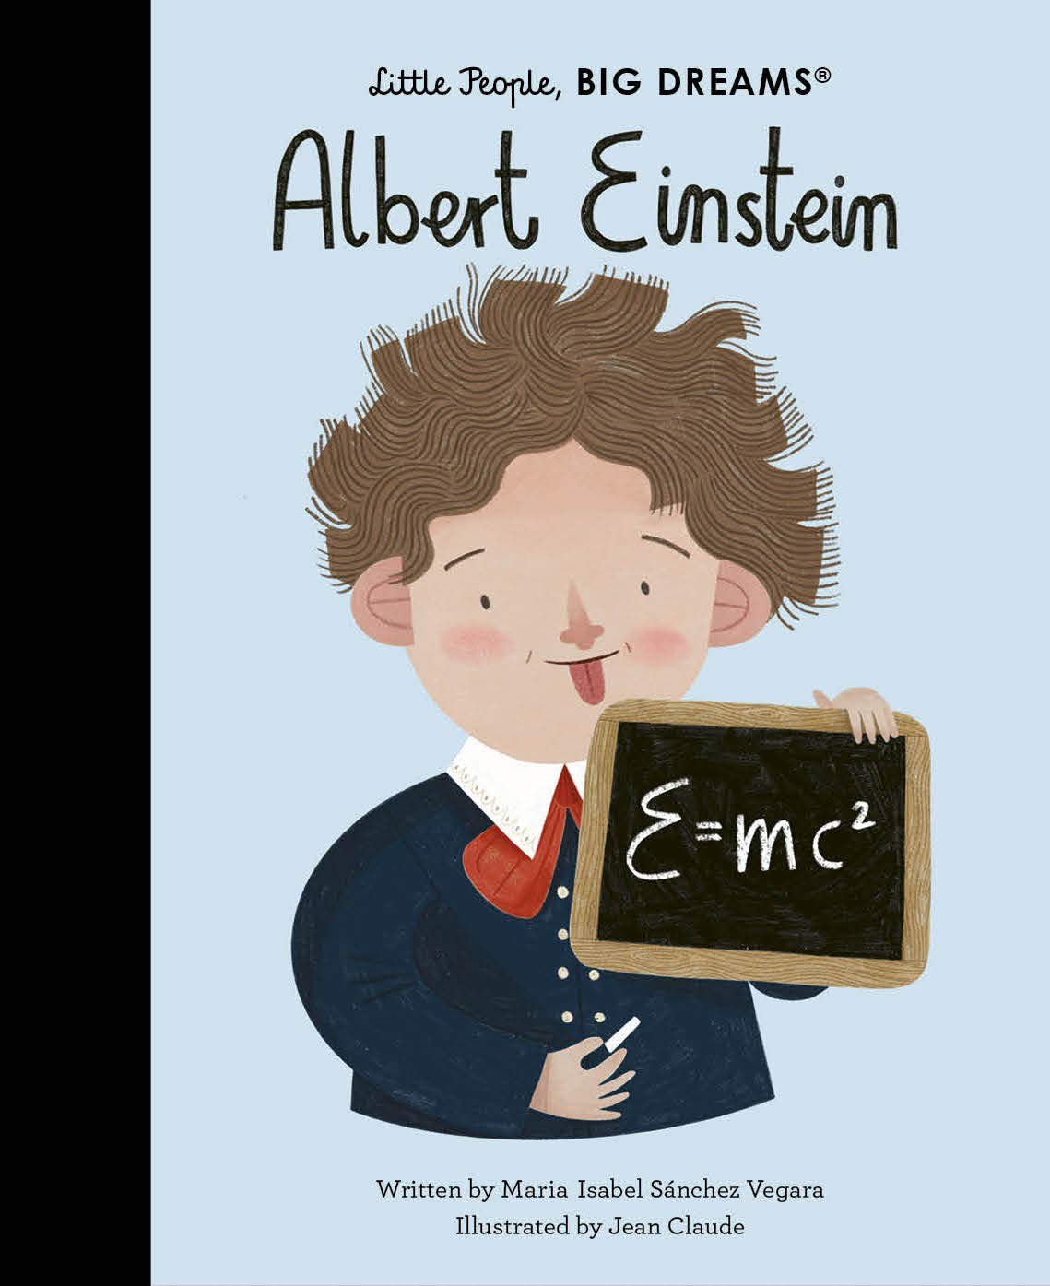


Year 3
Summer term
1
Ready Respectful Safe
Other texts we use in school:
Our Extended Book Spine
Find out how, when and why the inventions which we take for granted today happened, and learn more about the people who created them.
Immerse yourself in the world of the spellbinding genius Leonardo da Vinci, master of art, architecture, engineering, mathematics and more.
Accidents happen. Sometimes that’s a good thing.
Did you realize cheese puffs, Coca-Cola, bubble wrap, and the Post-it note were all invented by accident?
With Fun Illustrations For Every Story!
On a Beam of Light celebrates curiosity and the powerful mind of a quiet little boy called Albert. Albert watched the world in silence – not speaking at all as a young child. Then one day he is given a magnetic compass, and it sparks a lifetime of exploration.
Leonora Bolt spends her days creating incredible inventions in her TOP SECRET laboratory, under the watchful eye of her terrifying uncle.
We adore these books in the series Little People, Big Dreams. These 3 have made it into our list of top recommendations for Year 3 this half term.

