Slide 1

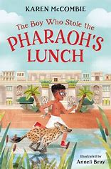
Year 3
Autumn term
1
Ready Respectful Safe
The boy who stole the Pharaoh's Lunch
Why this particular book and not something else?
Understanding events that happened thousands of years ago can be very hard when you are only 7 years old yourself and trying to understand an Egyptian sarcophagus or a canopic jar is very challenging indeed. Luckily, in 'The boy who stole the Pharaoh's lunch' all of this vocabulary is encountered.
When we first got hold of this brand-new book, what stood out most was the story’s structure. As an introduction to chapter books, we felt the structure of this book very much supports the children’s understanding of how a story develops. The structure is very clear – in fact, the story structure is very similar to the good old-fashioned Magic Key books. But in being a chapter book, rather than a picture book, each step in the story sequence is expanded with detail and is packed with key vocabulary.
School values this book reinforces:
Being curious is a key value that we believe all children should develop and we encourage them to be critical thinkers, just like Seth. At the start of the story, Seth isn’t at all curious and he is not very keen on learning either. Through Seth’s character development, this book shows our children that by being a critical thinker, we can begin to better understand the world around us.
Writing Composition in school:
In school, our main focus is story structure. Children will plan a story that follows the same structure as our lead text. They will write a story start that will give them the opportunity to demonstrate their descriptive writing skills.
Children will also write a recount of their school trip to Dorchester.

Slide 2
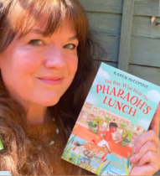
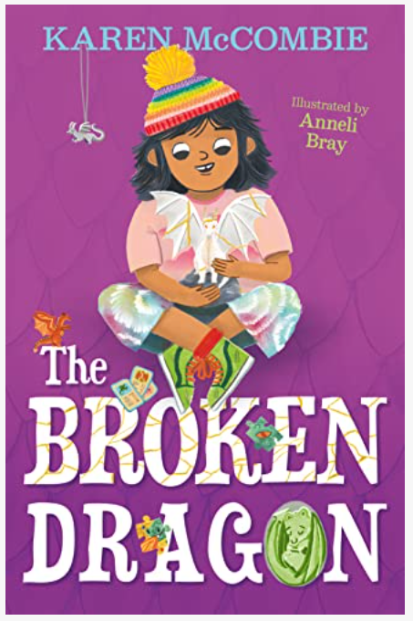
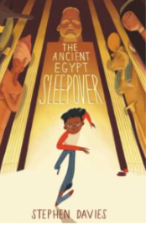
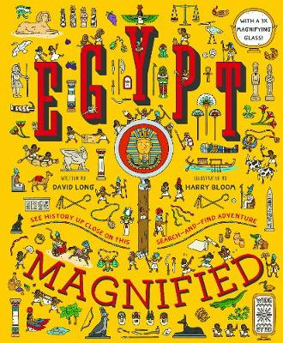
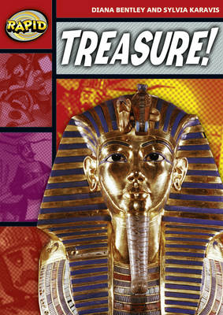
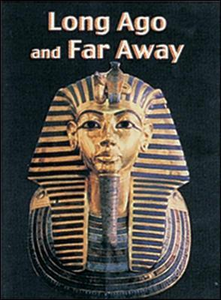
Year 3
Autumn term
1
Ready Respectful Safe
The boy who stole the Pharoah's Lunch
Skills that will be developed through this unit:
This unit supports children to understand how stories are structured. We consider what common features must be established at the start, middle and end of any story.
We learn how to plan a chronological sequence using a Story Mountain.
Use of a dictionary and thesaurus will be another skill that is rehearsed in class and parents might want to consider supporting their child by looking at alphabetical order and using a dictionary together at home.
We consider the editing and redrafting phase.
When we meet the author, we will look at composing questions.
Throughout this term, teachers will be looking for adventurous language choices and acquisition of vocabulary specific to this Egyptian unit.
Our Extended Book Spine

Slide 3
Year 3
Autumn term
1
Ready Respectful Safe
Writing Homework
Here is an overview of each written task for this half term. Over this half term, your child should aim to complete some writing at home each week. The time they invest in their written homework will vary from child to child – parental discretion is advised. Alternatively, you may wish to focus on just one or two of these activities and develop them over several weeks with your child.
Complete your own research about the Egyptians. Choose just one aspect that interests you and try to focus your research on that one area. So instead of a title, ‘Egyptians,’ your title might be ‘The Egyptian Pyramids.’ Create a fact sheet to present your findings. When you compose your work, consider using ICT to publish your work – the teachers love PowerPoint!
As our focus is settings, show off your skills by choosing a new setting of your own choice that Seth could visit. Think about the types of setting that could generate some wonderful language choices. For example, a woods at night time might give you more opportunities than some less exciting settings.
Have a listen to songs on the radio! Choose a song that you like to hear and write down some of the lines. Your challenge is to put the words into direct speech. I wonder what song you’ll choose. “I get up too late,” sang Taylor Swift.
Step outside your house and jot down what you can see/hear and smell. When you get back inside, build your observations into full descriptions. Check that all full stops and capital letters are correct. To make it more interesting for your reader, you could pick some words to improve by using a thesaurus.
Collect some leaflets of attractions. (The foyer of Sainsbury’s at Castlepoint often has them.) Which leaflets look the best? If you could visit any place, where would you go?
Create a postcard that the Egypt Museum could sell or make a postcard and write on it about your day.
Keep a diary this week. Aim to write a couple of sentences for each day. What was the best part of the day? What made you laugh and smile?

