Slide 1






Year 2
Spring term
1
Ready Respectful Safe
The Hodgeheg
Why this particular book and not something else?
Dick King-Smith’s The Hodgeheg is our key text for Spring 1. The adventure of Max, the hedgehog, takes us on twisting and winding paths through a town where Max is desperately trying to find a safe way to cross the road. It’s a brilliant book! We pick out Dick King’s-Smith’s wonderful characterization to support our own character development and there are plenty of good writing opportunities (see below) that support Max on his mission. Our wider curriculum is then supported using this book - we link Max’s adventures to our Road Safety walk through Muscliff; this is used as a stimulus for the children to write a recount of their trip. In geography, we consider our local area of Throop and Muscliff and we begin to understand maps.
Writing Composition in school:
This half term, children are taught to write in a variety of genres. We write letters and begin to understand how letter writing style is different to story writing style. We create instructions on how to cross a road safely. There’s also fact writing about animal habitats. Finally, the children adapt Max’s story and use their imaginations to create their own stories about Max’s adventures. In further pieces of writing, the children develop their knowledge of command sentences by writing instructions for Road Safety and create persuasive letters which argue for more zebra and pelican crossings around our school.
School values this book reinforces:
Resilience is the key value in this book. When Max can’t find a place to cross at first, he keeps trying until it is safe to cross the road.
English Skills that will be developed through this unit:
Plenty of writing skills are developed this half term in order to support the full range of tasks and styles the children tackle in order to get Max across that road safely. We formulate questions (remembering a question mark and how to spell the ‘wh’ words: what, when, where, why) and remind children of all 4 sentence types (questions, commands, statements and exclamations) that we encountered earlier this year. We use these skills to help us write a set of instructions on how to cross a road. We look at adding an adverb to our commands to be more precise. “Walk across the road sensibly.”
We suggest synonyms to improve our vocabulary for the reader. “Never sprint across a road.”
We take a look at spelling patterns that use _ing when we explore present tense.
Comparing adjectives using _er and _est is another skill to add to our set. Quickest, slowest.
And of course, it wouldn’t be Y2 without another hit on conjunctions (because, so, when, and).

Slide 2
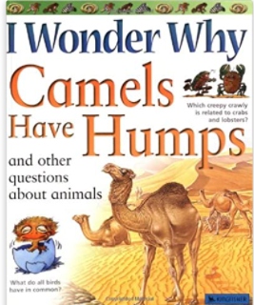
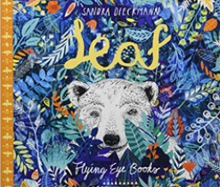
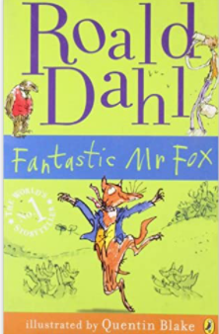
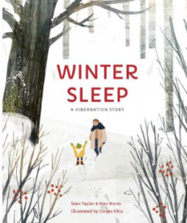
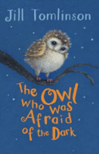
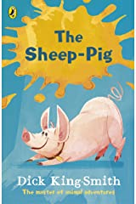
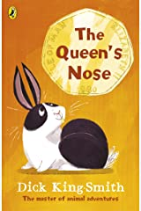
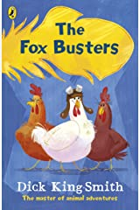

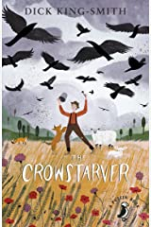
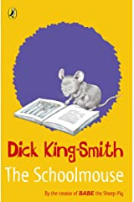
Year 2
Spring term
1
Ready Respectful Safe
Writing Homework
Here are the writing tasks that will appear each week this half term on the homework sheet in the red folder. The tasks here mirror the children’s learning in class. As always, the task is secondary to the conversation you have with your child about their learning. It’s that chat that will support your child most with their progress and understanding!
1) We have been reminding ourselves of the 4 sentence types (questions, commands, exclamations, statements). Pick an object, any object – it could be your child’s favourite toy or something completely random. Place it in the centre of a piece of paper. Around it, write an example of each sentence type. In this example, I have picked a potato! (how random!):
Question = What is the best way to cook you?
Command = Jump in my oven and don’t come out until you are cooked.
Exclamation = What a strange shape you are!
Statement = Potatoes can be cooked in many different ways.
2) Faster, stronger, better are _er adjectives. Draw a picture of a cool toy and explain why it is the best toy ever! Write a few sentences. For example, This RC car is faster than any other. It has brighter lights.
3) Make a short poem by adding your own animals. Follow the pattern by using noun phrases:
If I were a butterfly, I would have colourful, stunning wings.
If I were a monkey, I would have a long, powerful tail.
4) Write a letter to Mrs Fenby to tell her what you like most about Year 2.
5) How to instructions have been a feature this week. Write a set of instructions of your choice. You could write about how to brush your teeth or even how to bake cookies. It’s up to you!
Our Extended Book Spine
To complement The Hodgeheg, our school can thoroughly recommend these texts for this half term:
Please turn over to find out more about these recommended books.
If you are enjoying the Hodgeheg, you might want to explore other books by Dick King-Smith. He has written far too many books to list here but you may be interested in these:

Slide 3
Year 2
Spring term
1
Ready Respectful Safe
Our Extended Book Spine
To complement Treasure Island, our school can thoroughly recommend these texts for this half term:
Book Title | Spring 1 – Year 2: The Hodhegheg | What our teachers think about this book:
I wonder why Camels have humps? | This is a large, colourful non-fiction text which show-cases clearly all the features of non-fiction. It addresses such questions about animals as why camels have humps, how bats see in the dark, and why birds have feathers. | We think that this one will be popular in the book corner. It encourages book talk and oracy whilst stimulating the importance of making observations and questioning in a non-fiction text. It’s just a great example of non-fiction!
Leaf by Sandra Dieckmann | When a polar bear arrives unexpectedly in the woods, the other animals fear and avoid him, suspecting him to be dangerous - and his odd habit of collecting leaves only adds to their distrust. Then one day, they watch as he attempts to fly over the water with wings made of colourful leaves... trying to get back home. Perhaps he isn't so different after all? | We enjoy this book because it provides the opportunity to explore many themes – displacement, exclusion, equality, refuges as well as the plight of wildlife with climate change effecting habitats. It gives us an opportunity to reinforce our school’s values.
The Owl who was afraid of the dark Full version Jill Thomlinson | A cuddly classic about fitting in and being brave. If you’re scared of the dark, join this little owl and learn to beat your fear. Being afraid of the dark is a common problem for lots of small people like you. But just imagine how much worse it is if you’re a barn owl, like Plop! After all, owls come out at night. Plop is meant to love the dark. Will he ever learn to be a true night owl? Follow Plop on a magical journey to find out… | This is a book every child should read! We are pretty confident that most KS1 classes across the school had this on the bookshelf even before we created our reading spine. Jill Thomlinson’s humorous word choices describe Plop’s character perfectly and show that we can create a picture in our mind through word choices alone!
Fantastic Mr Fox Roald Dahl | Fantastic Mr Fox is the legendary tale of the most cunning fox in the world by Roald Dahl. Every time Mr Fox steals a chicken from the farm, Farmers Boggis, Bunce and Bean grow wild with rage! They're the nastiest crooks in the valley, and they've concocted a cunning plan to dig him out of his hole once and for all. But it never occurs to them that Mr Fox has a fantastic plan of his own . . . | A modern classic narrative text. It wouldn’t be a reading spine without Roald Dahl. This could be your child’s first introduction to Roald Dahl texts with the added bonus that the film can be watched after! It has humour, very strong character descriptions and short manageable chapters. We can thoroughly recommend this book for Y2 – they will love it!
Winter Sleep – A hibernation Story. | Sean Taylor partners with ecologist Alex Morss and illustrator Cinyee Chiu to create the text for this quiet, enticing walk into the natural world. The story begins in summer, with a young boy staying at Granny Sylvie’s, on a walk to their secret glade, taking in the wonder of the vibrant wildlife all around. Readers next meet them in winter, with the delights of the summer hidden; only able to be visualised by the boy through Granny Sylvie’s rich and vivid descriptions. The pictures work alongside the rich, poetic language to create a sense of awe, wonder and joy in the natural world. An appended information section provides an illuminating guide for young explorers. | Ok, it is a book about Winter so if you’re interested in this book, read it straight away before the spring arrives. This links well to our Year 2 Science habitats work and ongoing observations of the seasons. It’s an interesting mix between fiction and non fiction and the joy that can be found by listening to other people’s stories!

