Slide 1

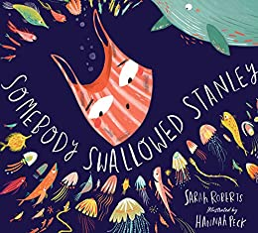





Year 2
Autumn term
1
Ready Respectful Safe
Somebody Swallowed Stanley
Why this particular book and not something else?
Living in a seaside town, our beach and the coast are important to the children of Muscliff and looking after our surroundings, particularly the wildlife in the sea, is meaningful to the children in Year 2. That’s why Year 2 have selected this text – it’s very relevant to us here in Bournemouth. As a relatively newly written book, Somebody Swallowed Stanley is up –to-date and very topical. It provides opportunities to explore new vocabulary, discuss important issues around recycling and produce some great pieces of work. Through these texts, the children will be exposed to a variety of fiction and non-fiction writing. These engaging authors use a range of sentence types and punctuation in their writing, which really supports the children as they develop their own understanding of commands and questions.
School values this book reinforces:
The focus of this unit is our school’s value of responsibility. Through our lead text and complementary books, children recognise that it will be their responsibility to care of the environment and the world that they will inherit. Of course, we are also responsible for our own actions and for caring for our locality and school.
Writing Composition in school:
Using all of the key skills listed in the box below, the children work towards creating an information page about how we should look after our school. This will provide them with an opportunity to use the 4 sentence types (statements, commands, exclamations and questions) to engage their reader and use these constructions to help their reader to also understand how important it is to take a responsibility. Children will also be required to use vocabulary that they have acquired throughout the unit. Instructions will also be a style of writing that children explore.
Skills that will be developed through this unit:
Identifying nouns
Creating noun phrases
Identifying adjectives
Subject and verb - can we consistently identify the verb in each sentence and who is ‘doing’ the action?
Past tense/ present tense - can we sort sentences by identifying the verb in these sentences?
Changing tenses - can you change the tense of the verb?
-ed suffix words - spelling words are linked to past simple tense verbs ending in _ed. For example, played.
Some irregular past tense verbs - not all verbs in the past end in _ed. For example, brought, caught.
Commands
Questions
Sequence commands
Conjunctions (co-ordinating and subordinating)

Slide 2
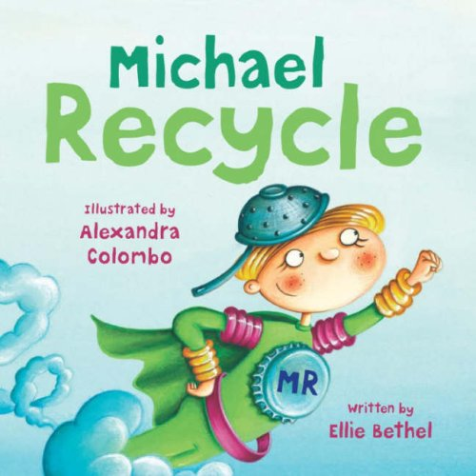
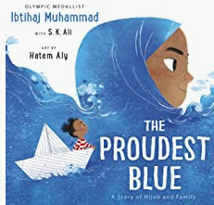
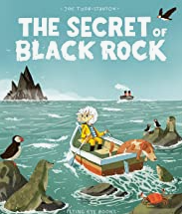
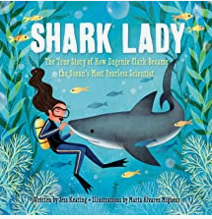
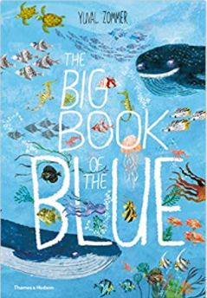
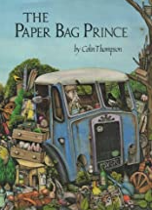
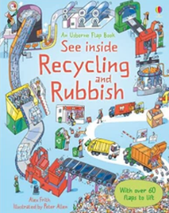
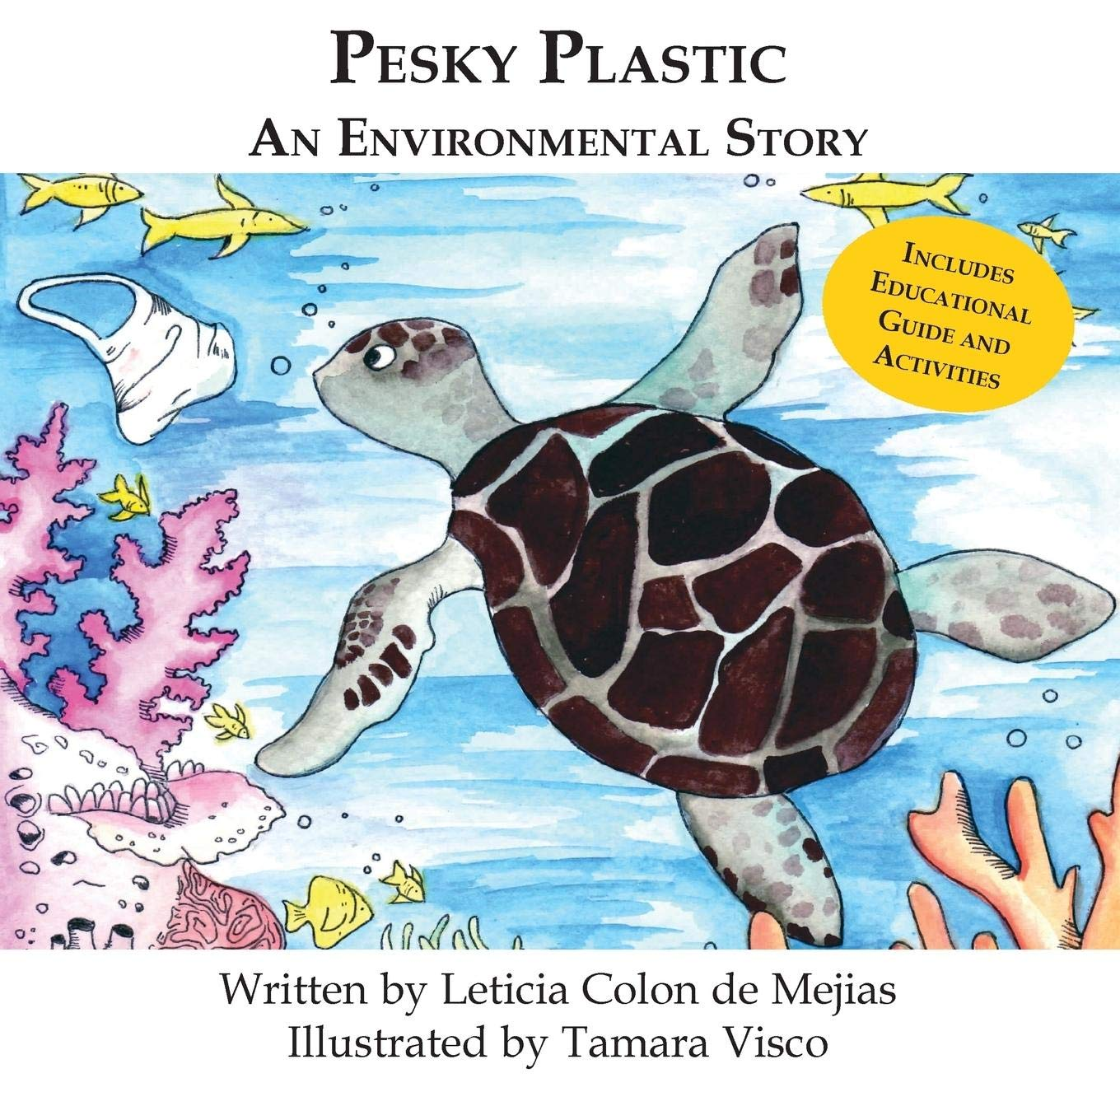
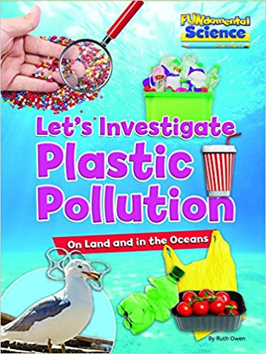

Year 2
Autumn term
1
Ready Respectful Safe
Writing Homework
Here is an overview of each written task for this half term. Over this half term, your child should aim to complete some writing at home each week. The time they invest in their written homework will vary from child to child – parental discretion is advised. Alternatively, you may wish to focus on just one or two of these activities and develop them over several weeks with your child rather than completing all of the tasks.
Make an alphabetical list of things to do with this ocean and the beach. For example, A is for Angel fish, B is for Beach, C is for Coral…
Write a diary of your weekend news. If you use a verb that ends with _ed, underline it.
Design a poster for the beach urging people to take their litter home or a sign for Throop Mill that tells people to pick up after their dog.
Imagine you are at the beach. Write a postcard to your teachers explaining what you’ve been up to.
Create a set of instructions explaining a process of your choice. This could be as simple as how to brush your teeth (properly!) or could be a more complicated process, such as how to play your favourite game.
Our Extended Book Spine
To complement Somebody Swallowed Stanley, our school can thoroughly recommend these texts for this half term:
Please turn over to find out more about these recommended books.
Reading any of these books will contribute towards a new reading star!

Slide 3
Year 2
Autumn term
1
Ready Respectful Safe
Our Extended Book Spine
To complement Treasure Island, our school can thoroughly recommend these texts for this half term:
Book Title | What is it about? | What your teachers think about the book…
The Big Book of the Blue: Yuval Zommer | A non-fiction text providing the answers to many questions about the sea and all the creatures who live there. Each new double page is a new adventure, under the general heading. Each picture is one to explore, things to find out, things to count and ever more details to be seen. | Quirky illustrations show off all kinds of sea creatures and the chatty, funny and amazing facts make it a book to be looked at many times. Could be a way in for more reluctant readers as the text is presented in small snippets and is heavily supported by powerful illustrations.
The Proudest Blue: Ibtihaj Muhammad | Written by Ibtihaj Muhammad (a fencer and first Muslim American woman in hijab to compete and to win a medal for the US in the Olympic Games). A ground-breaking picture book about religion, sisterhood and identity. Asiya's hijab is like the ocean and the sky, no line between them, saying hello with a loud wave. It’s Faizah’s first day of school, and her older sister Asiya’s first day of hijab – made of a beautiful blue fabric. But not everyone sees hijab as beautiful. In the face of hurtful, confusing words, will Faizah find new ways to be strong? | True Story – representing communities and diversity. This is an uplifting, universal story of new experiences, the unbreakable bond shared by siblings and of being proud of who you are. Fantastic for self-esteem and recommended by all members of Y2 Team.
The Secret of Black Rock | A modern folk- tale which tells the story of an adventurous girl who must protect a peaceful living creature. Erin loves to lie on a jetty, looking for the weirdest fish in the sea – the weirder the better! And she knows the best ones must be further out, where her Mum won’t let her go…Out there in the deepest sea lies the Black Rock: a huge, dark and spiky mass that is said to destroy any boats that come near it. Can Erin uncover the truth behind the mysterious legend? | It is a deceptively simple tale of acceptance and bravery with a positive ecological slant in which nature wins over machines and shows Erin’s Mum succeeding in a typically male dominated profession. It show cases a girl with a large heart, courage, sense of adventure and the ability to stand up for what she believes. Non-linear time sequence.
Shark Lady: The true story of how Eugenie Clark became the ocean’s most fearless Scientist | This is the true story of a woman who dared to dive, defy, discover and inspire. Eugenie Clark fell in love with sharks but quickly discovered that many people found sharks to be ugly and scary – and they didn’t think women should be scientists. This book is Eugenie’s story of her journey in showing the world that sharks should be admired rather than feared and that women can do anything they set their mind to. | Representation/ true story/ simple biography. The book is a celebration of the wonder of nature and of a daring woman who changed the way the world saw the ocean. Fun facts and a timeline covey Eugenie’s courage and determination. We really like this book!
Flotsam David Wiuesner | A wordless picture book that offers endless opportunities for discussions. A beach combing boy finds a washed up camera on the shore and when the film is developed it reveals new world of creatures in the ocean. | The incredible illustrations provide the perfect chance to imagination, create and explore. There is no right or wrong in this book it is how you choose to interpret the illustrations through your imagination – everyone’s thoughts are different. Resistant Texts – assembling meaning around picture clues. Again – this is a picture book with no words.
The Paperbag Prince Colin Thompson | The Paperbag Prince is an old man living in a railway carriage on a rubbish dump. But he knows that even rubbish can sometimes contain treasure, and that if he stays long enough, gentle nature will heal the countryside and make the green come again. | Beautifully illustrated book with small details to generate discussion – conservation, recycling, respect for wildlife, kindness and trust. It doesn’t have the typical happy ending as not everything is cleaned up and tidy. A story with a male protagonist who is patient, eccentric, nurturing and quiet. Narratively complex.
Seal Surfer Michael Foreman | Ben, a young disabled boy, loves the ocean. One afternoon, when he witnesses the birth of a seal, the boys bond with the sea grows even stronger. Season after season, Ben watches the young pup do many of the same things he loves to do: swim, fish, bask in the sun--and surf! Ben and the seal glide with the swells, watching for good waves together. But danger looms, and soon Ben will have to rely on his ocean friend not only for companionship but for his very survival. | Shows the seasons over a couple of years and shows the life cycle of the seal and links well to habitats and adaptation. It shows the passage of time, change and history. Although Ben has an adapted surfboard this is not the focus of the story and inclusive outcomes of the story teach it all!
Rubbish and Recycling by Alex Frith Usborne | This book takes a comprehensive look at what happens to our rubbish – how it is collected right through to being recycled. | Flaps to lift up, engaging illustrations and fun facts – this book is packed full of information on recycling and resource recovery – all presented in a unique and motivating way. The pictures themselves communicate a huge amount of information and the language used is accurate and not over simplified. Lots of environmental scientific vocabulary. This one is great to reinforce our topic.

