Slide 1

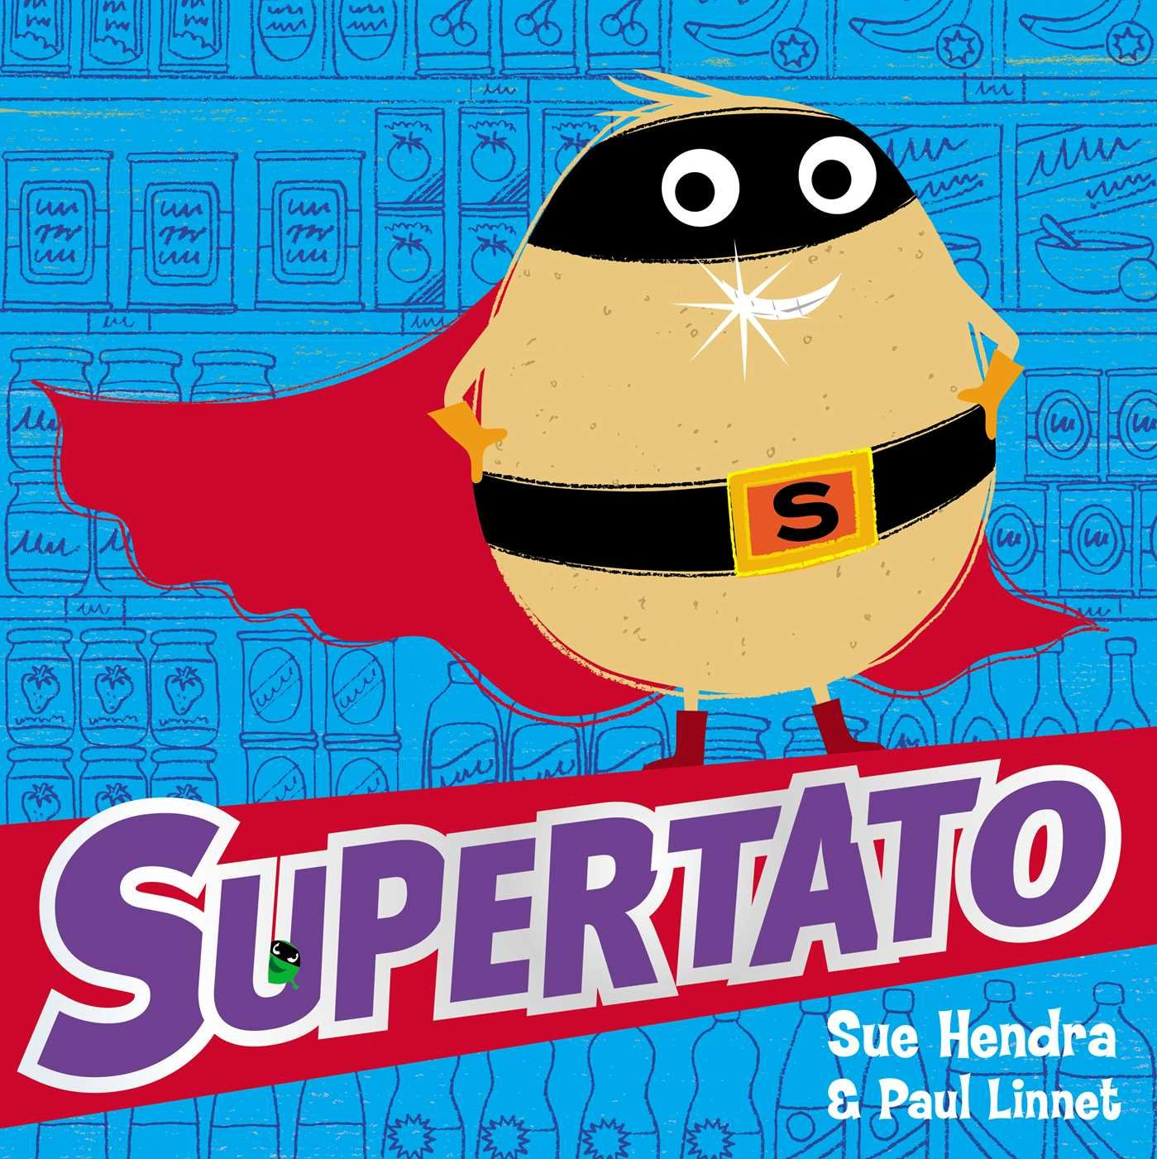
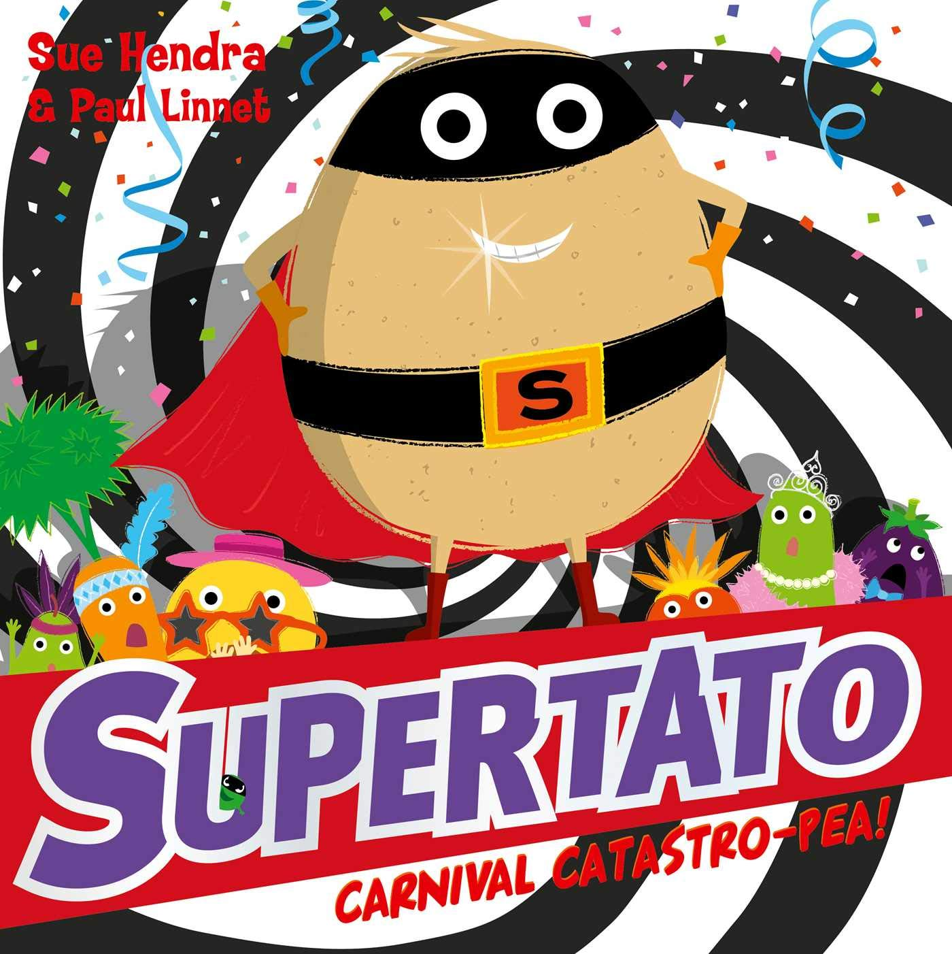
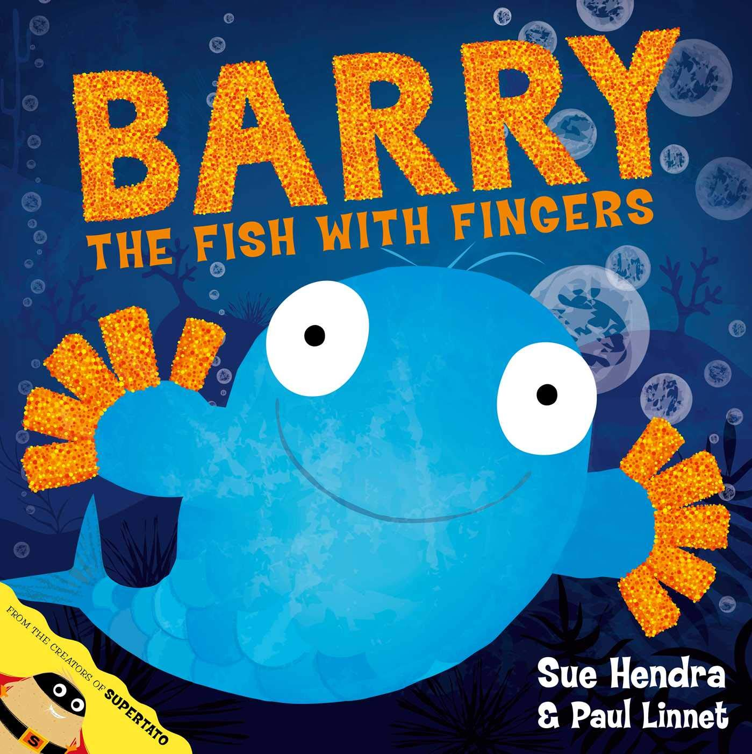





Year 1
Spring term
1
Ready Respectful Safe
Sue Hendra
English Skills that will be developed through this unit:
Imitation, Innovation and Application
We choose Sue Hendra as our author for this half term as she provides the best role model for the English skills that we want our children to develop at this point of Year 1. Her stories are delightfully appealing to Year 1 but there’s a reason why…
Each of Sue Hendra’s books have a lead character who shows predictable character traits and a villain who is equally predictable. Each story, although different, follows the same predictable structure. It is that familiarity that we pounce on! Once we are familiar with Sue Hendra’s story structure, we can learn how she creates an enjoyable story and do the same.
This unit supports children with independent writing skills (so that they are then able to create their own stories) through 3 steps. In step 1, we imitate. This means listening to lots of Sue Hendra stories, predicting what happens (and recognising how it’s so easy to predict ) and internalising how stories are sequenced and structured. Children retell the Sue Hendra stories and this can be supported through actions.
Step 2 is all about innovation. Now the children know how the story works, they can begin to make sensible substitutions. (So instead of a potato being the hero, they could change it to a carrot.) They may add their own ideas or alter some of the events. But what stays the same is the style that Sue Hendra models. So far so good!
The final stage is application. This gives the children a chance to combine the techniques they’ve learned and create their own story. The end result is that Year 1 children have written their own story that could have been written by Sue Hendra herself.

Slide 2
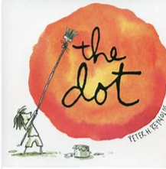
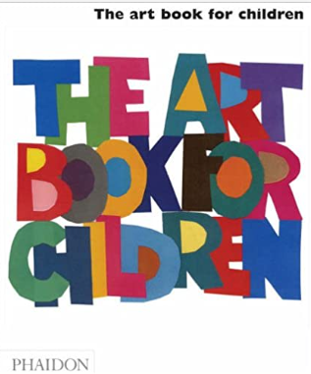
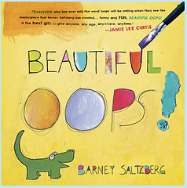
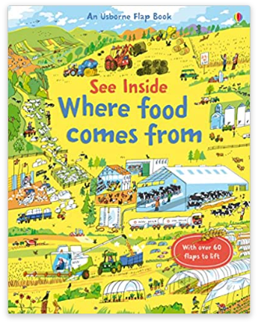
Year 1
Spring term
1
Ready Respectful Safe
Writing Homework
Here are the writing tasks that will appear each week this half term on the homework sheet in the red folder. The tasks here mirror the children’s learning in class. As always, the task is secondary to the conversation you have with your child about their learning. It’s that chat that will support your child most with their progress and understanding!
Spend some time with a fairy tale that your child knows well, such as Goldilocks. Read the book together a couple of times first over the week. Then, using the pictures in the book as a prompt, begin to support your child to retell the story for themselves.
Using the same familiar tale that you looked at for homework last week, create a series of pictures of each main event in the story. A good way to do this would be by providing your child with boxes on paper. To extend this, cut the boxes out, muddle them up and ask your child to re-sequence the events correctly.
Continuing with the same story, talk about the main events once again. What were the most important parts of the story? Can you write a sentence for each step in the story. Use the pictures in boxes that you created last week to help.
Still working with the same story, look at the book once again. What could be changed in the story without changing the ending? For example, if you have chosen Goldilocks as your book, instead of porridge the bears could eat Weetabix. Instead of Goldilocks breaking Baby Bear’s chair, she could break his Nintendo Switch. Have fun exploring and changing parts of the story.
Last week you thought of sensible ways to substitute parts of the story, go back to creating a series of pictures… But this time use the changes your child came up with in last week’s homework.
You might have guessed it already but this week, take your pictures from the last homework and add sentences to the key events of your child’s innovated story.
Our Extended Book Spine
To complement Supertato, our school can thoroughly recommend these texts for this half term:

Slide 3
Year 1
Spring term
1
Ready Respectful Safe
Our Extended Book Spine
To complement Treasure Island, our school can thoroughly recommend these texts for this half term:
Title | What is about? | Why is it chosen?
‘The Dot’- Peter Reynolds | Art class is over, but Vashti is sitting glued to her chair in front of a blank piece of paper. The words of her teacher are a gentle invitation to express herself. But Vashti can't draw - she's no artist. To prove her point, Vashti jabs at a blank sheet of paper to make an unremarkable and angry mark. "There!" she says. That one little dot marks the beginning of Vashti's journey of surprise and self-discovery. That special moment is the core of Peter H. Reynolds's delicate fable about the creative spirit in all of us. | Encouraging resilience in art PSHE link to kindness
‘Beautiful Oops’- Barney Saltzberg | A torn piece of paper, a spill, a smudge can all be transformed into something beautiful. Every oops mistake is worth exploring – you never know what you will create. This inventive, brightly-coloured novelty book is perfect for discussing the value of mistakes as part of a growth mindset and encouraging creativity and perseverance. | Encouraging resilience in Art
Various titles by Sue Hendra | Sue Hendra collection- Meet Barry, the fish with fingers, No-Bot, the robot with no bottom, and many more weird and wonderful characters in The Sue Hendra Collection! You will get lost in the colour and crazy worlds that the bestselling picture book author has created. | Links to the Sue Hendra topic and PSHE
The Art Book For Children – Phaidon | A perfect introduction to art for children everywhere, The Art Book for Children brings the clarity and innovation of Phaidon's bestselling Art Book to our youngest readers ever. A guide to 30 great artists and their most famous works, designed for both parent and child to enjoy together. The book encourages children to look closely and use their imagination to understand why artists choose to create the work they do and in the way that they do it. | Early introduction to a range of ‘Great Artists’
Where Food Comes From- Emily Bone | With over 90 flaps, the scenes in this colourful book show children where the food they eat comes from. They can discover food produced on farms, in the sea and in greenhouses, and the importance of wheat, rice and corn around the world. There's a map with flaps showing where the things we love to eat, including chocolate, olives and tea, come from. | DT- knowing where and how food is grown and produced

