Slide 1

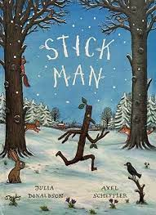
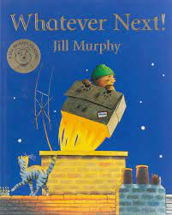
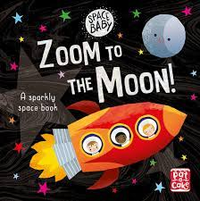
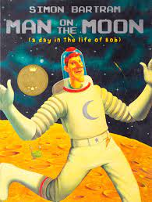
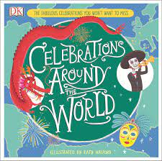
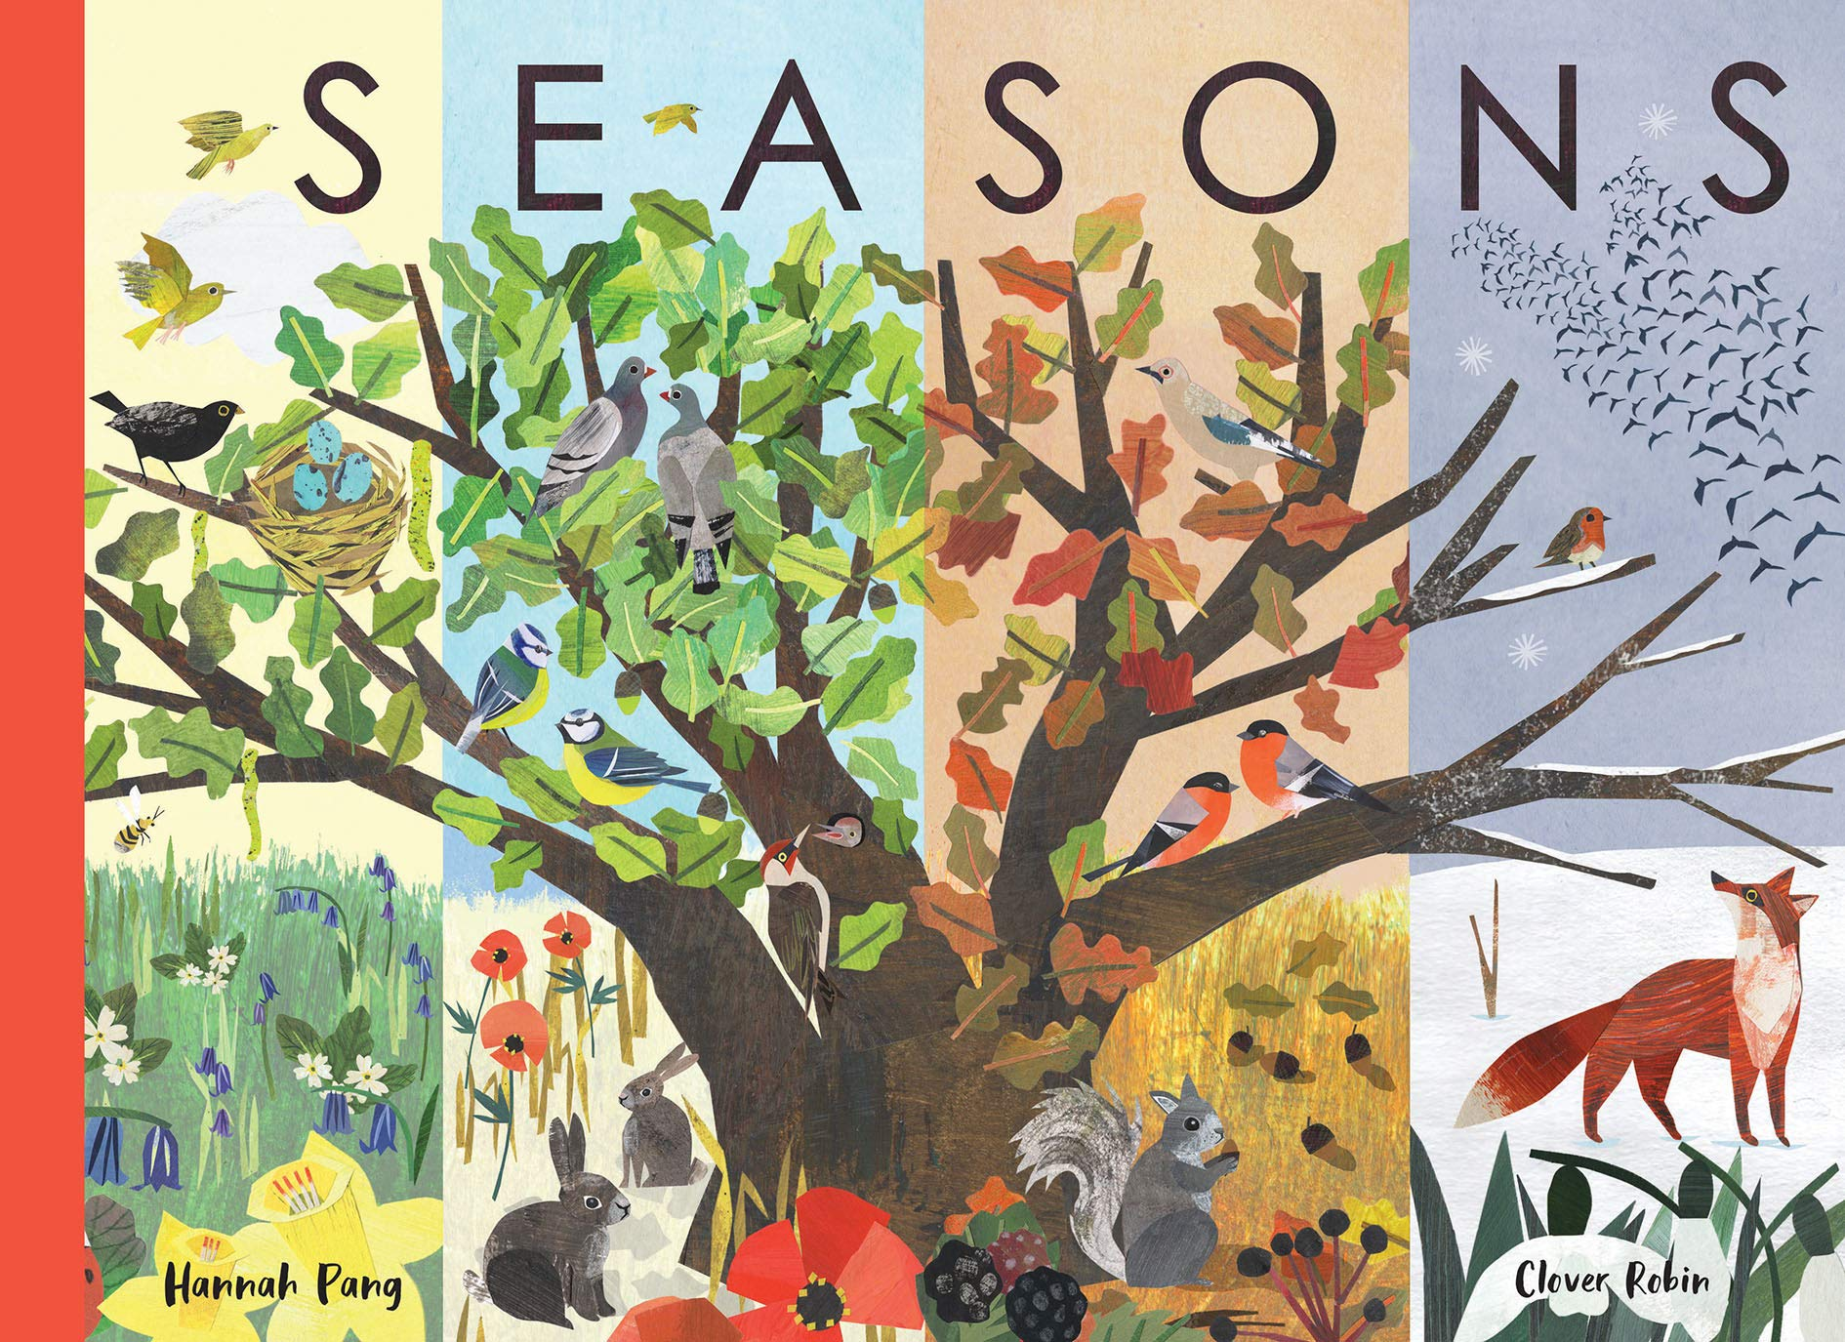





Year 1
Autumn term
2
Ready Respectful Safe
Earth and Our Moon!
Why these particular books and not something else?
In this half term, our learning is linked to the changing seasons followed by research on the moon. It’s a very busy time, indeed – and that’s all before we begin to consider Christmas. We have chosen these stunning picture books for English as a stimulus for our learning as they perfectly model the writing skills children will need this term. On top of this, these books will support the children in understanding their science, geography and history work as we become experts on seasons and the moon. Some of these books may be familiar to you and if you do have a copy of your own at home (or can borrow one from the library) we urge our families to follow these books alongside us. If you come across any other books that you think we could enjoy, let us know and perhaps we can enjoy them during Story Time at the end of the day.
Skills that will be developed through this unit:
Key skills (full stops, capital letters) continue to be reinforced at every opportunity. We will also be having a focus on spelling ‘tricky words’ this half term – please support your child by keeping on top of the spellings sent home in the red reading record.
Specific to this unit, we will explore the features of a non-fiction text and how we can tell the difference between fiction and non-fiction.
Fact and opinion will be explored as we write statement sentences.
We will explore expanding ideas using ‘and’ whilst ensuring our full stops and capital letters remain solid.
Autumn is an ideal time to discuss adjectives as we describe the seasons.
Talking of time, sequencing writing using ‘time words’ is another skill to add to our repertoire.

Slide 2
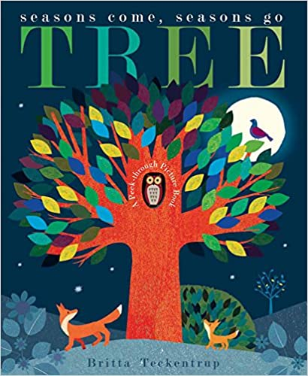
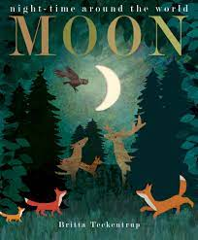
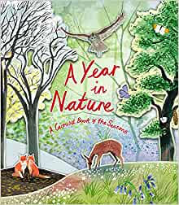
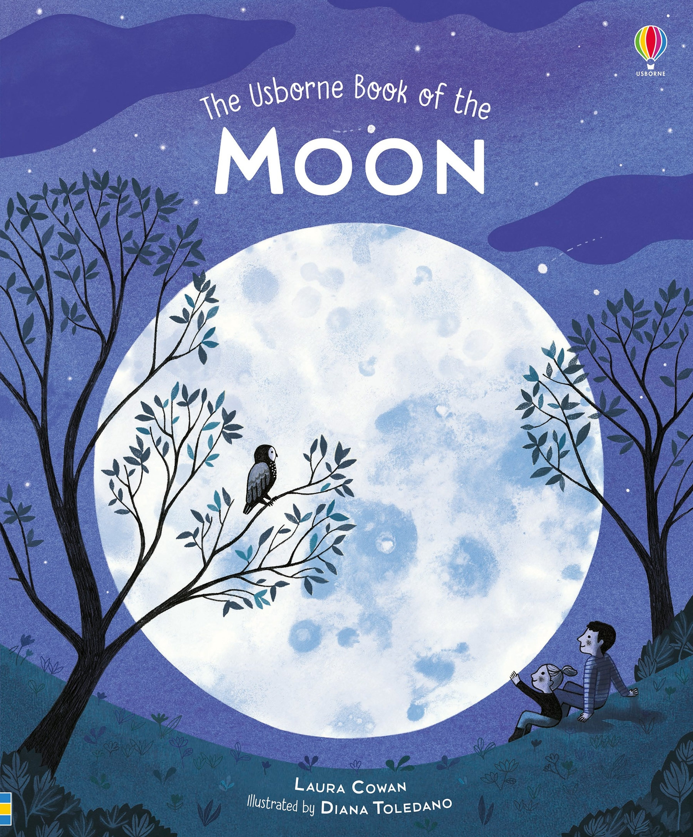
Year 1
Autumn term
2
Ready Respectful Safe
Writing Homework
We have been practising tricky words in school. Your task this week is to play a treasure hunt game with these words. Write each word out on separate small pieces of paper and hide them around the room. Can you find each word and copy them down correctly?
In class we have been finding out the difference between fact and opinion. Fact = in autumn the evenings are darker. Opinion = I like the dark autumn evenings.
Together talk about the different things that happen in autumn and the things that you like and don’t like about this season. When your child is ready, write a couple of sentences down reinforcing the difference between fact and opinion. Don’t forget to check for full stops and capital letters too.
Here is a picture of the four seasons. What do you notice in each season? Can you spot the differences and changes? Look through pictures in magazines, books or even family photos. Can you tell which season the picture is from? How can you tell? Discuss some ideas and then orally rehearse the idea as a full sentence using just your spoken words. I like to count the words on my fingers. When your child is ready, write the sentences down taking care to say the sentence aloud several times.
We love autumn! The season is full of colour and beauty. Collect some leaves and grab a pen… Can you write a different autumn adjective on each leaf? An adjective describes a noun. For example, golden, red, crunchy.
Think about a story that you and your child know very well. It might be a fairy tale or your child’s favourite book. Using the book (especially the pictures) as a prompt, model retelling the story in your own words. Take turns. Perhaps your child can take over in the oral retelling. You will notice that you both naturally use ‘time words.’ Here are two examples, ‘next,’ ‘after that.’ Retell the story to your child again but when a ‘time word’ is said, develop an action so that your child remembers the ‘time word.’
Let’s have another look at those tricky words… They aren’t called tricky words for nothing! Your task this week is to play a memory game (Pairs) with these words. Write each word out twice on separate pieces of paper. Muddle all of the pieces of paper up and place them face down. Turn over two at a time to see if you have uncovered a match.
An acrostic poem is always good to bring out the best presentation. Choose a word associated with winter or Christmas. Write it vertically. Find words that start with that word. Present you poem beautifully!
Our Extended Book Spine
Let us know if you come across any other books that are about your body or self-awareness or would be a good read to match this theme. If you can, bring the book to school and we can read the book as a class story at the end of the day. At Muscliff Primary School, we are keen to create a culture of recommending books and this would be an excellent way to share our book knowledge.

