Slide 1

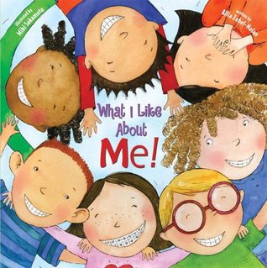





Year 1
Autumn term
1
Ready Respectful Safe
What I Like About Me!
Why these particular books and not something else?
Understanding ourselves, our feelings and listening to our bodies must come first if we are to understand the world around us. Self awareness is important because when we have a better understanding of ourselves, we are able to experience ourselves as unique and separate individuals. We are then empowered to make changes and to build on our areas of strength as well as identify areas where we would like to make improvements. In the first part of the Autumn Term, Year 1 children think carefully about what makes them special. These texts have been carefully selected as they are the best books for promoting self awareness. Our teachers read these texts with a passion which prompts our Year 1 learners to embrace what makes each of them special.
School values this book reinforces:
This unit is all about being curious! We encourage the children to ask questions about themselves and to find out about what makes them special. Curiosity is a very important school value!
Writing Composition in school:
In the box below, you’ll see that there are plenty of skills to acquire on our journey to outstanding writing! Children are shown that whenever we write, we must always be aware of presenting our work neatly and with pride.
An independent writing composition, creating a story start for Funny Bones, is a piece of writing that gives children the opportunity to be proud of the skills that they have developed.
Skills that will be developed through this unit:
Constructing full sentences orally is an important skill to develop before we pick up a pencil. Children say their sentence aloud and make sure that it is a full idea.
We continue to ‘Grow the Code,’ continuing to acquire new sounds using Little Wandle and we ask children to match sounds to new topic specific words.
Capital letters to start simple sentences and capital letters for names (proper nouns) are a key focus this half term - can we find the right capital letter to start?
Identifying the subject and verb in their sentence is another key aspect of being able to recognise what a sentence actually is. We encourage children to underline a subject in green and a verb in red?

Slide 2
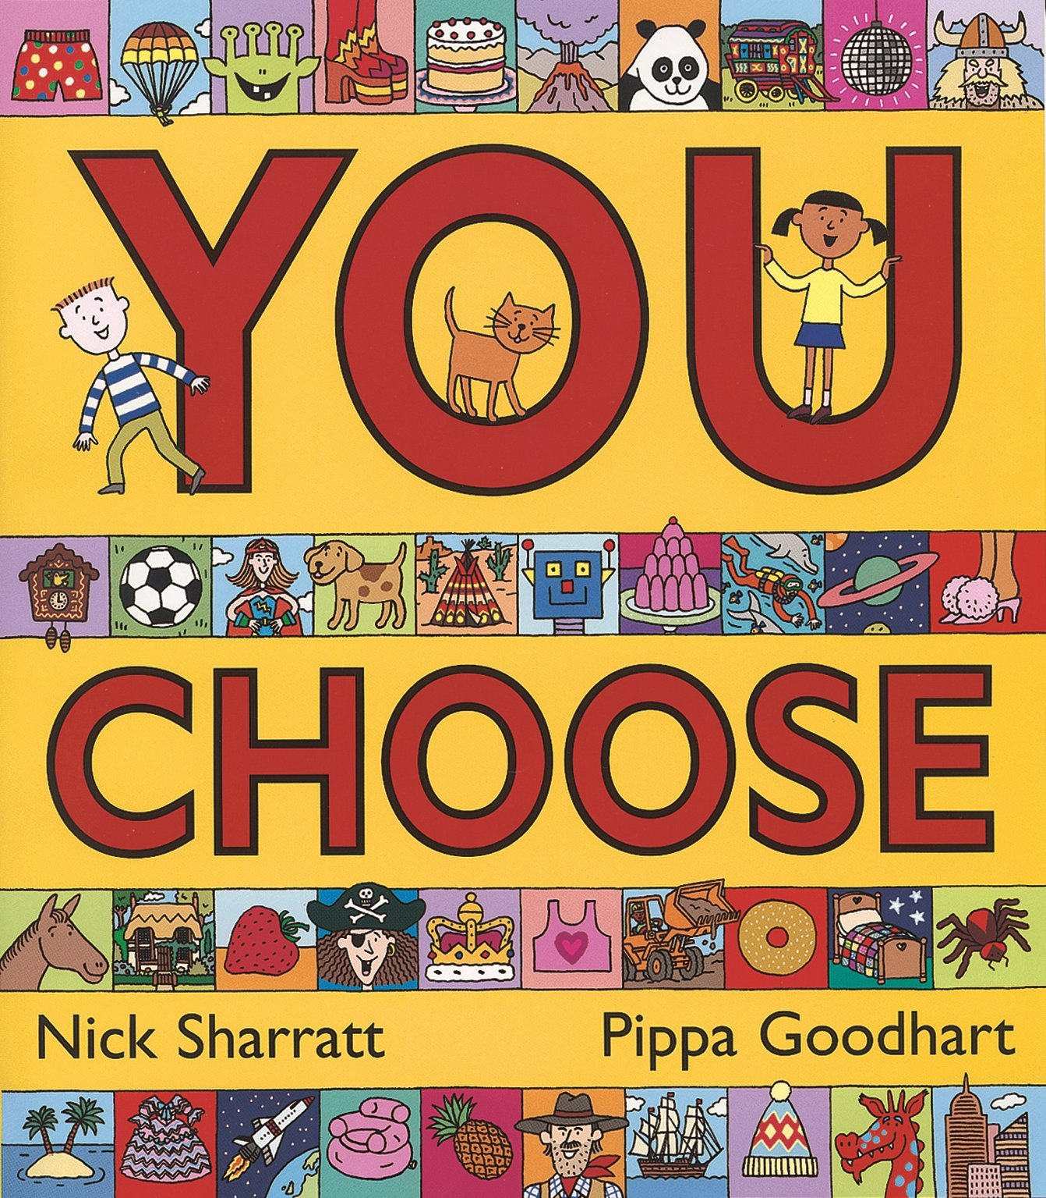
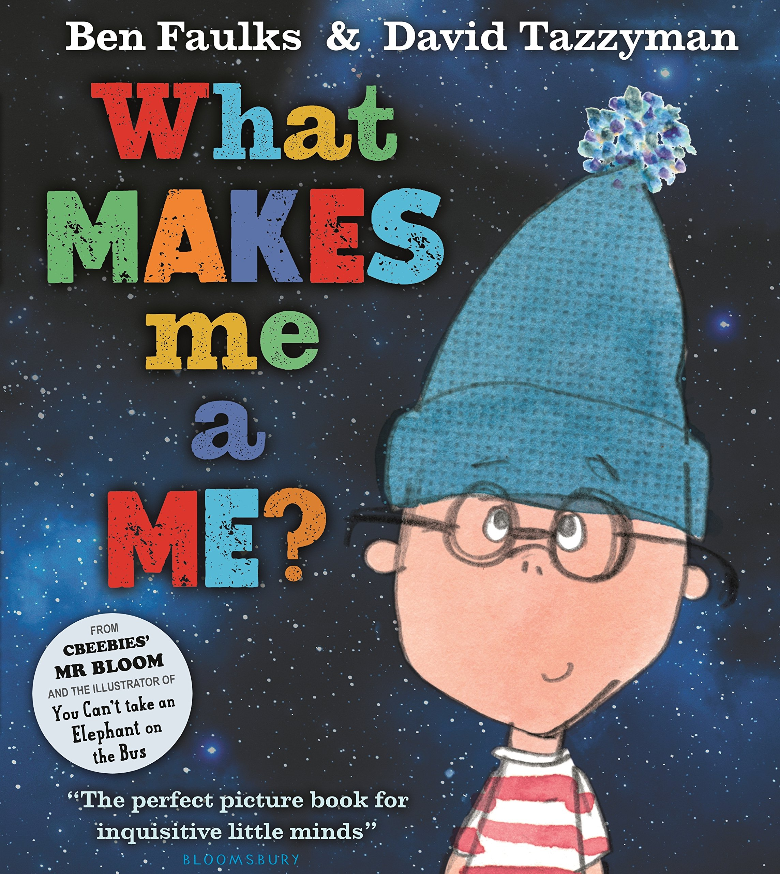
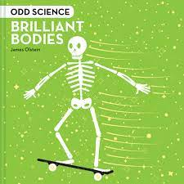
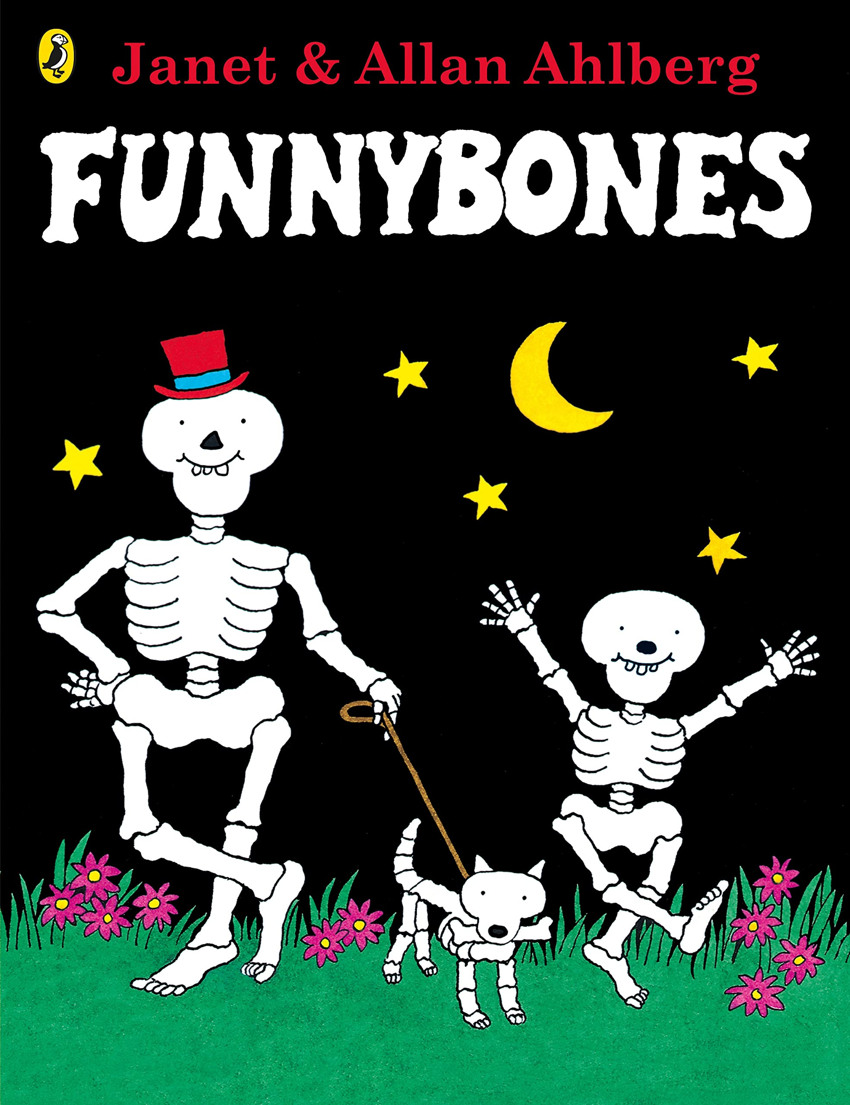
Year 1
Autumn term
1
Ready Respectful Safe
Writing Homework
Here is an overview of each written task for this half term. Over this half term, your child should aim to complete some writing at home each week. The time they invest in their written homework will vary from child to child – parental discretion is advised. Alternatively, you may wish to focus on just one or two of these activities and develop them over several weeks with your child rather than completing all of the tasks.
Create a family tree of close relatives. Use a capital letter for each name.
Make a list of children in your class. Can you remember 10 names? Have a go at writing the names of 10 friends but remember to start each name with a capital letter.
Pick a child in your class. Create a card or picture for them just to say, ‘You are my friend.’
If you have Guess Who (or an equivalent), play the game together. Think about what questions you ask. Try to answer in full sentences. Grown-ups can write down some of the most interesting questions. You could even make your own Guess Who using pictures of family members! As a challenge, you could make a new version of Guess Who using pictures of different people cut out from magazines.
Discuss a photograph that you have in your house. Who is in the photo and what is the memory? If you can, write down some short sentences together.
Our Extended Book Spine
To complement What I like about me, our school can thoroughly recommend these texts for this half term:
Let us know if you come across any other books that are about your body or self-awareness or would be a good read to match this theme. If you can, bring the book to school and we can read the book as a class story at the end of the day. At Muscliff Primary School, we are keen to create a culture of recommending books and this would be an excellent way to share our book knowledge.

