Slide 1

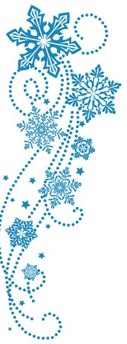
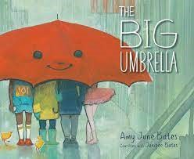
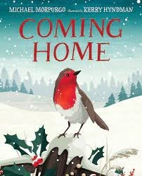
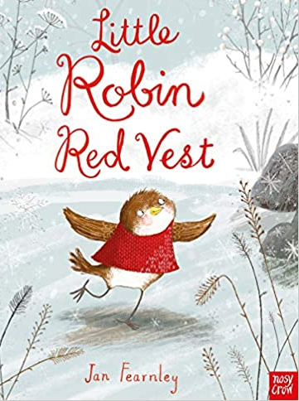
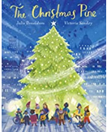
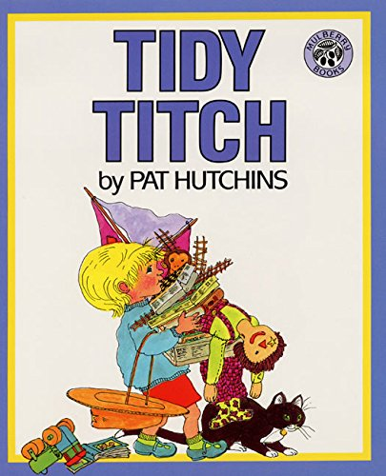
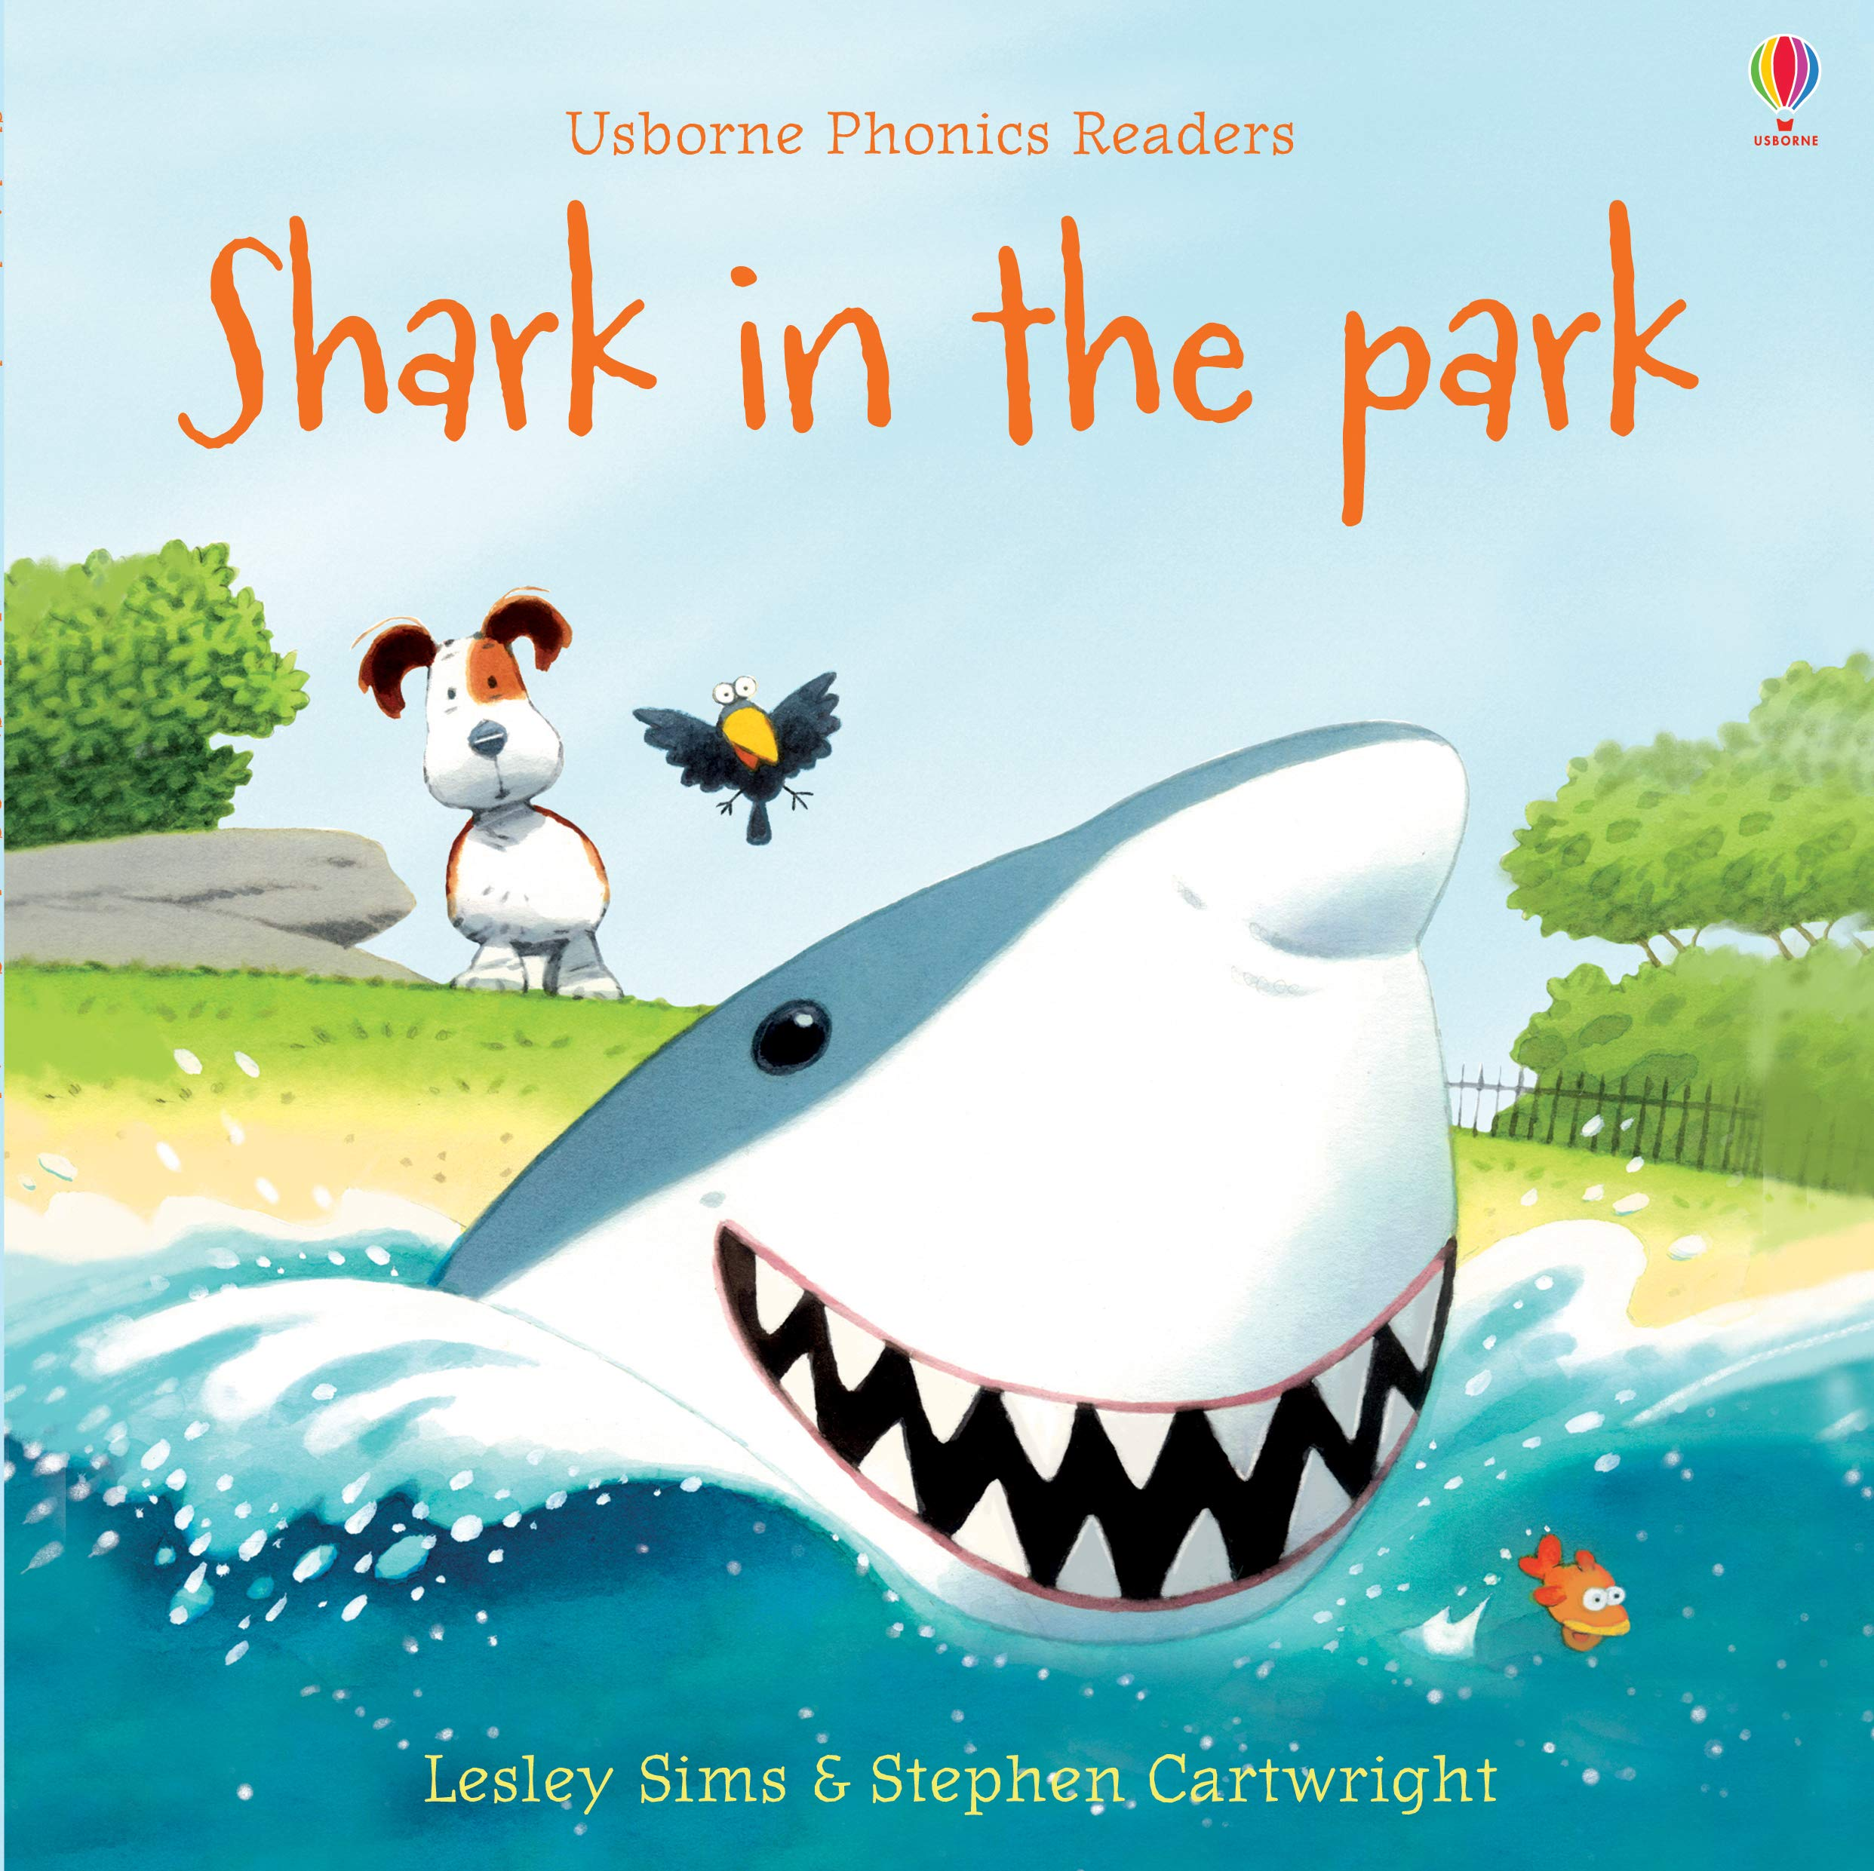
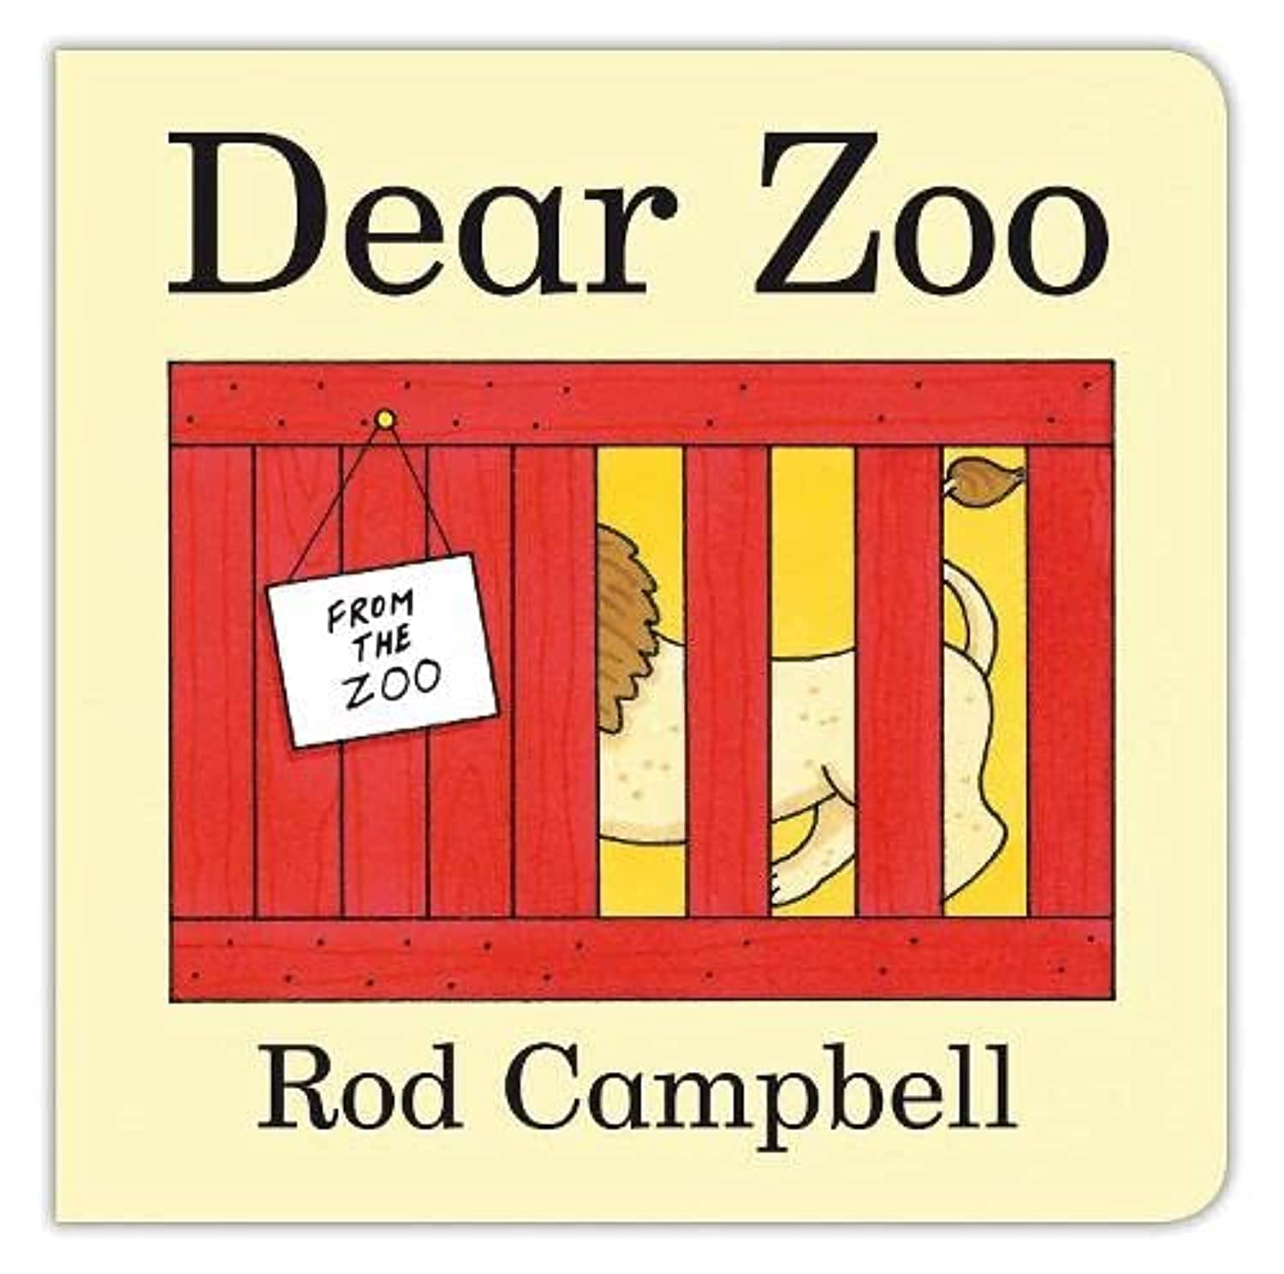
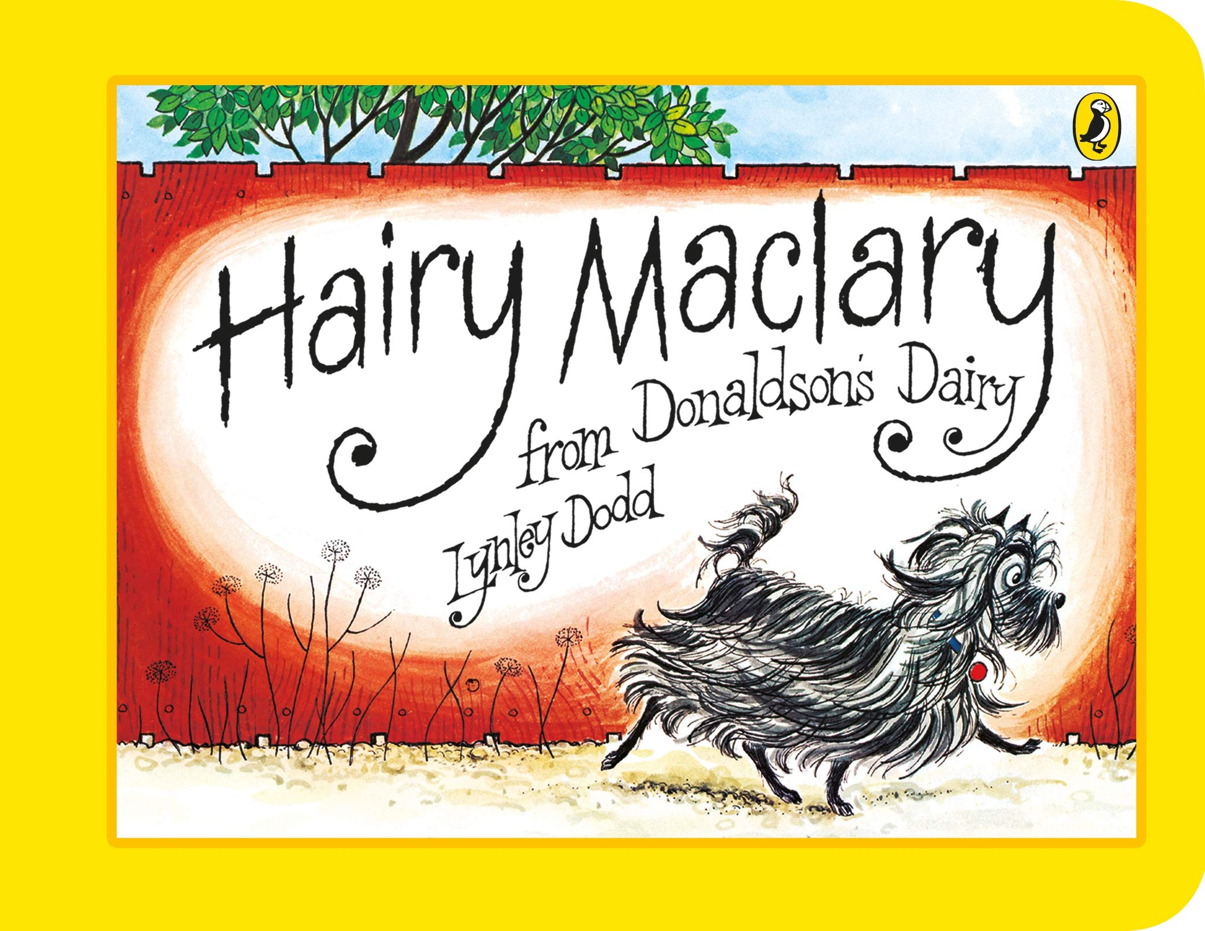
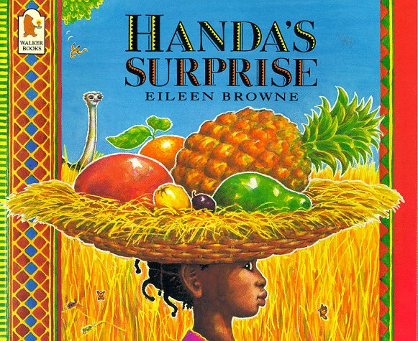
Ready Respectful Safe
Autumn 2 English Skills Progression
​As the winter months arrive and the days get that little bit colder, we find comfort in our wonderful books.
The books that we have chosen to study this half term in English are rooted in our underpinning key values and act as a vehicle to drive our whole curriculum.* ​
This document outlines all the books that we use in our school during this half term alongside the English skills that will be taught. Whilst progressively supporting children to achieve the statutory English standards outlined within the National Curriculum, and with an unwavering focus on progress, our carefully crafted English curriculum also promotes the spiritual, moral, cultural, and mental development of pupils at our school.
The Progress Check can be found in the children’s composition books.
*For further information, including our rationale for choosing these books specifically as well as additional books that we use to complement the lead text, please refer to our Reading Spine documents.
Whole School Assemblies
Reception
Shark in the park​
Dear Zoo​
Handa's surprise​
Hairy Maclary​
Tidy Titch​
Value: Responsibility

Slide 2
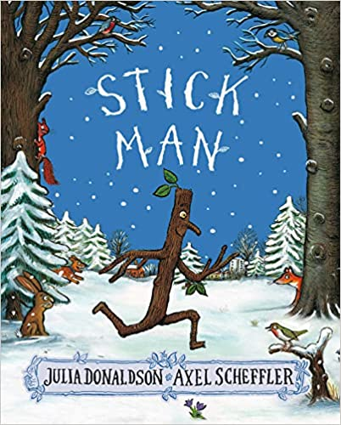

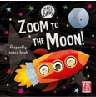
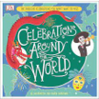
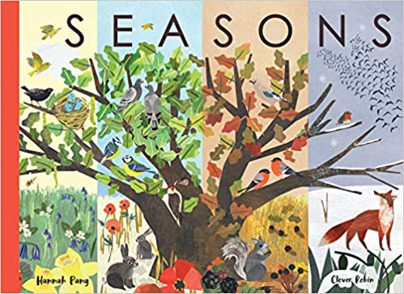
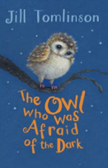
Autumn term
2
Ready Respectful Safe
Year 1
Stick Man​
Seasons
Man on the Moon​
Zoom to the Moon​
Celebrations around the World
Value: Curiosity
I can begin to use full stops, capital letters.
I increase my knowledge of ‘tricky words’ in spelling.
I can explore the features of a non-fiction text and can tell the difference between fiction and non-fiction.​
I talk about fact and opinion.
I expand ideas using ‘and’ whilst ensuring my full stops and capital letters remain solid.​
I use adjectives to describe the seasons.​
I can sequence my ideas using ‘time words.’
Progress Check:
I can retell stories that I know in the correct sequence.
Year 2
Lead Text: The Owl who was Afraid of the Dark
Value: Resilence
I use adverbs of time to help the reader understand how the sentence fits into the bigger piece.
I can develop cohesion by staying on one idea and developing several sentences on one idea before moving on to a different idea.
I can plan, draft and then edit a piece of writing making sure that I keep the needs of my reader as the main influence in any decisions that I make.
I make good vocabulary choices so I sound like an expert.
Progress Check:
There are three main writing genres that we tackle this half term.
1) Recounts: children will need to write in first person (I) and retell a real life event. They will write in the past tense and be encouraged to use adverbs of time to sequence the events.
2) Contrasting description: we aim to not only use exciting vocabulary but also use our suffixes _er and _est.
3) Instructions: how to make a toy owl OR an information page about weaving.

Slide 3
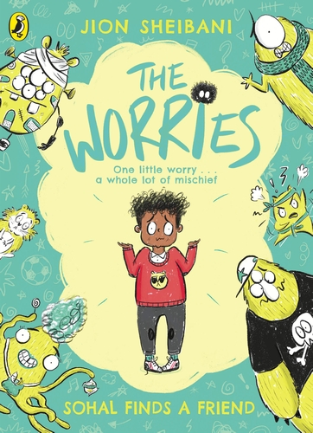
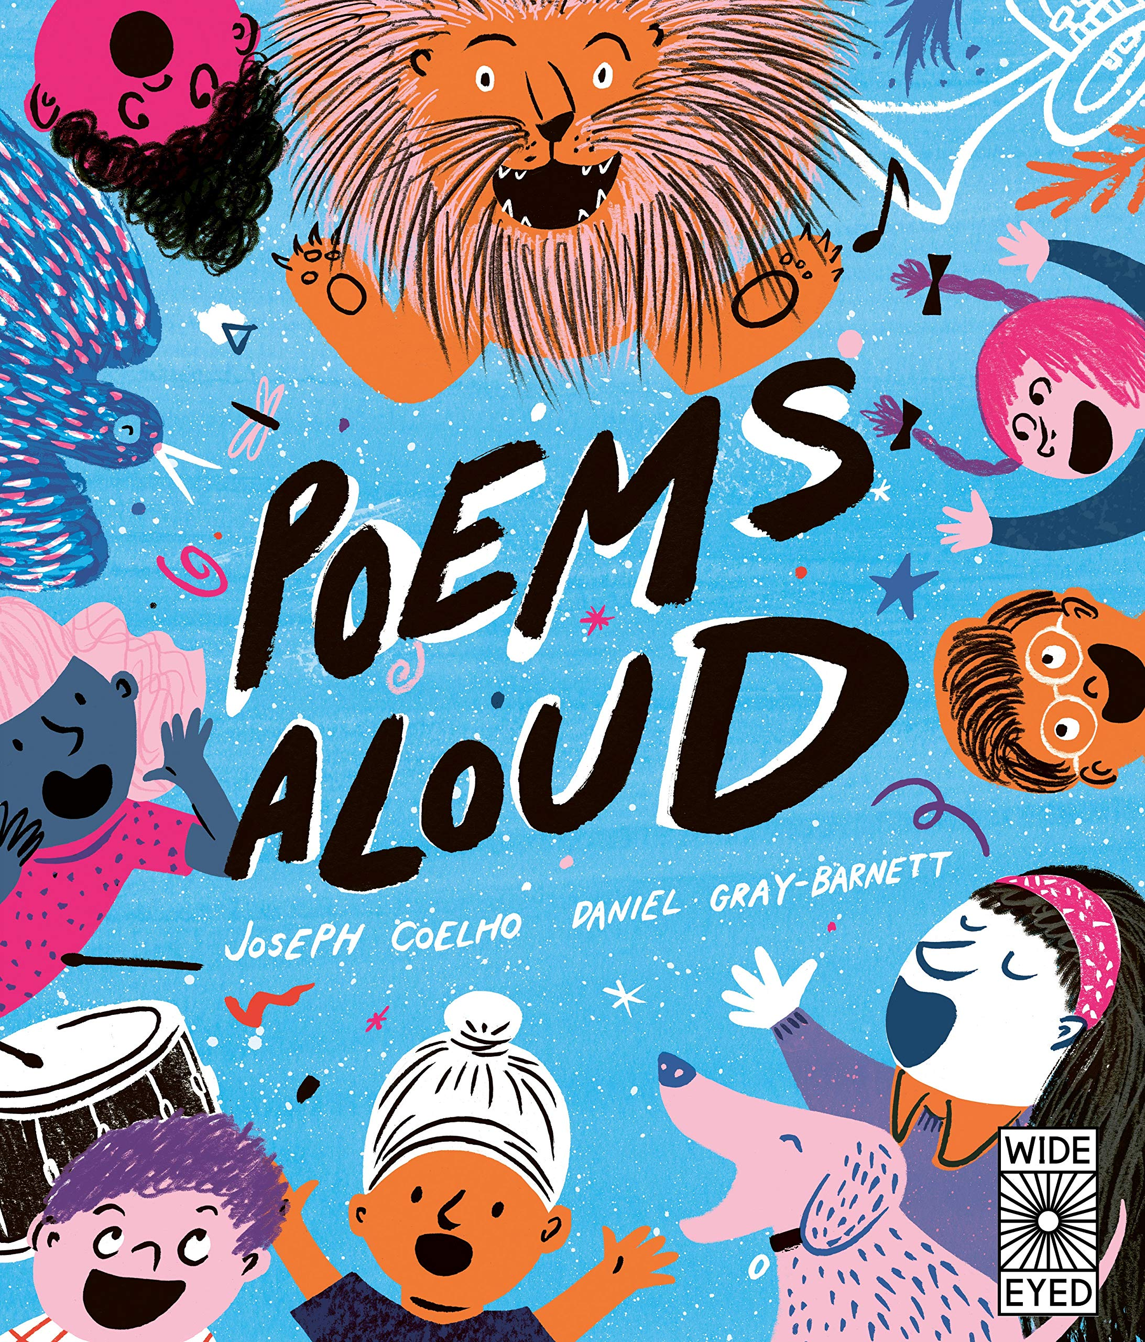
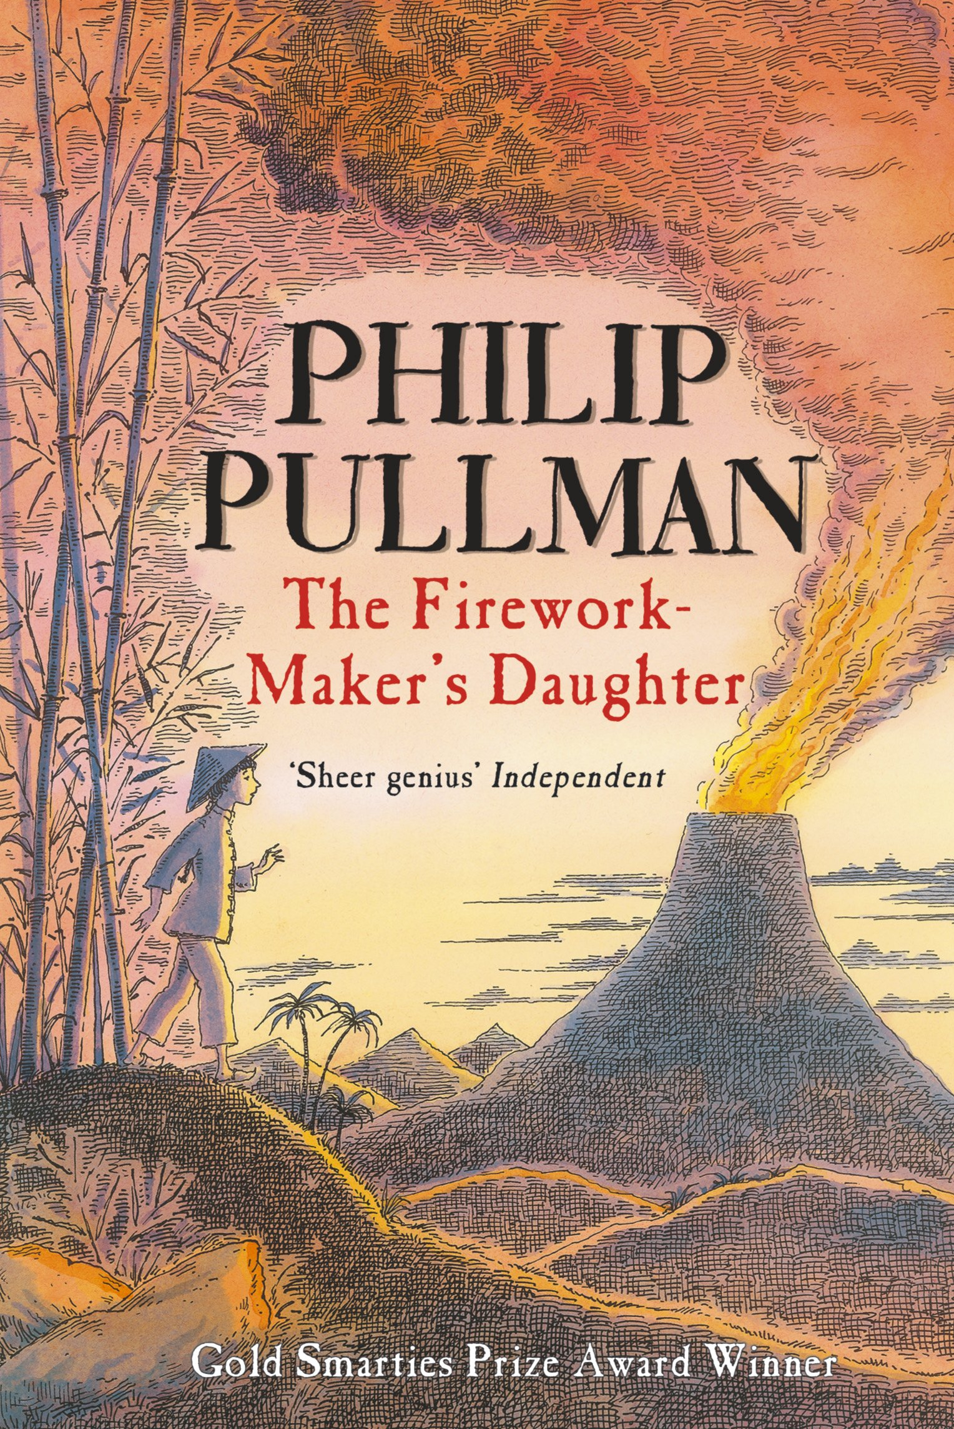
Autumn term
2
Ready Respectful Safe
Year 3
Lead Text: The Worries
Value: Resilience
I can identify the common characteristics of the villains in the book.
I can identify patterns and key themes and replicate these in my own writing.
I can design my own book characters by imitating then innovating ideas.
I can use speech to show how a character behaves.
I can describe a character’s behaviour to show how the character feels.​
I use well-chosen similes.
I use subordination to add information.
I can use modal verbs.
I can write sentences that offer advice, “When you feel like this, you could….” “If you begin to feel…., you might try….”​
​
Progress Check:
Children will create a non-fiction explanation text that details emotions, possible triggers that cause this emotion and then advice on how to manage these feelings.​
Our end piece of work will be a characterisation of a worry. How will the worry act, speak and interact with Sohal?
Year 4
Lead Text: Poems Aloud, The Firework Maker’s Daughter
Value: Resilience
I can recite poems using various techniques, such as: rhythm, volume, pace, building to a crescendo or reducing to a diminuendo.
I match techniques to the style and tone of the poem.
I can follow a set pattern to write a new poem that follows the same structure.
I can talk the common structure of fairy tales.
I identify common characteristics of heroes and villains and unpick the moral element of any fairy tale, regardless of its cultural origin.
I can build on my story telling skills so that I can replicate a story that demonstrates a moral.
Progress Check:
Children write a fairy tale, similar to a traditional tale, but based within a different culture.

Slide 4
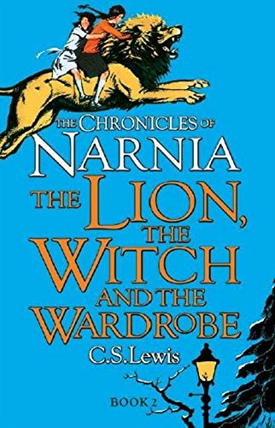
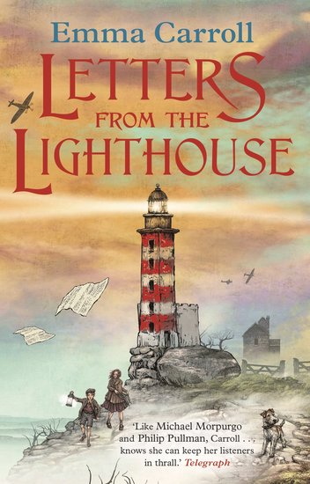
Autumn term
2
Ready Respectful Safe
Year 5
Lead Text: The Lion, The Witch and The Wardrobe
Value: Curiosity
​
I use figurative language, including simile/metaphor and personification.​
I can consider manipulating sentences by reordering and understand the changes this has on my reader’s experience.​
I use relative clauses to provide extra detail.​
I am confident in using adverbials of time, manner and place.​
Progress Check:
Towards the end of this unit children will re-write the scene where Lucy steps into the wardrobe for the first time. Using the skills mentioned above, children will describe the awe and wonder of Narnia and show Lucy’s amazement at seeing this world for the first time. Children’s work will be assessed using the skills taught within this unit as well as previously taught skills.​
Year 6
Letters from the Lighthouse
Value: Resilience
I can copy and correctly use some of the specific vocabulary in the book that is relevant to the 1940s.
I absorb and can use figurative phrases from the book that help show that the book is set in the 1940s. For example, ‘the bee’s knees.
I can use metaphors, alliteration, repetition, personification and onomatopoeia.​
I correctly use possessive apostrophes and consider irregular plurals alongside possessive apostrophe. For example, the difference in meaning between ‘the babies’ toys’ and ‘the baby’s toys’.
I use speech punctuation to add to the narrative. ​
Progress Check:
By the end of the unit, children will have developed the skills to be able to describe an air-raid in realistic detail. The children’s character might be sat in the red velour seats of their local cinema. Perhaps they are watching Judy Garland in The Wizard of Oz. Suddenly, the lights come on and the familiar sound of the air-raid siren begins… ​ This piece of writing will be successful if it sounds like it is set in the 1940s.

