Slide 1






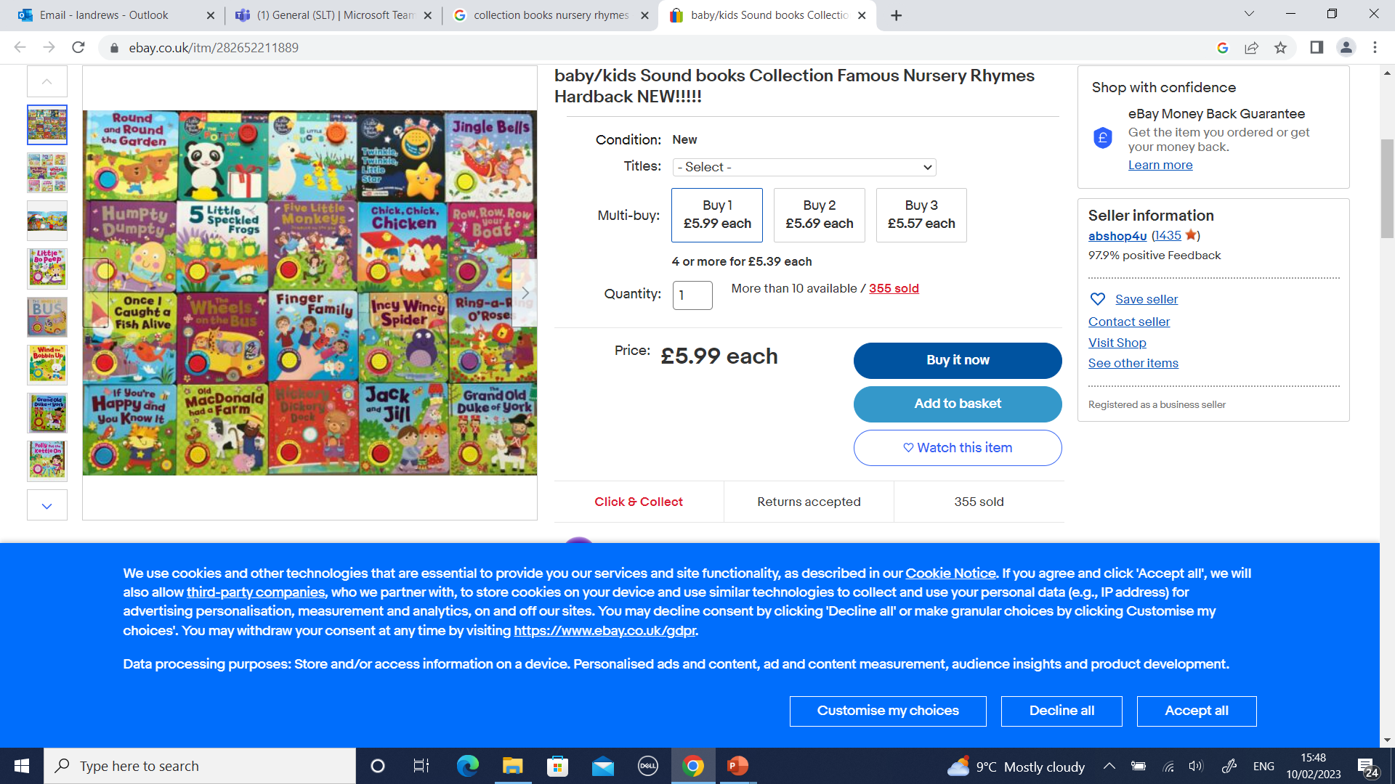

Ready Respectful Safe
Autumn 1 English Skills Progression
Autumn 1, the start of a new academic year, is always an exciting half term across the school. And with these inspiring books at the heart of our learning, children are supported to achieve well and make good progress. This is also facilitated by a smooth transition of skills between year groups. ​
​
The books that we have chosen to study this half term in English are rooted in our underpinning key values and act as a vehicle to drive our whole curriculum.* ​
This document outlines all the books that we use in our school during this half term alongside the English skills that will be taught. Whilst progressively supporting children to achieve the statutory English standards outlined within the National Curriculum, and with an unwavering focus on progress, our carefully crafted English curriculum also promotes the spiritual, moral, cultural, and mental development of pupils at our school.
The Progress Check can be found in the children’s composition books.
*For further information, including our rationale for choosing these books specifically as well as additional books that we use to complement the lead text, please refer to our Reading Spine documents.
Whole School Assemblies
Reception
Nursery rhymes​
London Bridge​
Twinkle Twinkle Little Star​
Wheels on the Bus
Grand Old Duke of York​
Ring a Roses​
Jack and Jill​
Incy Wincy Spider​
Old MacDonald​
Hickory Dickory Dock​
Hey Diddle Diddle​
Weather Rhymes​
Value: Kindness

Slide 2
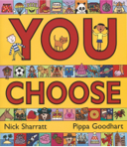
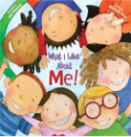
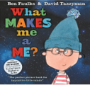

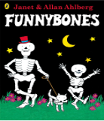
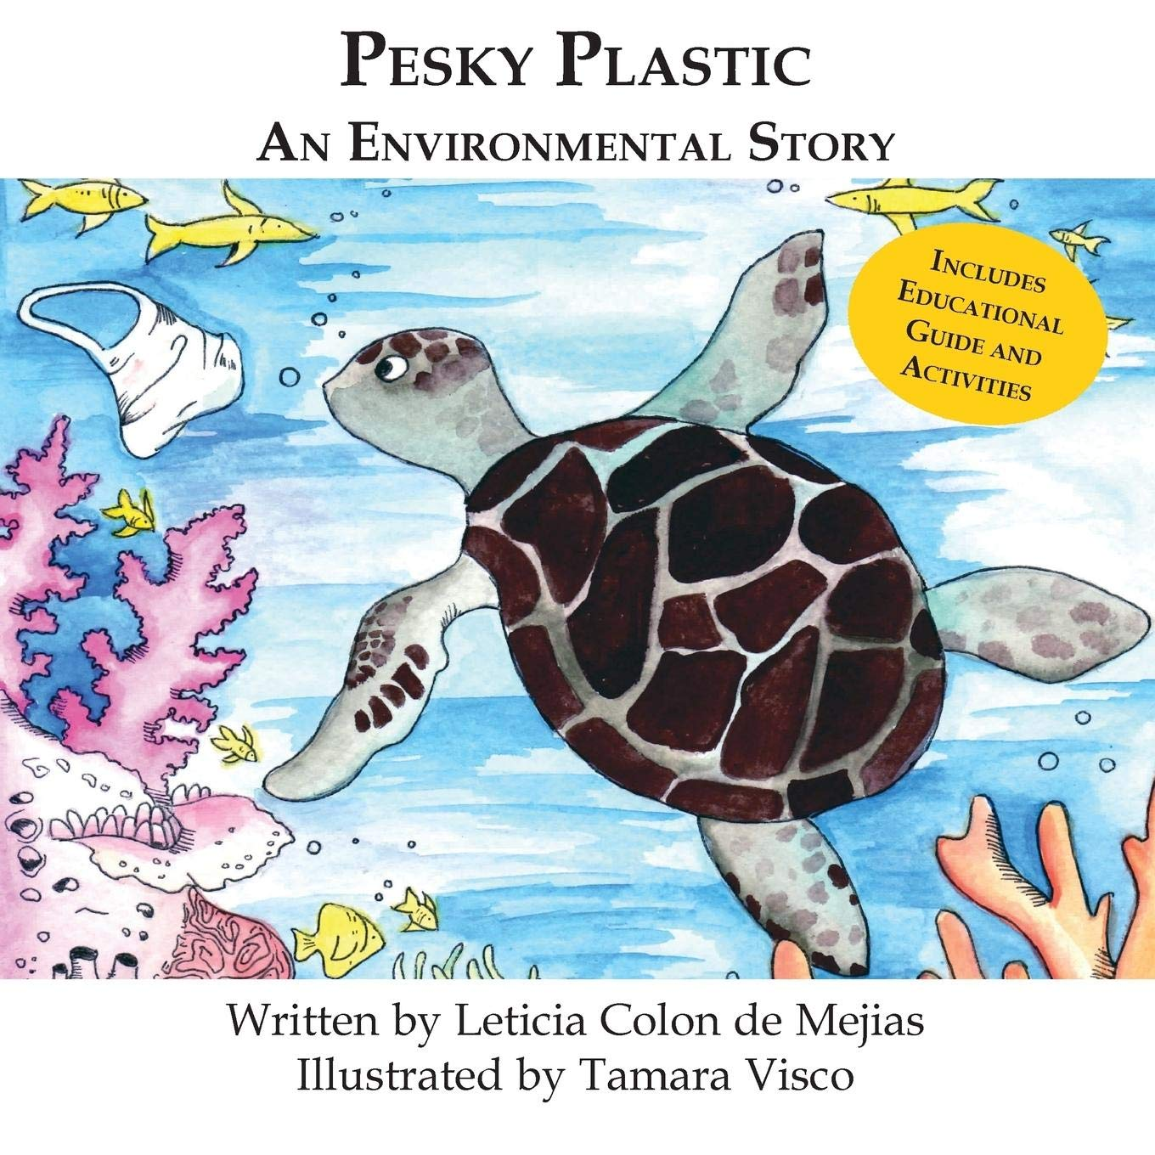
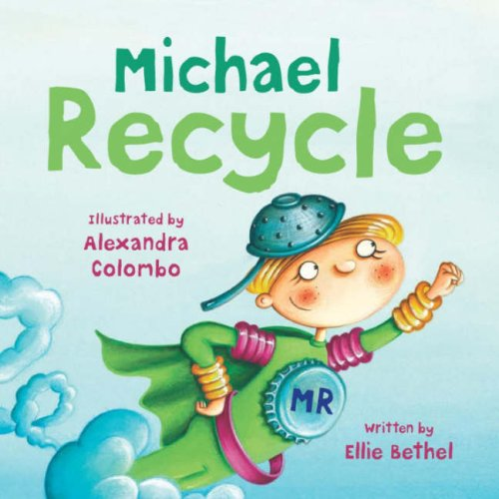
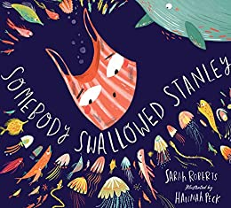
Autumn term
1
Ready Respectful Safe
Year 1
Lead Texts:
What I Like About Me
You Choose
Feelings
What Makes Me
Brilliant Bodies
Funny Bones
Value: Aspiration
I can construct full sentences orally – I can say my sentence aloud and make sure that it is a full idea.​
​I continue to ‘Grow the Code,’ continuing to acquire new sounds using Little Wandle.
I match sounds to new topic specific words.​
​I use capital letters to start simple sentences and capital letters for names (proper nouns).​
I identify the subject and verb in my sentence.
I can underline a subject in green and a verb in red.
Progress Check:
Creating a story start for Funny Bones, is a piece of writing that gives children the opportunity to be proud of the skills that they have developed.
Year 2
Lead Text: Somebody Swallowed Stanley
Value: Responsibility
I can identify nouns ​and adjectives and then create my own noun phrases.​
I can consistently identify the verb in each sentence to help me understand if my sentence makes sense.
I can sort sentences into past tense and present tense and begin to spot patterns.
I can spell the -ed suffix and link this to past simple tense.
I can write commands ​and questions.​
I use conjunctions (co-ordinating and subordinating).​
Progress Check:
Using all of the key skills listed above, the children work towards creating an information page about how we should look after our school. This will provide them with an opportunity to use the 4 sentence types (statements, commands, exclamations and questions) to engage their reader and use these constructions to help their reader to also understand how important it is to take responsibility. Children will also be required to use vocabulary that they have acquired throughout the unit.

Slide 3
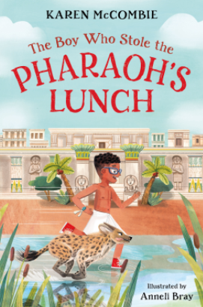

Autumn term
1
Ready Respectful Safe
Year 3
Lead Text: Pharaoh’s Lunch
Value: Curiosity
I create vivid images in my reader’s mind by drawing on the senses.
I am confident with the 4 sentence types: statements, exclamations, questions and commands and consider how these can have an impact on the engaging the reader.
I use the 4 sentence types to invite the reader into my description.​
I use a dictionary and thesaurus to help me make adventurous language choices and acquire new vocabulary.​
I know how different past and present tenses are formed.​
Progress Check:
Using the skills listed above, children will create a story start. They will also recount their trip to the museum.
Year 4
Lead Text: The Butterfly Lion
Value: Kindness
I use a range of phrases to enhance my sentences (noun phrases, prepositional phrases and adverbial phrases).
I begin to be more specific in my identification of pronouns.
I recognise and use a range of tenses, including past progressive (was playing) and past perfect (had played). ​
I am increasingly more specific in my language choices.
I replicate Morpurgo's vocabulary choices on two levels: firstly, I use very carefully chosen language to create vivid images. Secondly, with support, I can use some old-fashioned words to help set my work in a different period of time to today.
Progress Check:
Re-writing the scene where Bertie says goodbye to his lion gives the children an opportunity to use all of the skills mentioned above. Teachers will be assessing the child’s level of basic accuracy first and their use of phrases. Teachers will consider how the children have absorbed our key vocabulary and the active language choices they have made as well as the topic-specific language discussed in the unit.

Slide 4
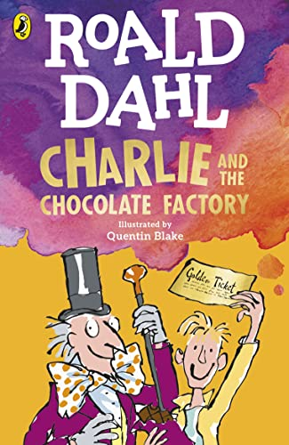
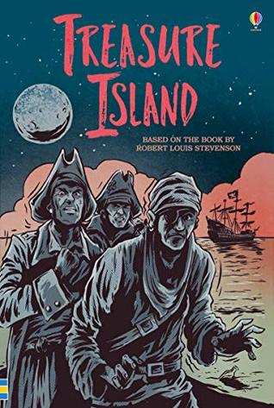
Autumn term
1
Ready Respectful Safe
Year 5
Lead Text: Charlie and the Chocolate Factory
Value: Kindness
I understand that the starting point to a well-developed sentence must be an accurate basic sentence.
I consider the choice of verb as an important building block.
I use a more ‘grown-up’ thesaurus to support language development.
I use full speech punctuation in developing my characters.
I avoid a speech ‘tennis match’ between characters and only use speech when it is purposeful and has an impact on the narrative.
I create a powerful reported clause to add value to the direct speech.
Progress Check:
Throughout this English unit, a key focus will be to understand how Dahl makes his character descriptions so successful. To assess the children’s writing skills children will be write a developed piece of work that describes Charlie’s reaction to the glass elevator at the end of the story. Your child will try to capture the awe and wonder of this scene and describe in great detail Charlie’s reaction. The direct speech and interaction between characters that develops the scene should be a key feature of this piece of work.
Year 6
Lead Text: Treasure Island
Value: Curiosity
I identify, replicate and explore the author’s use of clause structure to develop my own sentence construction.
I use more complex and adventurous sentence construction and am confident to ‘play’ with my sentences by moving the order of clauses.
I can say what difference moving a clause makes to the reader’s experience.
I continue to become more secure with sentence punctuation.​
​I use modal verbs (and auxiliary verbs) for simple and progressive tenses as well as sentences of possibility (would, could, should, might, must…)​.
​I spell patterns _Ible/_able, _Ibly/_ably and spellings containing _fer​.
Progress Check:
Children will develop skills in extended story writing with a focus on how authors use clause construction to add detail; little added details help to engage their reader. We will also aim to enrich the children’s vocabulary so that their written language sounds correct to the task and the genre. It sounds so much better to say, ‘Jim heaved himself up the rigging,’ than ‘Jim went up the rope’!
A diary extract will be written by the children to show the correct use of tenses. Diaries are naturally written in different tenses, including past, present and conditional tenses and this task presents the perfect opportunity to unpick our use of verbs.

